Slide 1
Gunshot Detection System On Edge Devices
Under the guidance of Dr. SHAIK RIYAZ HUSSAIN SIR
Prepared by:
P. Praveen Kumar - N210402
RAJIV GANDHI UNIVERSITY OF KNOWLEDGE TECHNOGIES, NUZVID
25 October 2025
RGUKT Nuzvid

Slide 2
Table of Contents
1
Introduction
2
Base Paper Overview
3
Results Obtained
4
Model Advancements
5 References
RGUKT Nuzvid

Slide 3
Introduction
RGUKT Nuzvid

Slide 4
Gunshot Detection — A Need for Intelligent Safety Systems
Public safety systems increasingly rely on AI-driven solutions for real-time threat detection. Gunshot detection is critical for:
Rapid emergency response in urban and public spaces. Accurate identification of firearm-related acoustic events.
Integration with surveillance networks for automated alert systems.
Challenge: Traditional sound-based systems often fail in noisy or cluttered environments.
RGUKT Nuzvid

Slide 5
Why Gunshot Detection on Edge Devices?
Cloud-based gunshot detection systems face latency and privacy challenges. To overcome these, lightweight models on embedded platforms like Raspberry Pi are ideal.
Enables real-time inference close to the source. Reduces dependency on high-speed internet.
Supports scalable and low-power deployment. Enhances community safety through rapid local alerts.
Goal: Design an efficient and accurate AI-based gunshot detection model for edge deployment.
RGUKT Nuzvid

Slide 6
Base Paper Overview
RGUKT Nuzvid

Slide 7
Real-time Gunshot Detection System
The base paper proposes a real-time gunshot detection system for enhanced public safety. It captures environmental audio, extracts features (MFCC or YAMNet), and uses neural network models for accurate gunshot classification suitable for edge devices like Raspberry Pi.
Audio capture and feature extraction
ML-based gunshot classification (up to 96% accuracy) Optimized for real-time, low-power hardware
RGUKT Nuzvid

Slide 8
Analysis of Base Paper
The base paper made significant contributions to real-time gunshot detection but also had limitations that inspired our enhancements:
Contributions:
Evaluation of multiple hardware platforms for real-time inference feasibility. Consideration of noisy environments and confounding audio events.
Limitations:
Hardware optimization and low-latency inference were limited.
Model compression techniques like pruning or quantization were not explored. Lightweight embedding-only inference for resource-constrained devices was not implemented.
Model was trained on small dataset only leading to overfitttig.
RGUKT Nuzvid

Slide 9
Gunshot Detection System Overview
The paper presents a real-time gunshot detection system integrated with camera surveillance. Audio data is pre-processed to improve model accuracy.
Gunshot sounds from various firearms (AK-47, MP5, M16, etc.), resampled to 1-sec 22050 Hz and filtered for low-energy noise, yielding 3210 samples.
Non-gunshot sounds (thunder, fireworks, drums, doors, clapping, barks) collected from YouTube, totaling 7758 samples after preprocessing.
RGUKT Nuzvid

Slide 10
Modeling Approaches
Two ML approaches were used for gunshot detection:
YAMNet Transfer Learning:
1024-dim YAMNet embeddings as input.
Three-layer network (512-unit dense + 2-output). 60/20/20 train/val/test split, 3200 samples/group. EarlyStopping, trained for 5 epochs.
MFCC-Based LSTM:
Audio MFCC features.
LSTM: 128-unit LSTM Flatten Dense layers (128, 64) 9-output. 50 epochs, batch size 72, SparseCategoricalCrossentropy loss, EarlyStopping.
1
2
RGUKT Nuzvid

Slide 11
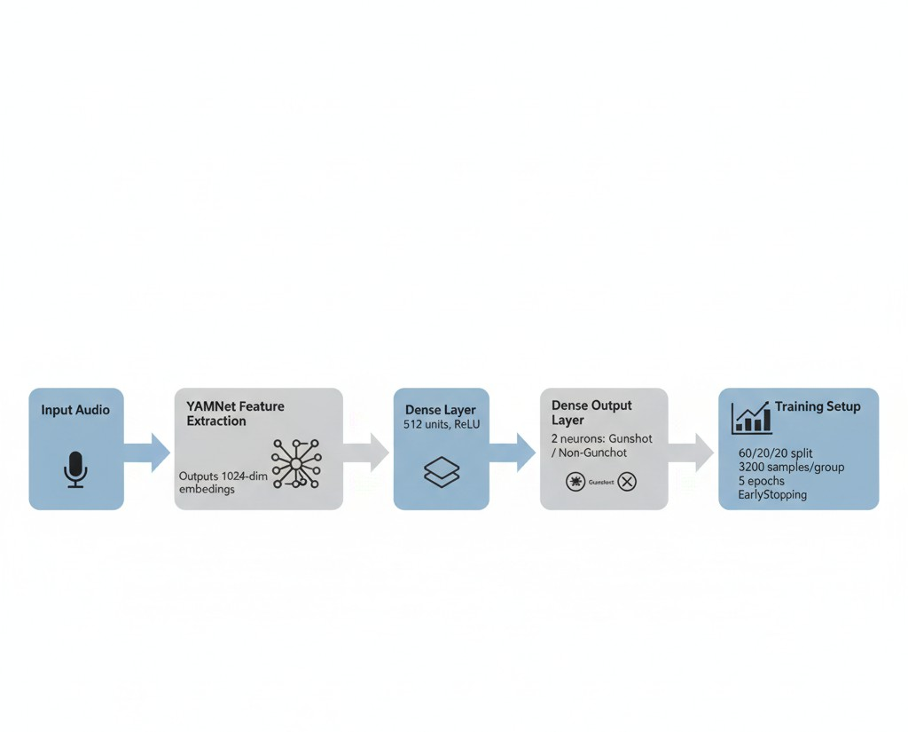
YAMNet Transfer Learning Flow
RGUKT Nuzvid

Slide 12
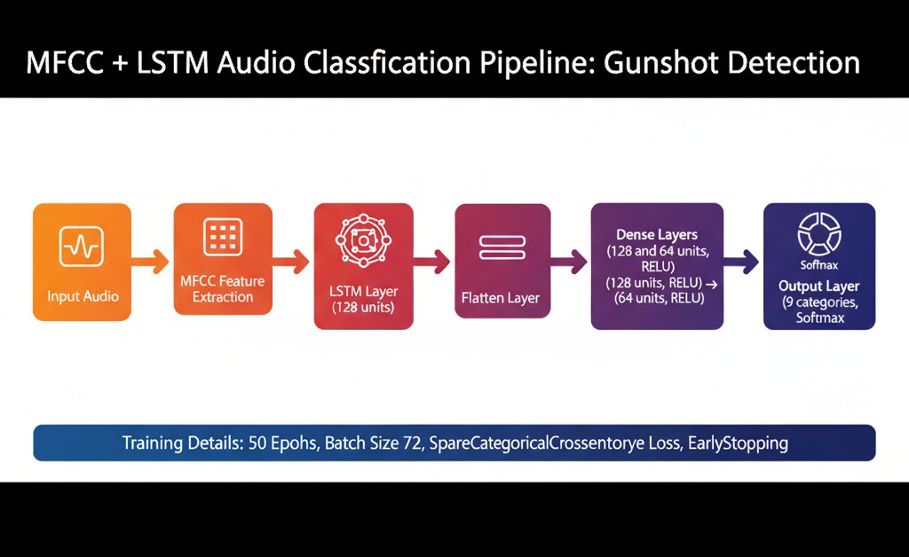
MFCC-Based LSTM Flow
RGUKT Nuzvid

Slide 13
Gunshot Detection Model Performance
TensorFlow YAMNet Transfer Learning Model:
Test set: Loss = 0.0490, Accuracy = 98.75%
Confusion Matrix (1280 samples): Gunshot: 637/640 correct, Non-gunshot: 635/640 correct
Minimal misclassification demonstrates strong predictive power for real-world deployment.
MFCC-Based LSTM Model:
Test set: Loss = 0.1676, Accuracy = 96.95%
Confusion Matrix (1280 samples): Gunshot: 623/640 correct, Non-gunshot: 618/640 correct
High accuracy indicates strong generalization for real-world use.
RGUKT Nuzvid

Slide 14
Results Obtained
RGUKT Nuzvid

Slide 15
Test Performance Comparison
Both models achieved high accuracy on training, validation, and test sets. Final evaluation results are as follows:
YAMNet Transfer Learning
Test Loss: 0.0384
Test Accuracy: 98.52% Confusion Matrix:
MFCC-Based LSTM
Test Loss: 0.1706
Test Accuracy: 96.04% Confusion Matrix:
636 4
10 630
619 21
23 617
RGUKT Nuzvid

Slide 16
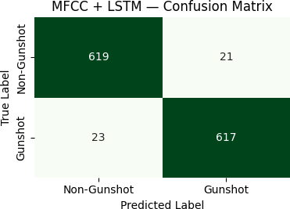
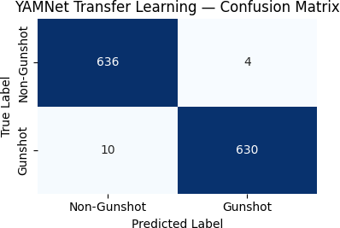
MFCC vs YAMNet Feature Matrices
MFCC Matrix
YAMNet Matrix
Spectral–temporal representation extracted using MFCC features.
Deep audio embeddings learned by YAMNet pretrained model.
The MFCC matrix captures handcrafted frequency features, while YAMNet embeddings provide high-level semantic representations learned from large-scale audio datasets.
RGUKT Nuzvid

Slide 17
YAMNet vs MFCC-LSTM Evaluation Summary
Metric | YAMNet Transfer Learning | MFCC-Based LSTM
Test Loss | 0.0384 | 0.1706
Test Accuracy | 98.52% | 96.04%
Gunshot Correct (out of 640) | 636 | 619
Non-Gunshot Correct (out of 640) | 630 | 617
Total Misclassifications | 14 | 44
Inference Complexity | Low (Dense only) | Moderate (LSTM + Dense)
FPGA Deployment Suitability | High | Medium
Conclusion: YAMNet-based model achieves higher accuracy and efficiency for real-time deployment.
RGUKT Nuzvid

Slide 18
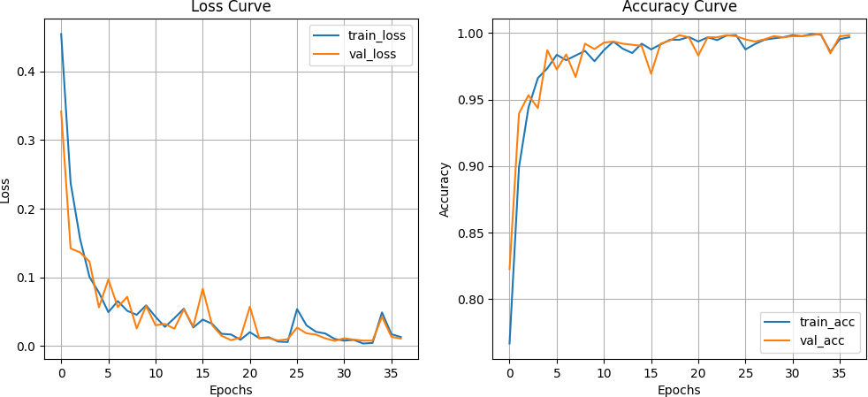
MFCC + LSTM Model Performance
The MFCC-LSTM model achieved strong accuracy, though with slightly higher loss and slower convergence.
Accuracy and Loss Curves
Final Test Accuracy: 96.04% — Test Loss: 0.1706
RGUKT Nuzvid

Slide 19
Model Advancements
RGUKT Nuzvid

Slide 20
Model Architecture Overview
Goal: Enhance gunshot detection by combining spectral–temporal learning with attention mechanisms.
Model Highlights:
CNN14 (PANNs): Extracts deep log-Mel spectral embeddings.
BiLSTM: Captures forward–backward temporal dependencies.
Attention Layer: Focuses on key temporal frames, suppresses silence or background noise.
Dense Head: Fully connected layers with 128 and 64 ReLU units + dropout for regularization.
Output Layer: Softmax activation producing Gunshot / Non-Gunshot classification.
RGUKT Nuzvid

Slide 21
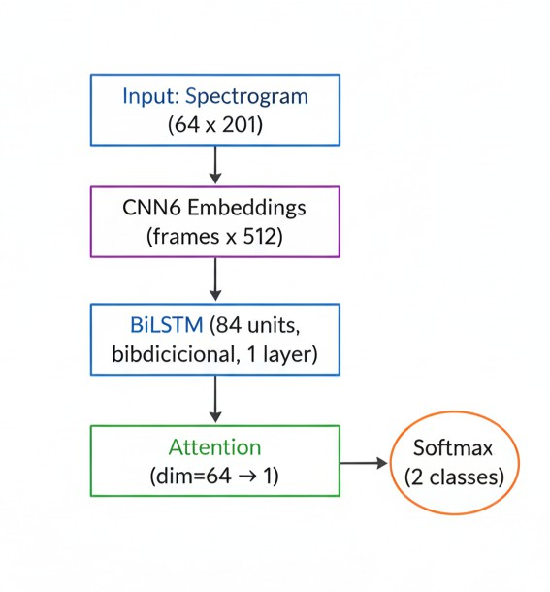
Proposed Model Architecture
CNN14 BiLSTM Attention Dense Output
RGUKT Nuzvid

Slide 22
References
RGUKT Nuzvid

Slide 23
References I
Xinzhang Xiong, “Real-time Gunshot Detection System Integration to Camera Surveillance System”, Pennsylvania State University, State College, USA. Email: xpx5059@psu.edu
Google Research, “YAMNet: Pretrained Audio Event Classification Network”, Available at: https:
//github.com/tensorflow/models/tree/master/research/audioset/yamnet
Kong, Qiuqiang, et al. “PANNs: Large-Scale Pretrained Audio Neural Networks for Audio Pattern Recognition”, IEEE/ACM Transactions on Audio, Speech, and Language Processing, 2020.
T. Giannakopoulos, “Audio Feature Extraction using MFCCs for Environmental Sound Classification”, Elsevier, 2015.
S. Han, H. Mao, and W. J. Dally, “Deep Compression: Compressing Deep Neural Networks with Pruning, Trained Quantization and Huffman Coding”, ICLR, 2016.
RGUKT Nuzvid

Slide 24
Thank you!
RGUKT Nuzvid

