Slide 1
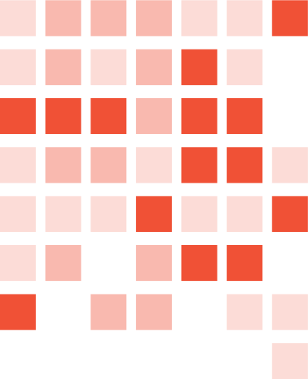
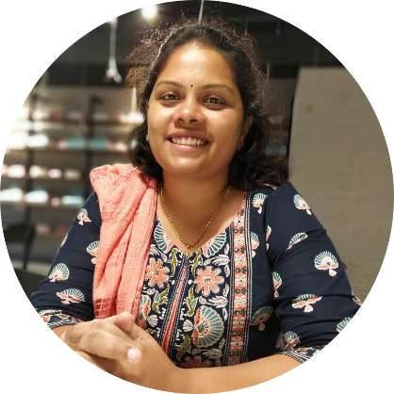
PICK FRESH
Eat Fresh
YASHASREE TUMMALA FSJ0420A105

Slide 2
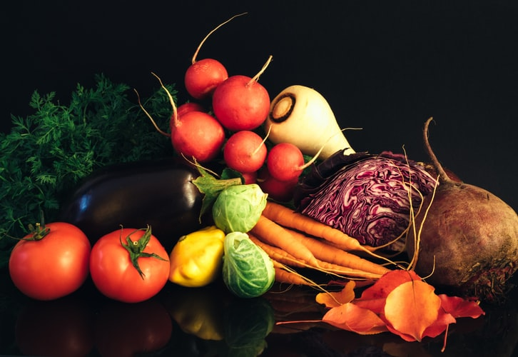
About The Project
Three Modules:
Shop Crop
Silver Platter
Order Food

Slide 3
Why This Project
1
This system have no middlemen and their role of dwindling profit among farmers.
2
Our chef-designed recipes include balanced meals, quick one-pan dinners, and top-rated customer favourites.
3
The canned food culture is exponentially growing in India …these kind of foods loaded with preservatives and other chemicals that are harmful to the body.

Slide 4
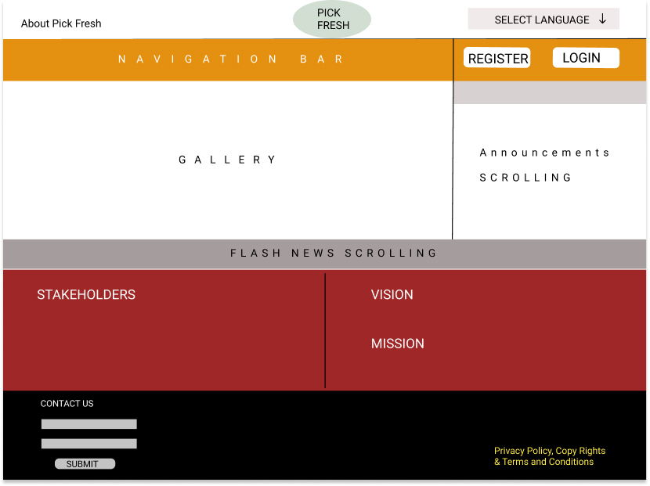
Home Page

Slide 5
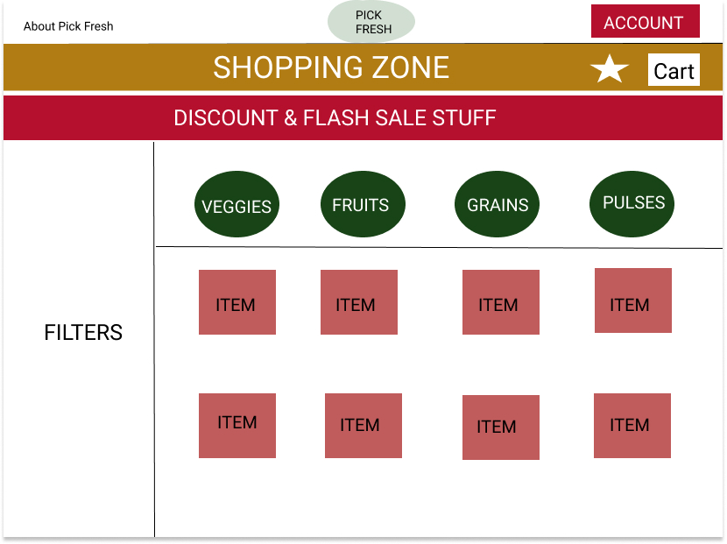
Shopping

Slide 6
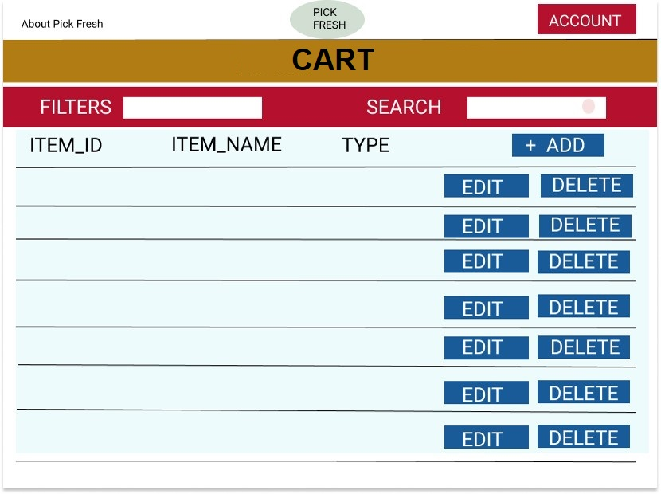
Cart

Slide 7
Concepts Used To Implement This Project
Module | Concept used to implement the module
Wired Frames | Figma.com
Creating Data (API) | SpringBoot - RestAPI
Testing the data & changes required | Postman & Swagger
User Login | Google API
Front end | ANGULAR MATERIAL (Service Injection, Routing), Html, CSS, TypeScript.

Slide 8

Thank You

