Slide 1
File Handling in Java

Slide 2
Agenda
What is File Handling in Java?
File Methods
File Operations

Slide 3

What is File Handling?
Reading from and writing data to a file
java.io package, allows us to work with different formats of files
Use Streams to make I/O operations
File Obj = new File("filename.txt");

Slide 4
File Methods
canRead()
canWrite()
createNewFile()
delete()
exists()
getName()
getPath()
length()

Slide 5

File Methods - Example
https://onlinegdb.com/HkyXUQNwv

Slide 6
File Operations
Create
Get File Info
Read
Write

Slide 7
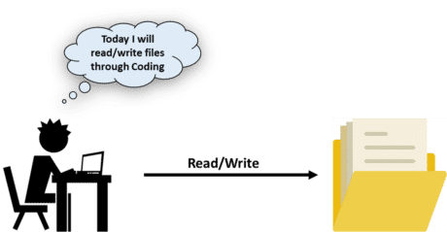
File Operations - Example
Creating a File - https://onlinegdb.com/HJBgcXEDD
Reading a File - https://onlinegdb.com/HJrR1VEPP
Writing a File - https://onlinegdb.com/SJA-ZEVww

Slide 8
Thank You!!!

