Slide 1
Java Threads

Slide 2
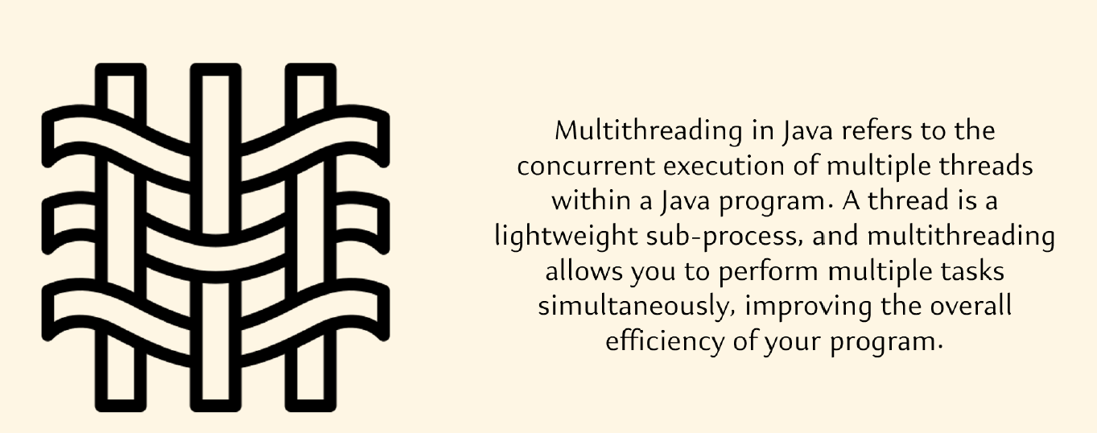

Slide 3
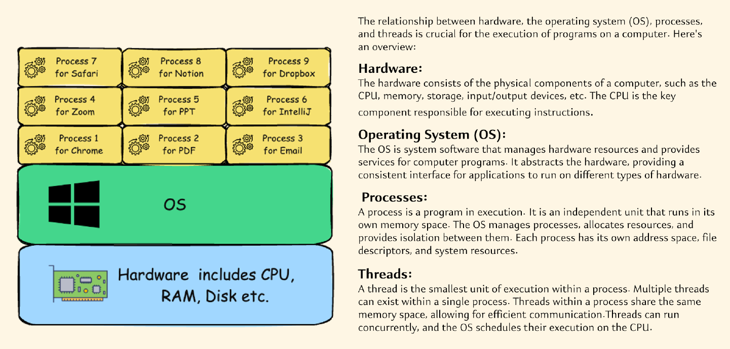
How a program or a software executes inside a computer?

Slide 4
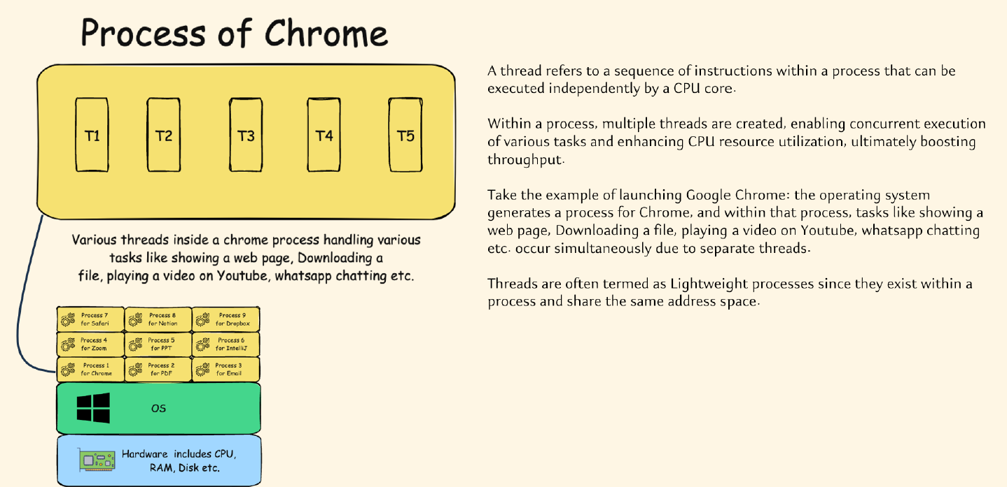
How a program or a software executes inside a computer?

Slide 5
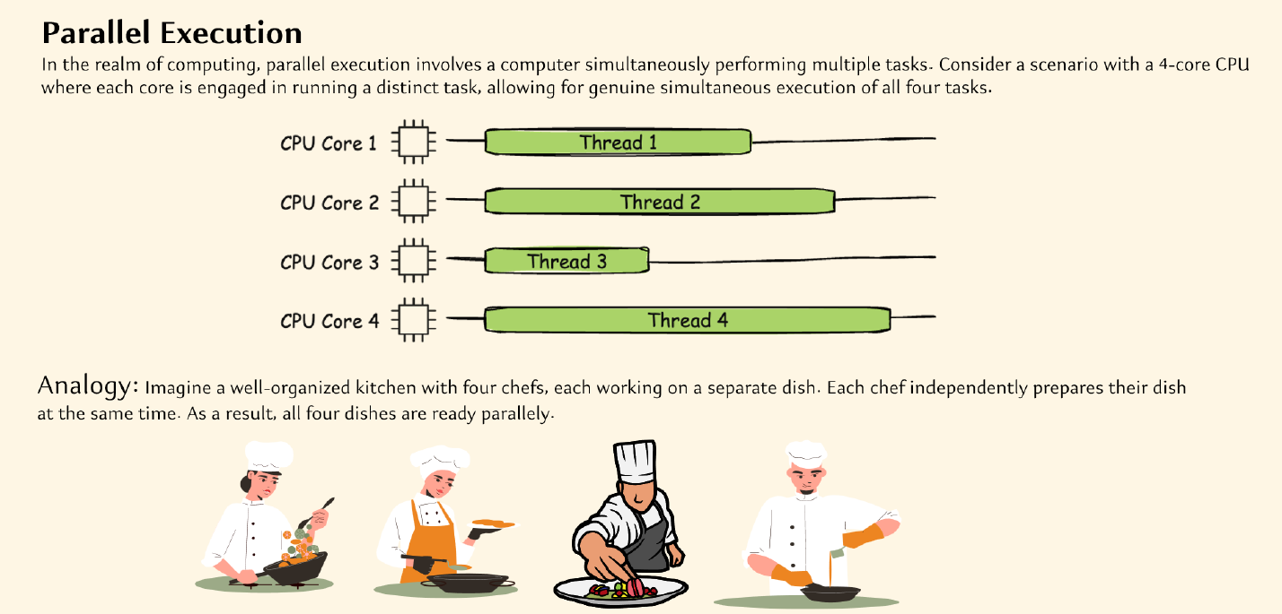
Parallel vs Concurrent Execution

Slide 6
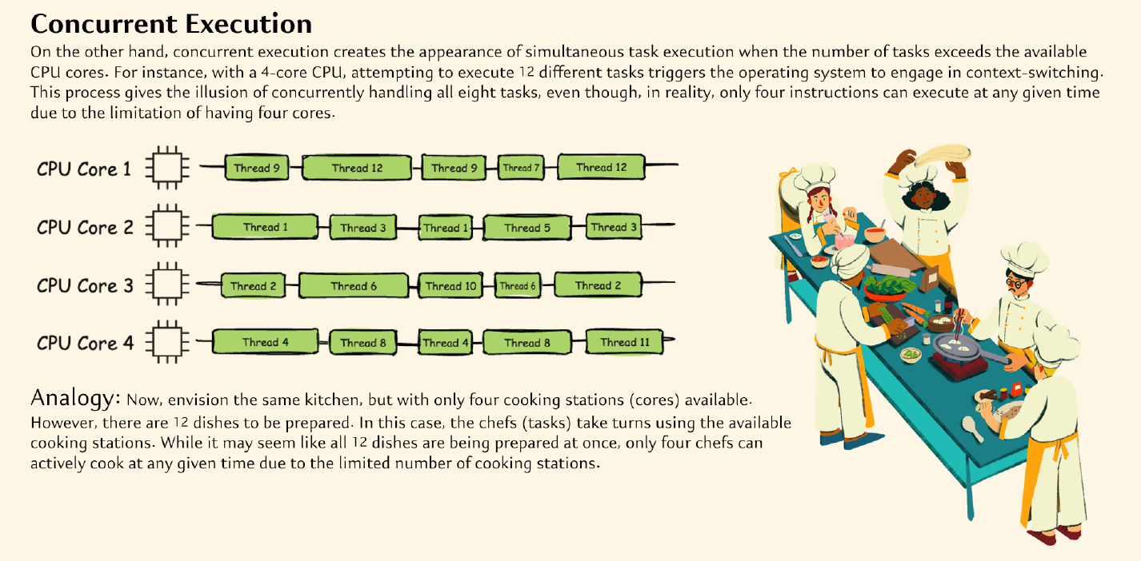
Parallel vs Concurrent Execution

Slide 7
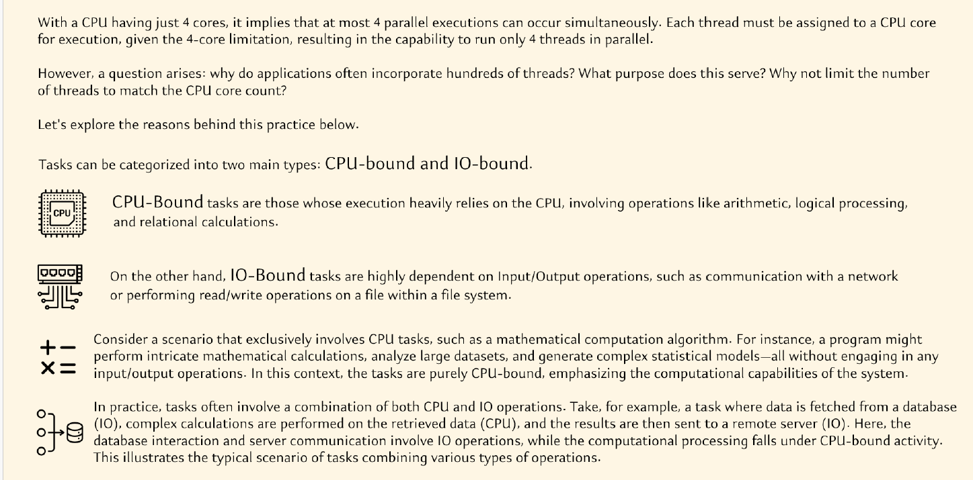
How multiple threads improve performance?

Slide 8
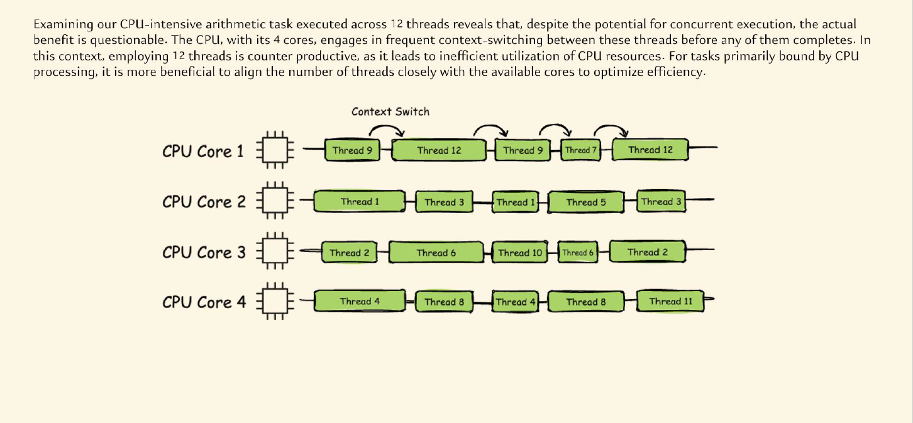
How multiple threads improve performance?

Slide 9
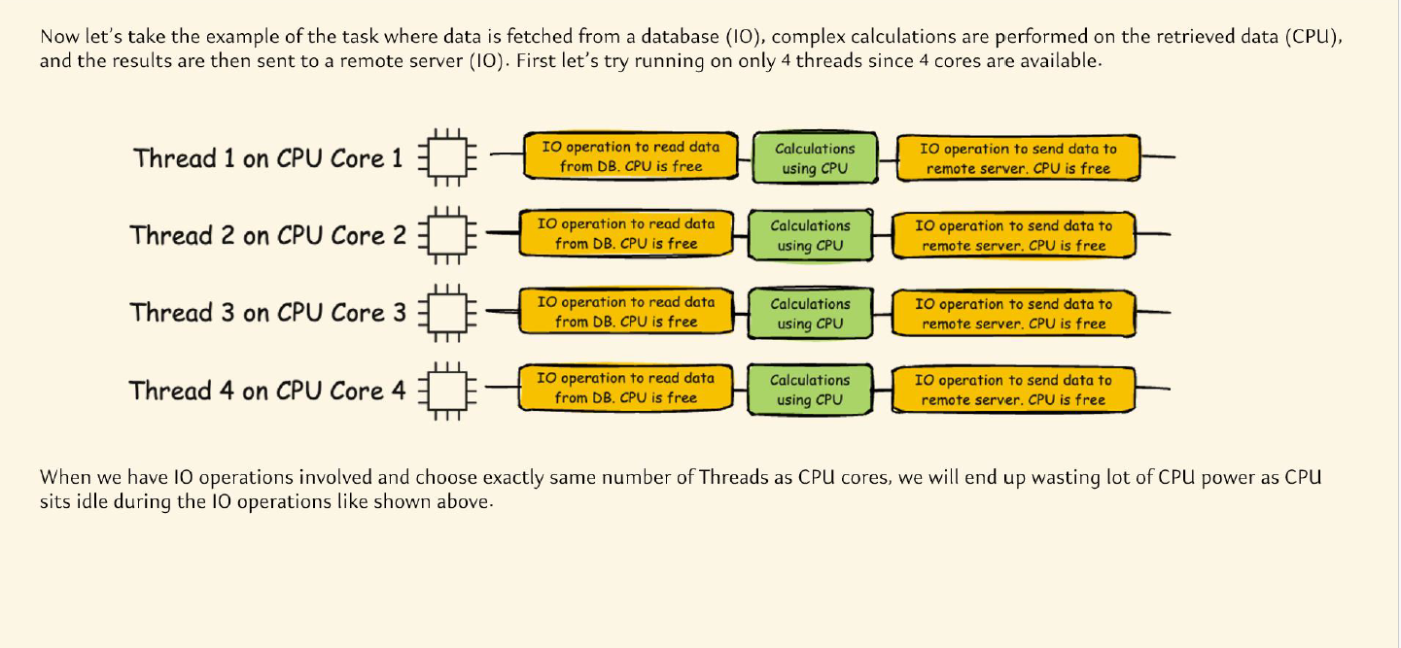
How multiple threads improve performance?

Slide 10
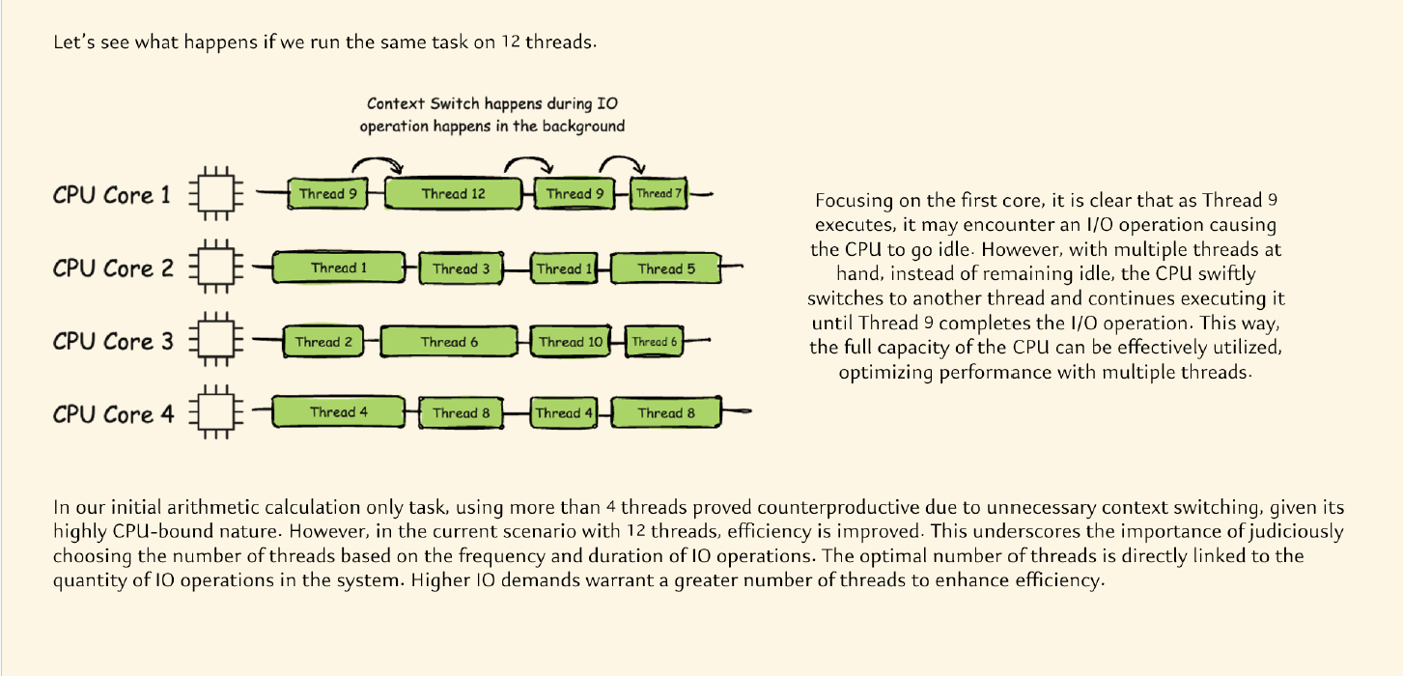
How multiple threads improve performance?

Slide 11
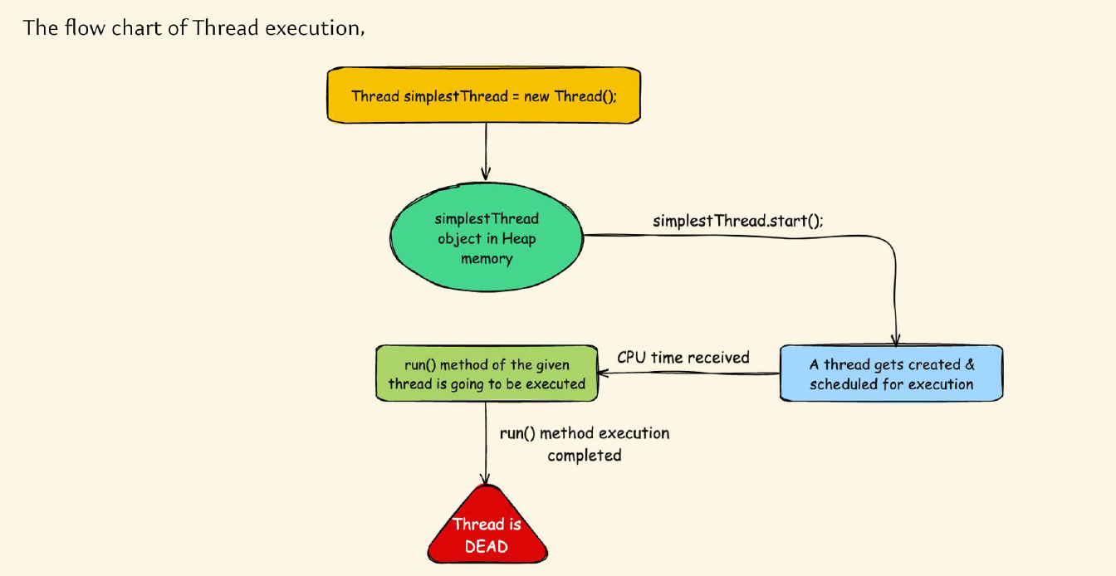
Flowchart of Thread Execution

Slide 12
Creating Threads in Java
Three approaches to specify code for execution by a thread.
1. By deriving your class from the thread class
2.By implementing the runnable interface
3.Using lambda expression

Slide 13
Example program by using Thread class
class MyThread extends Thread {
public void run() {
System.out.println("Thread is running");
}
}
public class Main {
public static void main(String[] args) {
MyThread t = new MyThread();
t.start();
}
}

Slide 14

Example program by using Thread class
public class AnotherThread extends Thread{
public void run() //Overriding run method of Thread class
{
System.out.println("Hello from another thread");
}
}
public class Main {
public static void main(String[] args) {
System.out.println("Hello from main thread");
Thread anotherThread = new AnotherThread();
anotherThread.start(); //To invoke run method
System.out.println("Hello from main again");
}
}
Output:

Slide 15
The order of execution of thread depends on the JVM and OS.
Each execution may produce different order of the result.
Main Thread:
It is the thread from where other “child” thread are spawned
It must be the last thread to finish execution.
When the main thread stops, the program terminates.
Main thread can also be controlled using a Thread object

Slide 16
Creating thread by implementing Runnable interface
public class MyRunnable implements Runnable{
@Override
public void run()
{
System.out.println("Hello from My Runnable implementation");
}
}
public class Main {
public static void main(String[] args) {
System.out.println("Hello from main thread");
Thread myRunnable = new Thread(new MyRunnable());
myRunnable.start();
}
}

Slide 17
Using Lambda Expressions
We can use lambda expressions to instantiate the ‘Runnable’ interface.
public class Demo {
public static void main(String[] args) {
Thread t = new Thread(() -> {
System.out.println("Thread is running");
for (int i = 1; i <= 5; i++) {
System.out.println(i);
}
});
t.start();
}
}

Slide 18
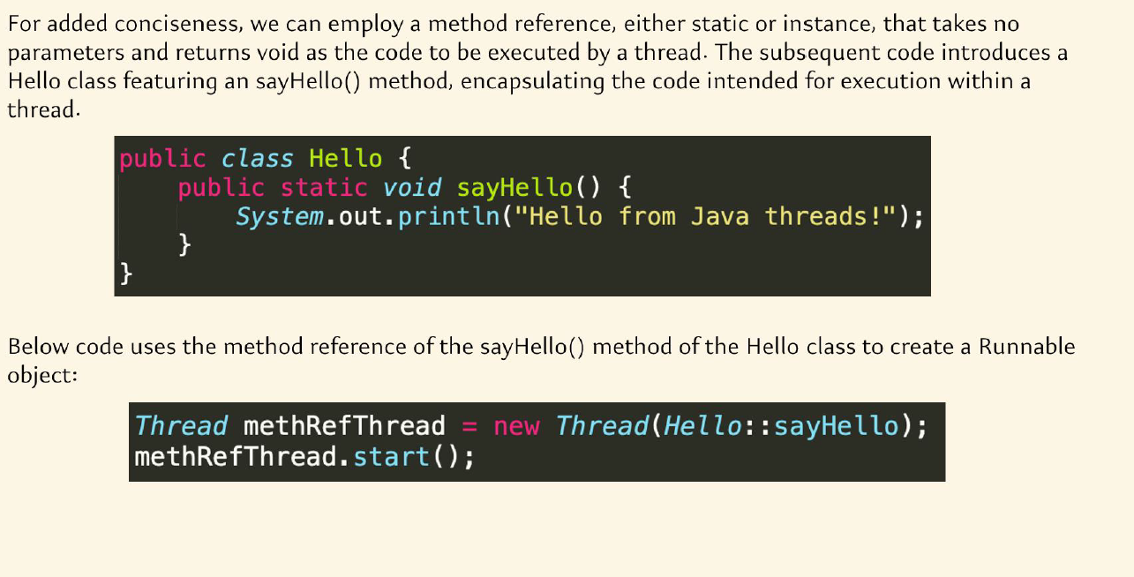

Slide 19
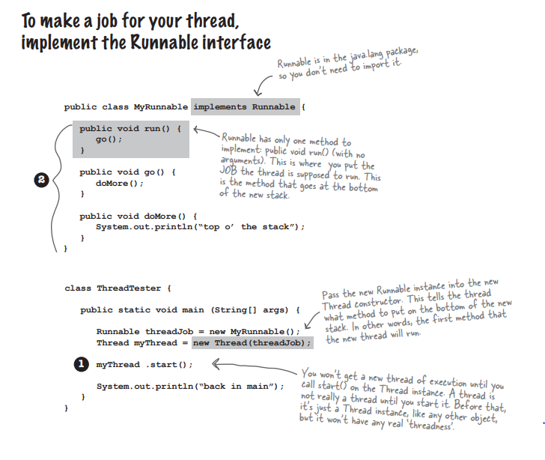

Slide 20
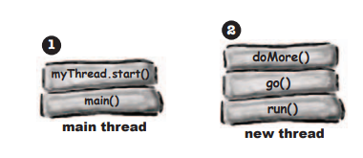

Slide 21
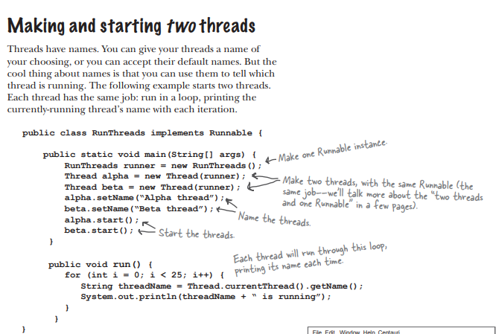

Slide 22
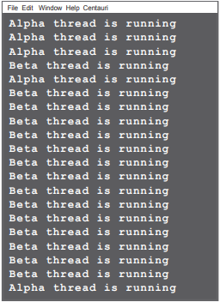
Output:

Slide 23
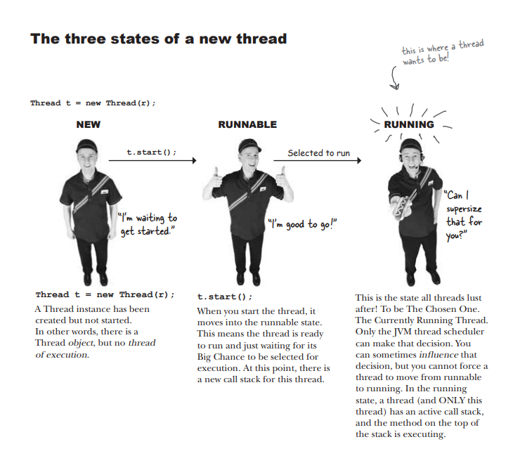

Slide 24
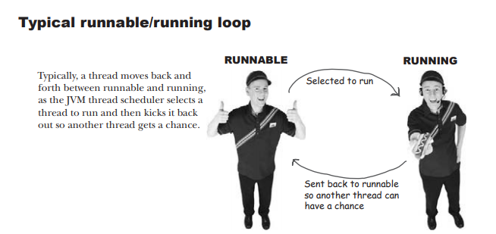

Slide 25
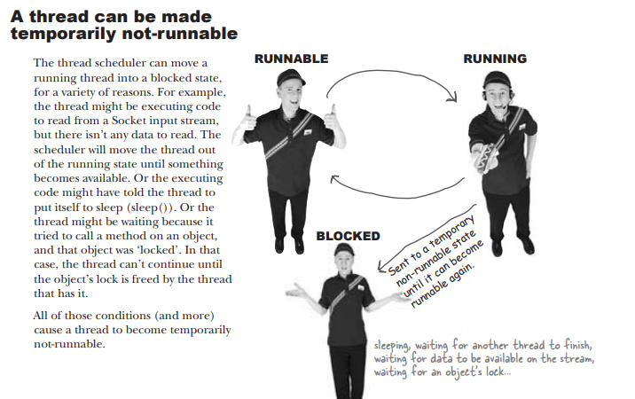

Slide 26
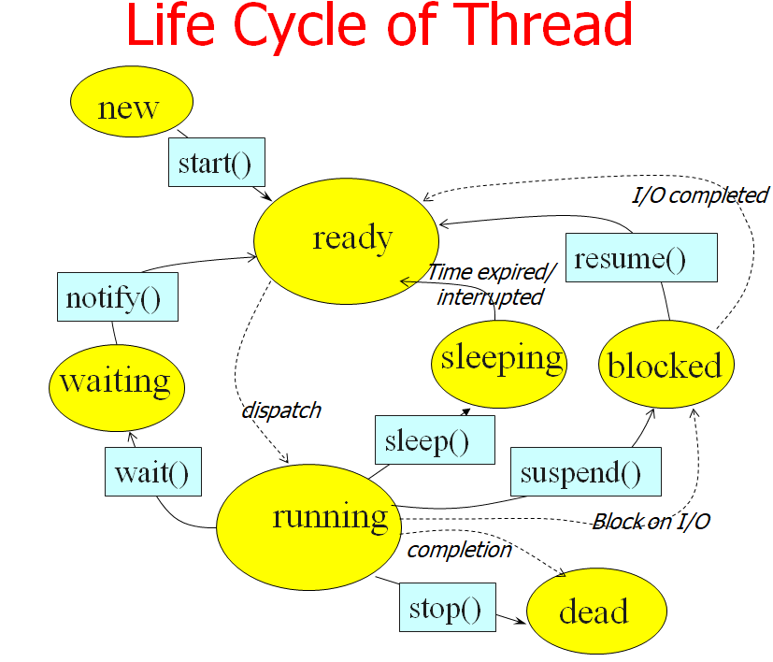

Slide 27
THREAD LIFECYCLE
The life cycle of threads in Java is very similar to the life cycle of processes running in an operating system.
During its life cycle the thread moves from one state to another depending on the operation performed by it or performed on it.
A Java thread can be in one of the following states:
NEW A thread that is just instantiated is in new state. When a start() method is invoked, the thread moves to the ready state from which it is automatically moved to runnable state by the thread scheduler.
RUNNABLE (ready running) A thread executing in the JVM is in running state.
BLOCKED A thread that is blocked waiting for a monitor lock is in this state. This can also occur when a thread performs an I/O operation and moves to next (runnable) state.

Slide 28
WAITING A thread that is waiting indefinitely for another thread to perform a particular action is in this state.
TIMED_WAITING (sleeping) A thread that is waiting for another thread to perform an action for up to a specified waiting time is in this state.
TERMINATED (dead) A thread that has exited is in this state.

Slide 29
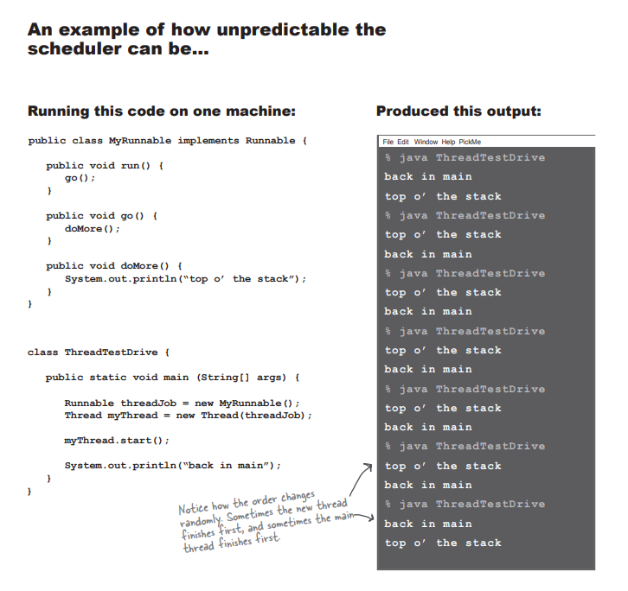

Slide 30
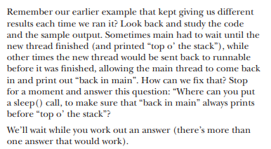
Using sleep to make our program more predictable.

Slide 31
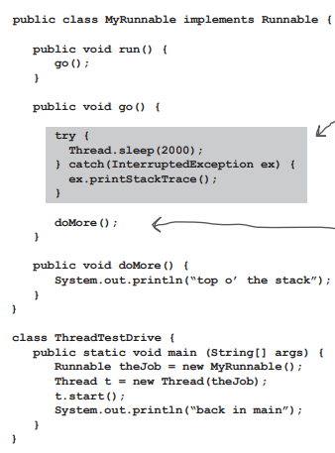
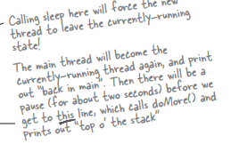

Slide 32
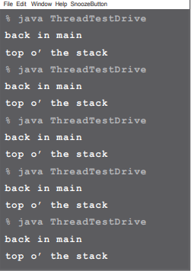

Slide 33
sleep()
Thread.sleep() method can be used to pause the execution of current thread for specified time in milliseconds. The argument value for milliseconds can’t be negative, else it throws IllegalArgumentException.
Thread.sleep() interacts with the thread scheduler to put the current thread in wait state for specified period of time. Once the wait time is over, thread state is changed to runnable state and wait for the CPU for further execution. So the actual time that current thread sleep depends on the thread scheduler that is part of operating system
sleep() should be always written within a try catch block as it will throw an InterruptedException

Slide 34
Thread Priority
In Java, each thread is assigned priority, which affects the order in which it is scheduled for running. The threads so far had same default priority (NORM_PRIORITY) and they are served using FCFS policy.
  Java allows users to change priority:
    ThreadName.setPriority(intNumber)
      MIN_PRIORITY = 1
      NORM_PRIORITY=5
      MAX_PRIORITY=10

Slide 35
Thread Priority Example
class X extends Thread
{
public void run()
{
System.out.println("Thread x Started");
for(int i=0; i<5; i++)
{
System.out.println("\t value of i in Thread x : " + i);
}
System.out.println("Threadx finished ");
}
}
class Y extends Thread
{
public void run()
{
System.out.println("Thread Y started");
for(int i=0; i<5; i++)
{
System.out.println("\tValue of i in Thread Y : " + i);
}
System.out.println("ThreadY Finished");
}
}

Slide 36
class Z extends Thread
{
public void run()
{
System.out.println("Thread Z started");
for(int i=0; i<5; i++)
{
System.out.println("\tValue of i in Thread Z : " + i);
}
System.out.println("ThreadZ Finished");
}
}
class ThreadPriority
{
public static void main(String[] args)
{
System.out.println("Main thread started");
X threadX = new X();
Y threadY = new Y ();
Z threadZ = new Z ();
threadZ.setPriority(Thread.MAX_PRIORITY); // priority = 10
threadY.setPriority(threadX.getPriority()+1); // priority = 6
threadX.setPriority(Thread.MIN_PRIORITY); // priority =l
threadX.start(); threadY.start(); threadZ.start();
try
{
threadX.join();threadY.join();threadZ.join();
}
catch(InterruptedException e){}
System.out.println("Main Thread Finished");
}
}

Slide 37
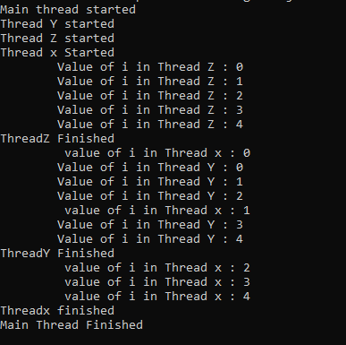
Generally higher priority threads can be expected to be given preference by the thread scheduler over lower priority threads. However, the implementation of thread scheduling is left up to the JVM implementation.
Output:
Although the threads are started in the order thread X followed by thread Y followed by thread Z but the thread Z (priority = 10) produces the output before thread Y (priority = 5) and thread X (priority = 1) because it has the highest priority.

Slide 38
Using isAlive( ) and join( )
Two ways exist to determine whether a thread has finished. First, you can call isAlive( ) on the thread. This method is defined by Thread, and its general form is shown here:
final boolean isAlive( )
The isAlive( ) method returns true if the thread upon which it is called is still running. It returns false otherwise. While isAlive( ) is occasionally useful, the method that you will more commonly use to wait for a thread to finish is called join( ), shown here:
final void join( ) throws InterruptedException
This method waits until the thread on which it is called terminates.
Its name comes from the concept of the calling thread waiting until the specified thread joins it.
Additional forms of join( ) allow you to specify a maximum amount of time that you want to wait for the specified thread to terminate.

Slide 39
Example of using join()
public class JoinExample {
public static void main(String[] args) {
Thread th1 = new Thread(new MyClass(), "th1");
Thread th2 = new Thread(new MyClass(), "th2");
Thread th3 = new Thread(new MyClass(), "th3");
// Start first thread immediately
th1.start();
/* Start second thread (th2) once first thread (th1)
* is dead
*/
try {
th1.join();
} catch (InterruptedException ie) {
ie.printStackTrace();
}
th2.start();
/* Start third thread (th3) once second thread (th2)
* is dead
*/
try {
th2.join();
} catch (InterruptedException ie) {
ie.printStackTrace();
}

Slide 40
Example of using join()
th3.start();
// Displaying a message once third thread is dead
try {
th3.join();
} catch (InterruptedException ie) {
ie.printStackTrace();
}
System.out.println("All three threads have finished execution");
}
}
class MyClass implements Runnable {
@Override
public void run() {
Thread t = Thread.currentThread();
System.out.println("Thread started: " + t.getName());
try {
Thread.sleep(4000);
} catch (InterruptedException ie) {
ie.printStackTrace();
}
System.out.println("Thread ended: " + t.getName());
}
}

Slide 41
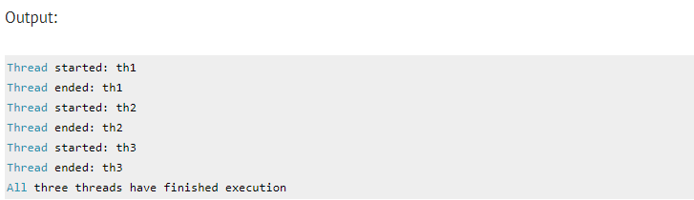

Slide 42
Synchronization
When two or more threads need access to a shared resource, they need some way to ensure that the resource will be used by only one thread at a time. The process by which this is achieved is called synchronization. As you will see, Java provides unique, language-level support for it.
Key to synchronization is the concept of the monitor.
A monitor is an object that is used as a mutually exclusive lock.
Only one thread can own a monitor at a given time.
When a thread acquires a lock, it is said to have entered the monitor.
All other threads attempting to enter the locked monitor will be suspended until the first thread exits the monitor.
These other threads are said to be waiting for the monitor. A thread that owns a monitor can reenter the same monitor if it so desires.

Slide 43
Understanding the problem without Synchronization
class First
{
public void display(String msg)
{
System.out.print ("["+msg);
try
{
Thread.sleep(500);
}
catch(InterruptedException e)
{
e.printStackTrace();
}
System.out.println ("]");
}
}

Slide 44


Understanding the problem without Synchronization
class Second extends Thread
{
String msg;
First fobj;
Second (First fp,String str)
{
fobj = fp;
msg = str;
start();
}
public void run()
{
fobj.display(msg);
}
}
public class Main
{
public static void main (String[] args)
{
First fnew = new First();
Second ss = new Second(fnew, "welcome");
Second ss1 = new Second (fnew,"to");
Second ss2 = new Second(fnew, “java");
}
}
Output: (The order varies during each execution)

Slide 45
Using Synchronized Methods
If you declare any method as synchronized, it is known as synchronized method.
Synchronized method is used to lock an object for any shared resource.
When a thread invokes a synchronized method, it automatically acquires the lock for that object and releases it when the method returns.
In the previous example include the keyword “synchronized” before the method “display”

Slide 46

class First
{
public synchronized void display(String msg)
{
System.out.print ("["+msg);
try
{
Thread.sleep(500);
}
catch(InterruptedException e)
{
e.printStackTrace();
}
System.out.println ("]");
}
}
The output will be :

Slide 47
The synchronized Statement
While creating synchronized methods within classes that you create is an easy and effective means of achieving synchronization, it will not work in all cases.
Imagine that you want to synchronize access to objects of a class that was not designed for multithreaded access.
That is, the class does not use synchronized methods.
Further, this class was not created by you, but by a third party, and you do not have access to the source code.
Thus, you can’t add synchronized to the appropriate methods within the class.
Fortunately, the solution to this problem is quite easy: You simply put calls to the methods defined by this class inside a synchronized block. This is the general form of the synchronized statement:

Slide 48

The synchronized Statement
Here, objRef is a reference to the object being synchronized. A synchronized block ensures that a call to a synchronized method that is a member of objRef’s class occurs only after the current thread has successfully entered objRef’s monitor.

Slide 49
// This program uses a synchronized block.
class Callme {
void call(String msg) {
System.out.print("[" + msg);
try {
Thread.sleep(1000);
} catch (InterruptedException e) {
System.out.println("Interrupted");
}
System.out.println("]");
}
}
class Caller implements Runnable {
String msg;
Callme target;
Thread t;
public Caller(Callme targ, String s) {
target = targ;
msg = s;
t = new Thread(this);
}
// synchronize calls to call()
public void run() {
synchronized (target) { // synchronized block
target.call(msg);
}
}
}

Slide 50
class Synch1 {
public static void main(String args[]) {
Callme target = new Callme();
Caller ob1 = new Caller(target, "Hello");
Caller ob2 = new Caller(target, "Synchronized");
Caller ob3 = new Caller(target, "World");
// Start the threads.
ob1.t.start();
ob2.t.start();
ob3.t.start();
// wait for threads to end
try {
ob1.t.join();
ob2.t.join();
ob3.t.join();
} catch (InterruptedException e) {
System.out.println("Interrupted");
}
}
}

Slide 51
Interthread Communication
To avoid polling, Java includes an elegant interprocess communication mechanism via the wait( ), notify( ), and notifyAll( ) methods.
These methods are implemented as final methods in Object, so all classes have them.
All three methods can be called only from within a synchronized context.
Although conceptually advanced from a computer science perspective, the rules for using these methods are actually quite simple:
wait( ) tells the calling thread to give up the monitor and go to sleep until some other thread enters the same monitor and calls notify( ) or notifyAll( ). • notify( ) wakes up a thread that called wait( ) on the same object.
• notifyAll( ) wakes up all the threads that called wait( ) on the same object. One of the threads will be granted access

Slide 52
These methods are declared within Object, as shown here:
final void wait( ) throws InterruptedException
final void notify( )
final void notify All( )
Although wait( ) normally waits until notify( ) or notifyAll( ) is called, there is a possibility that in very rare cases the waiting thread could be awakened due to a spurious wakeup
To begin, consider the following sample program that incorrectly implements a simple form of the producer/consumer problem.
It consists of four classes:
Q, the queue that you’re trying to synchronize;
Producer, the threaded object that is producing queue entries;
Consumer, the threaded object that is consuming queue entries;
and
PC, the tiny class that creates the single Q, Producer, and Consumer.

Slide 53
// A correct implementation of a producer and consumer.
class Q {
int n;
boolean valueSet = false;
synchronized int get() {
while (!valueSet) {
try {
wait();
} catch (InterruptedException e) {
System.out.println("InterruptedException caught");
}
}
System.out.println("Got: " + n);
valueSet = false;
notify();
return n;
}
synchronized void put(int n) {
while (valueSet) {
try {
wait();
} catch (InterruptedException e) {
System.out.println("InterruptedException caught");
}
}
Notes:
get() (called by the consumer)
Enter the monitor.
while (!valueSet): if there is nothing to consume, call wait() (releasing the lock).
When data is available, print Got: n, set valueSet = false (the buffer is empty again), call notify() to wake the producer, and return n.

Slide 54
this.n = n;
valueSet = true;
System.out.println("Put: " + n);
notify();
}
}
class Producer implements Runnable {
Q q;
Thread t;
Producer(Q q) {
this.q = q;
t = new Thread(this, "Producer");
}
public void run() {
int i = 0;
while (true) {
q.put(i++);
}
}
}

Slide 55
class Consumer implements Runnable {
Q q;
Thread t;
Consumer(Q q) {
this.q = q;
t = new Thread(this, "Consumer");
}
public void run() {
while (true) {
q.get();
}
}
}
class PCFixed {
public static void main(String args[]) {
Q q = new Q();
Producer p = new Producer(q);
Consumer c = new Consumer(q);
// Start the threads.
p.t.start();
c.t.start();
System.out.println("Press Control-C to stop.");
}
}

Slide 56
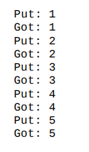
Inside get( ), wait( ) is called.
This causes its execution to suspend until Producer notifies you that some data is ready.
When this happens, execution inside get( ) resumes. After the data has been obtained, get( ) calls notify( ).
This tells Producer that it is okay to put more data in the queue.
Inside put( ), wait( ) suspends execution until Consumer has removed the item from the queue.
When execution resumes, the next item of data is put in the queue, and notify( ) is called. This tells Consumer that it should now remove it.
Output:

Slide 57

Obtaining a Thread’s State
You can obtain the current state of a thread by calling the getState( ) method defined by Thread. It is shown here:
Given a Thread instance, you can use getState( ) to obtain the state of a thread.
For example, the following sequence determines if a thread called thrd is in the RUNNABLE state at the time getState( ) is called:
Thread.State ts = thrd.getState();
if(ts == Thread.State.RUNNABLE) //
Depending on the circumstances, the state obtained by calling getState( ) may not reflect the actual state of the thread only a moment later.

Slide 58
Suspending, Resuming, and Stopping Threads
Prior to Java 2, a program used suspend( ), resume( ), and stop( ), which are methods defined by Thread, to pause, restart, and stop the execution of a thread.
The suspend( ) method of the Thread class was deprecated by Java 2 several years ago. This was done because suspend( ) can sometimes cause serious system failures.
The resume() and stop() methods were also deprecated.

Slide 59
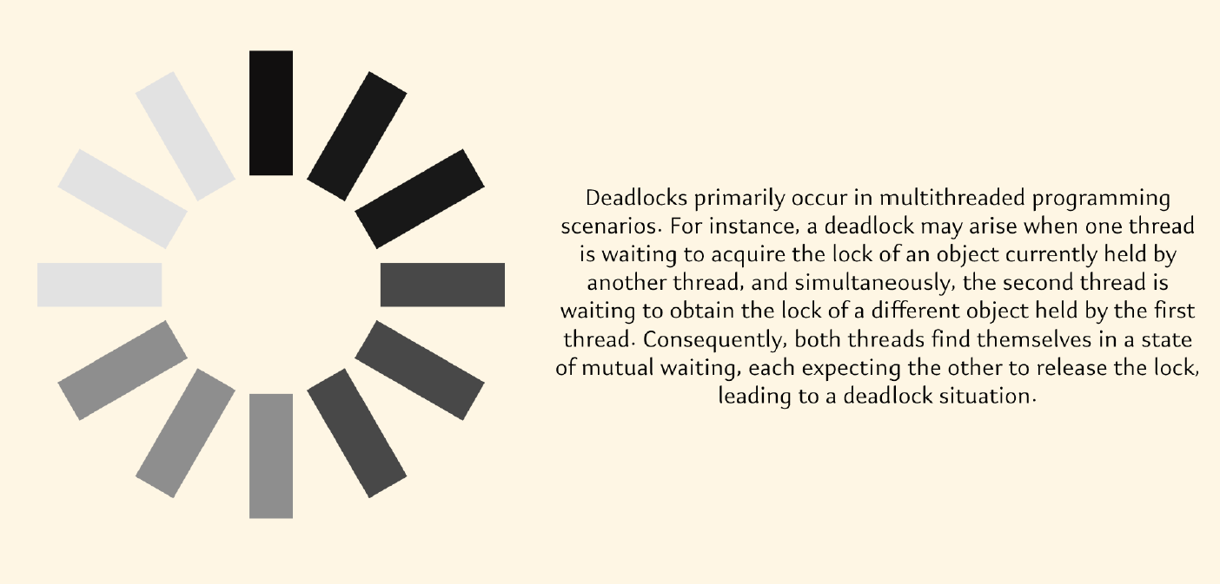

Slide 60
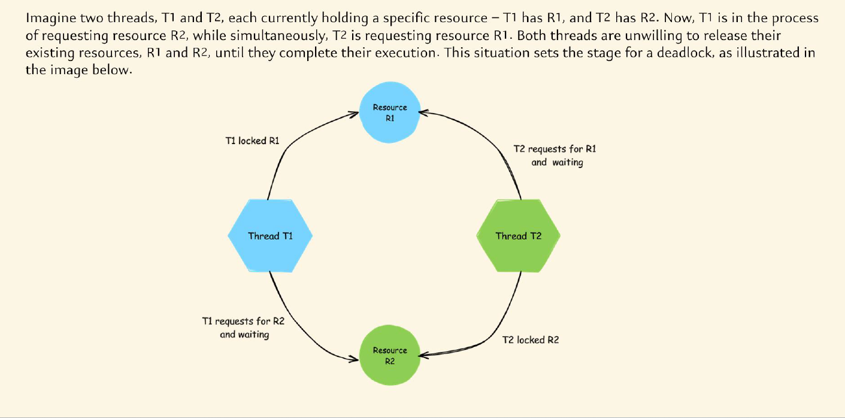

Slide 61
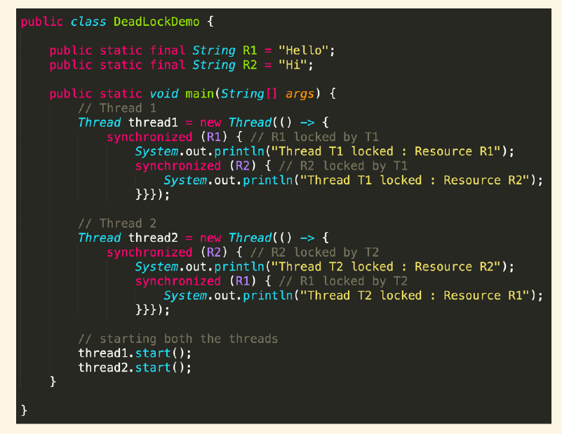

Slide 62
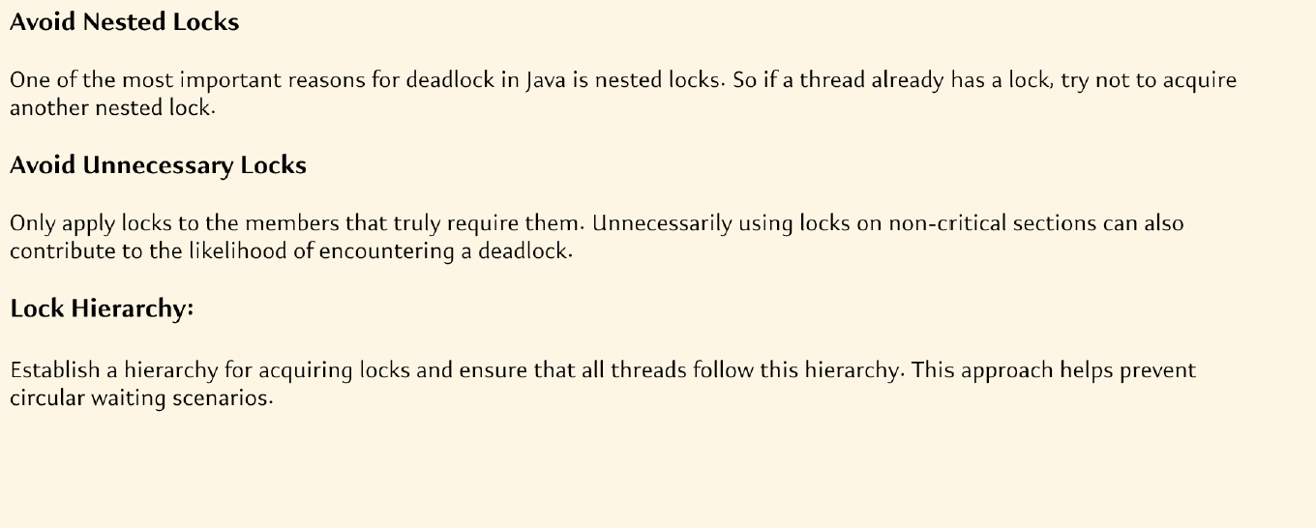
How to Avoid Deadlocks

Slide 63
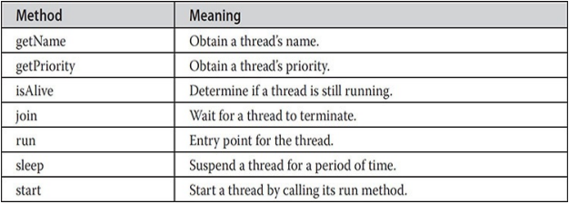
Methods in Thread Class
The Thread class defines several methods that help manage threads. Several of those used in this chapter are shown here:

