Slide 1
Stacks, Queues and Deque

Slide 2
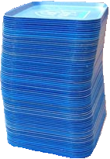
Stack
A stack is a data Structure in which insertion and deletion take place at the same end.
Stacks are known as LIFO (Last In, First Out) lists.
  The last element inserted will be the first to be retrieved.
  We can only add/remove/examine
  the last element added (the "top").

Slide 3
STACK OPERATIONS:
● Push:
To insert an item from Top of stack is called push operation.
● POP:
To put-off, get or remove some item from top of the stack is the pop operation.
● IsEmpty:
Stack considered empty when there is no item on top. IsEmpty operation return true when there is no item in stack else false.
● IsFull:
Stack considered full if no other element can be inserted on top of the stack.

Slide 4
Example of Push and Pop
Push
  Add an element to the top of the stack.
Pop
  Remove the element at the top of the stack.
IsEmpty stack
push an element
push another
pop
top
B
top
top
top
A
A
A

Slide 5
Example of Push and Pop
The Push Operation
Suppose we have an empty integer stack that is capable of holding a maximum of three values. With that stack we execute the following push operations.
push(5);
push(10);
push(15);

Slide 6
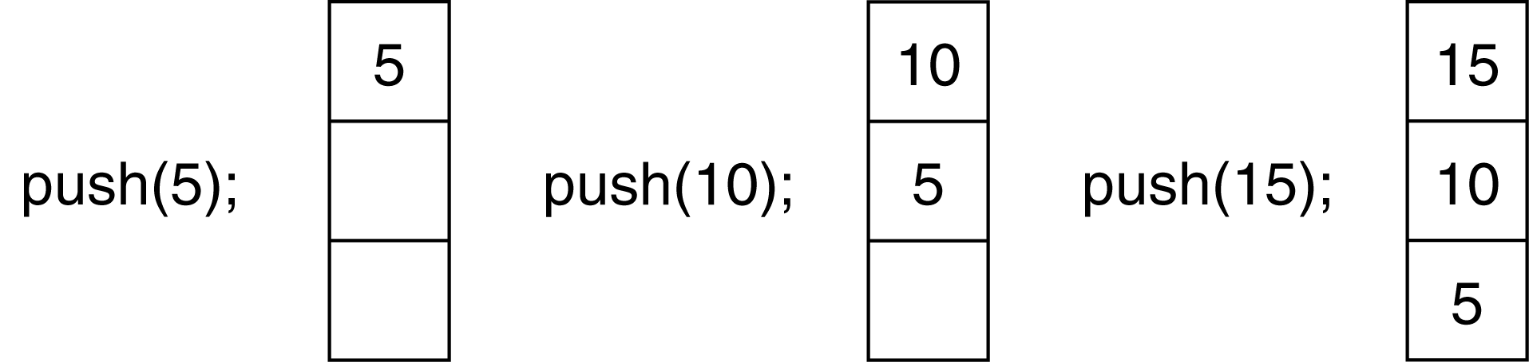
The state of the stack after each of the push operations:

Slide 7
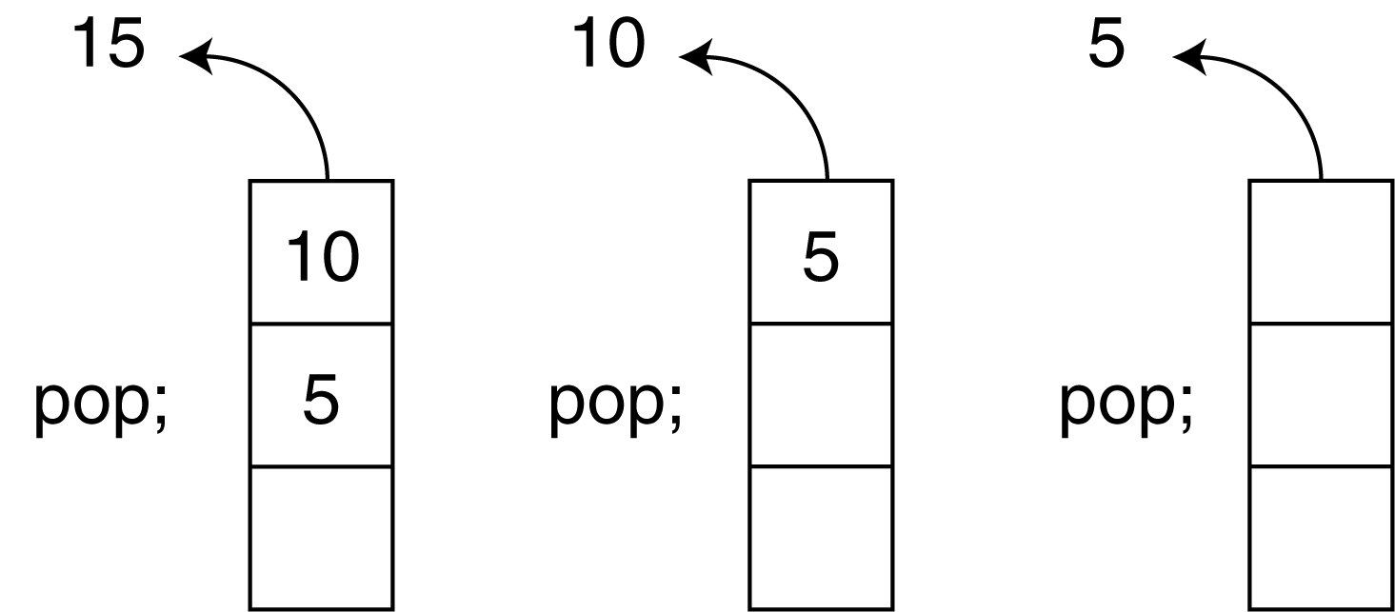
The Pop Operation
Now, suppose we execute three consecutive pop operations on the same stack:

Slide 8
This is a sample program to demonstrate push and pop functionality in Stack in Java:
public class StackDemo {
private int size = 3;
int arr[] = new int[size];
int front = -1; // variable declaration and initialize with -1
public void push(int pushedElement) { // push method
if (front < size - 1) { // when front of stack is less size-1
front++; // increment the top
arr[front] = pushedElement; // push value at array of front where front is index
System.out.println("Element " + pushedElement
+ " is pushed to Stack !");
printElements(); // calling statement of print element method
} else {
System.out.println("Stack Overflow !"); // print when stack is full
}
}

Slide 9
public void pop() { // pop method
if (front >= 0) { // if condition true when front is greater than 0
front--; // decrement the front
System.out.println("Pop operation done !");
} else {
System.out.println("Stack Underflow !");
}
}
public void printElements() { // display function heading
if (front >= 0) {
System.out.println("Elements in stack :");
for (int i = 0; i <= front; i++) { // loop start from 0 index to the front of the stack
System.out.println(arr[i]); // printing statement
}
}
}

Slide 10
public static void main(String[] args) {
StackDemo stackDemo = new StackDemo();
stackDemo.push(23); // calling statement of push method with parameter (passing value)
stackDemo.push(2);
stackDemo.push(73);
stackDemo.push(21);
stackDemo.pop(); // calling statement of pop method
stackDemo.pop();
stackDemo.pop();
stackDemo.pop();
}
}

Slide 11
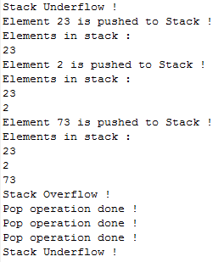
Output
If everything goes right you will see following output on console demonstrating all possible cases in Stack Implementation.

Slide 12
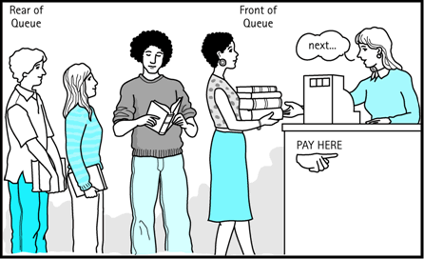
Queue
A queue is a Data structure, in which insertion is done at one end, while deletion is performed at the other end.
---Accessing the elements of queues follows a First In, First Out (FIFO) order.
  --Like customers standing in a line in a store, the first customer in is the first customer served.
  --We can only add to the end of the
  queue, and can only examine/remove
  the front of the queue.

Slide 13
Enqueue and Dequeue
Queue operations: Enqueue and Dequeue
Like lines in a store, a queue has a front and a rear.
Enqueue – insert an element at the rear of the queue
Dequeue – remove an element from the front of the queue
Remove
(Dequeue)
Insert
(Enqueue)
front
rear

Slide 14
Example of Enqueue and Dequeue:
Suppose we have an empty static integer queue that is capable of holding a maximum of three values. With that queue we execute the following enqueue operations.
Enqueue(3);
Enqueue(6);
Enqueue(9);

Slide 15
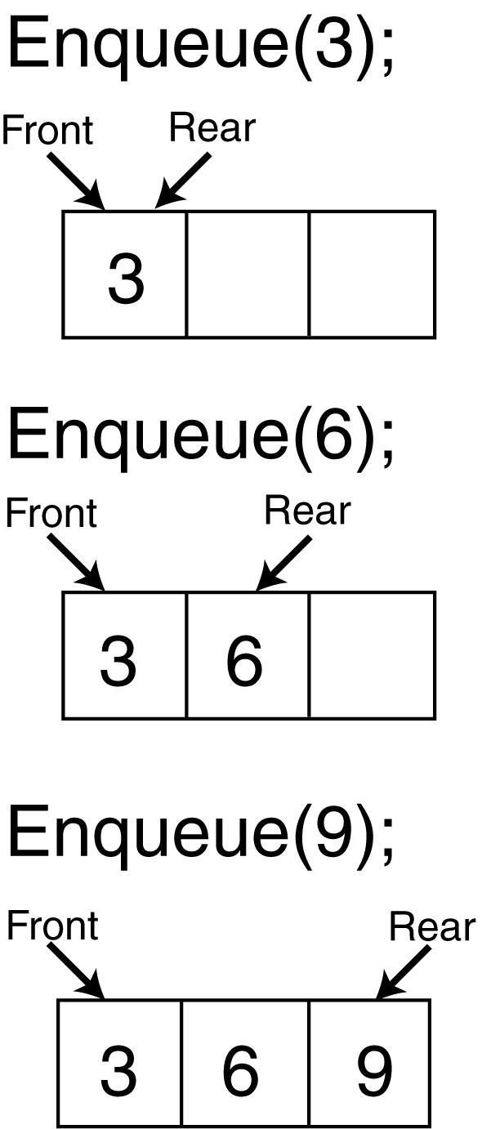
Example of Enqueue and Dequeue:
The state of the queue after each of the enqueue operations.

Slide 16
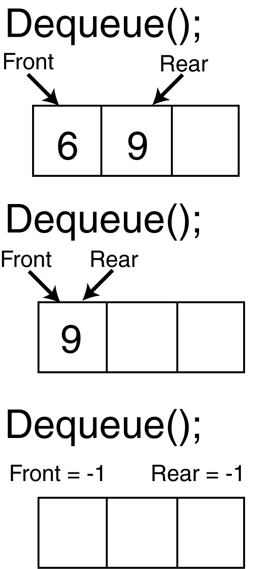
Example of Enqueue and Dequeue:
Now the state of the queue after each of three consecutive dequeue operations

Slide 17

Example Program for Stack implementation using Generics
import java.util.ArrayList;
interface Container<T> {
void push(T item);
T pop();
boolean isEmpty();
}
class Stack<T> implements Container<T> {
private ArrayList<T> items = new ArrayList<>();
public void push(T item) { items.add(item); }
public T pop() {
if (items.isEmpty()) throw new RuntimeException("Stack empty");
return items.remove(items.size() - 1);
}
public boolean isEmpty() { return items.isEmpty(); }
// generic method inside a generic class
public <U extends T> void pushAll(java.util.List<U> list) {
for (U u : list) push(u);
}
}
public class StackDemo {
public static void main(String[] args) {
Stack<Number> s = new Stack<>();
s.push(10);
s.push(2.5);
s.pushAll(java.util.List.of(1, 2, 3)); // U = Integer, a subtype of Number
while (!s.isEmpty()) System.out.print(s.pop() + " ");
}
}

Slide 18
Queue Implementation of Array
There algorithms to implement Enqueue and Dequeue
  When enqueuing, the front index is always fixed and the rear index moves forward in the array.
rear
rear
rear
3
3
6
3
6
9
front
front
front
Enqueue(3)
Enqueue(6)
Enqueue(9)

Slide 19
Queue Implementation of Array
  When dequeuing, the front index is fixed, and the element at the front the queue is removed. Move all the elements after it by one position.
rear
rear
rear = -1
6
9
9
front
front
front
Dequeue()
Dequeue()
Dequeue()

Slide 20
This is a sample program to demonstrate push and pop functionality in Queue in Java.
public class QueueDemo {
private int size = 3; // instance variable and size of of array
int arr[] = new int[size]; // declaration of array and assigning size to array
int front = -1; // front of queue
int rear = 0; // rear of queue
public void push(int pushedElement) { // insertion method declaration
if (front < size - 1) { // front is less then size-1
front++; //increment the front
arr[front] = pushedElement; // set element at array at front
System.out.println("Element " + pushedElement
+ " is pushed to Queue !");
display(); // display method calling statement
} else {
System.out.println("Overflow !");
}
}

Slide 21
public void pop() { // deletion method declaration
if (front >= rear) { // true till front is greater or equal to rear
rear++;
System.out.println("Pop operation done !");
display(); // display method calling statement
} else {
System.out.println("Underflow !");
}
}
public void display() { // display method declaration
if (front >= rear) {
System.out.println("Elements in Queue : ");
for (int i = rear; i <= front; i++) { // start from rear to front
System.out.println(arr[i]);
}
}
}

Slide 22
public static void main(String[] args) {
QueueDemo queueDemo = new QueueDemo();
queueDemo.pop();
queueDemo.push(23); // calling statement of insertion method
queueDemo.push(2);
queueDemo.push(73);
queueDemo.push(21);
queueDemo.pop(); // calling statement of deletion method
queueDemo.pop();
queueDemo.pop();
queueDemo.pop();
}
}

Slide 23
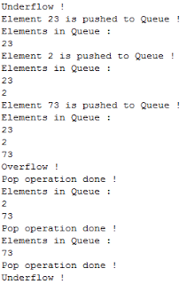
Output
If everything goes right you will see following output on console demonstrating all possible cases in Queue Implementation

Slide 24
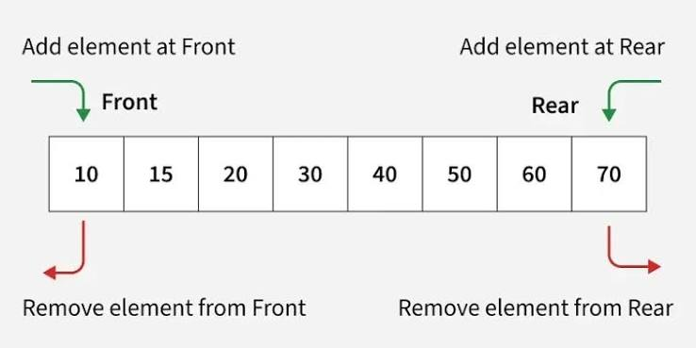
Deque
A Deque (Double-Ended Queue) is a linear data structure that allows insertion and deletion of elements from both ends.

Slide 25
Operations in Dequeue
insertFront(x) → Insert an element at the front end.
insertRear(x) → Insert an element at the rear end.
deleteFront() → Delete an element from the front end.
deleteRear() → Delete an element from the rear end.
getFront() → Retrieve (but don’t remove) the front element.
getRear() → Retrieve (but don’t remove) the rear element.
isEmpty() → Check if the deque is empty.
size() → Return the number of elements currently in the deque.

Slide 26
Stack, Queue and Deque in Java
Structure | Rule | Insert | Remove | Typical use
Stack | LIFO (Last In, First Out) | push (top) | pop (top) | Undo, recursion, expression evaluation
Queue | FIFO (First In, First Out) | enqueue (rear) | dequeue (front) | Scheduling, buffering, BFS
Deque | Double-ended: both ends allowed | front and rear | front and rear | Sliding window, palindrome check, work stealing

Slide 27
https://onlinegdb.com/uH3iVUpud
Program with classes implemented for stack, queue and deque

Slide 28
Using the JDK built in classes
ArrayDeque is the recommended choice for stack, queue and deque.
https://onlinegdb.com/sZuQ8XqvLC

Slide 29
Builtin Methods in ArrayDeque Class and Declaration
Deque<Integer> dq = new ArrayDeque<>(); // default capacity 16
Deque<String> dq2 = new ArrayDeque<>(50); // initial capacity hint
Category | Method | Syntax | Returns | If Deque Is Empty
Insert | addFirst | dq.addFirst(E e) | void | n/a
 | offerFirst | dq.offerFirst(E e) | boolean | n/a
 | addLast | dq.addLast(E e) | void | n/a
 | offerLast | dq.offerLast(E e) | boolean | n/a
Remove | removeFirst | E x = dq.removeFirst() | E | Throws NoSuchElementException
 | pollFirst | E x = dq.pollFirst() | E | Returns null
 | removeLast | E x = dq.removeLast() | E | Throws NoSuchElementException
 | pollLast | E x = dq.pollLast() | E | Returns null
Examine | peekFirst | E x = dq.peekFirst() | E | Returns null
 | peekLast | E x = dq.peekLast() | E | Returns null
Stack (LIFO) | push | dq.push(E e) | void | n/a
 | pop | E x = dq.pop() | E | Throws NoSuchElementException
 | peek | E x = dq.peek() | E | Returns null

Slide 30
Methods in ArrayDeque Class
Queue (FIFO) | offer | dq.offer(E e) | boolean | n/a
 | add | dq.add(E e) | boolean | n/a
 | poll | E x = dq.poll() | E | Returns null
 | remove | E x = dq.remove() | E | Throws NoSuchElementException
Utility | size | int n = dq.size() | int | Returns 0
 | isEmpty | boolean b = dq.isEmpty() | boolean | Returns true
 | contains | boolean b = dq.contains(Object o) | boolean | Returns false
 | clear | dq.clear() | void | No effect
Traversal | iterator | Iterator<E> it = dq.iterator() | Iterator<E> | hasNext() is false
 | descendingIterator | Iterator<E> it = dq.descendingIterator() | Iterator<E> | hasNext() is false

Slide 31
THE END

