Slide 1
American Express Campus Analyze This 2018
Final Submission

Slide 2
Team Details
Team Name :
Name | Campus | Roll No. | Mobile No. | Email Id
Ashutosh Gupta | IIT Kharagpur | 16AG30007 | 8764031749 | iamashu@iitkgp.ac.in
Praveen Kumar | IIT Kharagpur | 16AG30021 | 9807323764 | pkpraveen603@gmail.com
Notes:
<number>

Slide 3
Estimation Technique Used
Please provide the estimation/modeling technique(s)/approach used to arrive at the solution/equation:
After exploratory data analysis of the training data and plotting the distributions of the corresponding columns, we came to know that the dat is distributed variably i.e, normally , exponentially and chi-squared distribution . So, to have the better efficiency of classification model and also from observing other such problems , we arrived at a conclusion that decision tree-based models like GBM , XGBM , CatBoosting , LightGBM were best suited for this data .
After long and rigorous cycles of model training and validation, it was found out that Catboost worked best for this database. Furthermore, the model is improved by converting the continous data into categorical data by the percentile method.after categorisation .
Notes:
<number>

Slide 4
Strategy to decide final list
Please provide the strategy employed to decide the final list for submission:
After predicting on the evaluation data, we fabricated the final list by arranging the predicted probabilities of the rows (‘Defaulting’) in the ascending manner so as to put the less risky applications first.
Notes:
<number>

Slide 5
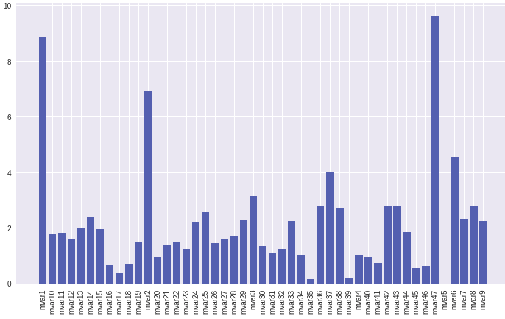
Details of each Variable used in the logic/model/strategy
Please provide details of each variable used in the final logic:
This Graph showcases the importance of all the features in our model. We can clearly see features like mvar17, mvar35, mvar39 , which has large number of nan values and hence less importance. The 2 most important features are:
Credit Worthiness Score Type of Product applicant applied for.
Notes:
<number>

Slide 6
Reasons for Technique(s) Used
Why do you think this is the best technique(s) for this particular problem?
The things to consider before answering this question are :
We used credit history, balance and related features, features were not similarly distributed, there were lots of missing, na and NaN values, and also most of the variables had a large number of outliers.
These things pointed towards : first categorisng the data and then using decision tree models for the prediction. Amongst these similar problems, XGBoost, LightGBM and Catboosting were popuar and final options, where all of them handle nan values very well without imputation. But catboost works best for categorical data, and hence it was best out of all the remaining models we had due to its ability to tackle all the problems that were asked here for. We also tuned then the parameters of this model to improve efficiency and accuracy.
Notes:
<number>

Slide 7
Final Submission File
Please embed your final submission file (.csv) here.
Submission File: Slytherin_IITKharagpur.csv
Link of the file: Click Here
Notes:
<number>

Slide 8
THANK YOU

