Slide 1
자바 프로젝트
2017301027
컴퓨터과학과
박경림

Slide 2
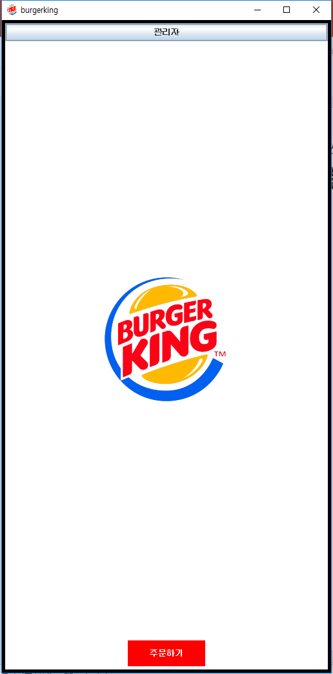
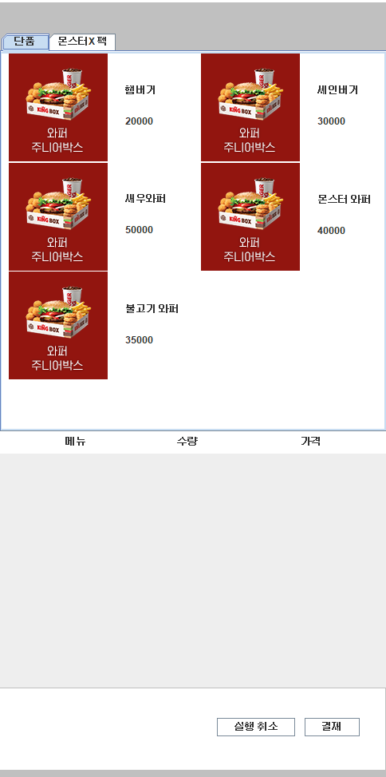
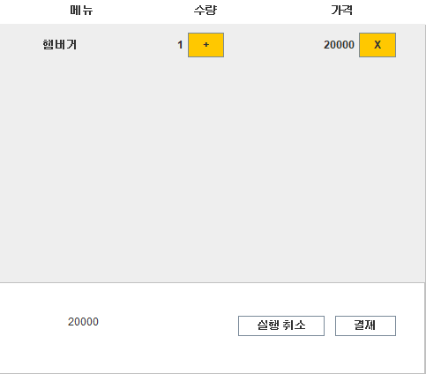
시작 페이지
음악 재생
static void PlaySound(File sound) {
try {
Clip clip = AudioSystem.getClip();
clip.open(AudioSystem.getAudioInputStream(sound));
clip.start();
} catch (Exception e) {
// TODO: handle exception
}
}

Slide 3
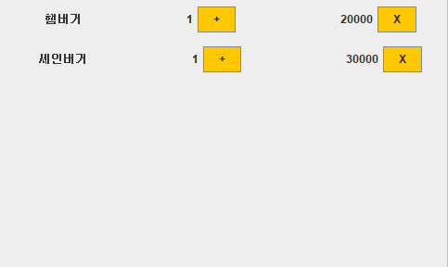
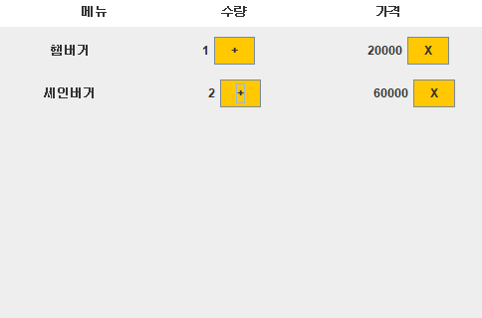
개수 추가
num[a][n-1]++;
//개수
menupage.itemcost[a][n]+=Integer.parseInt(menupricef);
numbertext[a][n-1].setText(" "+num[a][n-1]);//간격 맞추기
//가격
String price=Integer.toString(menupage.itemcost[0][n]);
pricetextfi[1][0].setText(“ "+itemcost[1][1]);//간격 맞추기
pricetextfi[a][n-1].repaint();
개수 추가 및 삭제
삭제
panel.removeAll();
panel.setVisible(false);
itemcost[a][n]=0;
num[a][n-1]=0;
name[a][n-1]=null;

Slide 4
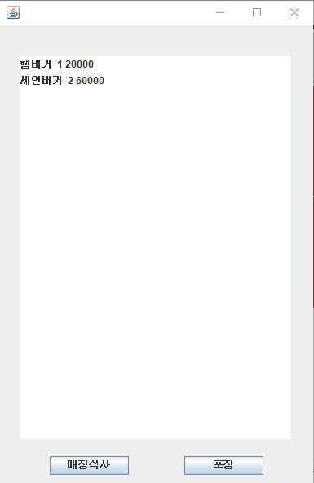
리스트
List 만들기
DefaultListModel<String> l1 = new DefaultListModel<>();
for(int i=0; i<3; i++) {
for(int j=0; j<10; j++)
if(name[i][j]!=null) {
l1.addElement(name[i][j]+" "+num[i][j]+" "+itemcost[i][j+1]);
}
}
JList<String> list = new JList<>(l1);
list.setBounds(24, 38, 332, 469);
frame.getContentPane().add(list);

Slide 5
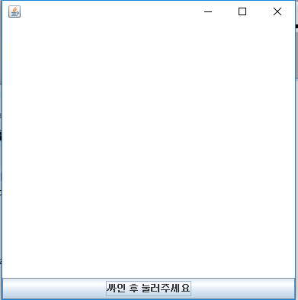
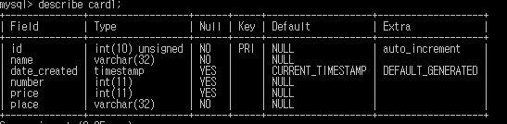
버튼 클릭시 db에 값 넣어주기
try {
String url = "jdbc:mysql://localhost:3306/demo?serverTimezone=Asia/Seoul";
String username="root";
String password="9707";
Connection conn = DriverManager.getConnection(url,username,password);
Statement st = conn.createStatement();
Calendar cal = new GregorianCalendar();
Timestamp ts = new Timestamp(cal.getTimeInMillis());
String stringDate = ts.toString();
String query = " insert into card1 (name, date_created, number, price,place)"
+ " values (?, ?, ?, ?,?)";
PreparedStatement preparedStmt = conn.prepareStatement(query);
preparedStmt.setString (1, a);
preparedStmt.setString (2, stringDate);
preparedStmt.setInt(3, b);
preparedStmt.setInt (4, c);
preparedStmt.setString (5, d);
preparedStmt.execute();
conn.close();
} catch (Exception ee) {
System.err.println("Got an exception! ");
System.err.println(ee.getMessage());
}
DB 값 넣어주기

Slide 6
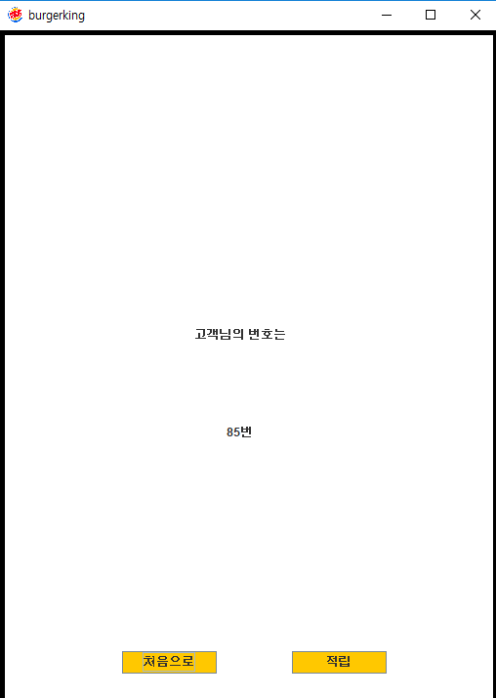
번호 구하기
Db를 통한 번호 구하기
try {
String url = "jdbc:mysql://localhost:3306/demo?serverTimezone=Asia/Seoul";
String username="root";
String password="9707";
Connection conn = DriverManager.getConnection(url,username,password);
Statement stmt = conn.createStatement();
String query = "select * from card1;";
System.out.println(query);
ResultSet rs;
rs = stmt.executeQuery(query);
while (rs.next()) {
int num = rs.getInt("id");
if(numberis<num)numberis=num;
System.out.println(numberis);
}
} catch (SQLException e1) {
e1.printStackTrace();
}

Slide 7
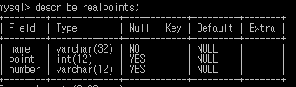
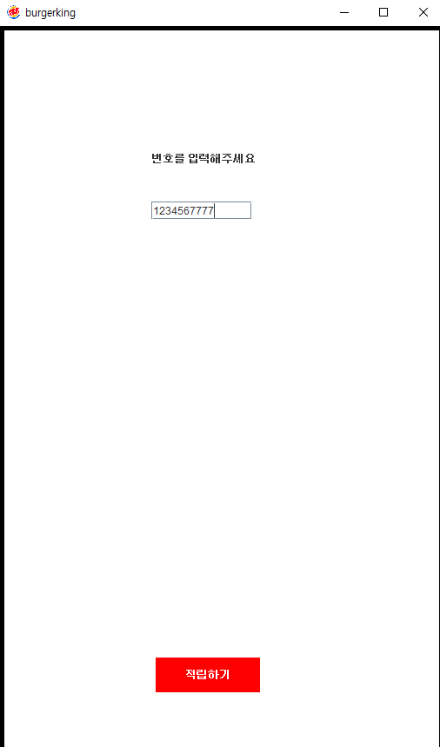
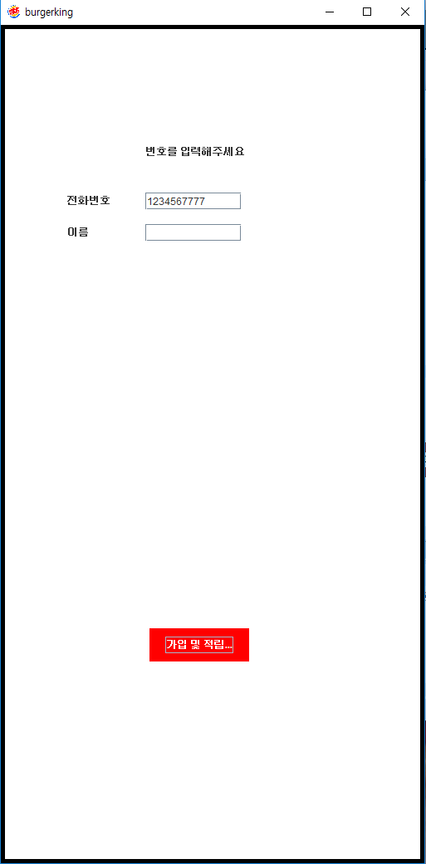
가입되어 있다면 db에 포인트 적립
while (rs.next()) {
num = rs.getInt("number");
System.out.println(num);
int number=Integer.parseInt(textField.getText());
System.out.println(number);
if(num==number) {
points=rs.getInt("point");
try {
String query1 = " UPDATE realpoints SET point=?"+" WHERE number=?";
PreparedStatement preparedStmt = conn.prepareStatement(query1);
preparedStmt.setInt (1, (points+(c/10)));
preparedStmt.setString(2, textField.getText());
preparedStmt.executeUpdate();
} catch (Exception e) {
// TODO: handle exception
System.out.println(e.getMessage());
}
mf.showpanel(new pointisdone(mf));
}
}
포인트 적립
가입 및 적립
String query = " insert into realpoints (name,point,number)"
+ " values (?, ?, ?)";
// create the mysql insert preparedstatement
PreparedStatement preparedStmt = conn.prepareStatement(query);
preparedStmt.setString (1, textField_1.getText() );
preparedStmt.setInt (2,(c/10) );
preparedStmt.setString (3, textField.getText());
preparedStmt.execute();

Slide 8

적립 후
5초뒤 화면 전환
Timer timer= new Timer();
timer.schedule(new TimerTask() {
@Override
public void run() {
// TODO Auto-generated method stub
mf.showpanel(new startpage(mf));
}
}, 5*1000);

Slide 9
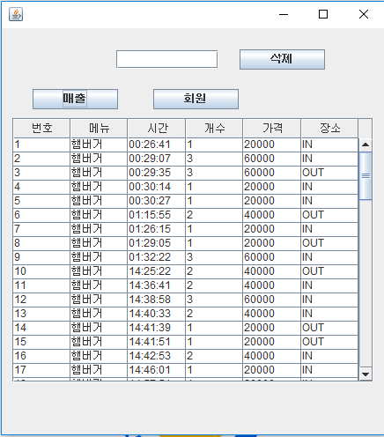
매출 관리
번호를 이용한 테이블삭제
String url = "jdbc:mysql://localhost:3306/demo?serverTimezone=Asia/Seoul";
String username="root";
String password="9707";
Connection conn = DriverManager.getConnection(url,username,password);
String what=text_Search.getText();
PreparedStatement st = conn.prepareStatement("DELETE FROM card1 WHERE id = ?");
st.setInt(1,Integer.parseInt(what));
st.executeUpdate();

Slide 10
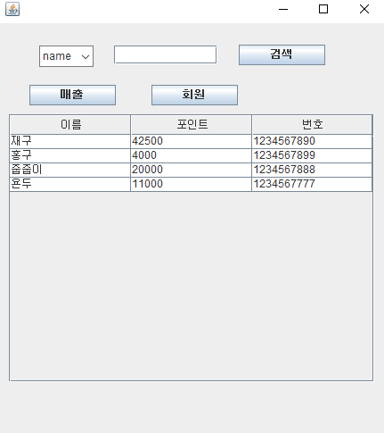
회원 관리
테이블검색
String what=text_Search.getText();
Statement stmt = conn.createStatement();
String sql = "select * from realpoints where "+field+" like"+""
+ " '%"+what+"%' ";
System.out.println(sql);
ResultSet rs;
rs = stmt.executeQuery(sql);
while((rs!=null) && (rs.next())) {
String name = rs.getString("name");
int point = rs.getInt("point");
String number = rs.getString("number");
Object row[] = { name,point, number};
model.addRow(row);
}

