Slide 1
Determinants of Housing Prices in Perth Metropolitan Suburbs
Team Members:
Adam Mayer-Diamond
Praveen Rachakonda
Steve Ramasamy
Notes:
Good Evening Class introduce members

Slide 2
Aims and Research Questions
Aim: To understand the relationships between the determinants and house price.
1. How does the age of a property and its distance from the CBD relate to its selling price?
2. What is the impact of school proximity and transportation availability on housing prices?
3. How do housing design features and land size influence property prices?
4. Is there a correlation between housing prices, train station accessibility, and distance to the CBD?
5. How do factors like income, school proximity and house design collectively/induvial affect house prices?
Hypothesis: That the determinants would influence housing prices.
Notes:
Our Study aims to investigate the significant determinants influencing housing prices in various suburbs within the Perth Metro area.
Coming into our study we hypothesized that the determinants would influence the property price.
As we are aware the real estate marker is influenced by a multitude of factors such as Prop Price, Prop Design, Property size, Property Distance from CBD and Train Stations
RQ

Slide 3
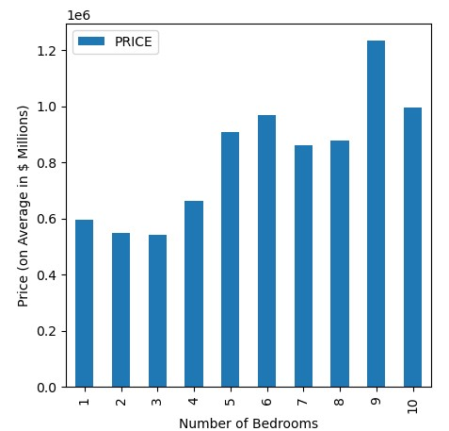
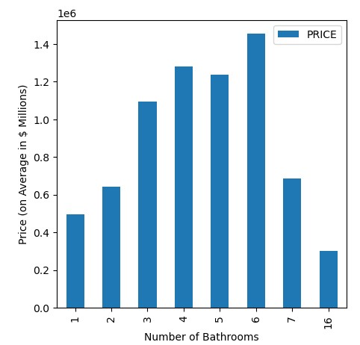
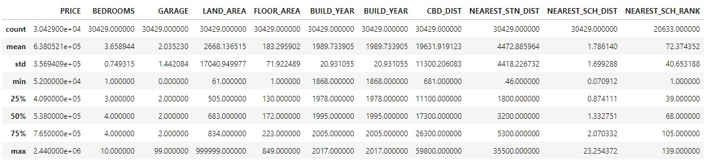
Exploratory Analysis
Notes:
Downloaded Data, imported as DF in2 Jlab. Ensured all prop has garage value, dropped all without a build year. Dropped duplicates.
Presented statistical analysis of the data. Note Price, wide range of build year of properties.
Grouped by number of Bed + graphed vs price. Looking at graph seems 2b trend increase. See jumps off close 37% and over 40%. Despite taper at start which could be due to
Grouped by number of Bath +graphed vs price.. Looking at graph seems 2b trend increase See rise and jump of 70% followed by decrease of just over half the property value, noting 16 bathrooms could be an outlier in the data set. As looking into the property in 2023 it was incorrectly labelled and when looking into one of the 7 bathroom properties it was evident that it was a work site warehouse, listed has having 1 bathroom.

Slide 4
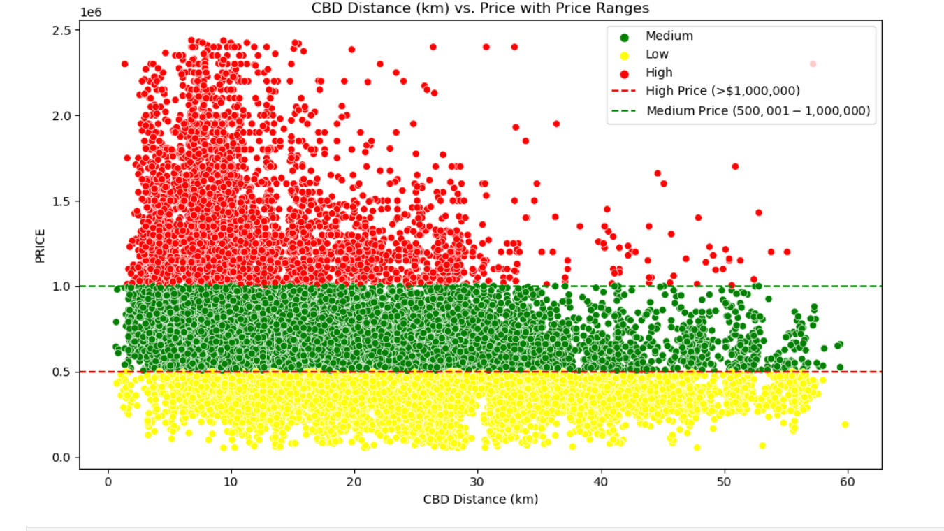
How does the age of a property and its distance from the CBD relate to its selling price?

Slide 5
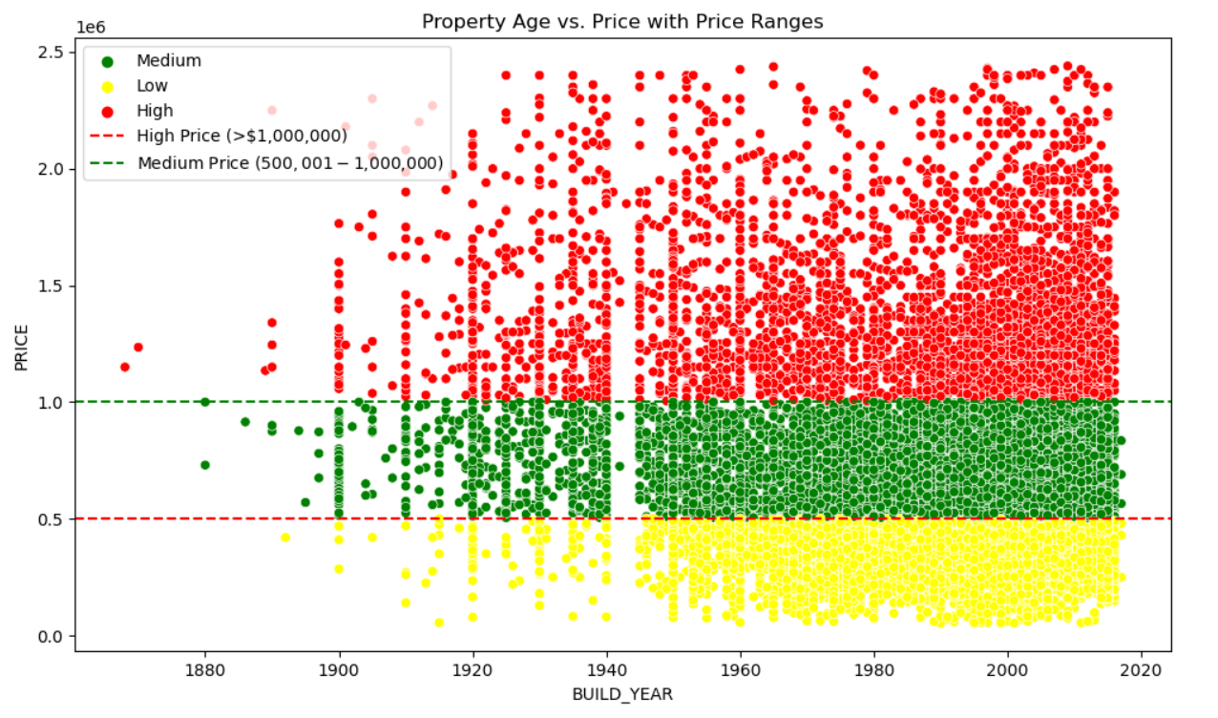

Slide 6
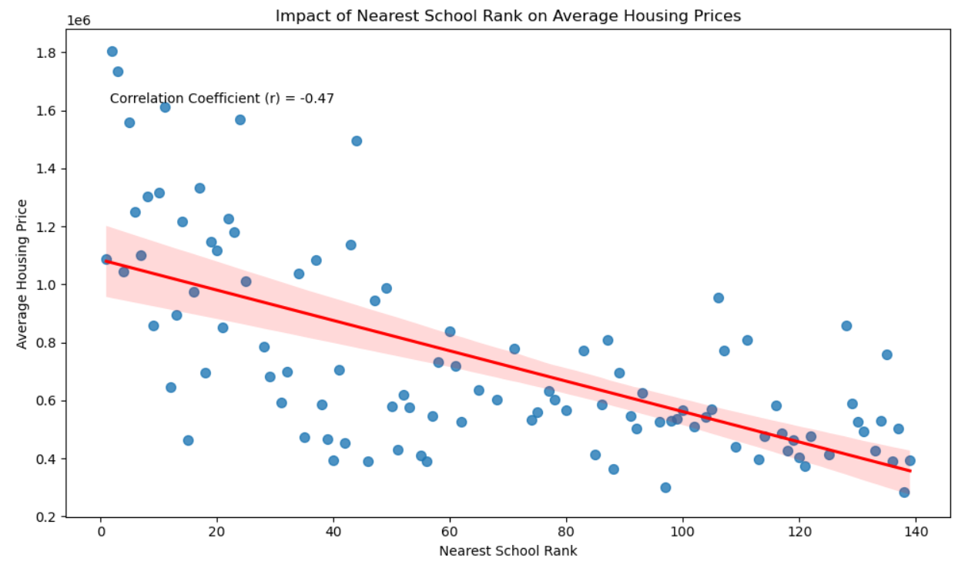

Slide 7
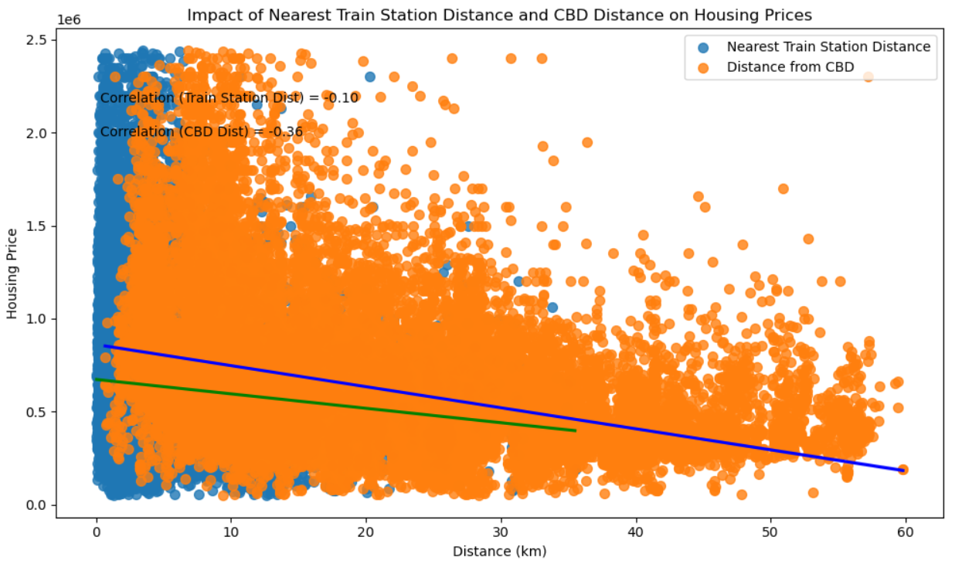

Slide 8
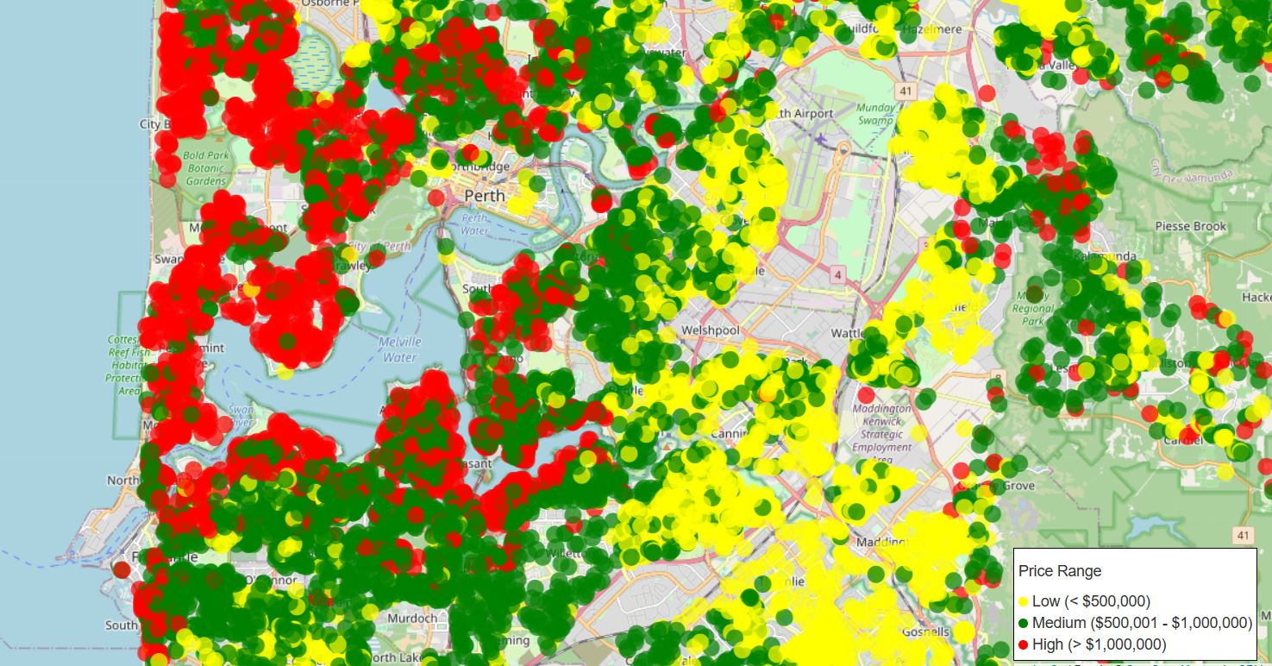
perth_property_map.html

Slide 9
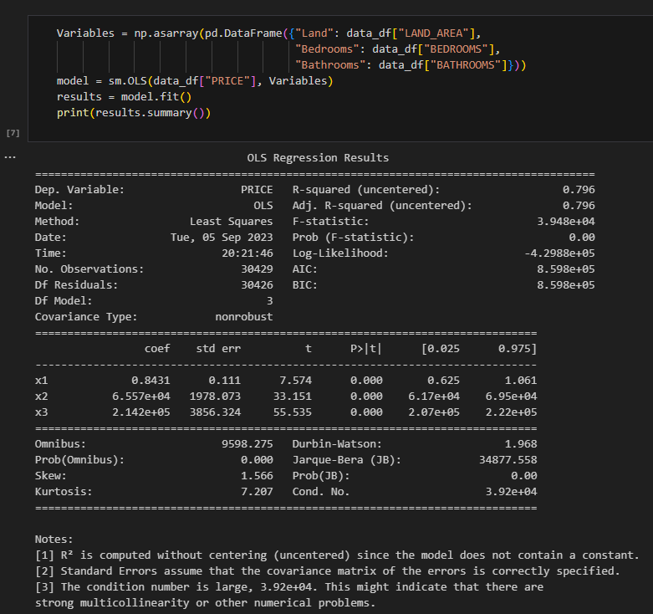

Statistical Analysis
Exploratory and Regression Analysis:
correlation exists
two variable only
cannot define the dataset’s statistical significance
Various Python packages are available for Statistical Analysis
STATSMODELS
ANOVA
Student’s T
Relationship between Property Price vs Property Features:
Multivariable analysis – OLS
Strong correlation between Dependent variable and Independent variables
Probability (p) < alpha value (= 0.05)
T and F –Statistics values < Critical value
Relation between Price and Property features
Critical value for entire sample set

Slide 10
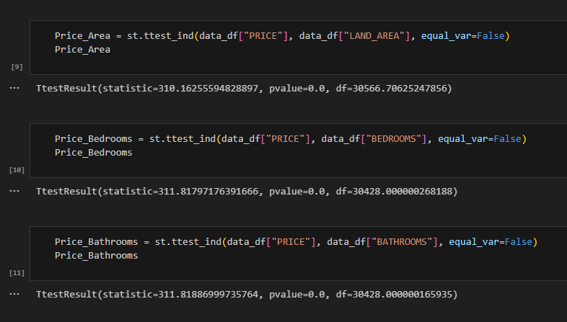
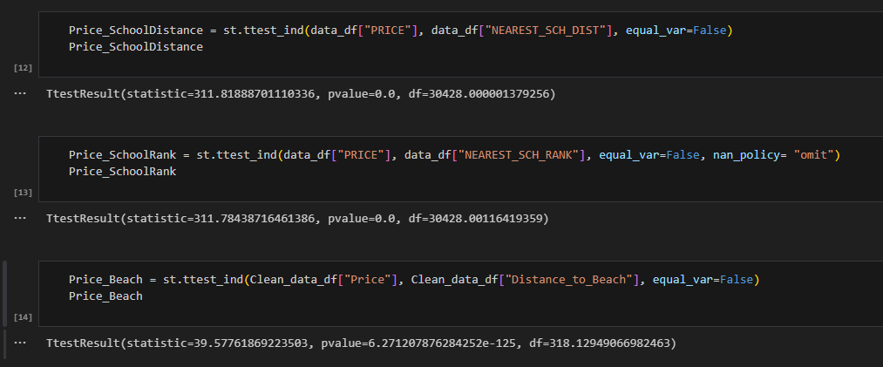
Further Analysis using Student’s T Independent Test
Note:
Distance to beach is obtained using Geoapify for a sample of the property dataset

Slide 11
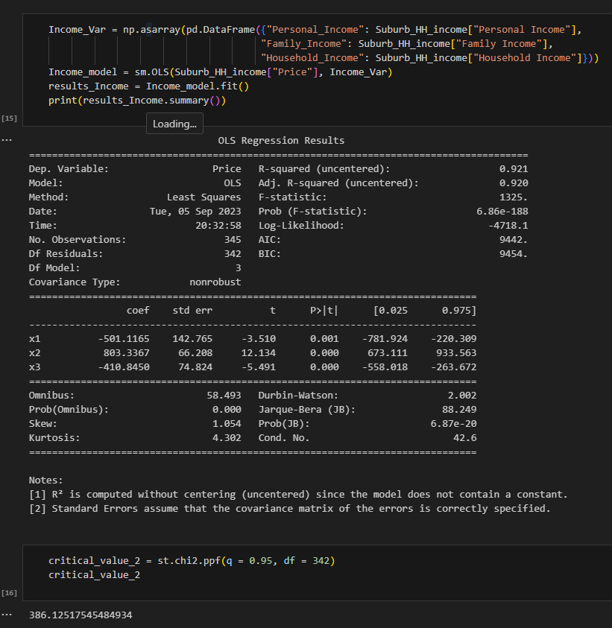
Further Analysis - Income vs Price
Note:
Datasets were obtained from WA SLIP Database and ABS Census.
Income information is accurate of 2021

Slide 12
Conclusion
Average property price tends to be higher as the number of bathrooms/bedrooms increase.
Generally, housing prices tend to be higher in the city center, areas with good school rankings, and coastal regions on the map.
Statistically significant relationship exists between Dependent variable (Property Price) and Independent variable’s
Hypothesis:
“That the determinants would influence housing prices” is Valid for the variables selected as part this study

