Slide 1

Project Overview
NimbusNest is a fictional e-commerce brand focused on home organization.
This case study explores Q1 inventory performance to identify turnover inefficiencies.
Data included inconsistencies, missing values, and needed to be cleaned manually.

Slide 2
Data Cleaning Process
Removed duplicates by Product ID and Warehouse.
Standardized date fields and cleaned null/inconsistent entries.
Added calculated columns for Days Since Restock and Turnover Ratio.
Created a structured dataset for analysis in Excel.

Slide 3
Key Metrics Summary
Closet Organizers: Highest turnover ratio (1.02)
Hangers: Low sales despite high inventory (0.32)
Average turnover across all categories: 0.51

Slide 4
Recommendations
Closet Organizers: Healthy turnover, monitor closely.
Underbed Boxes: Overstock risk with slower sales.
Implement proactive stock alerts and data validation.

Slide 5
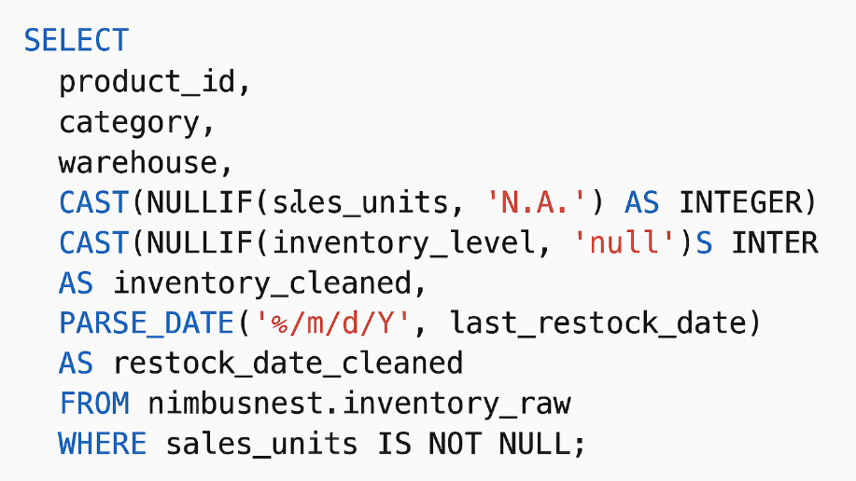
SQL Cleaning Example
Cleans sales_units and inventory_level by replacing non-numeric values like 'N.A.' or 'null' with actual nulls, then converts them to integers.
Converts last_restock_date from string format to proper DATE format for accurate date-based analysis.

Slide 6
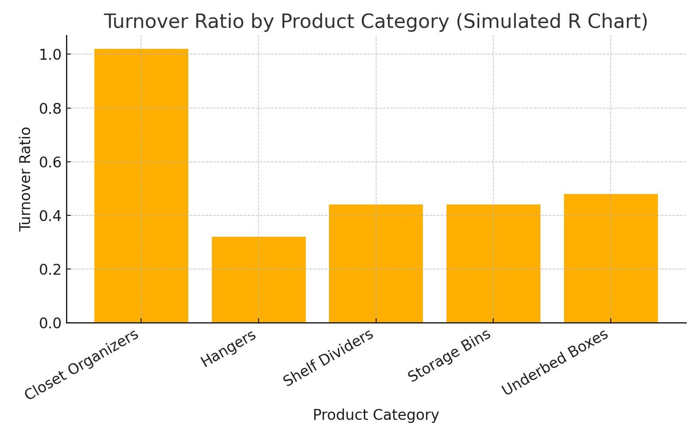
R Visualization Preview
This bar chart was created in R using ggplot2.
It shows my early comfort with R for data visualization.
I'm continuing to explore tidyverse tools in future projects.

