Slide 1
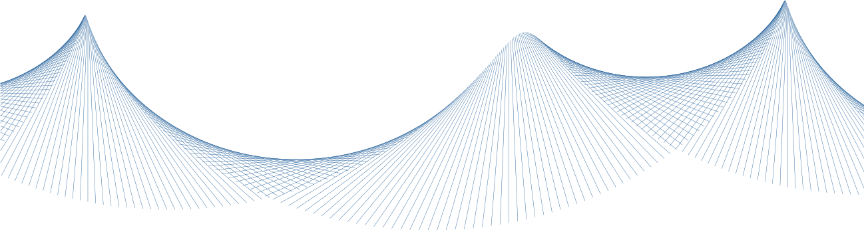
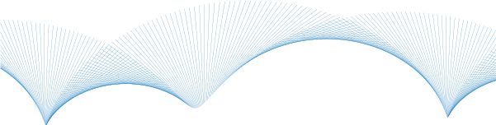


+
[confidential]
+
[proof-of-concept]
+
[cca 30 min]
+
+
Tensoria 3d
demo
+
+
+
Valor Research 2026 (c)

Slide 2
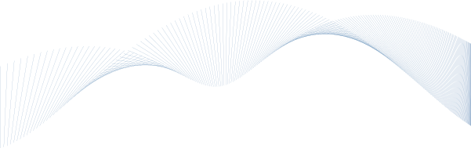
+
[confidential]
+
[proof-of-concept]
+
Valor Research 2026 (c)
Why new modeling paradigm?
How to shape anything? (organic and hard-surface shapes and don’t care about triangulation method much)
How to make complex local changes easily? (without affecting the rest of the model)
How to keep absolute precision? (for points and conic-sections)
How to make model suitable for real-time rendering? (without additional processing, with built-in continuous LOD)
How to keep it simple? (without rigid control point nets and complex modifier stacks)

Slide 3
+
[confidential]
+
[proof-of-concept]
+
Valor Research 2026 (c)
Existing modeling methods
 | shape anything | local changes easily | absolute precision | real-time rendering | keep it simple
(a) polygonal | YES | NO | NO | YES | YES
(b) parametric-nurbs | YES | NO | YES | NO | NO
(c) subdivision-based | NO | YES | NO | YES | YES
(d) voxel-based | NO | YES | NO | NO | YES
+
(a)
(b)
(c)
(d)

Slide 4
+
[confidential]
+
[proof-of-concept]
+
Valor Research 2026 (c)
Tensoria modeling method
 | shape anything | local changes easily | absolute precision | real-time rendering | keep it simple
(a) polygonal | YES | NO | NO | YES | YES
(b) parametric-nurbs | YES | NO | YES | NO | NO
(c) subdivision-based | NO | YES | NO | YES | YES
(d) voxel-based | NO | YES | NO | NO | YES
Tensoria 3d | YES | YES | YES | YES | YES
+
(a) X
(b) X
(c) X
(d) X

Slide 5
+
[confidential]
+
[proof-of-concept]
+
Valor Research 2026 (c)
Tensoria modeling method
We can think of it as a cloud of particles forming a forcefield.
A set of oriented points with adjacency. Every point has:
  Position
  Direction
  From 0 to N neighbors.
Between every two points there is a spline curve. Every face is covered by a spline surface.
We can also define discontinuities on points and egdges.
This way we can model any shape, no matter how complex.

Slide 6
+
[confidential]
+
[proof-of-concept]
+
Valor Research 2026 (c)
Tensoria modeling method
Exact watertight sphere
  Circular edges and points
Octhahedron
  Sharp edges and points

Slide 7
+
[confidential]
+
[proof-of-concept]
+
Valor Research 2026 (c)
Conclusion
Brand new modeling paradigm
Suitable for almost any interface and platform
  Real-time first method
  Simple yet powerfull
  Very intuitive
Allowing unprecedented degree of freedom and precision
  Solving weak points of other methods, keeping strengths
  Adding new possibilities of modeling, unleashing dreaming creativity
  Wide range of applications from artistic and biological to technical
  Potential to become a new well recognized standard format

Slide 8
+
[confidential]
+
[proof-of-concept]
+
PoC seed
✓
Valor Research 2026 (c)
What’s next
Investor
Finding a strategic, deep-tech investor
Patenting the technology
Implemeting a compact yet complete modeling engine
  Consistency across products
  Well maintainable and scalable
Using the engine in the real product(s) application(s)
  Health & Beauty
  3D printing
  Robotics CAD
  Generic modeling
Patent
Modeling engine
Product
Health & Beauty
3D printing
Robotics CAD
Generic modeling

Slide 9
+
[confidential]
+
[proof-of-concept]
+
Valor Research 2026 (c)
~ presentation complete ~
Thank you for your attention.

