Slide 1
Image Steganography With Generative Adversarial Networks
Preston Robinette

Slide 2
Steganography
Hidden messages in plain sight
Cryptography = privacy; steganography = deceit
History
“stegano(s)”+”graphy” is Greek for “covered writing”
440 BC: message sent by shaving the head of a servant, "marking" the message onto his scalp, then sending him once his hair had regrown
Female spies in the world wars used knitting to send messages
An irregular stitch or intentional holes in the fabric

Slide 3
Generative Adversarial Network (GAN)
Random Noise
Training Set
Generator Model
Generated Set
Discriminator Model
Real or fake
GANs
Error Back Propagation

Slide 4
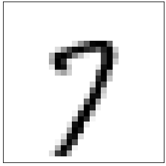
Steganography with GANs
“Message” to hide
MNIST Dataset
Generator Model
Hidden message
Discriminator Model
Real or fake
GANs
Error Back Propagation

Slide 5
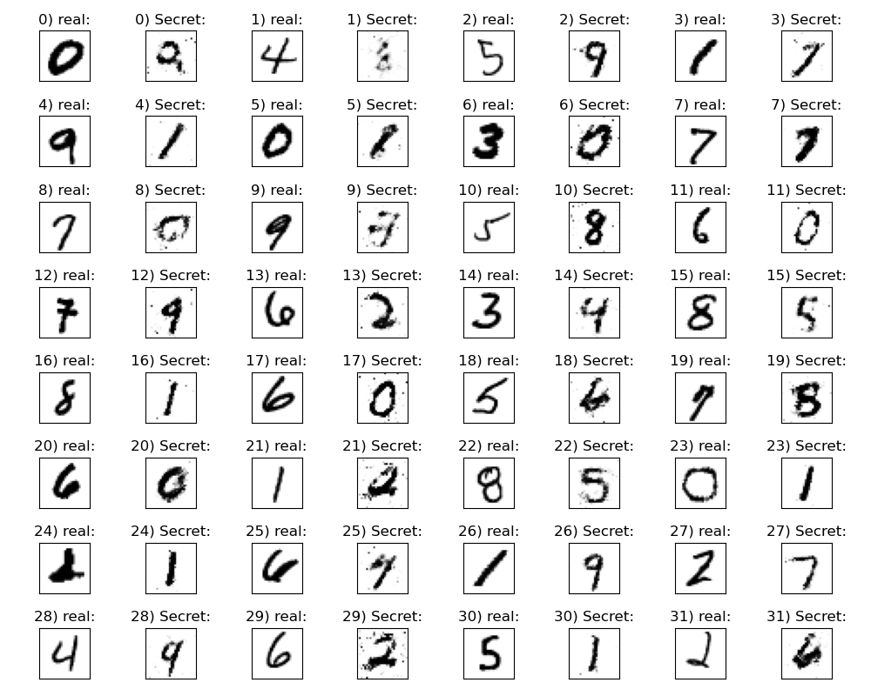
Results
Real = ”message” to be hidden
Secret = hidden message disguised as a different number

Slide 6
improvements
Input to generator = image + message to hide in the image
Must also be able to decode the message from the image
More complicated dataset

