Slide 1
Electoral Responsiveness in closed autocracies: Evidence from petitions in the former German Democratic Republic.
Hans Lueders
"I propose that closed autocracies engage in cycles of responsiveness before uncontested elections to assure citizens of their competence and raise popular support. They do so to mitigate the short-term destabilizing effects of elections."
Replication by Philip Kruger

Slide 2
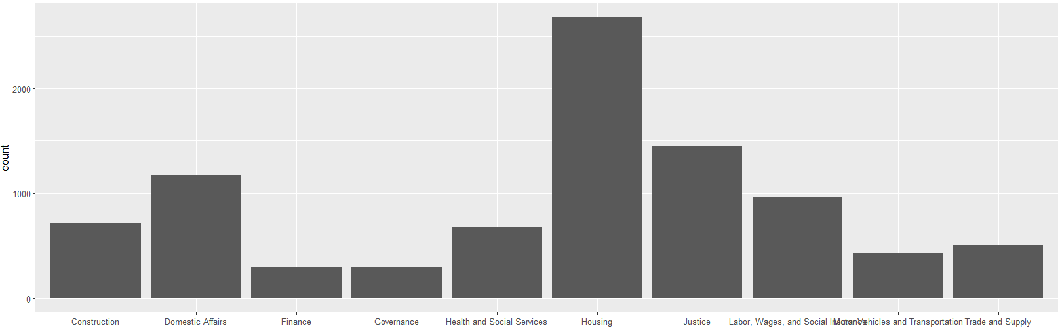
Hypothesis
Elections:
East Germany was an Authoritarian state without free elections from 1945 to 1990.
There were elections every three years where there was only 1 candidate on the ballot.
The last election was reported to have 99.7% turnout with 99.94% voting for the government.
Petitions:
Petitions were could be sent by individual citizens to any level of government
Between 0.5-1 million were submitted each year.
They could be about anything from personal housing to foreign policy.
This study measures the response speed and success rate to test for responsiveness to voters.
Government higher ups want to solve petitions to stop revolutions and uprisings. (especially around elections).
Local officials want to solve petitions to get good real turnout and vote share at elections to move up in the party.

Slide 3
Replication formulas
This study has 2 outcome variables:
The response time = 1+ln(date_petition_answered – date_petiton_received)
Positive resolution: dichotomous 0, 1 variable.
This paper statistically tests:
Response time 90 days before an election compared to 90 days after an election for the 1979, 1981 and 1984 elections.
Increase in positively resolved petitions before and after the 1982 election.
Response time for petitions critical of the government around all elections.
It uses simple fixed effects linear regression with the covariates:
Dichotomous Before/After Election
Number of Pending Petitions
District of Petitioner
Year completed
Day of Year
Dichotomous Positive Resolution

Slide 4
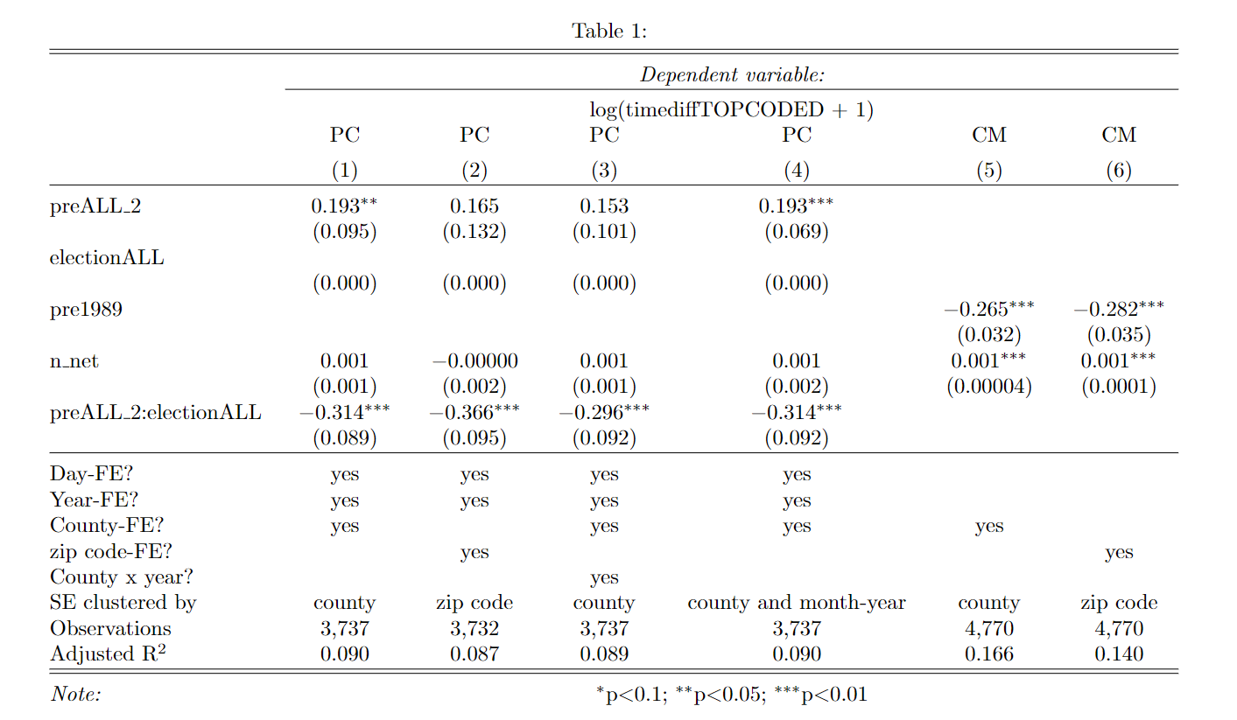
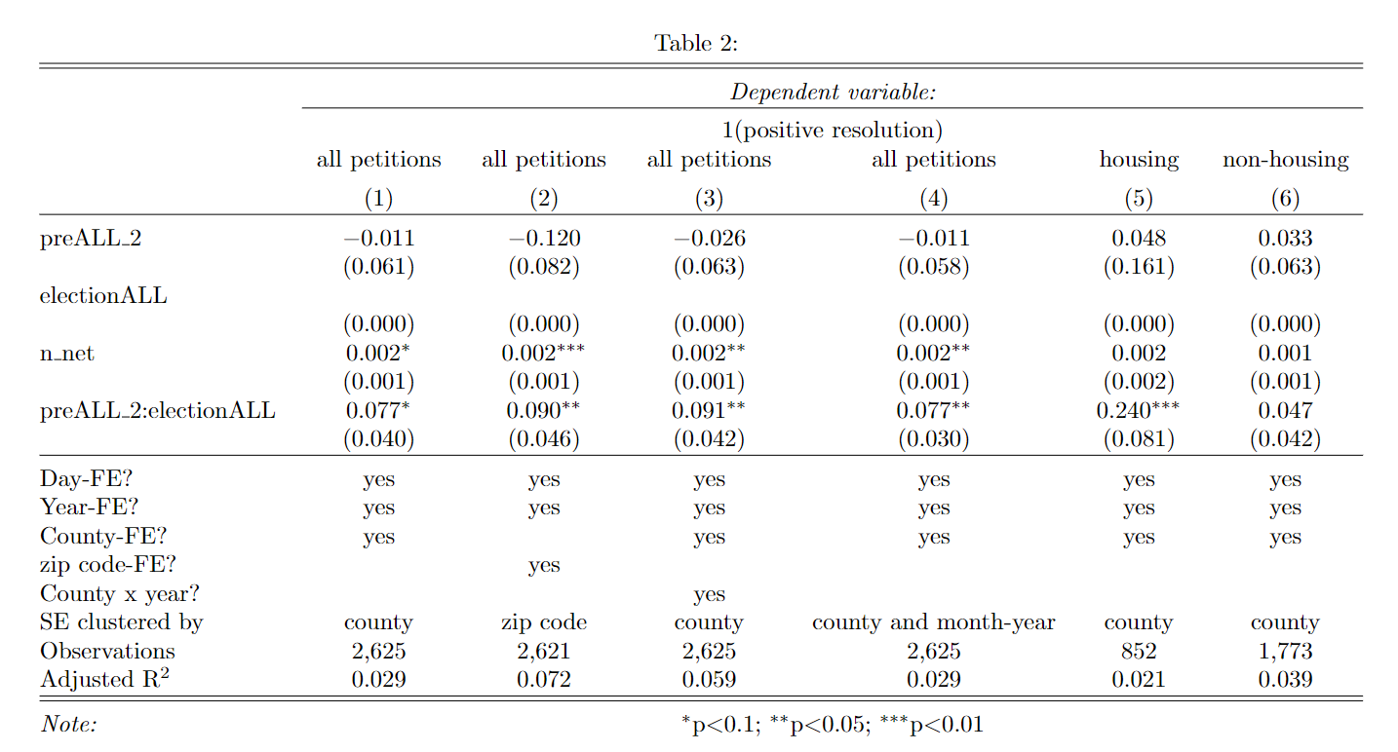
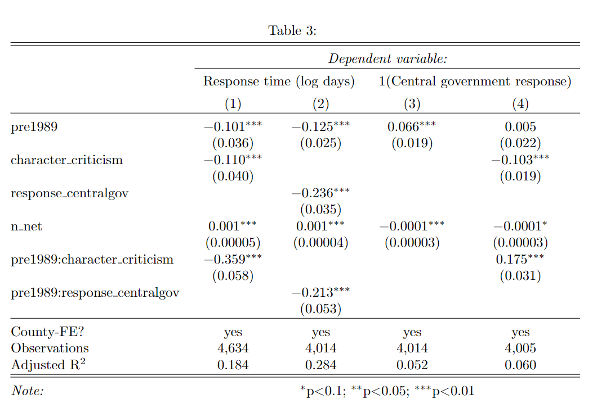
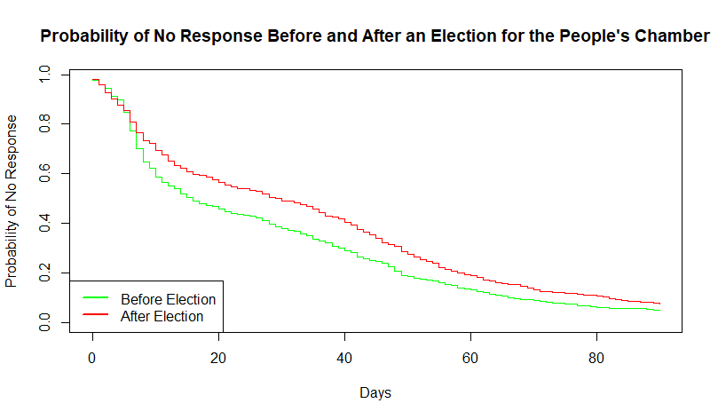
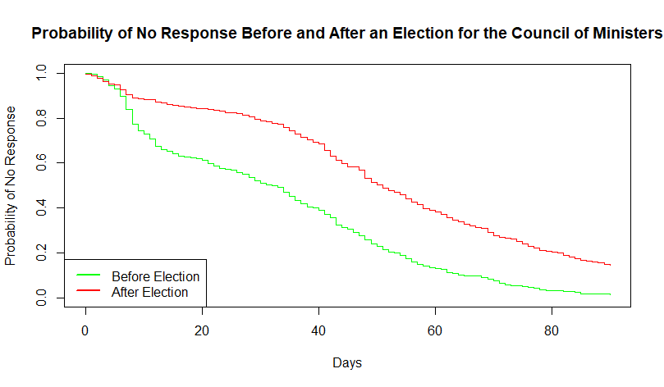
Replication Results

Slide 5
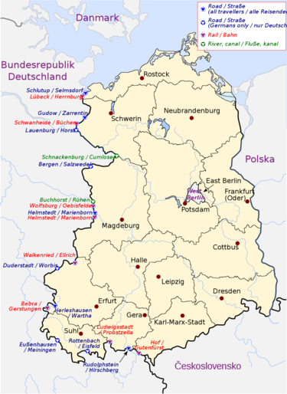
New Covariates Theory
The theory supposes that one reason that politicians are more responsive to petitions before elections to raise popular support to "mitigate the short-term destabilizing effects of elections". This is particularly true for higher ups in the party.
As such I propose that the increased response time and positive responses before elections will tend towards areas where unrest is more likely.
Using the district column in the dataset, I determine the Bezirk (county) and if it is urban or rural.
My hypothesis is that there would be a faster response time and more positive responses in western Bezike and around West Berlin than eastern Bezirke and that there would be faster response times and more positive responses in urban Bezirke than rural Bezirke.

Slide 6
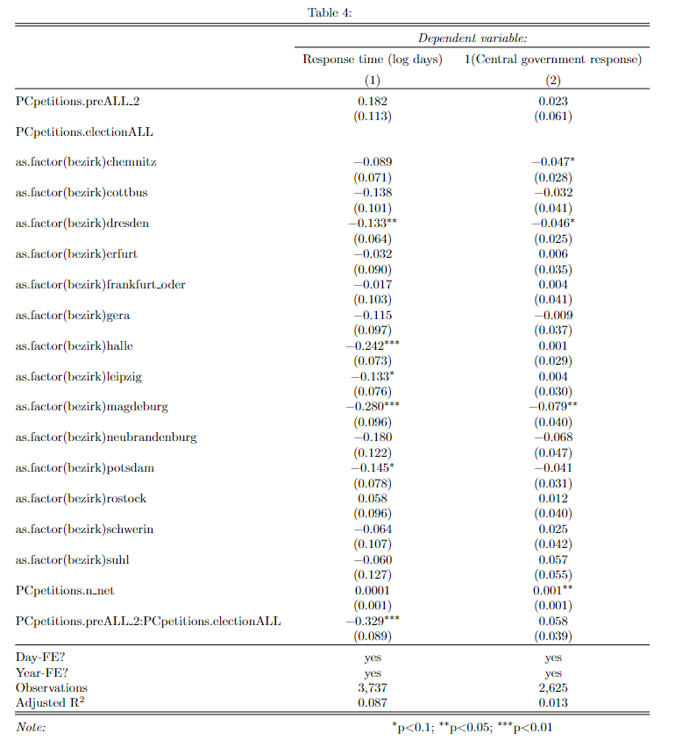
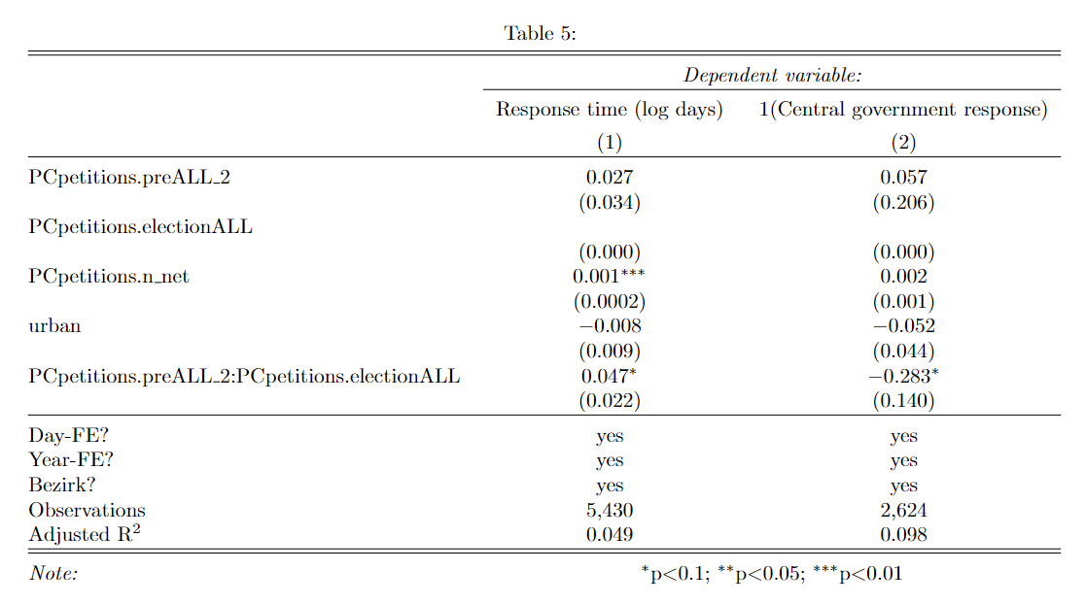
Results
The results are not statistically significant. As such we are unable to reject the null hypothesis that response times and positive responses do not favour western Bezirke and urban Bezirke over eastern and rural Bezirke.

