Slide 1


Slide 2

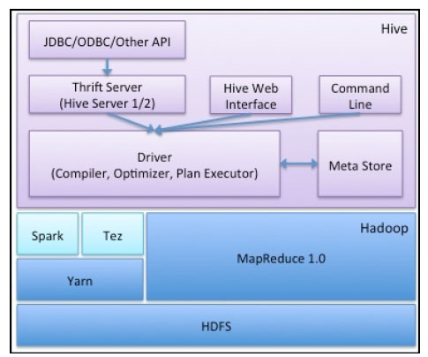
Apache HIVE
Apache HIVE is one of the component of hadoop build on the top of HDFS.
It is a warehouse kind of system in Hadoop stack.
Hive is associated with some meta store.

Slide 3

Meta store:
It is the Internal data store of HIVE.
All the tabular information are stored in Meta store.
1.Table name.
2.Schema definition.
3.Column information .
4. Partition key if any.
By default Derby database is a HIVE meta store.
But we can also configure some other database as metastore.

Slide 4
How to configure meta store in hive?
The meta store configuration is done in hive-site.xml file.
Path :/usr/lib/hive/conf/hive-site.xml

Slide 5
Different tables in HIVE
There are basically two types of tables in hive
1.Managed table
2.External table
1.Managed table: This is the default table .This table is managed by HIVE framework itself . All the managed data is getting stored in hive default warehouse location.
In HDFS, HIVE default warehouse location is - /user/hive/warehouse/databasename.db/tablename

Slide 6

How to create managed table:
Syntax:
Create table <<table_name>> (<<schema def>>)
row format delimited
fields terminated by <<delimiter>>
stored as <<file-format>>;

Slide 7
How to load data into managed table
1 .Local mode: In this mode data, data is taken from LFS path and once it is loaded into table that will path of default hive warehouse locations.
Syntax:
load data local inpath << ‘LFSpath-name’>> into table <<table-name>>;
2 .HDFS mode: In this mode,data will be taken from HDFS path and once it is loaded into table that will be the part of new hdfs hive warehouse path.
load data inpath <<‘HDFS-pathname’>> into table <<table_name>>;

Slide 8
External table
As the name say external, it is the external to the hive warehouse location.
Syntax:
create external table <<table-name>> (<<schema-def>>)
row format delimited
fields terminated by <<delimiter>>
stored as <<file-format>> location <<‘hdfs-location’>>;

Slide 9
Alter Hive Table
We can rename the table or add multiple columns into the existing table :
Syntax:
1> Rename Hive table
alter table <<existing-table-name>> RENAME to <<New-table-name>>
2> Adding extra columns
alter table <<existing-table-name>> ADD COLUMNS (<<schema>>);

Slide 10
Load data local inpath <<‘LFS-path’>> overwrite into table <<table-name>>
Create table as select(CTAS)
If you want to create table by selecting one or multiple columns from the existing table. That can be possible by using CTAS.
Once new table has been created , both tables will act as independent and individual tables.
Syntax:
Create table <<new-table-name>> as select <<one or multiple columns >>
from <<existing-table-name>>

Slide 11
Partitioning in Hive
If you want to provide one more layer of separation for your data and while selecting data using partition keys, the retrieval of data will very fast compared to normal table.
Syntax for creating partition tables:
create table <<table-name>> (<<schema-definition>>) PARTITIONED
by (<<partition –keys schema>>)
row format delimited
fields terminated by <<delimiter>>
stored as <<file-format>>
Limitation is : no of partition key should be less then or equal to table columns.

Slide 12
Bucketing in Hive
Syntax to create bucketing:
create table <<table-name>> (<<schema-def>>)
CLUSTERED BY(<<column-name>>) into <<no of>> bucket
row format delimited fields terminated by <<delimeter>>
stored as <<file-format>>;

Slide 13
Hive collection Data types
In order to store semi structure data we have 3 collection data type
1.Arrey :it is used to store homogeneous elements.
2. Struct: it is used to store heterogeneous elements.
3.map: it is used to store key , value kinds of value.
4.

