Slide 1
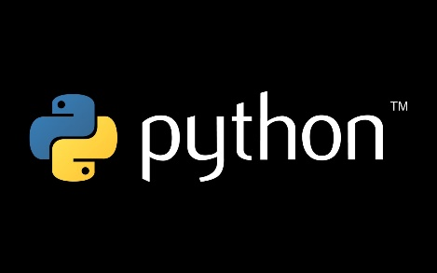

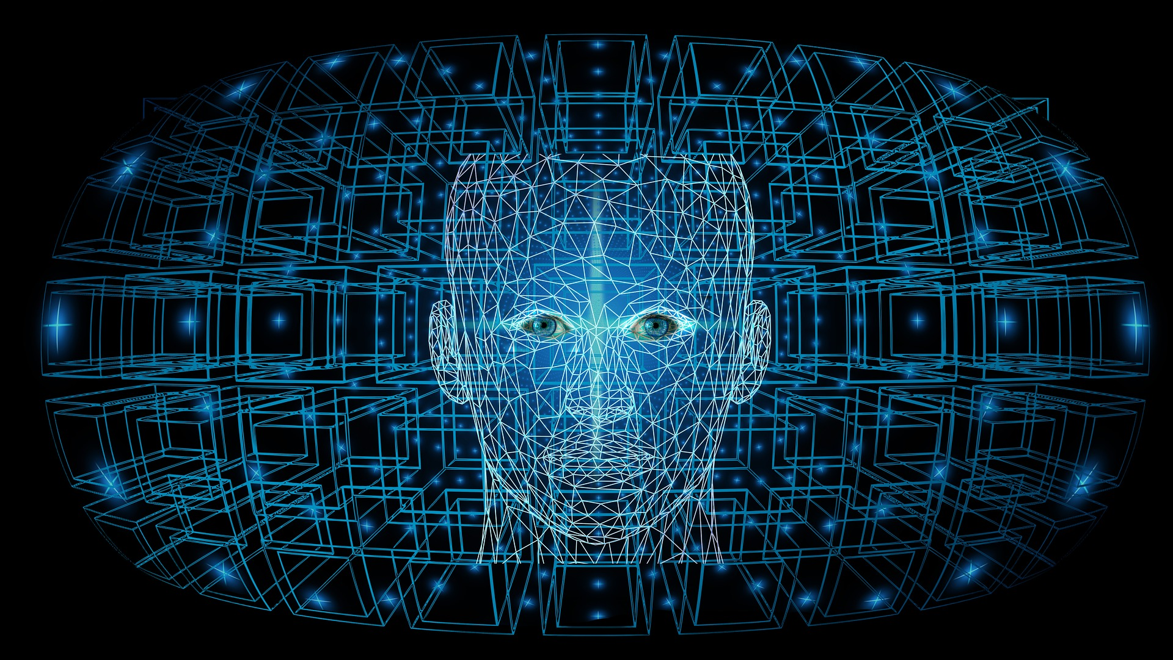

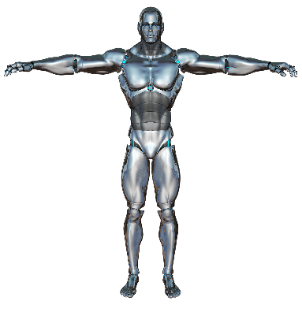




Workshop on Python
AI
Data Science
IOT
Why Python
Basic Concepts
2 – Days Workshop
Frequent Applications of Python
A Competition
Contact – 8009032632, 9559880983

