Slide 1


Simultaneously Reconstruction and Segmentation based on Mumford-Shah Model
It is based on Mumford-Shah functionals
Using Ambrosio and Tortorelli’s approximation
$$AT\left(f,v\right)={\left\|Rf−g\right\|}^{2}+α\int{\left(v^{2}+k_{ε}\right){\left|∇f\right|}^{2}dx}+β\int{ε{\left|∇v\right|}^{2}+\frac{{\left(1−v\right)}^{2}}{4ε}dx}$$
where
$f$: the image; $v$: the segmentation
$g$: the measured data
$R$: the forward transform
$α$, $β$, $k_{ε}$ and $ε$: parameters
1. D. Mumford and J. Shah. Optimal approximations by piecewise smooth functions and associated variational problems.
2. L. Ambrosio and V.M. Tortorelli. Approximation of functional depending on jumps by elliptic functional via gamma-convergence.
3. Jiang, Ming, Peter Maass, and Thomas Page, Regularizing properties of the Mumford–Shah functional for imaging applications.

Slide 2
Asynchronous update
Ray-based reconstruction
In order to achieve higher parallelism, instead of iterating the whole image, simple rays in projections are used as minimum granularity.
Such granularity involves synchronization issues for all the rays are heavily data dependent.
Asynchronous update
Multiple processing elements (X₁, X₂, and X₃) are working in parallel without lock. It brings conflicts and outdated data, as expected.
However, later updates will resolve the conflicts, with small or diminishing relaxations.
Applies to algorithms like order-subset methods and/or regularization with accelerators.
X₁
A
B
X₂
X₃
C
1. Zhang, W., Luo, G., Shen, L., Page, T., Li, P., Jiang, M., … Cong, J., FPGA acceleration by asynchronous parallelization for simultaneous image reconstruction and segmentation based on the Mumford-Shah regularization

Slide 3
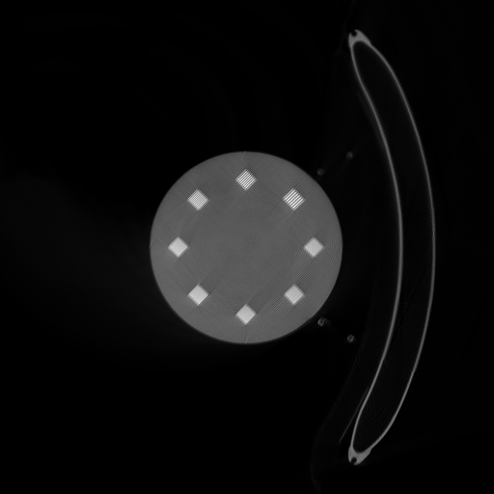
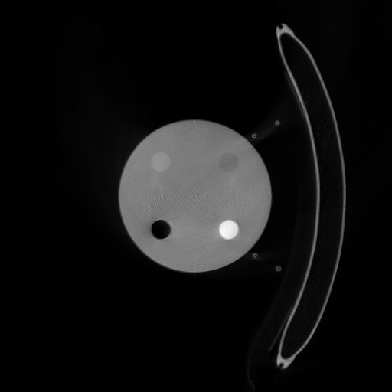
Temporal Results Using Phantom Data
Program is written by myself. Only used UCLA’s tracing codes. Still working on parameter adjustments.

Slide 4
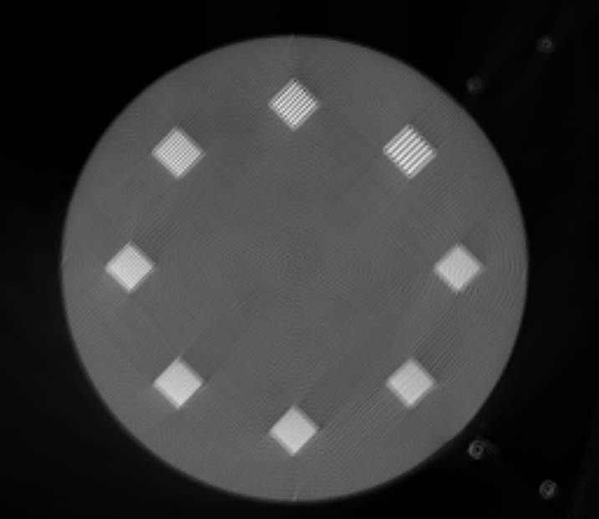
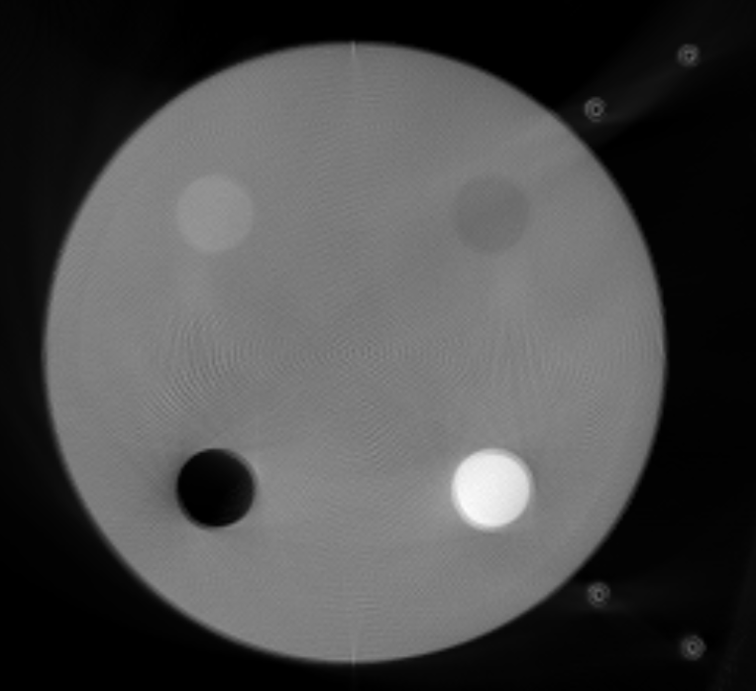
Temporal Results Using Phantom Data
Program is written by myself. Only used UCLA’s tracing codes. Still working on parameter adjustments.

Slide 5

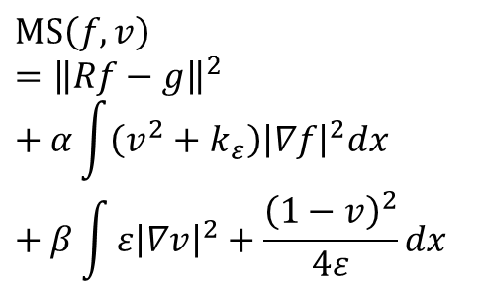
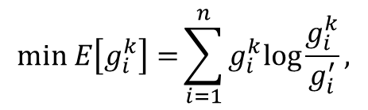
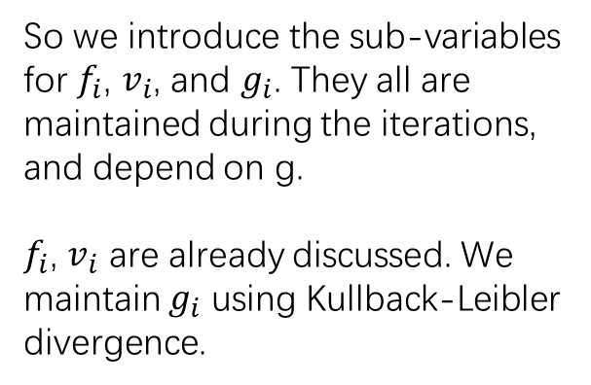



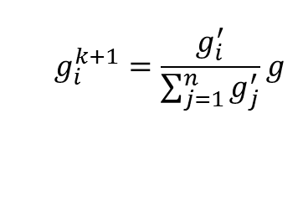


XCT Block Reconstruction
Sub-variables introduced
Basic transform
$f=∑f_{i}$, $g=∑g_{i}$, $v=∑v_{i}$
So we introduce the sub-variables for $f_{i}$, $v_{i}$, and $g_{i}$. They all are maintained during the iterations, and depend on g.
$f_{i}$, $v_{i}$ are already discussed. We maintain $g_{i}$ using Kullback-Leibler divergence.
$$Rf^{∗}=g$$
How to compute $g_{i}$?
Mumford-Shah Regularization
$$\min_{} E\left[g_{i}^{k}\right]={\sum_{i=1}^{n}{g_{i}^{k}log\frac{g_{i}^{k}}{g_{i}^{′}},}}$$
$$MS\left(f,v\right)={\left\|Rf−g\right\|}^{2}+α\int{\left(v^{2}+k_{ε}\right){\left|∇f\right|}^{2}dx}+β\int{ε{\left|∇v\right|}^{2}+\frac{{\left(1−v\right)}^{2}}{4ε}dx}$$
where $g_{i}^{′}=Rf_{i}^{k+1}$
The solution
$$f_{i}^{k+1}=arg\min_{}{{\left\|Rf_{i}^{k}−g_{i}^{k}\right\|}^{2}+L_{1}\left(f_{i}^{k}, v_{i}^{k}\right)}$$
We want to use multiple accelerators to accelerate the reconstruction.
1. Most accelerators have not enough local resource to store the complete f and v.
2. Data locality is crucial in iterative process.
$$v_{i}^{k+1}=arg\min_{}{L_{1}\left(f_{i}^{k}, v_{i}^{k}\right)+L_{2}\left(v_{i}^{k}\right)}$$
$$g_{i}^{k+1}=\frac{g_{i}^{′}}{\sum_{j=1}^{n}{g_{j}^{′}}}g$$
Notes:
In X-ray CT, basic operator R transform our image into the measured data.
Using Mumford-Shah regularization as an example.
This equation shows how to solve a two variables minimizer.
We would like to introduce sub-variables which are smaller enough to be stored on single FPGA.
Here, the only problem is to compute g_i. because we do not know the true value of it.
By using mathematic approach, we can obtain a iterative solution to our modified minimizer.

Slide 6
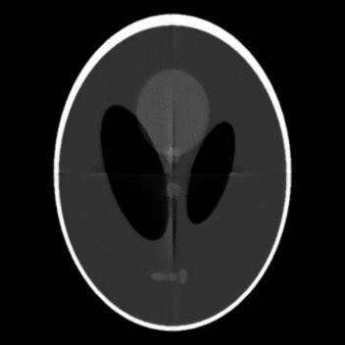


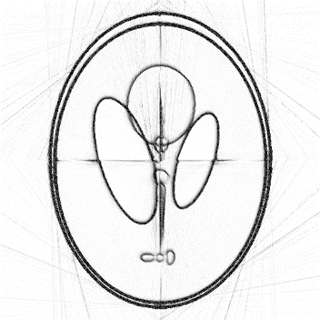
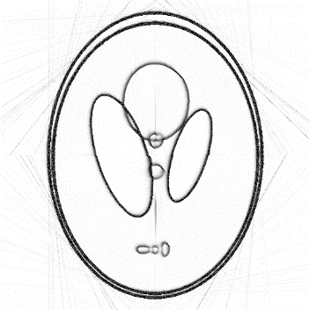
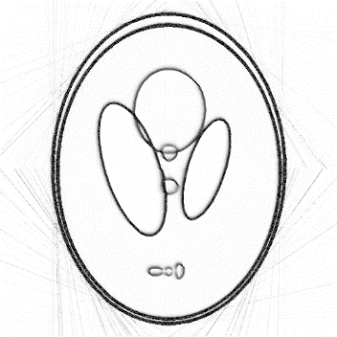
XCT Block Reconstruction – 2D demo
Tiling image into 4 blocks
10 Iterations
20 Iterations
50 Iterations
3D block reconstruction is in progress.
Notes:
This is our experimental results on two-dimensional shepp-logan image.
In this experiment, we tile the image into 4 blocks.
As we can see from left to right, more iterations produces better much results.
On the right side, MSE and SSM results prove our method’s quality.
The x-axis is the number of iterations proceeded.
B-one to four is the identity of different blocks.

Slide 7
Parameter issues
All the parameters have been carefully tuned by now.
There is only one with uncertainty.
Length of the detector
In the chest data NLST_R0928, UCLA’s EMTV codes show that
Where does that come from? Did not expect this …
(by now, I know how to calculate other parameters)

Slide 8
Reference for NLST_R0928
In order to understand this “Lenofdetector”. I list some parameters of NLST_R0928(Sensation64).
(unit: millimeter) (scanner info in the remark)
NDETECTOR = 672;
NCHANNEL = 16; (z-direction)
NPROJ = 5800; (number of the projections)
SOURCE_TO_ISO = 570.0;
SOURCE_TO_DET = 1040.0;
LENGTH_PER_DET = 360/4640.0;
LENGTH_PER_DET_Z = 18.0/16.0; (18.0 is the pitch value)
Notes:
RSrcToIso: 570.0
RSrcToDet: 1040.0
AnodeAngle: 0.1222
FanAngleInc: 0.00135
ThetaCone: 0.031576
CentralChannel: 334.25
NProjTurn: 1160
NChannels: 672

