Slide 1
event driven simulation using SystemC
编辑母版文本样式

Slide 2
Introduction to SystemC
SystemC addresses system design and verification
It focus on agile development of embedded SoC
It’s designed to easily model complex circuit functionality
But difficult to directly convert to RTL
Concept
Architecture
RTL
......
SystemC
High Level Modeling
RTL
Low Level Modeling

Slide 3
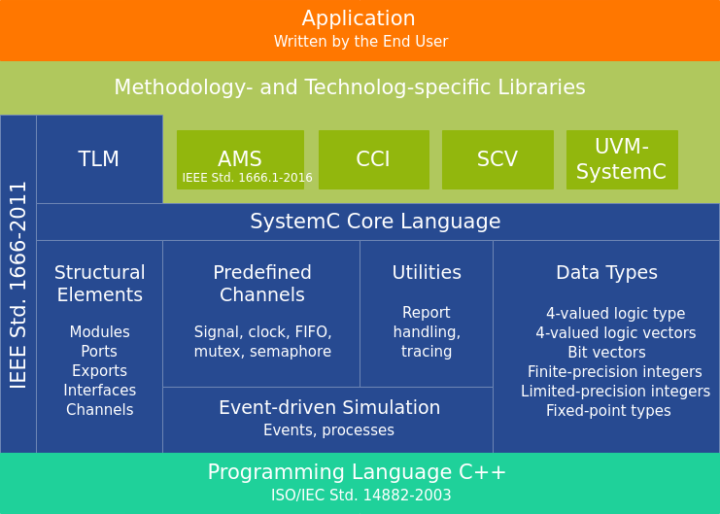
Introduction to SystemC
SystemC contains a lot of high level features
Embedded in C++, flexible and extensible
Builtin event-driven simulation
Support AMS for Analog/Mix-Signal modeling
Support UVM for system verification

Slide 4
This LAB
This lab is divided into 4 parts
Basic SystemC: a simple adder module
Event driven: a adder module with delay
High level design: a pipelined multiplier
High level design: a UART module

Slide 5
Install depedency
Install systemc first
apt install libsystemc-dev
Gtkwave is needed to show the waveform
Please connect server using VNC

Slide 6
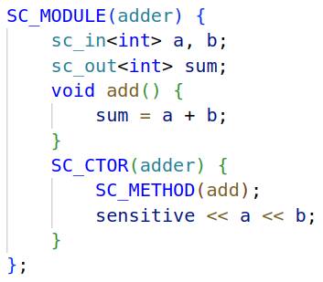
Part 1. Basic SystemC
Basic SC Module
SC_MODULE to define a module
SC_CTOR to define construction method
SC_METHOD to define functionality
sensitive to define the sensitive list
When any var in the sensitive list changes, the function in SC_METHOD will be called immediately

Slide 7
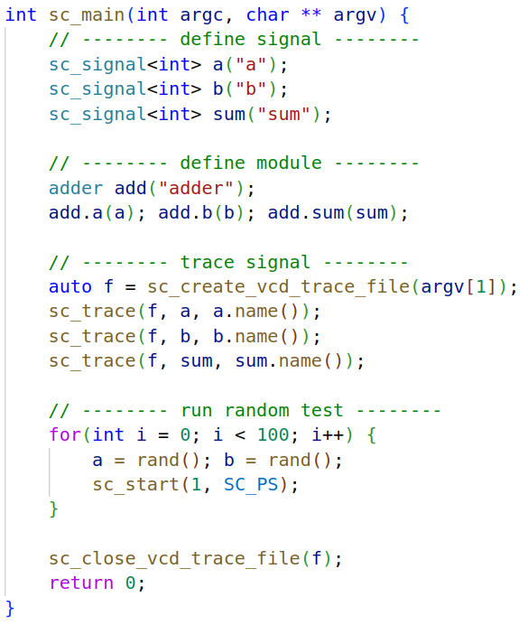
Part 1. Basic SystemC
Basic testbench
sc_signal to define signal
operator () to connect signal
create trace vcd file and trace signal
run random test
make run-01-adder

Slide 8
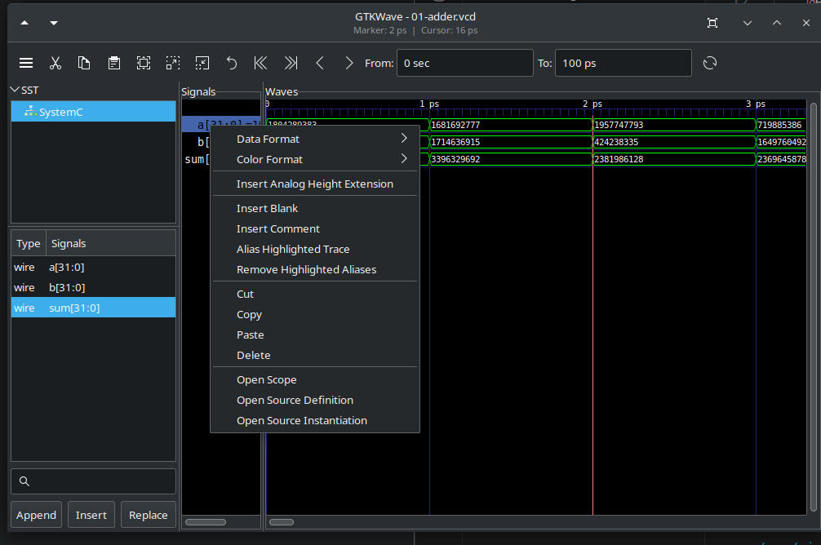
Usage of GTKWave
Click “SST” to show signal list
Drag wire to “Signals” to show the signal
Ctrl + Scroll to scale time axis
Right click signal, you can change its format

Slide 9
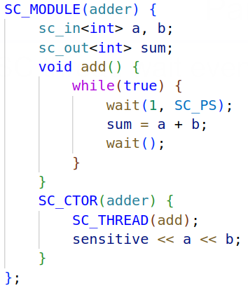
Part. 2. Event driven
SC thread wait event explicitly
SC_THREAD to define a thread
wait() to wait signal explicitly
The add function
it is triggered when a or b changes
then it delay 1ps and output a + b
and wait next event

Slide 10
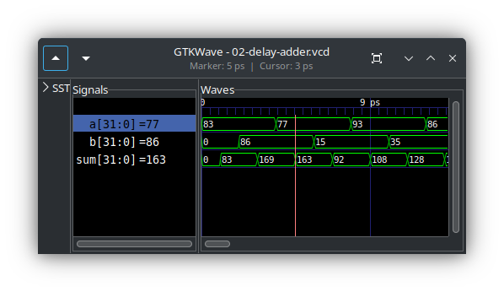
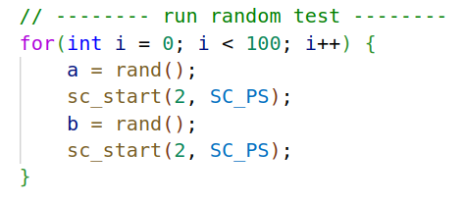
Part. 2. Event driven
Delay is 4ps, signal changes every 2ps
Use decimal format

Slide 11
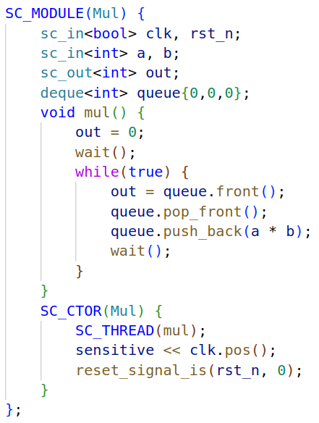
Part. 3. High level design
a pipelined multiplier
latency = 3 cycle
use std::deque to simulate the behavior
sensitive to clk.pos()
code before the first wait() is reset logic
SC_THREAD active thread immediately
reset_signal_is define reset signal
reset signal restart all thread
reset logic

Slide 12
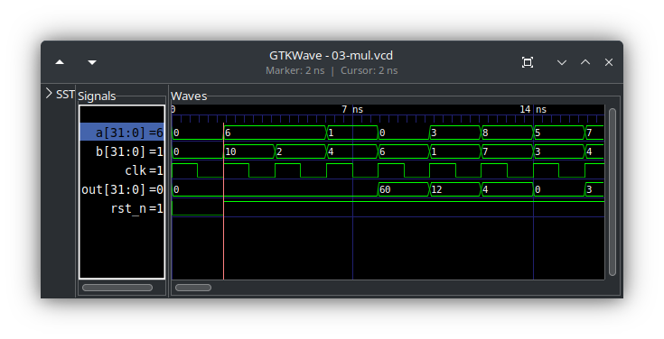
Part. 3. High level design
make run-03-mul

Slide 13

Part. 4. High level design
UART: Universal Asynchronous Receiver/Transmitter
UART protocol: output 1 bit data in each cycle
first output start bit ‘0’
then 8 bit to represent the data
finally 2 bits ‘11’ (usually 1.5bit, here is a simplified model)

Slide 14
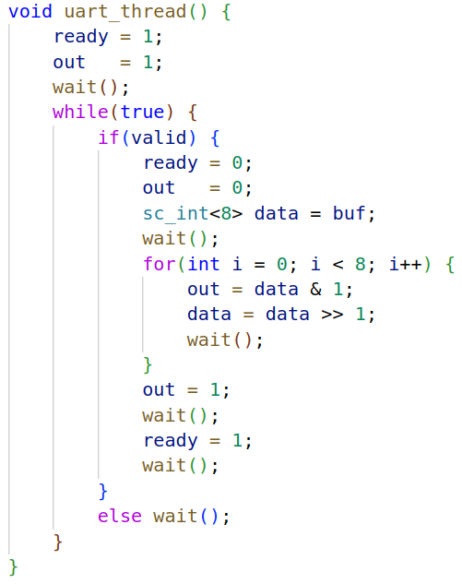
Part. 4. High level design
Try to use SC_THREAD to implement it
before start, ready is 1
when valid, set ready to 0, output start bit
send each bit
set stop bit, it takes 2 cycle
ready is reset to 1 in the second stop bit

Slide 15
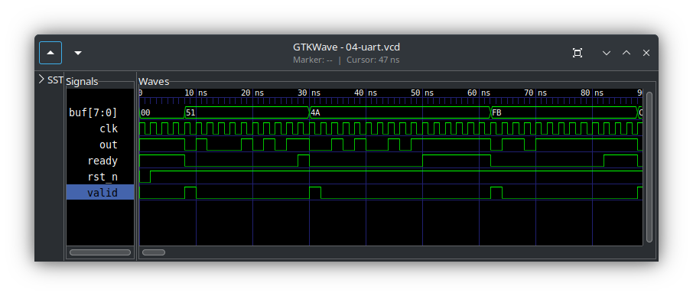
Part. 4. High level design
make run-04-uart

Slide 16
Part. 4. High level design
Imaging how to implement the module by Chisel
Check how many states are there
idle -> start -> send -> stop
Check the state transition
Implement each state
Debug
It’s difficult to get it work in RTL
In early development, high level model language is very important
SystemVerilog is similar to SystemC
but there is no opensource event-driven simulator

