Slide 1
FULL cycle simulation using verilator
编辑母版文本样式

Slide 2
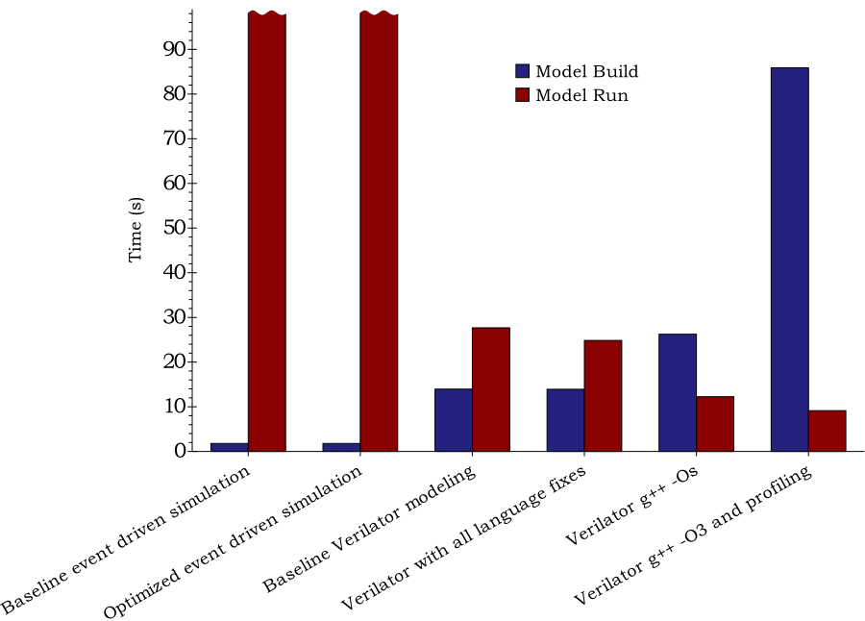
Introduction to Verilator
Verilator is the state-of-the-art RTL simulator
support a lot of SystemVerilog feature
compile Verilog / SystemVerilog to C++
Verilator Performance

Slide 3
This LAB
This lab is divided into 4 parts
use verilator to lint code
write a simple C++ testbench
use verilator to run coverage test
build large design and tune compilation options

Slide 4
Install depedency
apt install npm lcov cloc
npm install light-server

Slide 5
Part. 1. Lint
In 01-simple, the ‘alu.sv’ has some typos
check the output and fix the typos
verilator --lint-only alu.sv

Slide 6
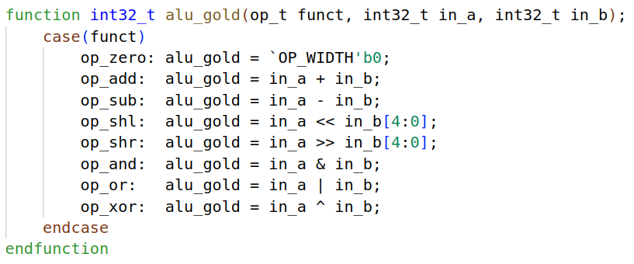
Part. 2. A Simple C++ Testbench
The testbench is a simple alu
the detailed implementation is in alu.sv
the functional equivalent module is in alu_tb.sv

Slide 7

Part. 2. A Simple C++ Testbench
Add verilator compile command to Makefile
--sv: this is a sv module
--cc: compile to cpp
--exe: build executable, not library
--build: build after emit
--trace: enable signal trace
$^: means the alu.sv alu_tb.sv tb.cpp
the order matters!

Slide 8
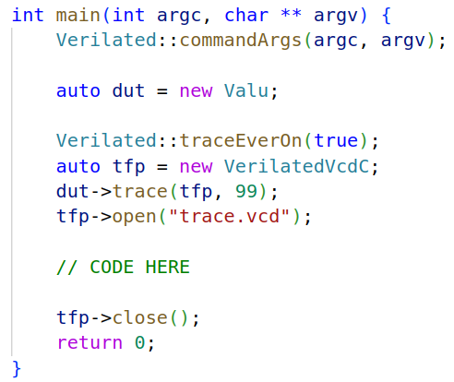
Part. 2. Simple C++ Testbench
First tell verilator the command args
Instanciate the target module
Open trace file
Run test
Close trace file

Slide 9
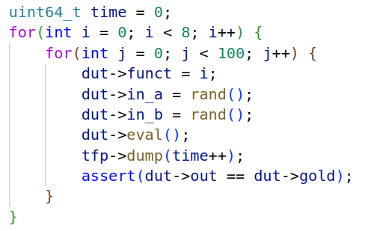
Part. 2. A Simple C++ Testbench
make, to ensure no compilation error
Then, we enumerate all funct, and generate test input
unlike SystemC, verilator has no timing information
the time cycle is user managed tfp->dump(time++)

Slide 10
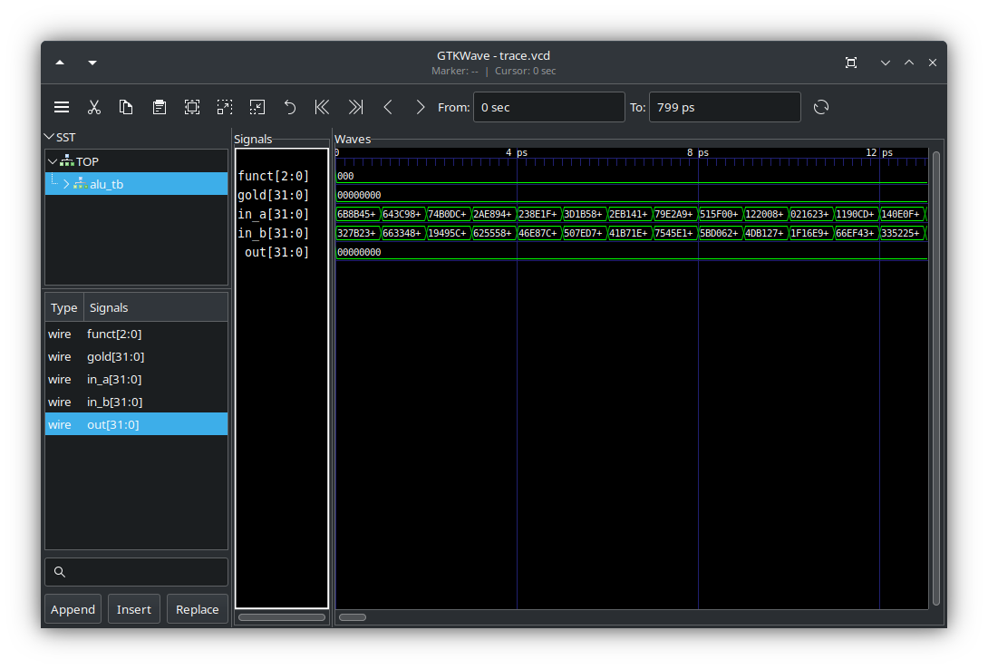
Part. 2. A Simple C++ Testbench
make to compile and run
make show to show the waveform

Slide 11
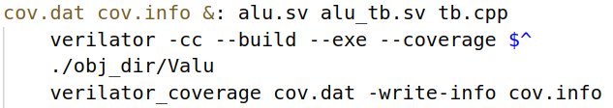
Part. 3. Coverage Test
In 02-coverage, the design is the same as 01
Modify the Makefile
--coverage: turn on coverage test
./obj_dir/Valu: run target program to gen coverage data
verilator_coverage: convert converage data

Slide 12
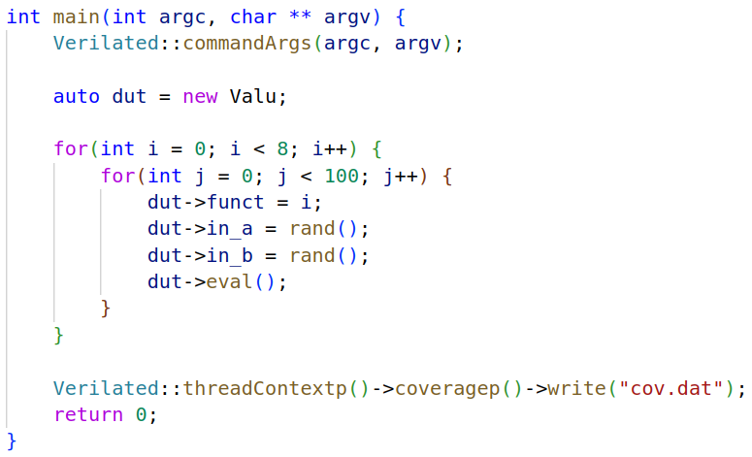
Part. 3. Coverage Test
Add Code to export coverage data:
run make to do coverage test

Slide 13

Part. 3. Coverage Test
show coverage stat: make stat
There is only 97.1% coverage
lcov --summary cov.info
Reading tracefile cov.info
Summary coverage rate:
lines......: 97.1% (67 of 69 lines)
functions..: no data found
branches...: no data found

Slide 14

Part. 3. Coverage Test
Open coverage report to find uncovered code
ssh -L 4000:127.0.0.1:4000 root@115.27.161.184 -p xxxx
Open your browser, open http://localhost:4000
modify the code to cover the

Slide 15
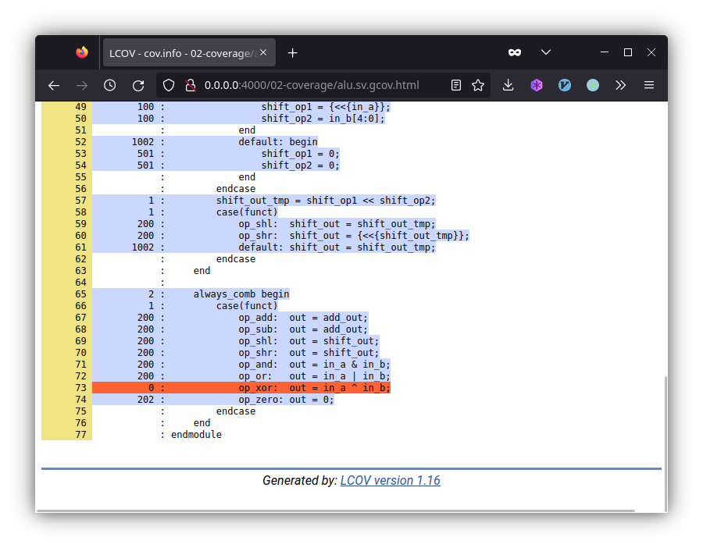
Part. 3. Coverage Test

Slide 16
Part. 4. Large Design
In 03-large, follow the README.md

