Slide 1
Competitive Analysis - Portfolios
By Philip Ku

Slide 2
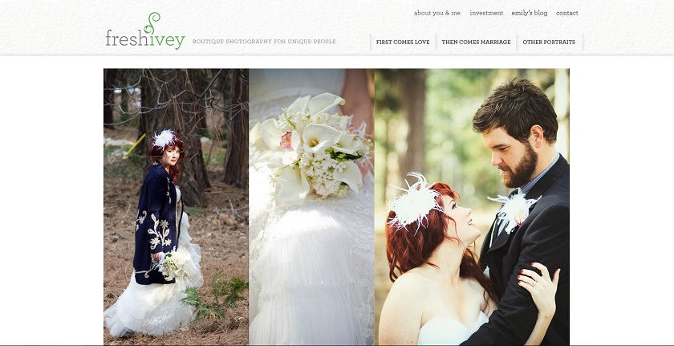
1) Fresh Ivey Photography
www.freshivey.com
Date visited: 1/17/12
Layout – Featured Photo

Slide 3
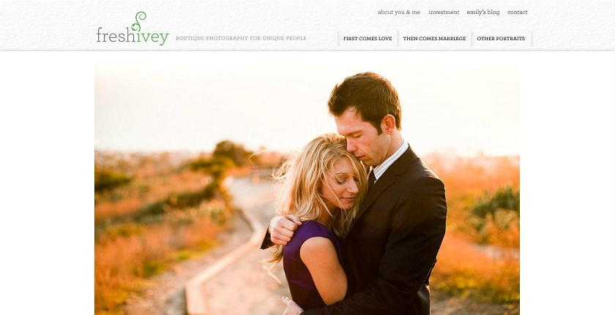
Brand
Clean – White background. Not very flashy. Brings focus the photos.
Natural – Most photos involve nature. ‘Ivey’ as a theme.
Beautiful - Accentuates the beauty of photos. Leaves no distraction.

Slide 4
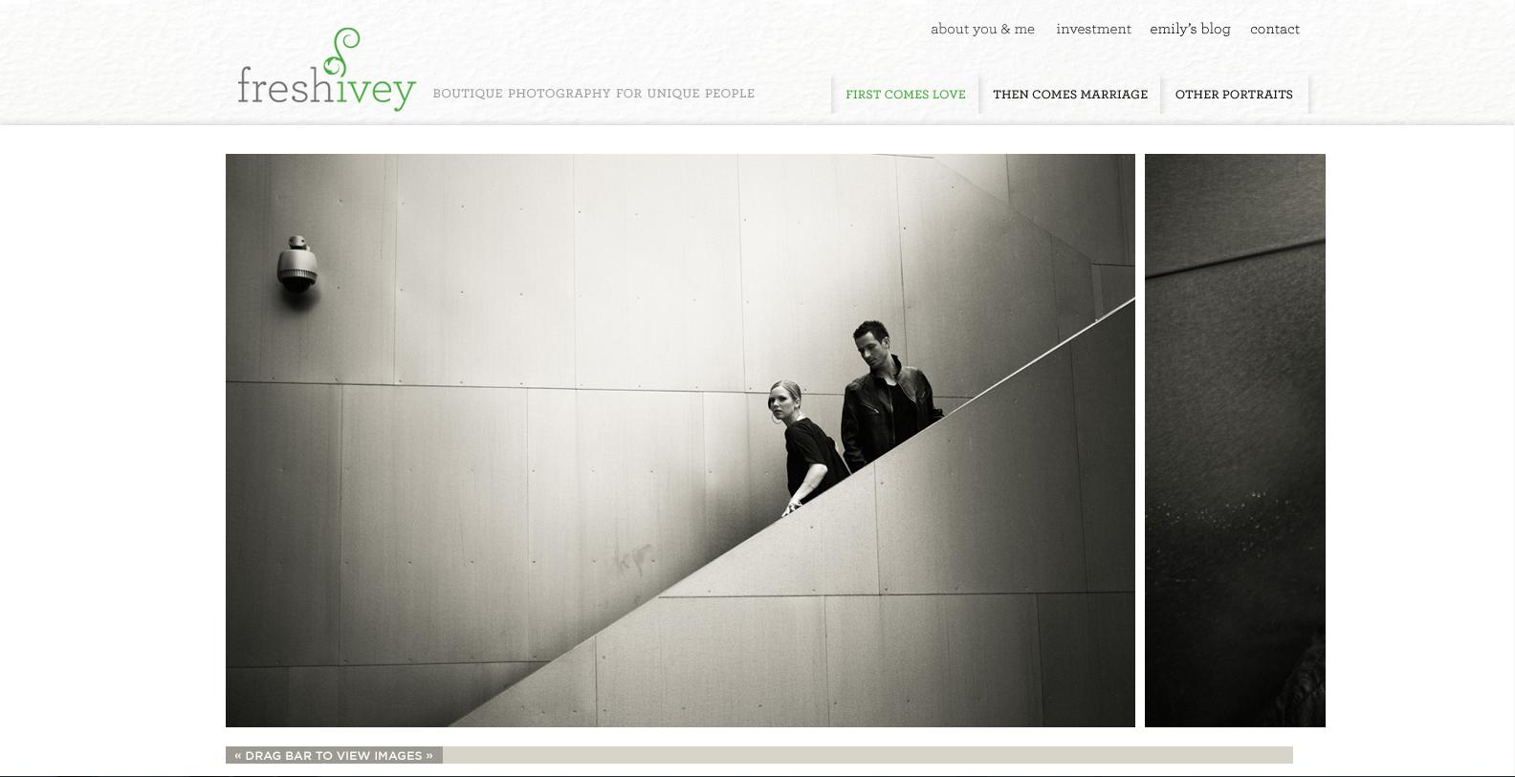
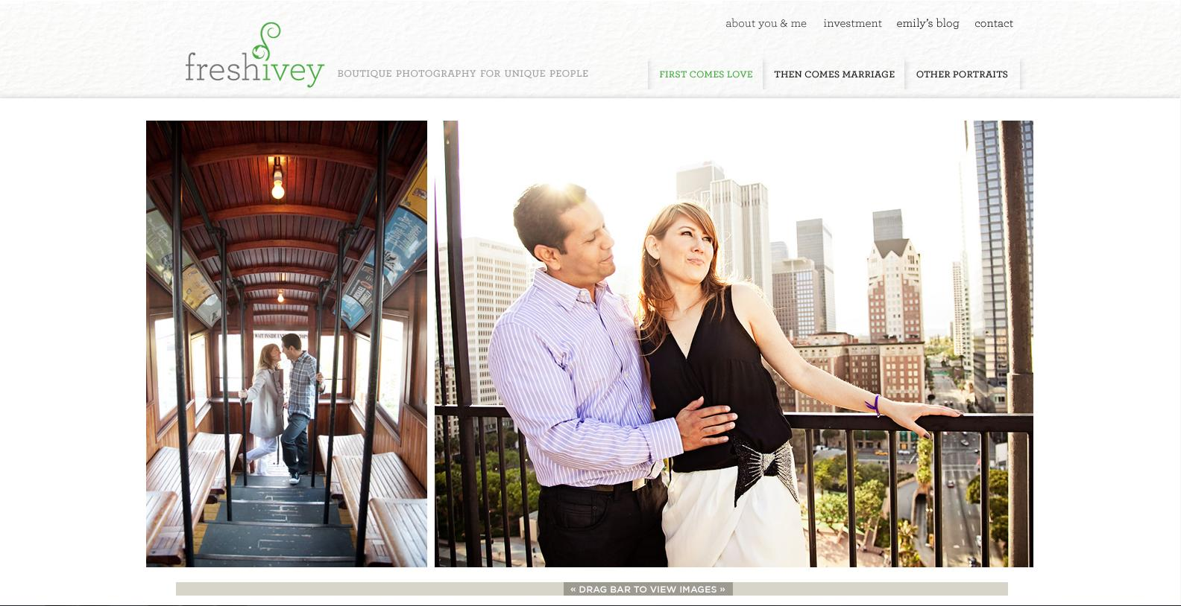
Functionality
There is an interesting side-scrolling function for viewing images. The only problem I see is that the scroll bar auto-centers itself when you select it, which also moves the image. It makes it seem choppy. However, when the page is first loaded, it moves with mouse scrolling if you have a wheel.
The 3 Tabs showcase different types of photos.
You cannot enlarge the images. However, they are already pretty big, so it’s not really a problem.

Slide 5
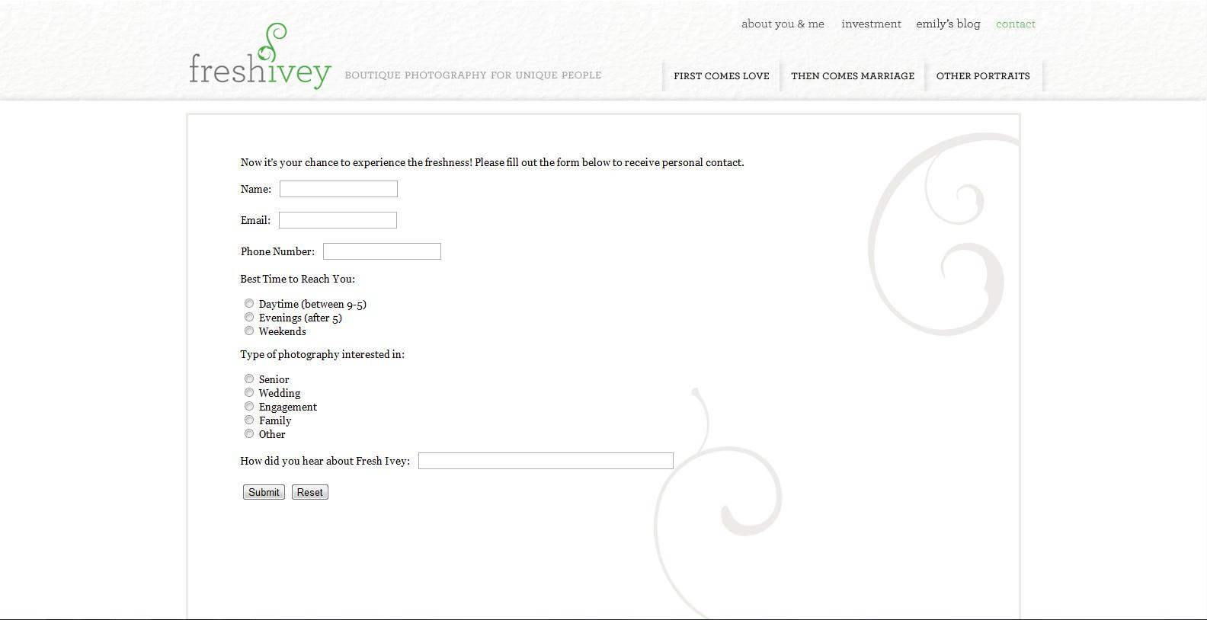
Interactivity
There isn’t much interactivity aside from the tabs to select different photos.
You cannot select the photos.
The home page automatically showcases different photos.
There is a page where you can submit info to contact the person.

Slide 6
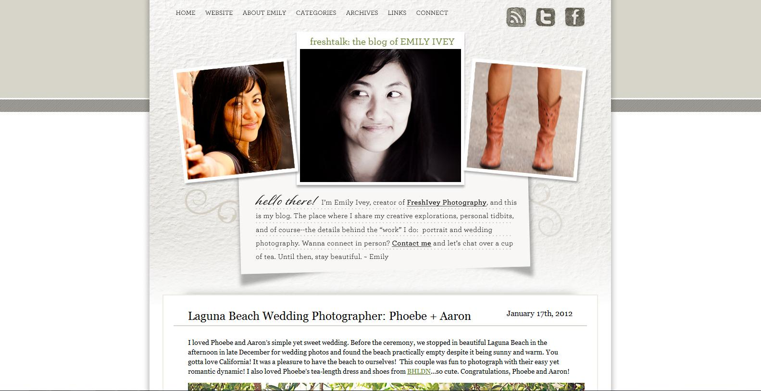
Navigation
Very simple and easy. There are tabs to every page available. The tabs are always at the top of the page. Clicking the name of the site brings you back to the home page.
There are more pages in her blog, but the layout is relatively the same.

Slide 7
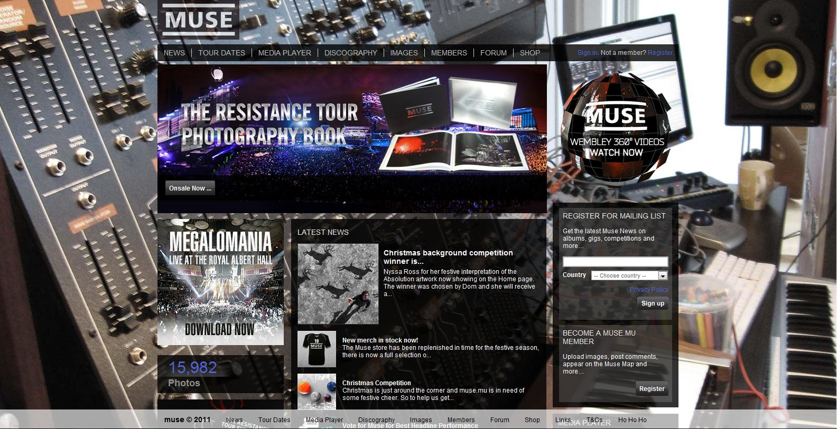
2) Muse
www.muse.mu
Date Visited: 1/17/12
Layout – Power Grid

Slide 8
Brand
Professional - They have loads of information, even archives.
Social – Inviting you to become a member, join the forums, check out photos/videos, etc.
Prestigious – The fact that the can fill a Power Grid layout means that they have a lot of media and experience in making music.

Slide 9
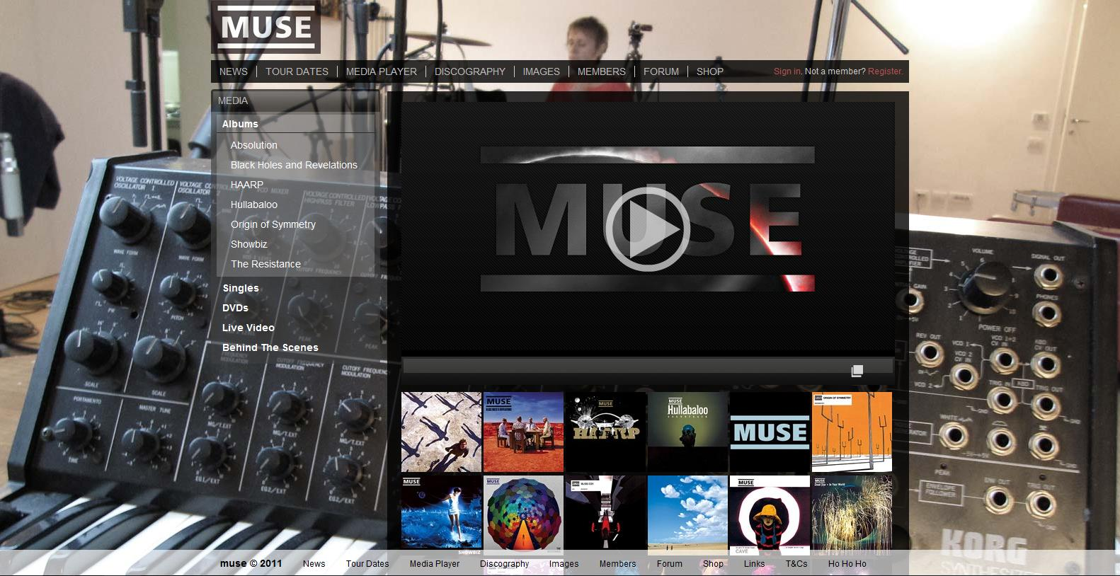
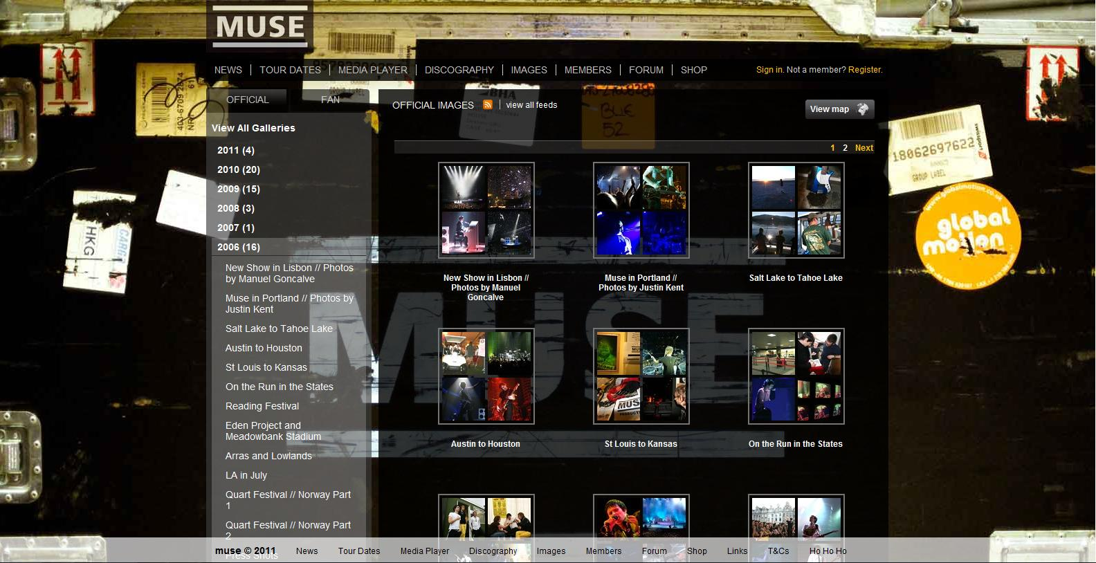
Functionality
Each tab opens up a new page with a sidebar.
The links on the sidebar open up after being selected to reveal more options.
Every picture on the right-hand side can be selected to view that piece of media.
Different pages have similar layouts.
This makes viewing every form of media easy.

Slide 10
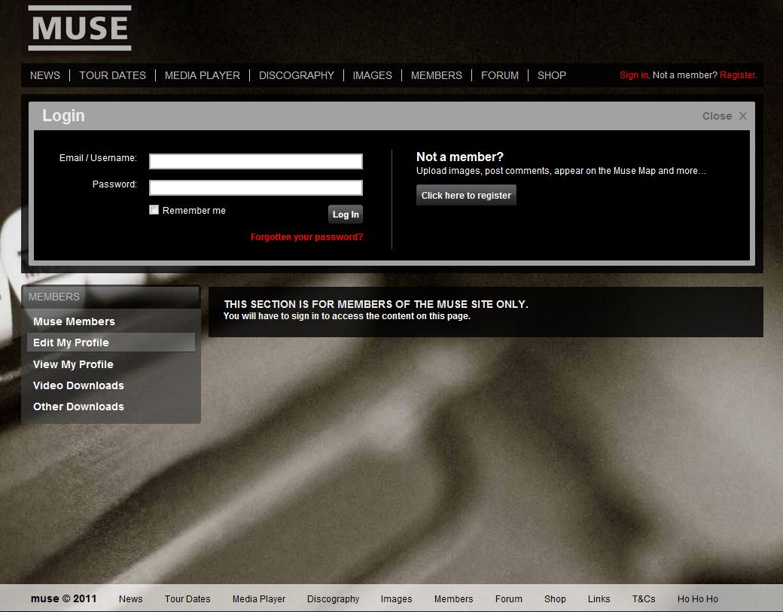
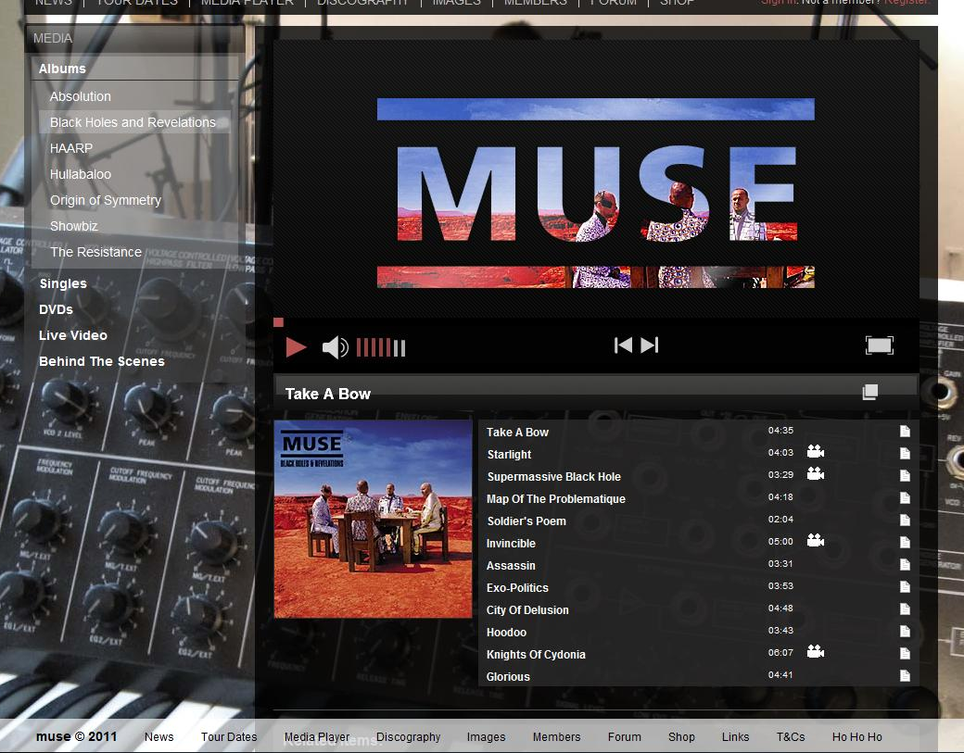
Interactivity
The top links are not highlighted when selected, but the sidebar selections are.
When the mouse falls on a link, it lights up.
Their video/audio streams allow you to see/hear what they do. You can select the song, album, change the volume, etc.
You can also join their network and socialize with other members.

Slide 11
Navigation
Top navigation bar is there on every page. Sidebars have drop-down menus that come down after selecting it.
Relatively easy to know where you are and where you can go.
There is also an extra navigation bar at the bottom.
It seems extraneous, but there are some extra links there that aren’t at the top.

Slide 12
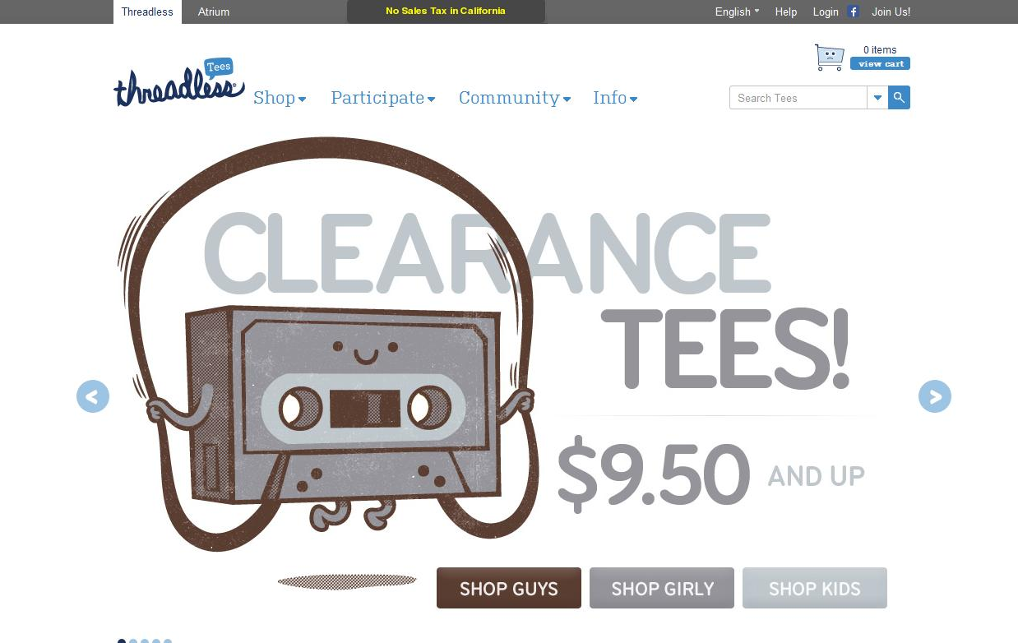
3) Threadless Tees
www.threadless.com
Date Visited – 1/19/12
Layout - Custom (Five Boxes + Headline & Grid)

Slide 13
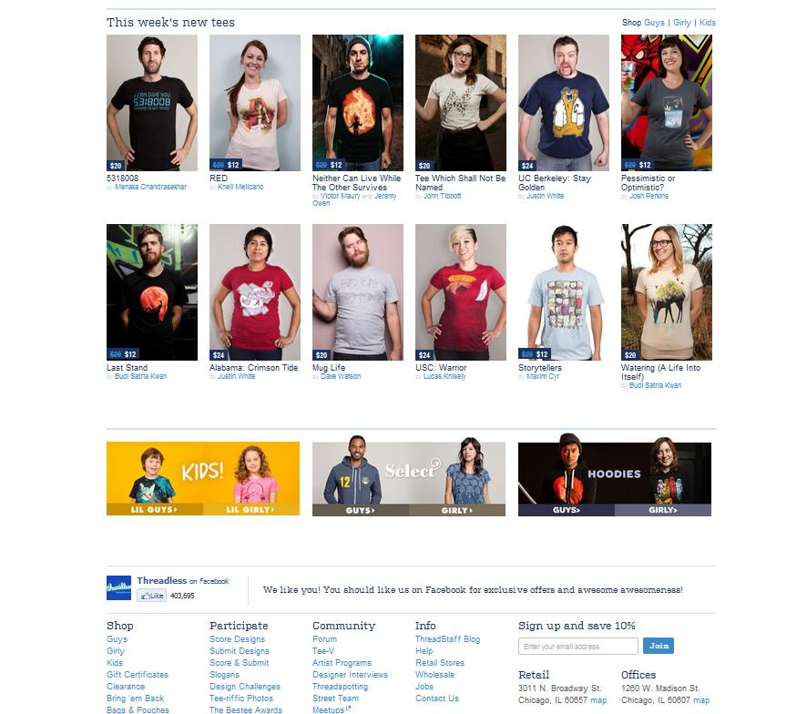
Brand
Fun – The art style on the shirts seems fun.
Artistic – Many creative designs
Social – Shopping, members, community tab. Encourages participation.

Slide 14
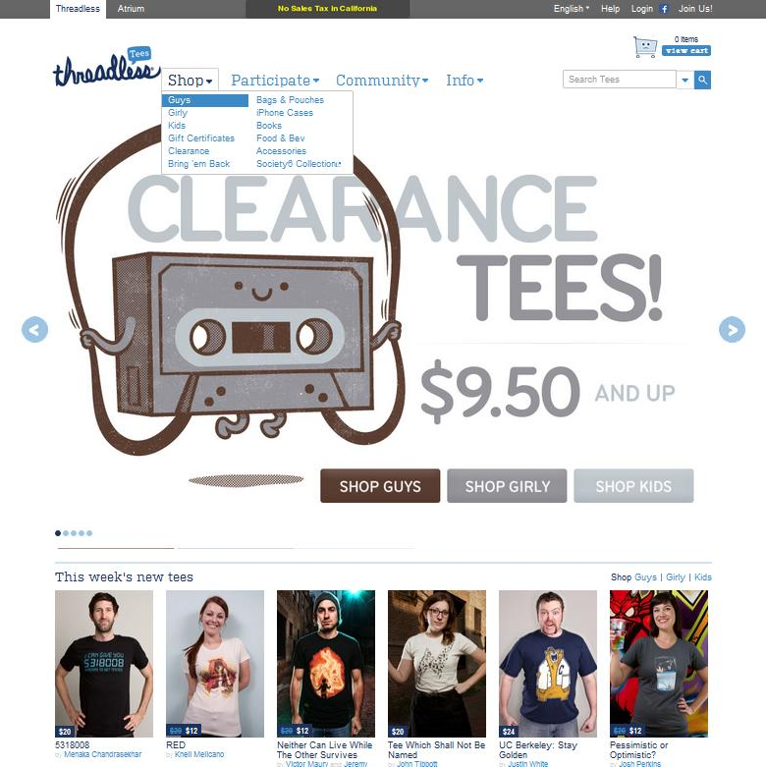
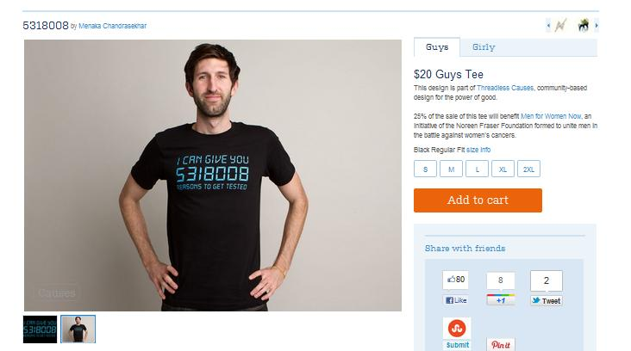
Functionality
The tabs have drop down menus to show what other products there are.
Shopping cart to keep track of sales.
The main image has links within it that you may browse.
A section displays the newest designs.
Selecting a shirt will bring you to a new page showcasing that shirt.

Slide 15
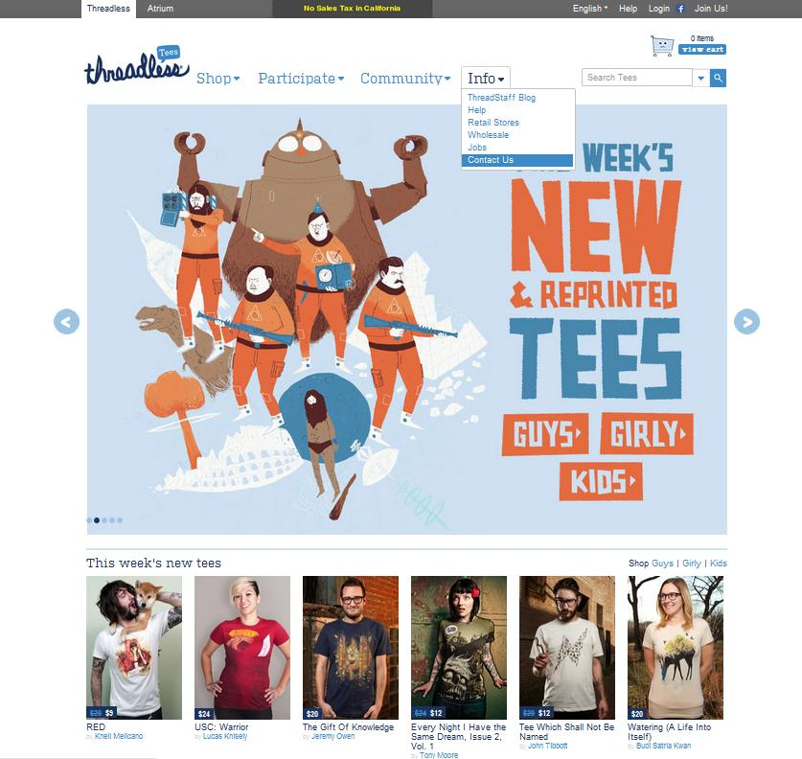
Interactivity
Main tabs have drop-down menus. Mouse-over highlights your selection.
There are arrows that you can select to scroll through the main images. You can also click the circles to browse.
The main image also has links to select.
Clicking on a shirt will bring you to a new page to show you more details about the shirt.
The top grey tab allows you to change the language. You can also join the community by registering with the site.

Slide 16
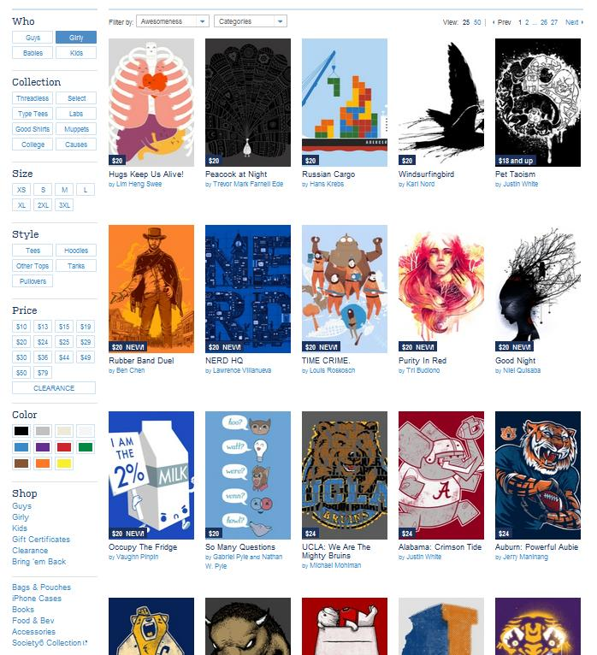
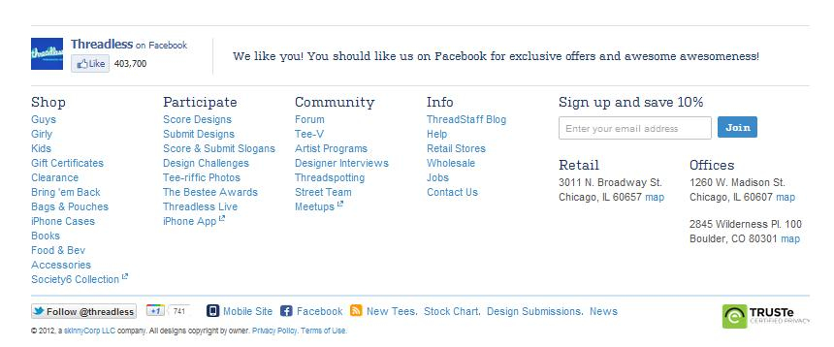
Navigation
Easy to find what you want. Selections are on the side tab for what kind of shirt you want, including size, color, etc..
Selecting a shirt will bring you to that shirt’s page. This page lists more info about the shirt, including comments about the shirt and suggestions for other shirts.
You can also select the designer’s name to see more of his/her works.
You can browse through all the pages of shirts available.
The top tab is present on every page, so you can always go back to a main section. There is also a section at the bottom of the site with every link.

Slide 17
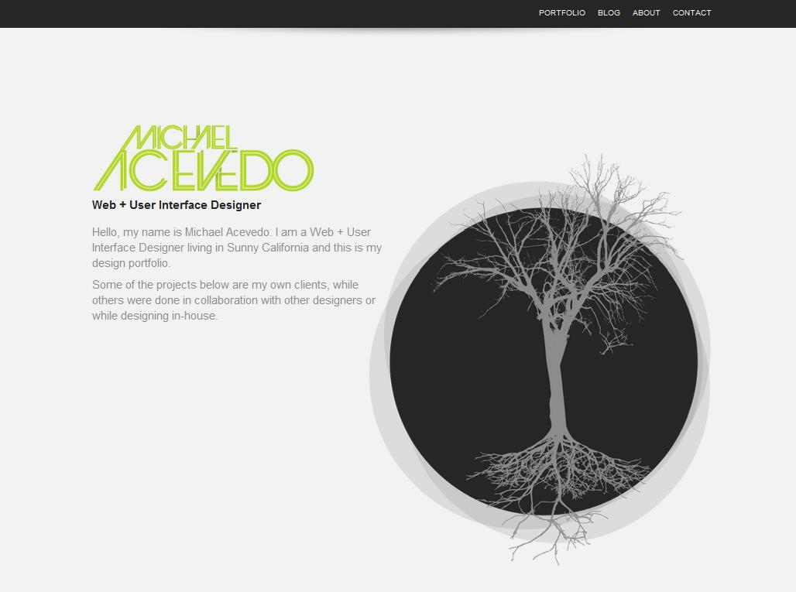
4) Michael Acevedo
michaelacevedo.com
Date Visited: 1/19/12
Layout: Featured Graphic

Slide 18
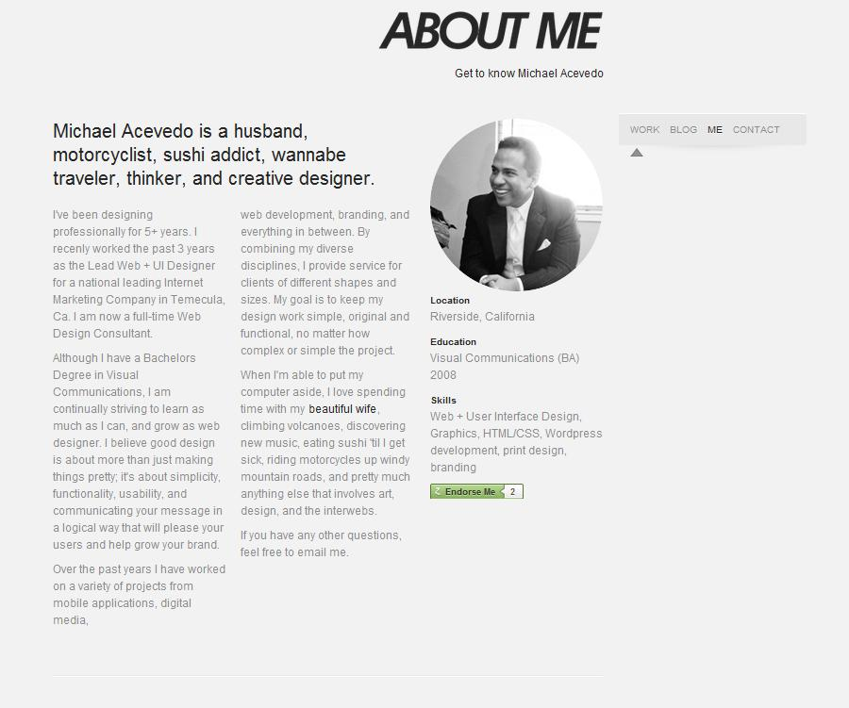
Brand
Clean – The simple white, gray, and black colors give a clean feel.
Casual – They way he writes is friendly, personable, and not too serious.
Skilled – He demonstrates his skill through his smooth transitions.

Slide 19
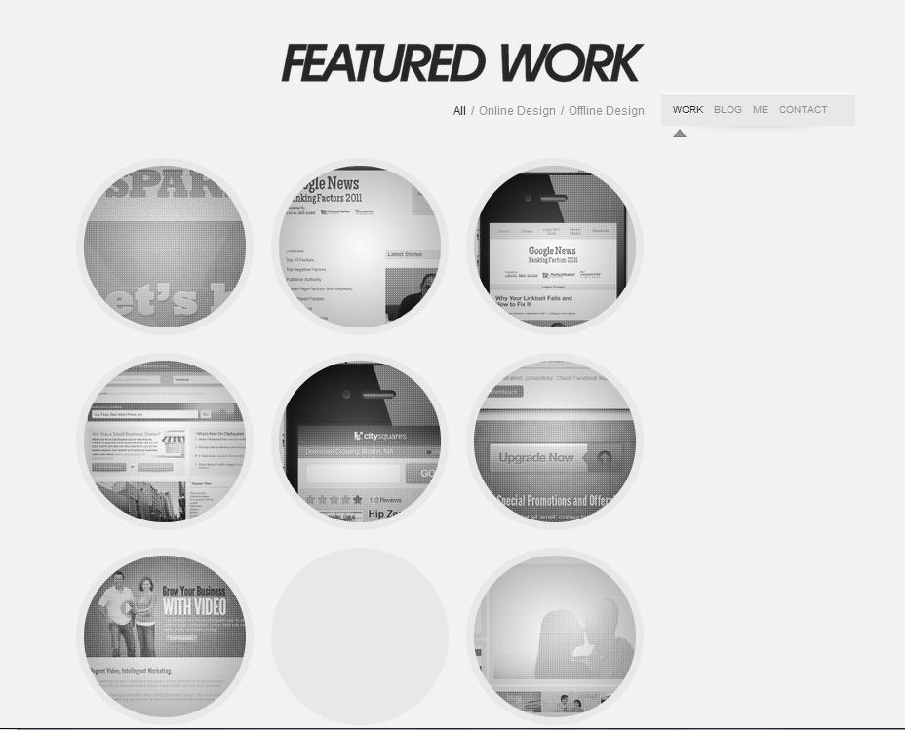
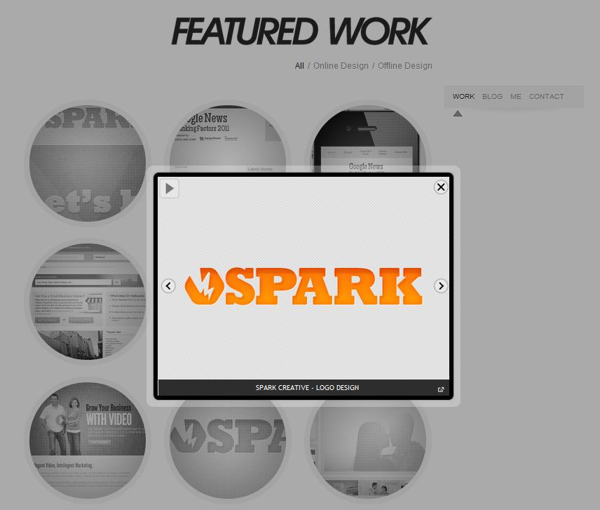
Functionality
Instead of having different pages, he has all his info on a single large page.
You can either scroll through or use the little navigation bar on the right side which will slide you to the section you select, which is a nice transition.
Selecting a picture will bring up a display of the site and a description of how he contributed to the site.

Slide 20
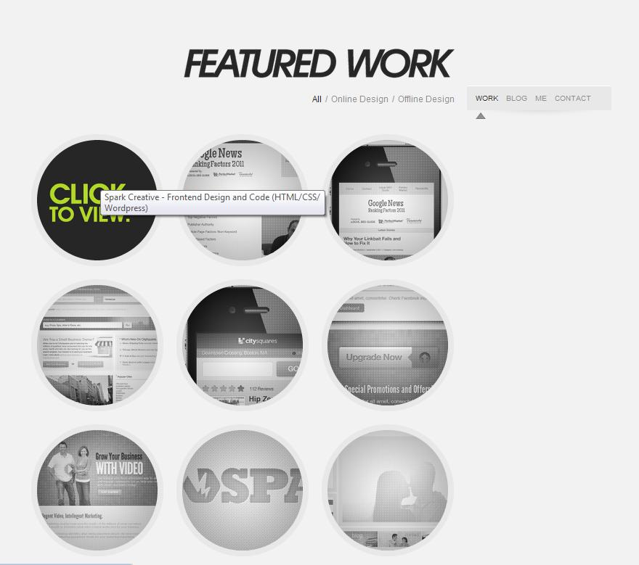
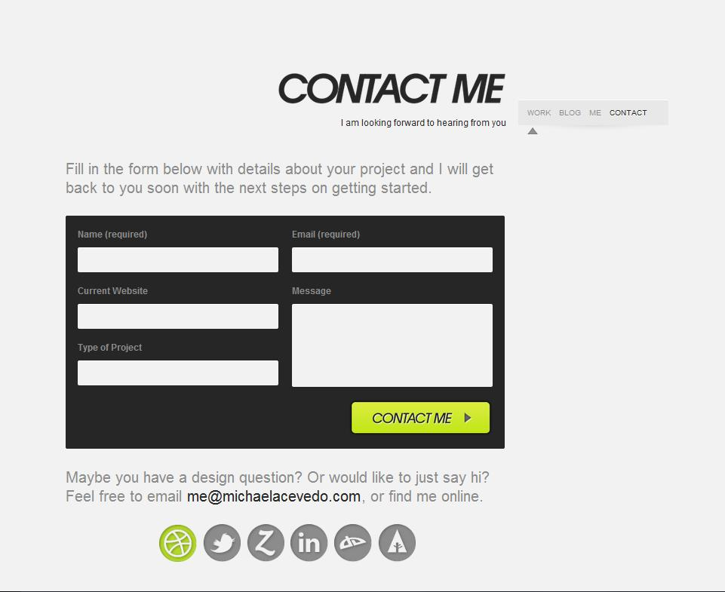
Interactivity
You can select each work to view it.
A mouse-over will change the image. However, the image might not reappear after moving your mouse away.
When viewing a design, you can manually view each one or start a slideshow.
You can also fill out this form to contact him.

Slide 21
Navigation
Since it is all on one page, navigation is simple. It is made easier by the top bar and the sidebar, which only appear after the top bar moves off-screen.
Moving back to the home page from selecting a design is easily done by clicking away from the image or clicking the exit button.

Slide 22
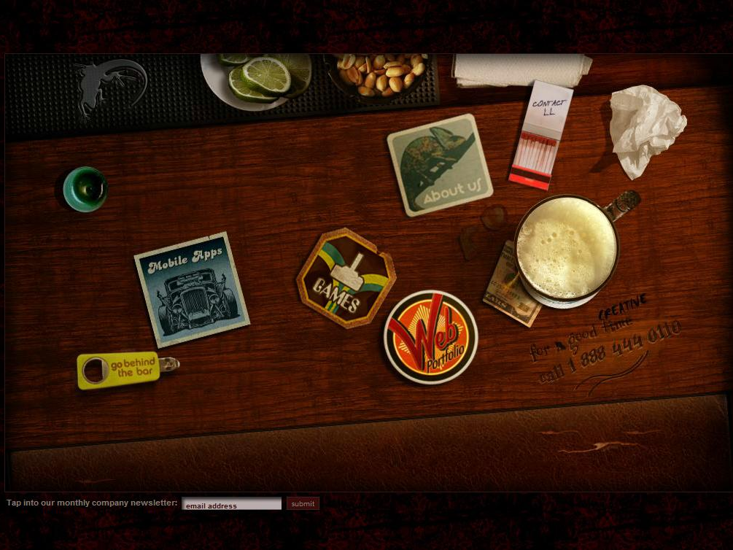
5) Lounge Lizard
www.loungelizard.com
Date Visited: 1/19/12
Layout – Custom (Interactive)

Slide 23
Brand
Creative – A fully interactive homepage with a bar theme. Each link is associated with an image that moves when moused-over.
Skilled – It takes skill to create such a homepage.
Fun – There are games and small extras on the site just for fun. (You can light the candle)

Slide 24
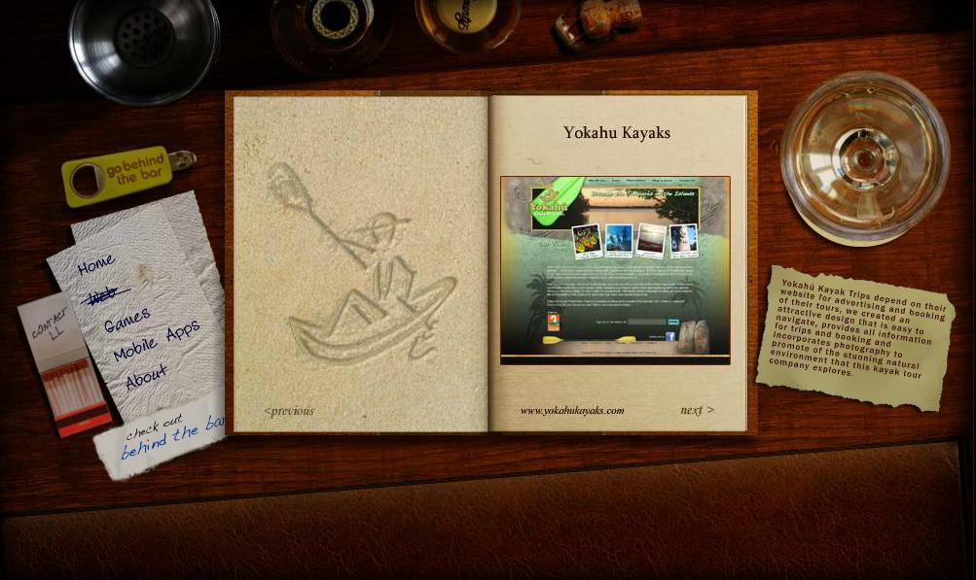
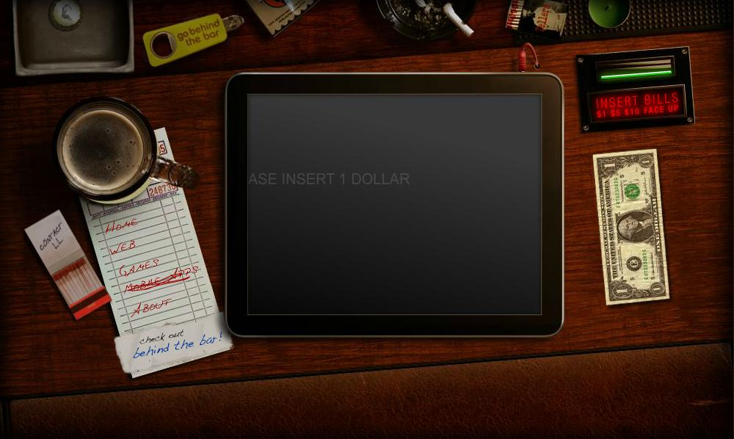
Functionality
Aside from the actual site to demonstrate their skill, they also have a web portfolio for people to see what other woks they have done.
They also explain their ideas behind each design on the right.
Although the site may seem confusing at first, there are breadcrumbs to lead you toward the right direction.
The text is scrolling across the screen to tell you what to do.

Slide 25
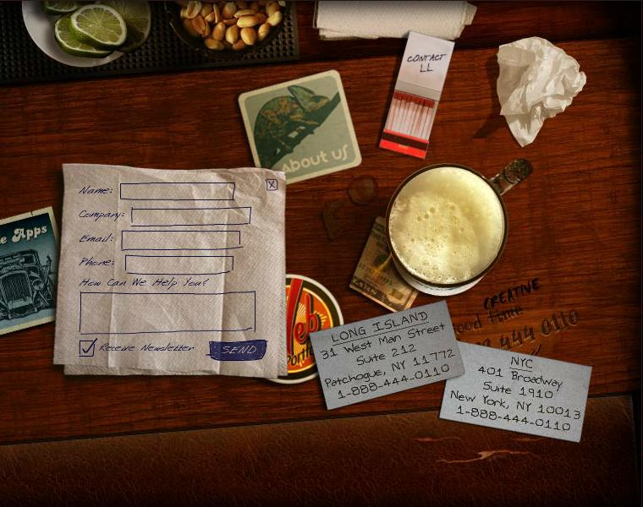
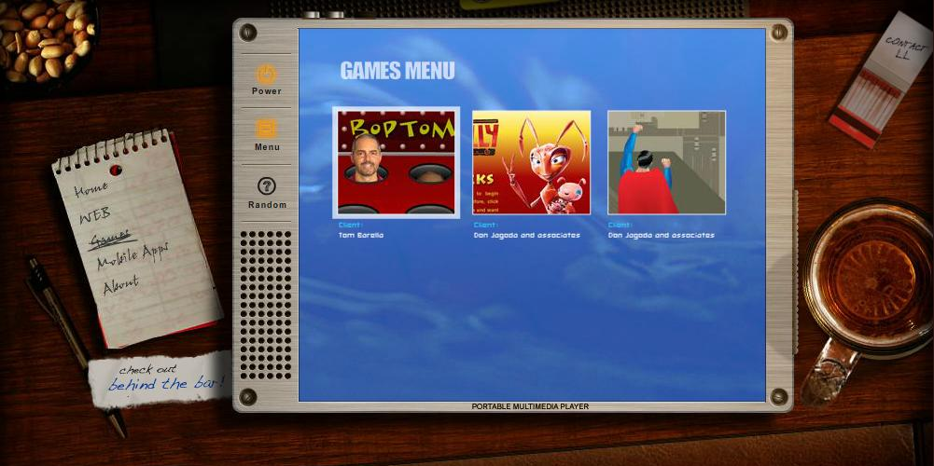
Interactivity
The site is almost completely interactive. You cannot get any information without interacting with the site. This might provide usability issues.
You can even play games on the site!

Slide 26
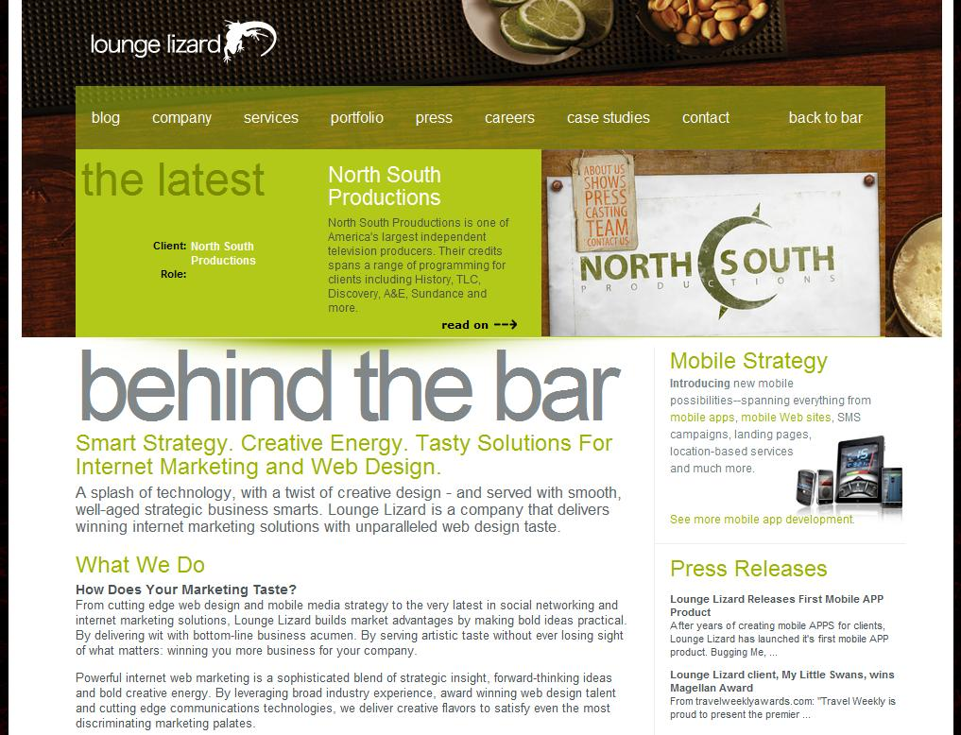
Navigation
Even though the site is fully interactive, it is still easy to navigate. All the links are named. There is an indicator to tell you what page you’re on. Every page has a link to all the other pages.
However, for a more professional look, there is a link to see ‘Behind the Bar’. This is basically a more conventional site. This page is definitely more professional looking. It has tabs with even more information, and even a link to return to the bar interface.

