Slide 1
Competitive Analysis - Portfolios
By Philip Ku

Slide 2
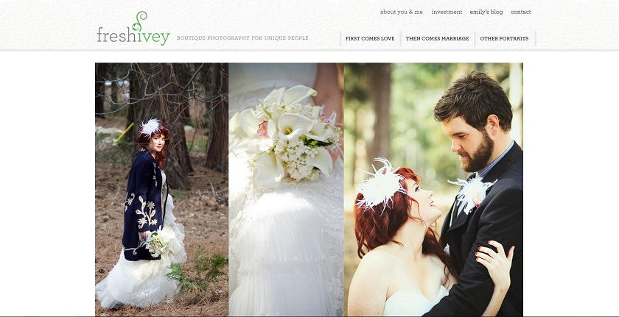
Fresh Ivey Photography
www.freshivey.com
Date visited: 1/17/12
Layout – Featured Photo

Slide 3
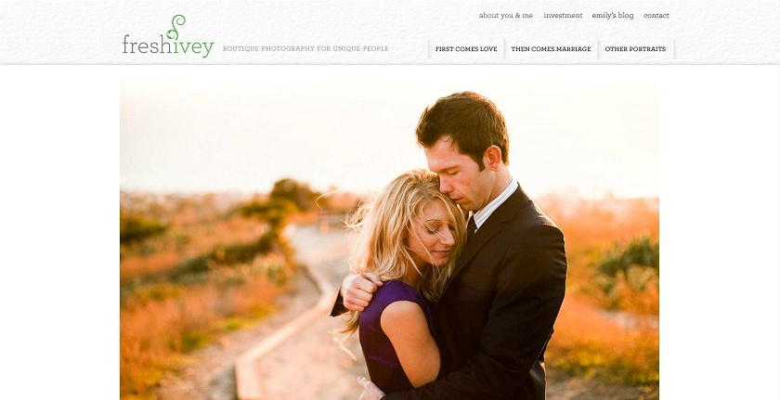
Brand
Clean – White background. Not very flashy. Brings focus the photos.
Natural – Most photos involve nature. ‘Ivey’ as a theme.
Beautiful - Accentuates the beauty of photos. Leaves no distraction.

Slide 4
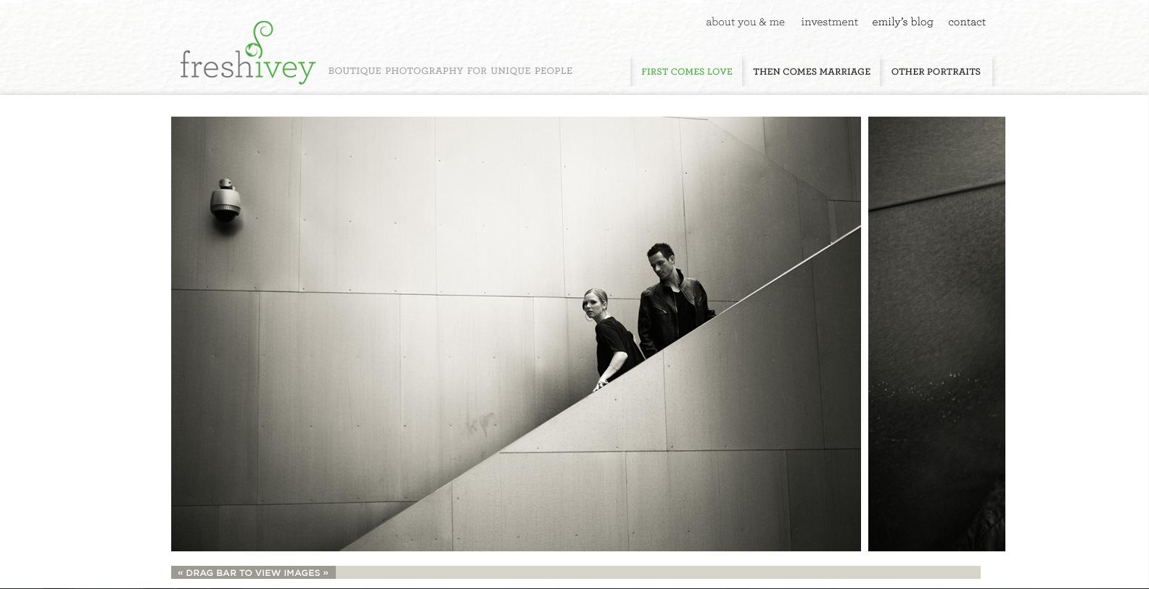
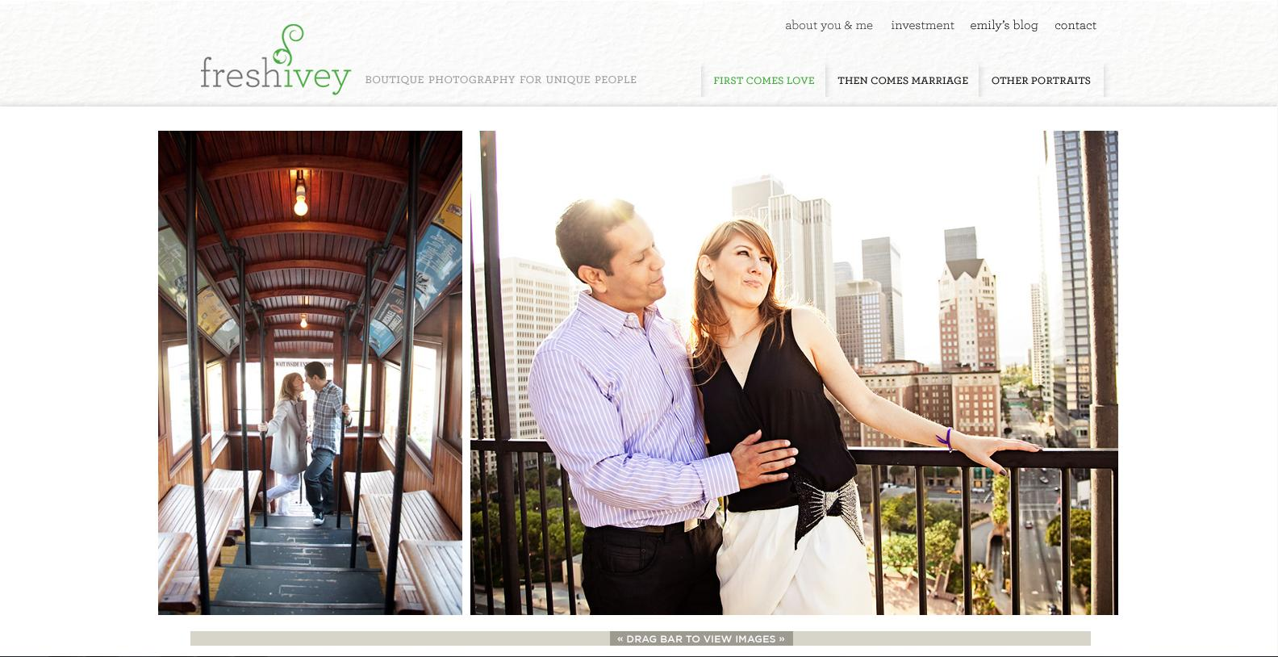
Functionality
There is an interesting side-scrolling function for viewing images. The only problem I see is that the scroll bar auto-centers itself when you select it, which also moves the image. It makes it seem choppy. However, when the page is first loaded, it moves with mouse scrolling if you have a wheel.
The 3 Tabs showcase different types of photos.
You cannot enlarge the images. However, they are already pretty big, so it’s not really a problem.

Slide 5
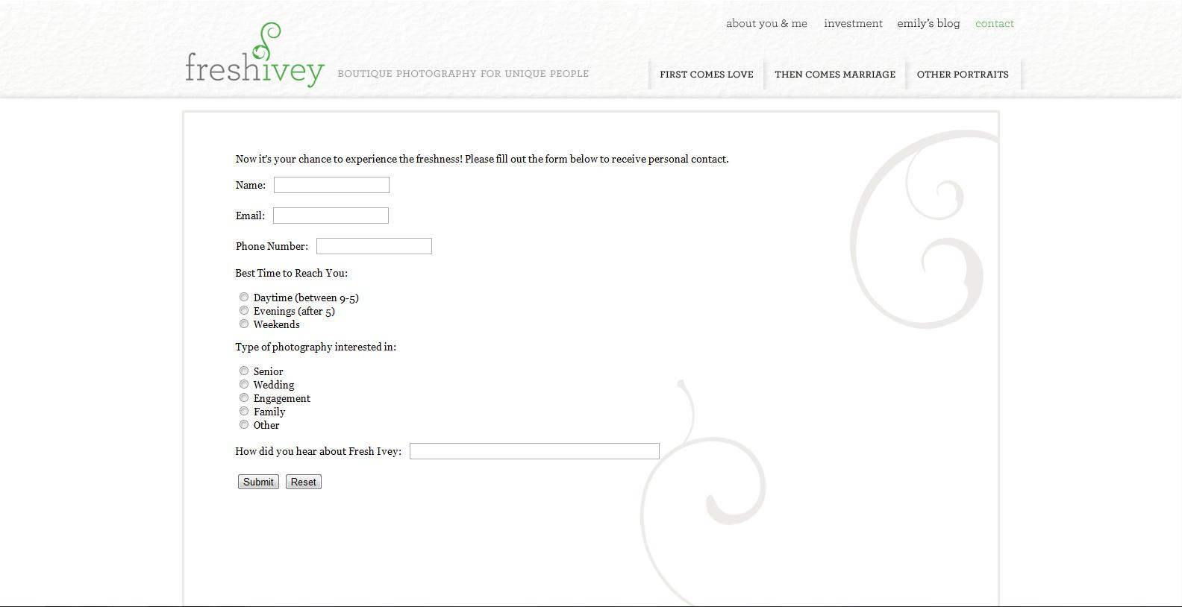
Interactivity
There isn’t much interactivity aside from the tabs to select different photos.
You cannot select the photos.
The home page automatically showcases different photos.
There is a page where you can submit info to contact the person.

Slide 6
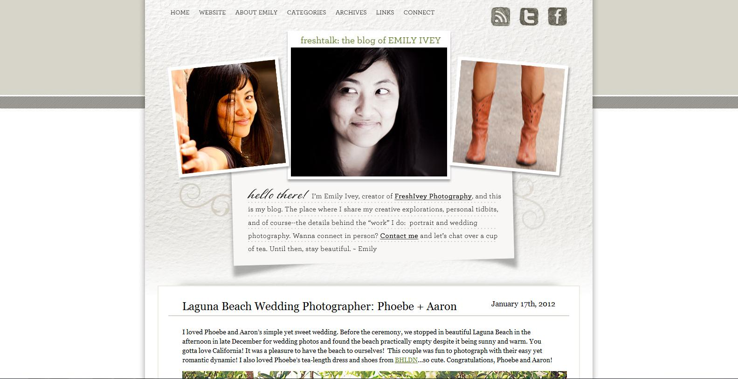
Navigation
Very simple and easy. There are tabs to every page available. The tabs are always at the top of the page. Clicking the name of the site brings you back to the home page.
There are more pages in her blog, but the layout is relatively the same.

