Slide 1
Competitive Analysis - Portfolios
By Philip Ku

Slide 2
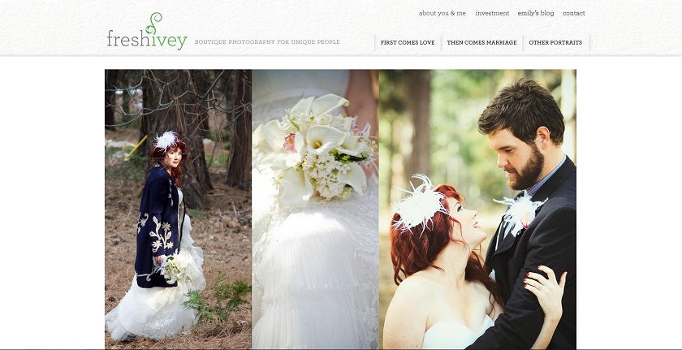
Fresh Ivey Photography
www.freshivey.com
Date visited: 1/17/12
Layout – Featured Photo

Slide 3
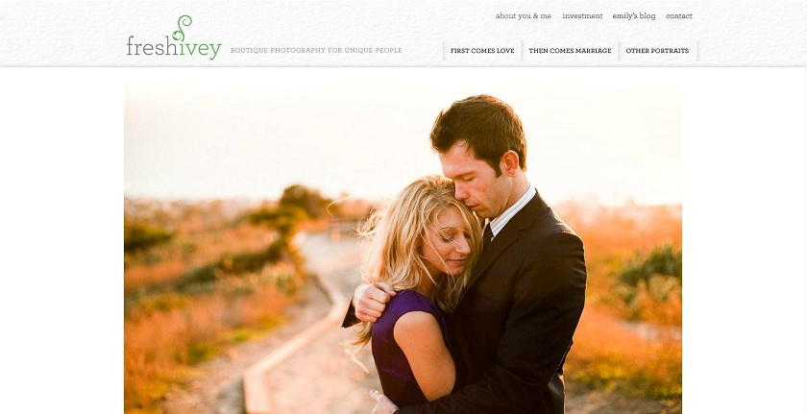
Brand
Clean – White background. Not very flashy. Brings focus the photos.
Natural – Most photos involve nature. ‘Ivey’ as a theme.
Beautiful - Accentuates the beauty of photos. Leaves no distraction.

Slide 4
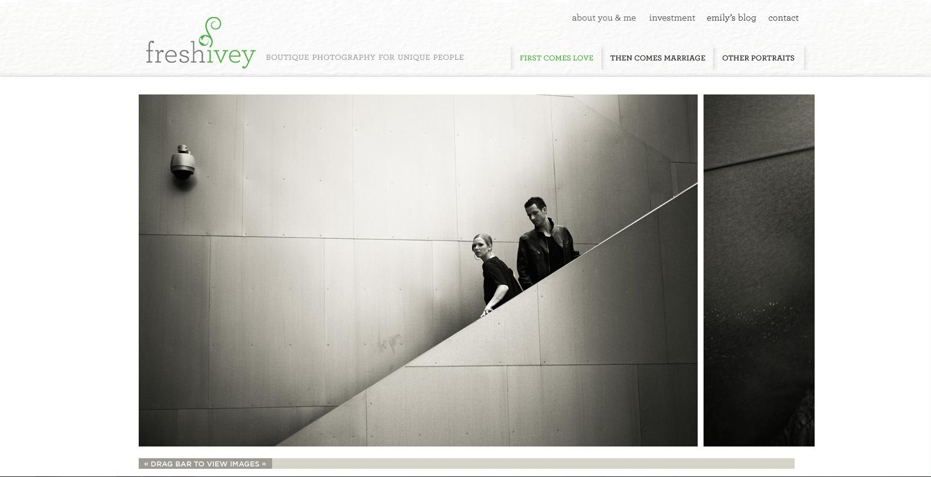
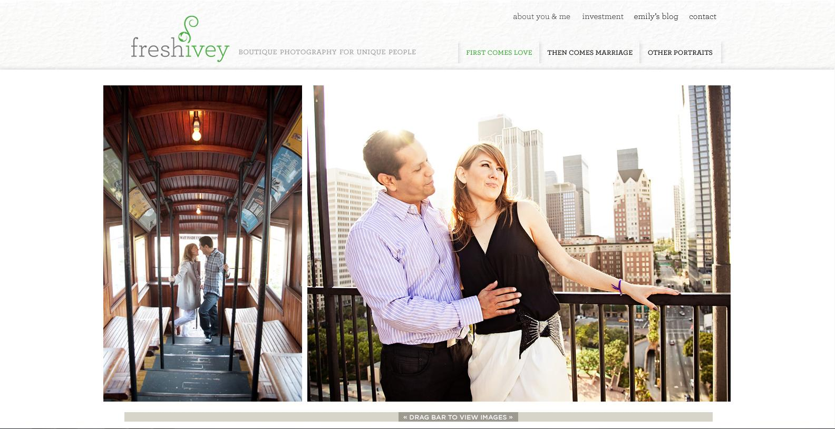
Functionality
There is an interesting side-scrolling function for viewing images. The only problem I see is that the scroll bar auto-centers itself when you select it, which also moves the image. It makes it seem choppy. However, when the page is first loaded, it moves with mouse scrolling if you have a wheel.
The 3 Tabs showcase different types of photos.
You cannot enlarge the images. However, they are already pretty big, so it’s not really a problem.

Slide 5
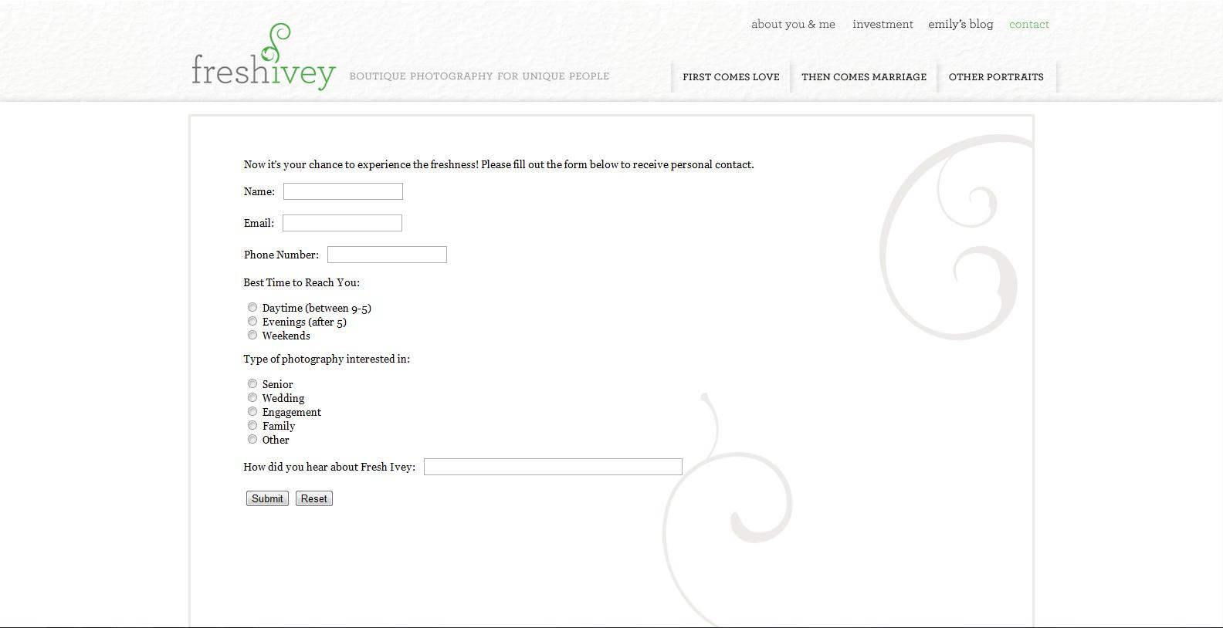
Interactivity
There isn’t much interactivity aside from the tabs to select different photos.
You cannot select the photos.
The home page automatically showcases different photos.
There is a page where you can submit info to contact the person.

Slide 6
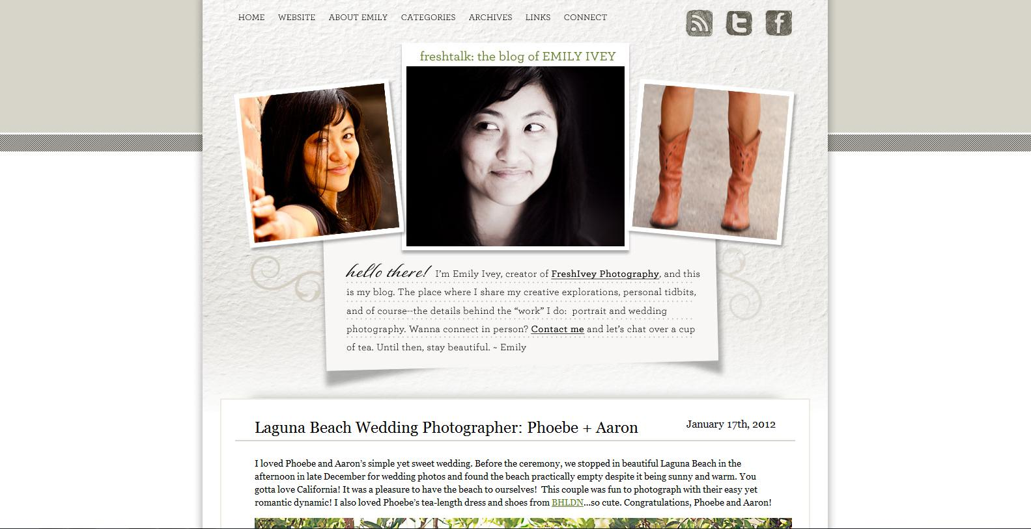
Navigation
Very simple and easy. There are tabs to every page available. The tabs are always at the top of the page. Clicking the name of the site brings you back to the home page.
There are more pages in her blog, but the layout is relatively the same.

Slide 7
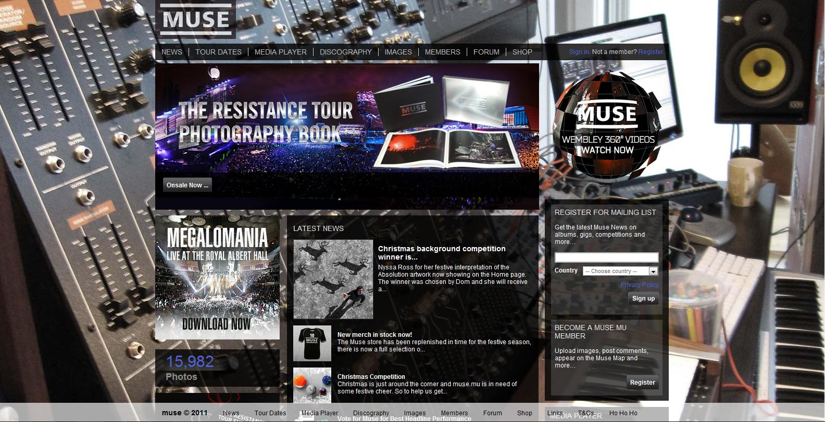
Muse
www.muse.mu
Date Visited: 1/17/12
Layout – Power Grid

Slide 8
Brand
Professional - The amount of info shows how prestigious they are.
Social – Inviting you to become a member, join the forums, check out photos/videos, etc.

Slide 9
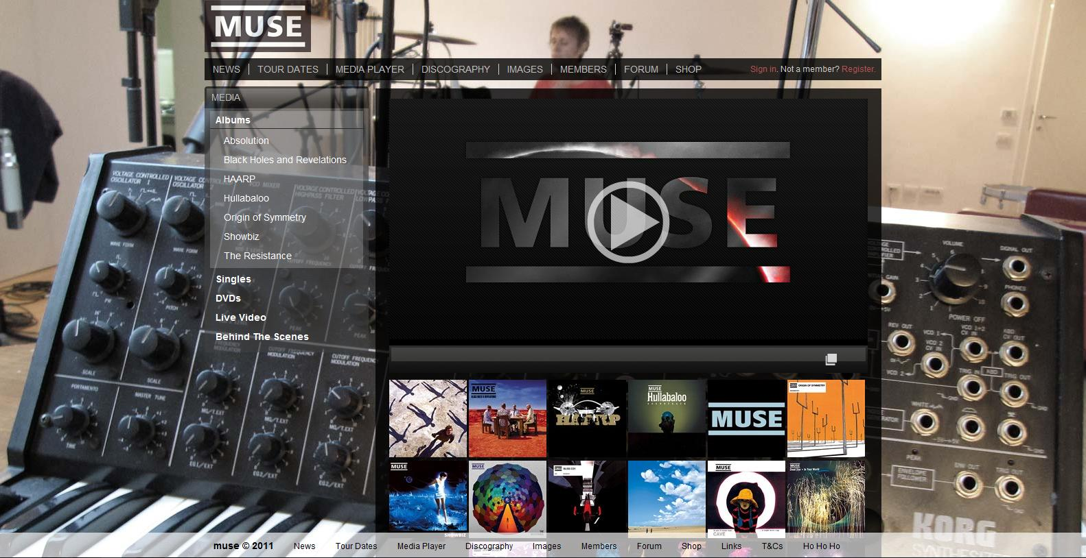
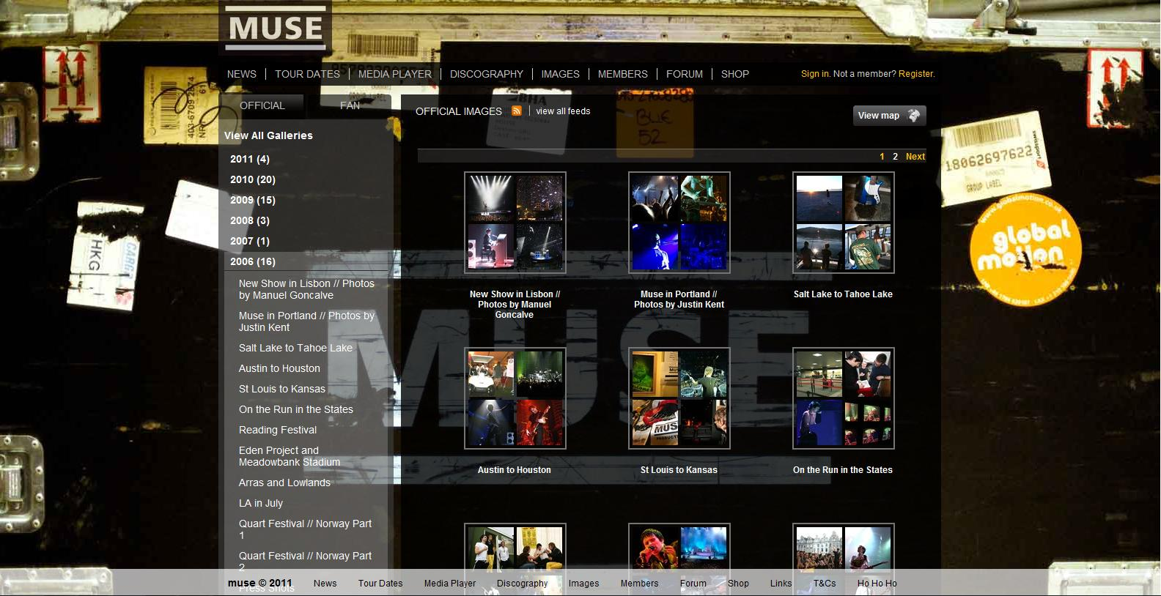
Functionality
Each tab opens up a new page with a sidebar.
The links on the sidebar open up after being selected to reveal more options.
Every picture on the right-hand side can be selected to view that piece of media.
Different pages have similar layouts.
This makes viewing every form of media easy.

Slide 10
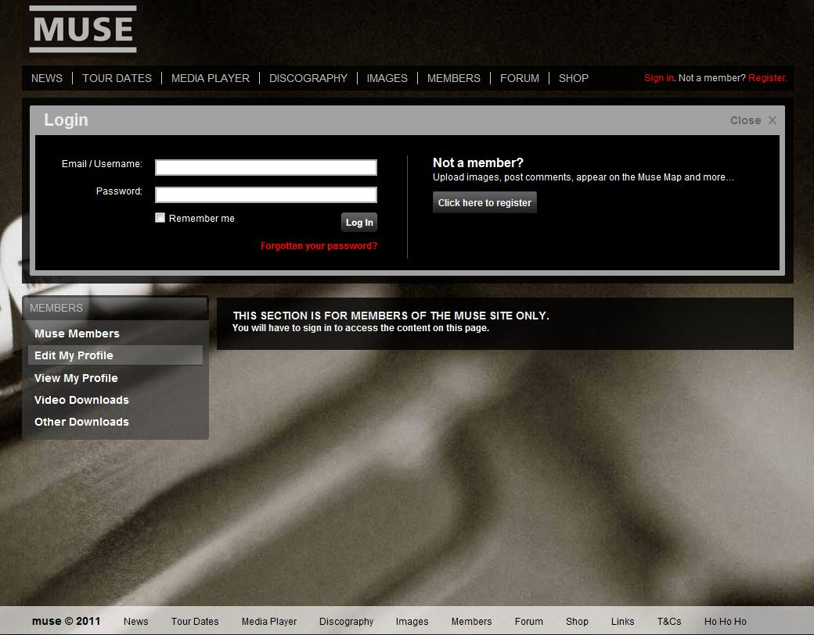
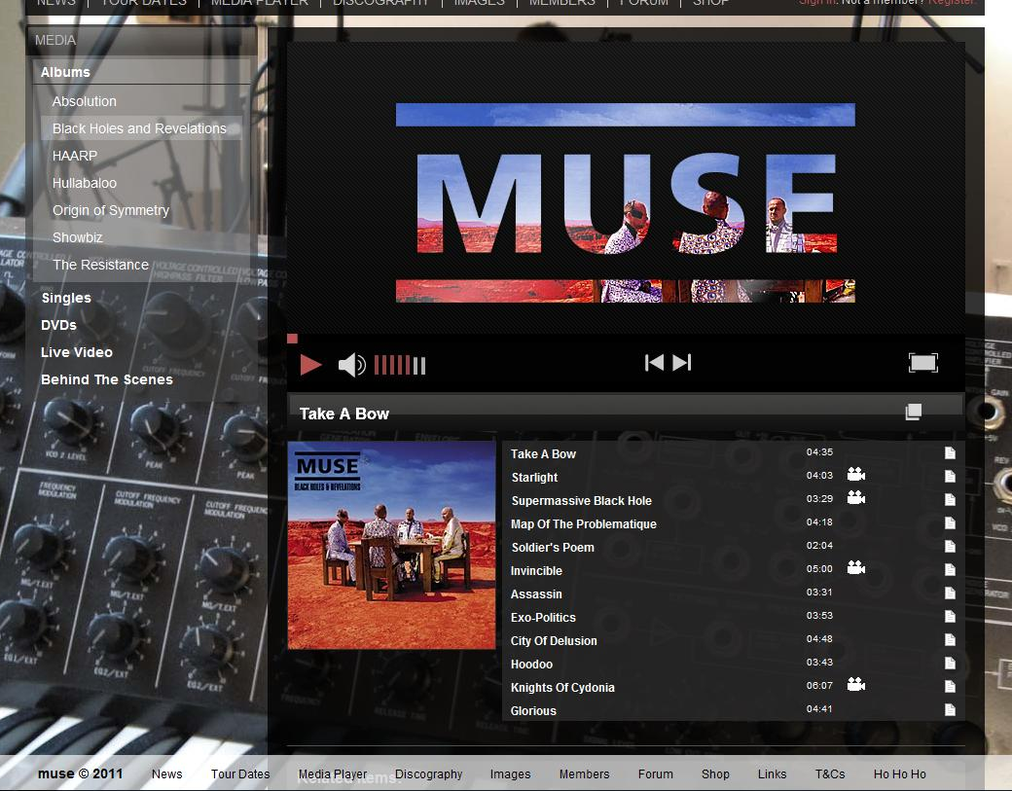
Interactivity
The top links are not highlighted when selected, but the sidebar selections are.
When the mouse falls on a link, it lights up.
Their video/audio streams allow you to see/hear what they do. You can select the song, album, change the volume, etc.
You can also join their network and socialize with other members.

Slide 11
Navigation
Top navigation bar is there on every page. Sidebars have drop-down menus that come down after selecting it.
Relatively easy to know where you are and where you can go.
There is also an extra navigation bar at the bottom.
It seems extraneous, but there are some extra links there that aren’t at the top.

Slide 12
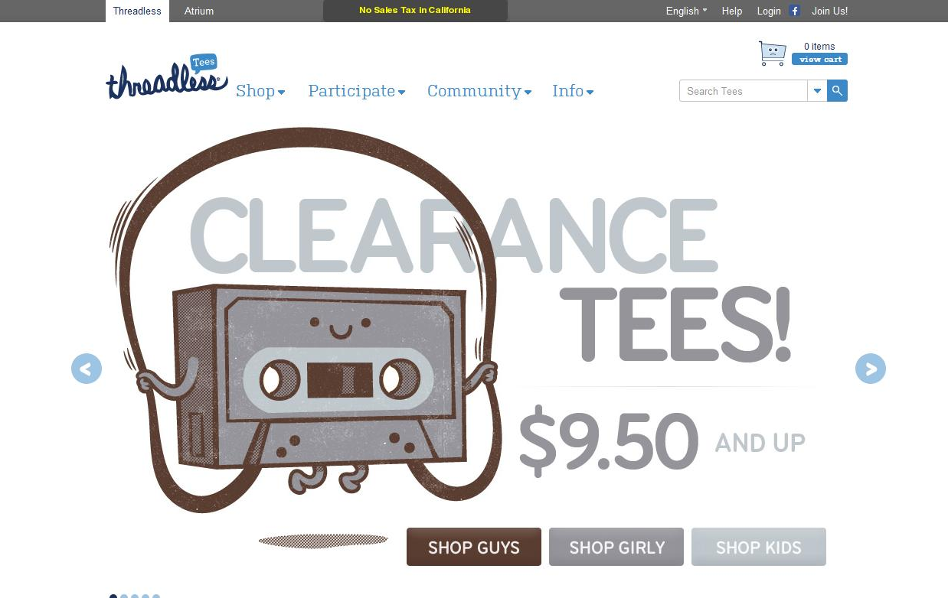
Threadless
www.threadless.com
Date Visited – 1/19/12
Layout - Custom (Five Boxes + Headline & Grid)

Slide 13
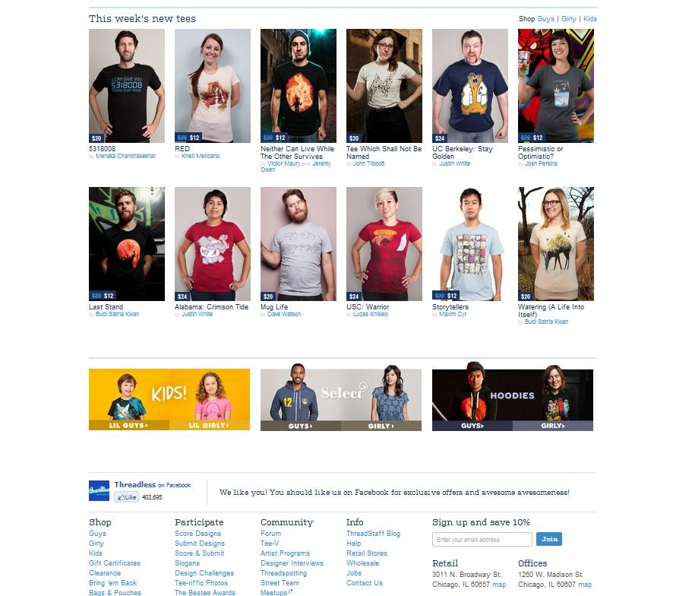
Brand
Fun – The art style on the shirts seems fun.
Artistic – Many creative designs
Social – Shopping, members, community tab. Encourages participation.

Slide 14
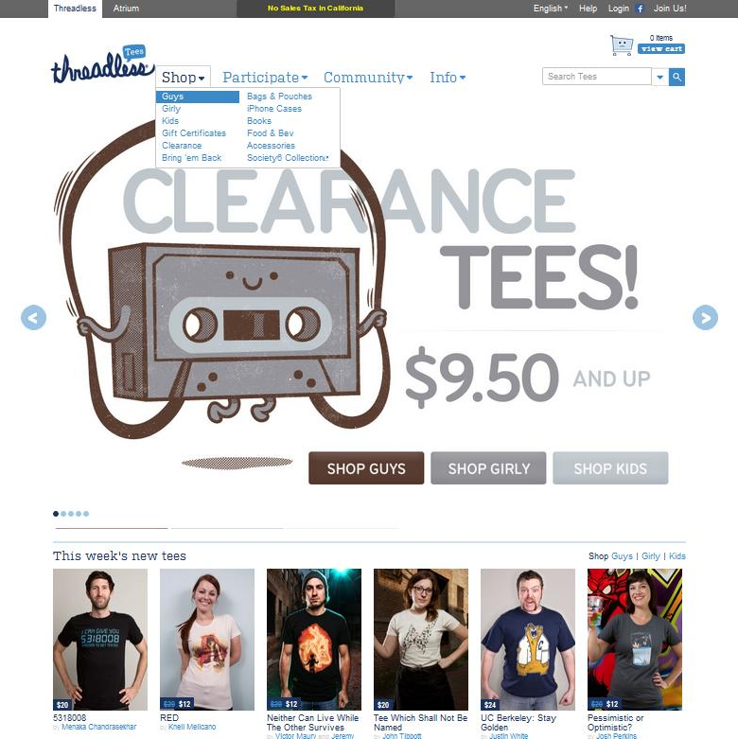
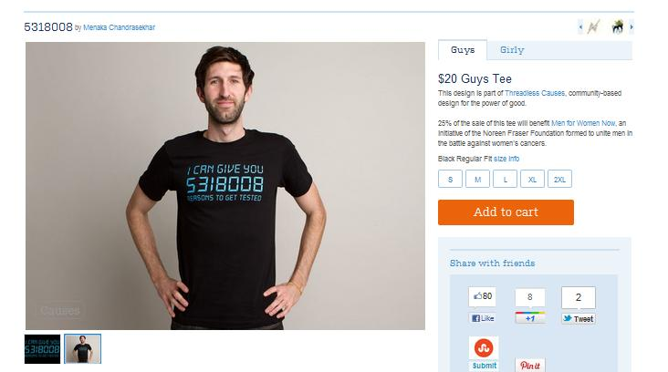
Functionality
The tabs have drop down menus to show what other products there are.
Shopping cart to keep track of sales.
The main image has links within it that you may browse.
A section displays the newest designs.
Selecting a shirt will bring you to a new page showcasing that shirt.

Slide 15
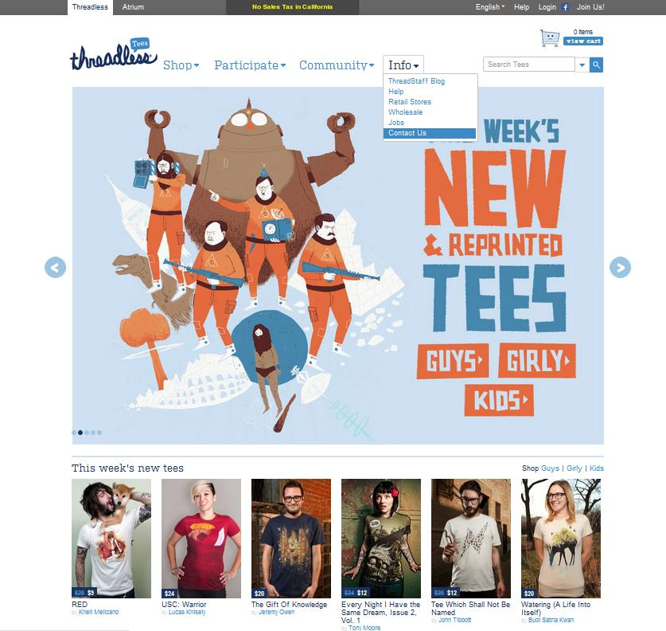
Interactivity
Main tabs have drop-down menus. Mouse-over highlights your selection.
There are arrows that you can select to scroll through the main images. You can also click the circles to browse.
The main image also has links to select.
Clicking on a shirt will bring you to a new page to show you more details about the shirt.
The top grey tab allows you to change the language. You can also join the community by registering with the site.

Slide 16
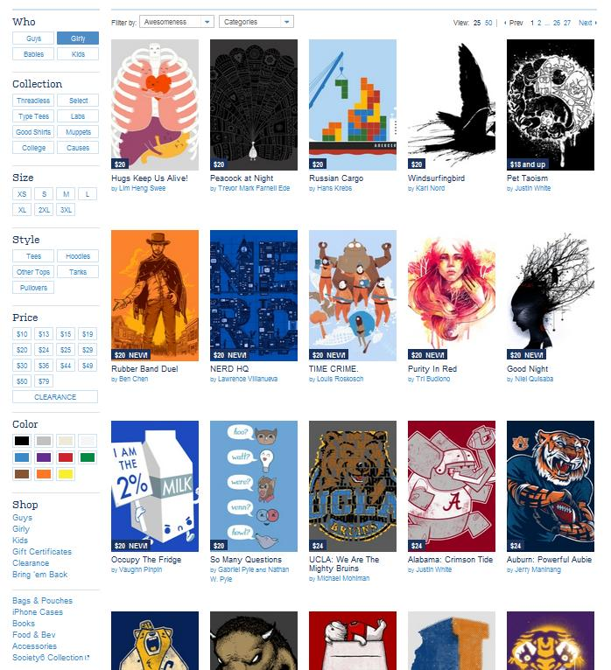
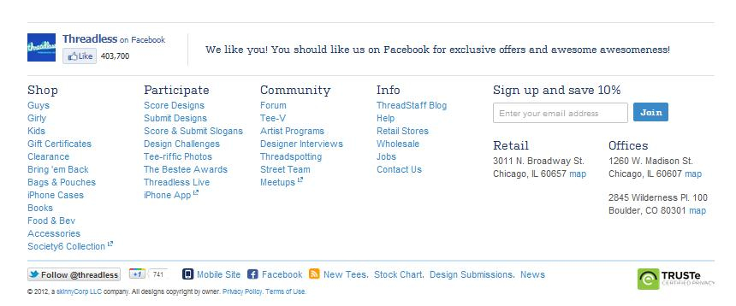
Navigation
Easy to find what you want. Selections are on the side tab for what kind of shirt you want, including size, color, etc..
Selecting a shirt will bring you to that shirt’s page.
You can also select the designer’s name to see more of his/her works.
You can browse through all the pages of shirts available.
There is also a section at the bottom of the site with every link.

