Slide 1

S&P 500 Stock Dashboard

Slide 2
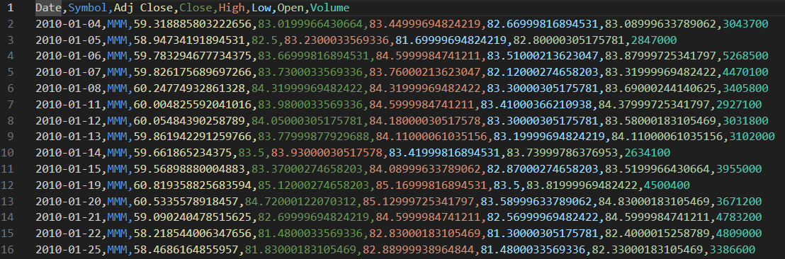
Sp500_stock.csv

Slide 3
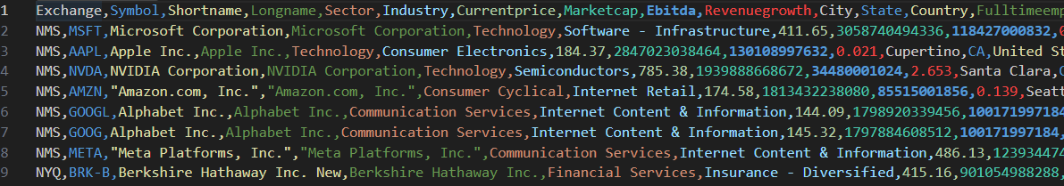
Sp500_companies.csv

Slide 4
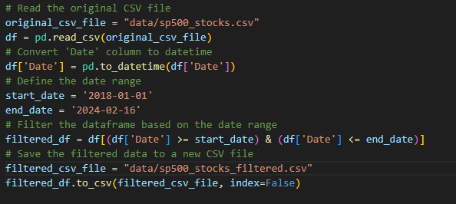
Data Filtering

Slide 5
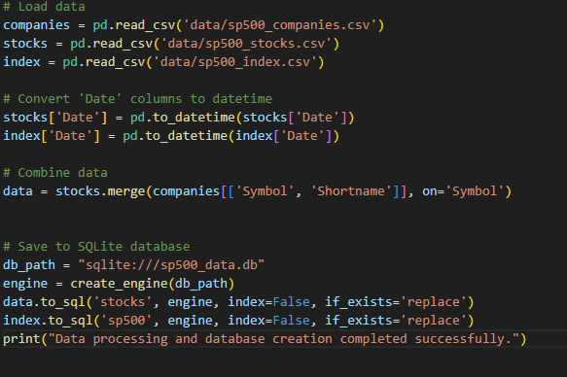
Creating Data base using sqlite

Slide 6
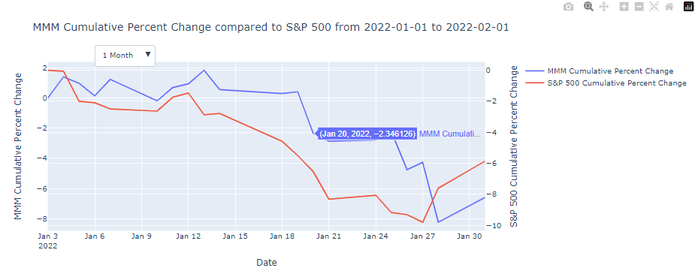

Slide 7
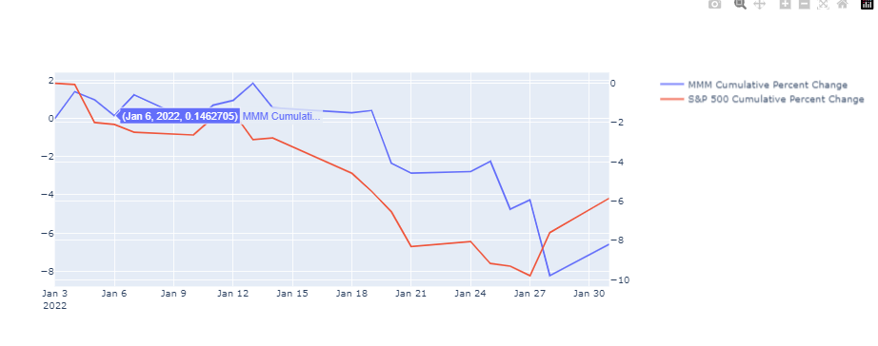

Slide 8
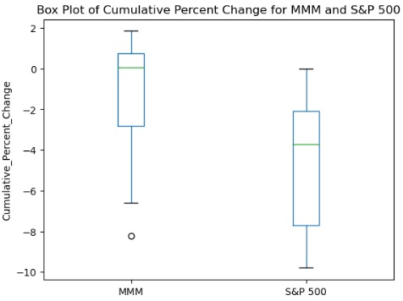

Slide 9
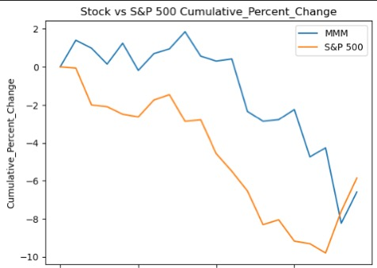

Slide 10
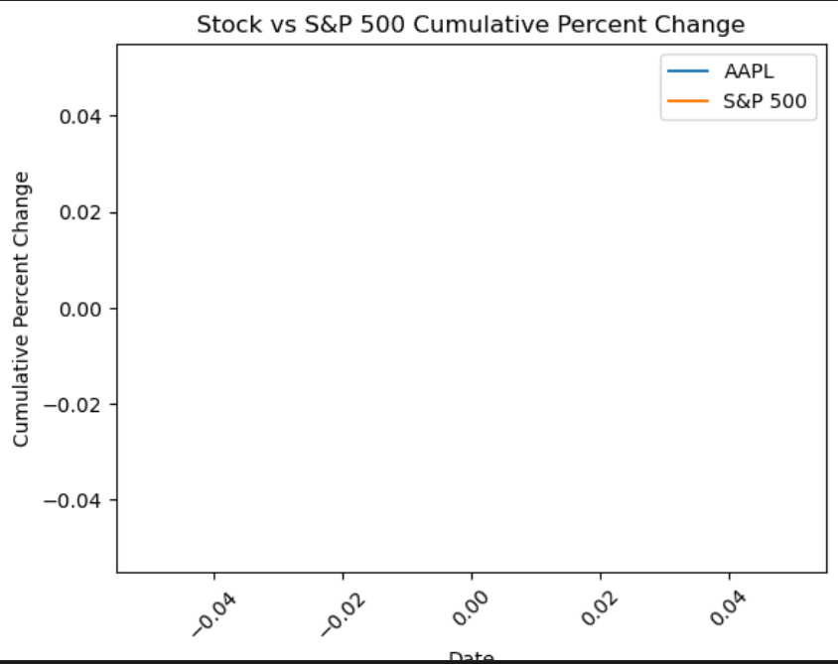

Slide 11
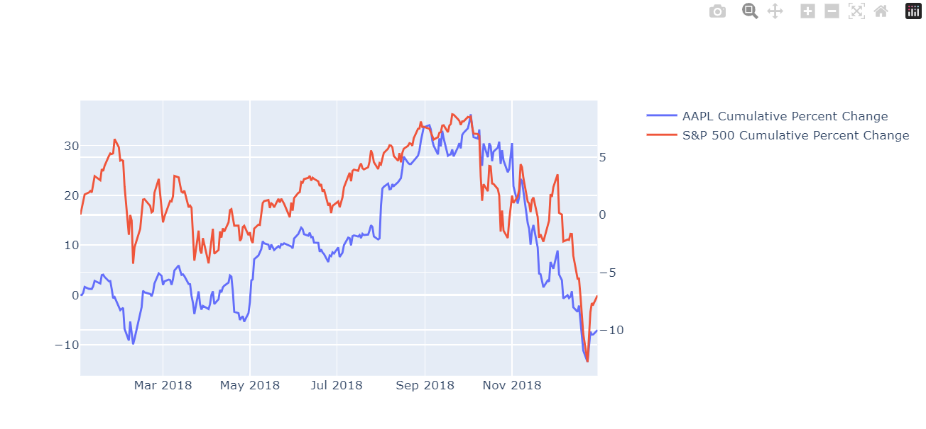
Using Plotly Plot

Slide 12
Creating App Using Dash
Dash is Python framework for building web applications. It built on top of Flask, Plotly. js, React and React Js.
It enables you to build dashboards using pure Python. Dash is open source, and its apps run on the web browser.

Slide 13
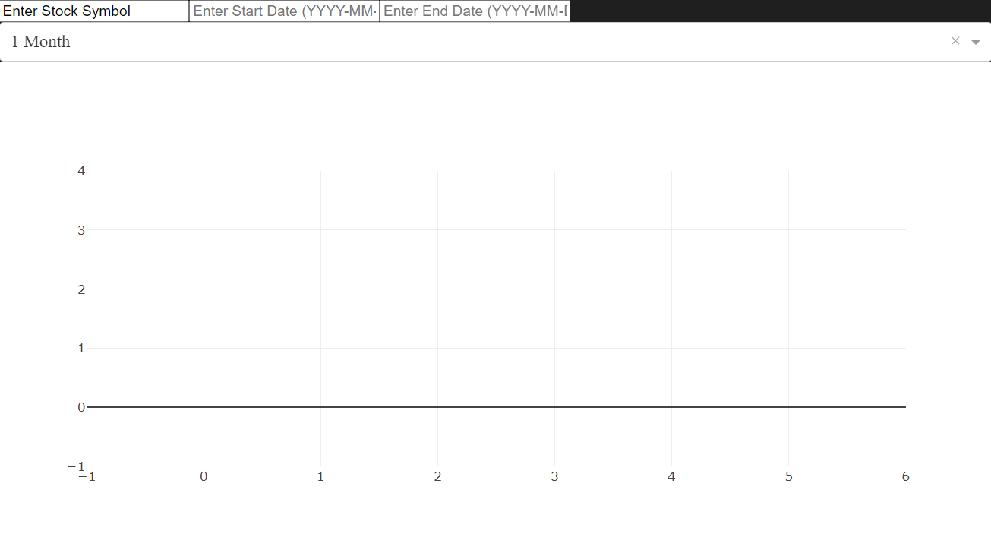

Slide 14
Conclusion
Can be very useful visualization for investors if all the functionality bugs are worked out.
Additional functionality that can be added is comparisons for more than two elements(Stocks and Markets etc…
Limitations – Database Size limited by github limited the amount of historical data stored.

Slide 15
Conclusion
Can be very useful visualization for investors if all the functionality bugs are worked out.
Additional functionality that can be added is comparisons for more than two elements(Stocks and Markets etc…
Limitations – Database Size limited by github limited the amount of historical data stored.

