Slide 1
World-wide Technical Alliance Management
Ray Zhan Su
Worldwide Technical Alliance Manager
July 3 2009, PKU

Slide 2

Topics
About the speaker
What is alliance
Alliance Examples
Alliance Process Example
Lessons and Tips
Other Potential Q&A topics
Notes:
HP Customers really want it all … leadership technology, lowest cost and best experience. In this presentation I will be discussing how we work with our partners to exceed our customers expectations.
I will summarize our partnering strategy and the put it into the context of our vision of the Adaptive Enterprise. It is hard to find a CIO today that is not worried about the business value of IT, or utilization rates of IT assets, or craving for better agility to keep up with business changes.
Finally I will review the details of a few specific partnerships to give you a sense of how our strategy becomes value delivered to our customers. Proof that we deliver that value is indicated in part by the leading position we maintain with our strategic ISV’s.
Other Misc speaker notes:
What is a solution? For our purposes I say that solutions are really a continuum. Perhaps on one extreme is the transformational business reengineering and outsourcing level of solution. On the other end, perhaps co-selling with solution ISVs.

Slide 3
About the Speaker
Worldwide Technical Alliance Manager HP
Other HP jobs: IT, Professional Services (HP HK)
Founding team member of PKU JadeBird, Daiyu, and GISOFT. VP Outsourcing at GISOFT
MSCS, the Chinese Academy of Science
BSCS, Peking University
Community leader in Silicon Valley. Vice Chair of PKUAANC board and co-director for the PKUAANC Entrepreneur and Executive (EE) club.

Slide 4

What is Alliance
What is Alliance
  Generate value through cooperation/partnership
Driving Force – Corporation Evolution and Alliances
  from managing a portfolio of products …
  To Managing a portfolio of businesses …
  To Managing a portfolio of relationships …

Slide 5
Strategic Alliances are Hot!
“This may be the most powerful trend that has swept American business in a century: Strategic alliances are hot.” -Matt Schiffrin, Editor, Forbes.com Best of the Web Magazine
There were 10,200 alliances created in 2000.
According to Accenture, in 1999 Alliances accounted for 26% of the average Fortune 500 Company’s revenues, up from just 11% in 1995. This figure is expected to reach 35% by 2005.
IBM’s Solution Providers Alliances contributed $4 billion to corporate revenues in 2001. $7 billion in 2003.
80% of top executives consider strategic alliances to be a prime vehicle for future growth and they expect alliances to account for an average of 25% of their companies market value within five years.

Slide 6
Alliances are Hot!
It is estimated that U.S. companies with at least $2 billion in revenues formed an average of 138 alliances from 1996-1999.
“In the decades to come, managers will either be part of an alliance or competing with one.”
  Paul Lawrence, Professor Emeritus, Harvard Business School
Companies having a dedicated alliance program have an average Stock Market gain of $77 million following Alliance Announcements according to Drs. Harbir Singh of Wharton and Jeffrey Dyer of Brigham Young University.

Slide 7
HP - Partnering for success
Delivering the most comprehensive set of solutions for transforming business and IT environments with our customers
We help you on the journey to an Adaptive Enterprise for today
We create innovation for tomorrow
We take an open, assertive and collaborative approach
  From executive level to business/product teams
Notes:
Together we help you build an Adaptive Enterprise today and create innovation tomorrow. Our integrated solutions offer reliable business value for your most immediate business needs while strengthening the enterprise for the long run
Together our alliance enhances your value through well defined teaming approaches that produce tangible results . Everything we do is guided by your business needs.
An open, assertive and collaborative approach to partnering starts at the executive level and proliferates down through the alliance teams all the way to business and product teams. Our integrated teams work with customers to optimize business results enabling you to be more adaptive.

Slide 8

HP and Partners Driving value
Through strong collaboration, HP and its alliance partners are:
  Driving the digital technology revolution
  Reducing total cost of ownership
  Providing new solutions
  Enhancing customer value
  Creating new markets
  Designing, developing and delivering superior, affordable end-to-end solutions
Notes:
Through strong collaboration, HP and its global alliance partners are:
Driving the digital technology revolution
Reducing total cost of ownership, providing new solutions to enterprise, SMB and consumer customers
Enhancing customer value
Creating new markets, business models and opportunities for revenue growth
Designing, developing and delivering superior, affordable end-to-end solutions that help businesses to be more profitable, more competitive and more agile.

Slide 9
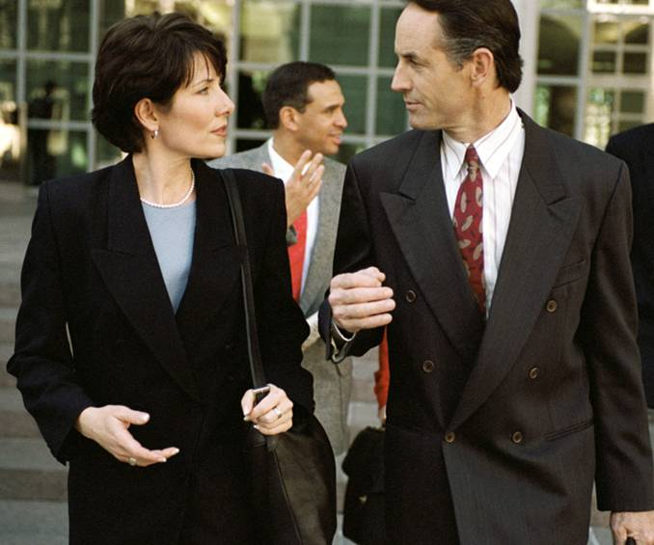
Collaboration is paramount
HP and its alliance partners share a common:
  View of customers
  Business strategies
  Desire to shape markets
Provide unique value with R&D investments
Combine the power of our joint capabilities
Deliver innovative solutions and rewarding customer experiences
Support open standards
Support a common collection of partners in Microsoft, Oracle, Cisco, SAP and others

Slide 10























Partnering with the best
Technology partners
Software partners
System
integration partners
Channel partners
Notes:
Every customer faces unique challenges and circumstances. Realizing the full benefits of an Adaptive Enterprise is not a cookie cutter, one size fits all journey. HP partners with corporations who are leaders in their respective areas to help drive the standards that enable adaptability, and to provide the flexibility and expertise to address your specific solution requirements. This slide notes a few key partners working with HP to help you simplify, become more agile and get a better return on IT.
Standardization is essential to developing adaptability in a heterogeneous environment. By teaming with technology partners, we both leverage and help drive standards that simplify integration and interoperability, and reduce costs. J2EE, .NET, WebServices management framework, Blades architecture, etc.)
HP’s partnerships with leading and best-of-breed software vendors assure you choice and flexibility of applications and operational model to solve your specific business problem. HP works with these partners to ensure performance characterization and optimization of their applications across your choice of hardware platforms and architectures. We extend the value of solutions based on partner software applications through Integration with enabling management software, support products/services, and services.
Systems Integrators bring complementary industry expertise that results in faster deployment. HP works with Integration partners to develop reference architectures and rapid deployment methodologies to increase supportability, and agility, and reduce the total cost of ownership of solutions. Through the combined strengths of HP and multiple partners, we are able to provide the right combination of business process consulting, implementation, and application management to address your requirements.
Finally, HP’s extensive network of Channel partners provides additional solution expertise and flexibility in how and from whom you choose to acquire, implement and support your solutions.
Partnering effectively enables HP to provide the right solution, through your choice of sales and delivery channel, at the right total cost of ownership and return.

Slide 11
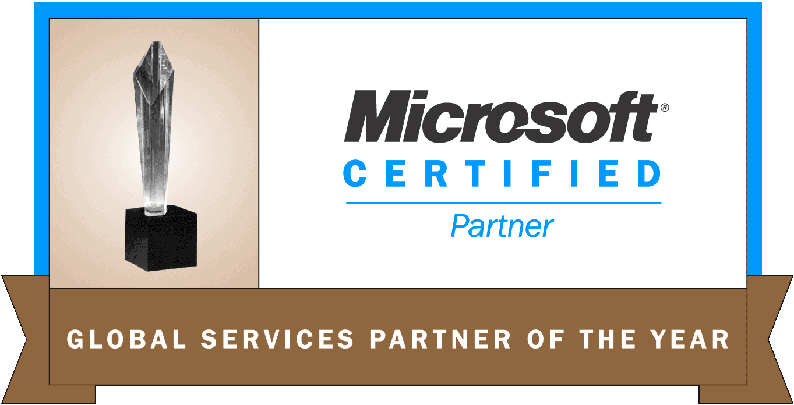
HP and Microsoft—Partnering to extend Windows farther into the data center
HP and Microsoft—20-year partnership, 8 years joint development on Itanium® 2–based solutions
HP servers—#1 position in Windows market-share revenue*
HP Integrity servers—Microsoft’s 64-bit development platform
HP’s enterprise Windows expertise helps to ensure that customers get maximum benefit from their Windows solutions
* Source: IDC Quarterly Server Tracker 3Q04
Notes:
More proof points of HP’s expertise in the enterprise Windows space…
World-leading SQL Server 2000 (64-bit) and application performance on HP Integrity servers up to 64 processors
Complementary HP Integrity and ProLiant server solutions delivered via an integrated and robust 32-bit and 64-bit Windows ecosystem
Based on joint engineering and collaboration, HP Integrity servers deliver best-in-class 64-bit solutions with major Windows ISVs, including Microsoft (SQL Server), SAP, and SAS

Slide 12

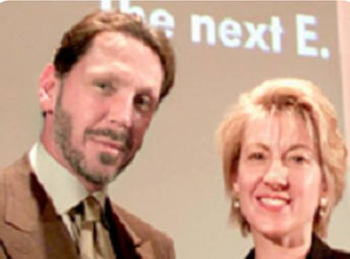

HP/Oracle alliance
Executive alignment
25 years of collaborative partnership
More Oracle database customers use HP systems than any other vendor
88,000+ combined customers
$6 billion business
400 HP people dedicated to Oracle
13 worldwide technology & competency centers
Extensive R&D and Technology investment
Notes:
How strong is this alliance? Well it starts at the top. If you know anything about Oracle, you know that if you do not have Larry Ellison's mindset and mind share, your relationship will not be at a strategic level. As reported in the San Jose Mercury News, Larry himself takes credit for bringing HP together with Compaq. Based on his conversations with Compaq about building clustering into their future products, Larry picked up the phone to make Carly Fiorina aware that this technology was worth talking to each other about. While this is now history, the executives continue to hold their regularly scheduled twice yearly summits, where they agree upon the high level activities and strategies for the two corporations.
Over a 25-year period, this working relationship has extended from the boardroom – to engineering -- sales – consulting – support and more. In fact, more Oracle database customers use HP systems that any other vendor and over 70% of HP-UX customers run Oracle. These 88,000+ combined customers represent a $6 billion business when you look at the entire ecosystem of servers leveraged, storage leveraged, training, service support and delivery. This is why Oracle is now designated as a DNA partner with HP, and gets all the attention that's necessary to provide customers with the confidence and assurance that buying Oracle and HP is the right decision.
To support this, the HP/Oracle alliance team is 400 people strong, and includes 13 worldwide technology and competency centers, which we will tell you more about in awhile.

Slide 13
HP Oracle Solution/Product Mapping
The Adaptive Enterprise
Business objectives and strategy
Enterprise Management – HP OpenView*
Oracle integration with HP OpenView Web Services
Oracle Enterprise Mgmt Solution
IT business management
Business services
Application services
Oracle Application Server 10g
Oracle Applications & Collaboration Suite
Infrastructure services
ProLiant Essentials
GWLM
Oracle integration into UDC console
Service delivery management
Service delivery
Enterprise storage*
Oracle Storage Compatibility Program (OSCP)
Workload Manager
ProLiant*
Blades*
Superdome*
OS*: UX, Linux, Windows, VMS
Network components
Itanium*
Oracle 10g Database
Oracle Real Application Clusters
Clustering*
  TruCluster
  MC ServiceGuard
Enterprise Services* leadership – availability, deployment, and performance services
Joint Services

Slide 14
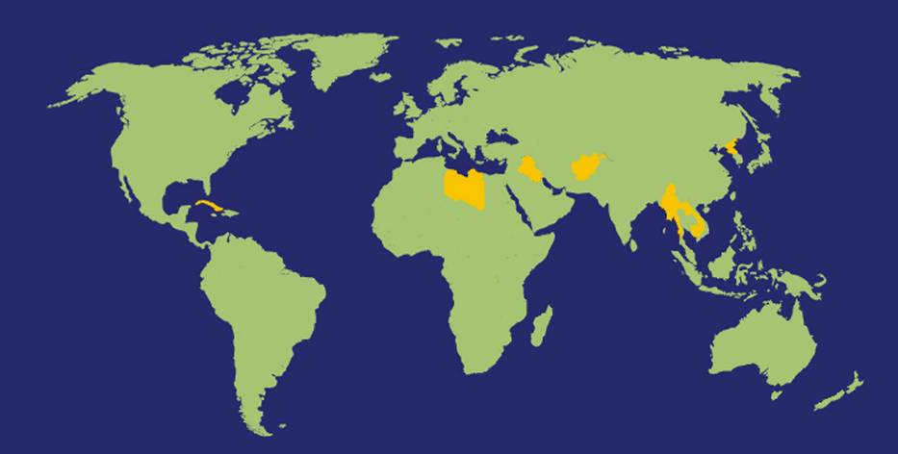
HP/Oracle alliance centers around the world
Technology center
Technology center
Technology center
Competency center
Competency center
Technology center
Technology center
Technology center
Technology center
Technology center
Technology center
Technology center
Technology center
Notes:
Another way that HP helps you, our customers, is our investment in technology and competency centers. What’s the advantage? Well, when customers like AT&T come for two to three months, they bring their entire data and application stacks. We set up environments that will simulate how they will be able to achieve the performance goals set forth in the pilots (e.g. for doubling the size of their business.). In the case of AT&T, they wanted to see how HP was going to actually take them from 800,000 transactions per second to three million transactions per second. Thanks to the competency center, we were actually able to shift and try different combinations of hardware and storage and backplanes to achieve that level of performance.
Quite simply, no other platform partner for Oracle has the technical breadth and depth to do that level of work with Oracle.

Slide 15
HP & Partners – Better Together
Collaborating with our customers and partners on the journey to:
  Improved quality of service
  Increased agility
  Mitigate risk
  Manage costs
Enabling the Adaptive Enterprise with our Partners
Notes:
Delivering the best Return on your IT Investment by working closely with our partners to deliver highly flexible solutions with the level of accountability that you need/desire.
greater business value from IT investments for our customers
leadership in platforms and infrastructure services
worldwide partnering and solution value chain
leading position with partners to drive industry standards
collaborative versus competitive approach
flexibility and choice
innovation
best-in-class solutions

Slide 16
More Alliance Examples
HP and webMethods (now SoftwareAG)
HP and SeeBeyond (now SUN)
HP and ATG

Slide 17
HP & Partners – Better Together
Collaborating with our customers and partners on the journey to:
  Improved quality of service
  Increased agility
  Mitigate risk
  Manage costs
Enabling the Adaptive Enterprise with our Partners
Notes:
Delivering the best Return on your IT Investment by working closely with our partners to deliver highly flexible solutions with the level of accountability that you need/desire.
greater business value from IT investments for our customers
leadership in platforms and infrastructure services
worldwide partnering and solution value chain
leading position with partners to drive industry standards
collaborative versus competitive approach
flexibility and choice
innovation
best-in-class solutions

Slide 18


delivering partner value
ISV partner lifecycle with hp
recruit
package
incubate
organized around ISV needs:
IP integration and support
sales engagement
demand generation
channel access
grow
renew
Notes:
HP is investing in ISV partner resources to address the partner relationship across its entire life-cycle. In this way, we’re building long-term value for everyone not just HP but for the partner & our joint customers.
How do we do it? Following initial recruitment, HP applies technical resources to port, tune, benchmark, and certify ISV software.
ISV-focused sales consultants identify joint sales funnel opportunities with partners … and work with them to sell and deliver reference accounts. While at the same time getting HP and the partners regional sales teams linked together for future efforts.
HP’s end-user sales force is also now compensated on co-selling results with ISVs. As a result, HP’s ISV sales funnel has grown 25% in the last quarter. Not bad, for a slowdown…
Building long term value necessitates that we create the right partnerships, for the right reasons, and that we invest appropriately to create and extract the value. HP is investing in ISV partner resources to address the partner relationship across its entire life-cycle.
How do we do it? Following focused initial recruitment, HP applies technical resources to port, tune, benchmark, and certify ISV software. (Portal, PTACs, PCES)
ISV-focused sales consultants identify joint sales funnel opportunities with partners … and work with them to sell and deliver reference accounts.
As HP’s the business relationship with the ISV evolves, both parties look for ways to add additional value. IP integration, new sales and marketing initiatives all increase the value to our customers, and therefore to our partnerships.

Slide 19
Lessons and Tips
Alliance is generating values
Alliance is about process
Alliance is about relationship
Alliance is balance of win/lost.
Confidentiality
Innovation
Horizon functions
Political

Slide 20
Other Sharing and Q&A topics
Hard skills and career path for various technical jobs
  Research (R&D lab) - concept (scientist), CTO
  R&D – product (project/program mgmt, architecting, design, code, QA, sys admin, ATC, technical alliance, product manager), lab manager, VP engr, CTO
  Marketing (product manager, technical marketing manager, etc) marketing mgr, CMO
  Information Technology – internal application (proj mgmt, dev, support), IT engr -> IT manager -> IT director->CIO
  Pre-sale/SE – selling to customer, SE, Sr SE, Architect
  Professional Services (architect, consulting and integration) – implementation for customer, technical consultant, sr. consultant, managing consultant, principal consultant
  Customer Support – post-sale support (account and program management, escalation mgmt, from helpdesk to deep level support, ATC), support engineer, manager, director, etc.
Other soft skills
  Self-awareness (culture, personality, interests)
  Communication
  Personal branding
  Project management
Where to learn them, on the job training

Slide 21
Other Sharing and Q&A topics
Other supporting resources when you working at Silicon Valley Corporations
  Asian Employee Resource Groups (http://www.caaen.org)
  Alumni Organization (http://pkualumni.org)
  Chinese student association at your university (Stanford etc)
  Other professional associations
  Other Chinese communities

Slide 22
Backup Slides

Slide 23
Alliance Definition
Legal Definition
  Cooperative Business Relationship
  formed by two or more separate organizations
  for strategic purposes
  that allocates
    ownership,
    operational responsibility,
    financial risks and rewards to each member,
  while preserving their separate corporate identity/autonomy
Functional Definition
  Synergistic (1+1>3) & Aligned
  Strategic - Affects Long Term Destiny
  Tight Operating Linkages
  Interaction at Multiple Levels
  Win-Win
  Top Rank Support
  Reciprocal Relationships
  Sharing Strengths & Information
  Collaborative Management Style
Joint Venture: Separate Organization & Management

Slide 24




Corporate
Mission
Strategy &
Goals
DRIVING FORCES
Strategic Synergy
1+1=3
Alliance
Strategy
Alliance
Development
Pyramid
Driving Forces
Corporate Impact
Alliance Strategems
Value Proposition Champions
Phase 1
Alliance Analytics
Phase 2
STROI Financial & Risk Analysis
3- D Fit Value Chain Re-eingineering
Right Partners Due Diligence
Negotiations/Co-Creation
Strategy Drive Function
Form Follows Function
Phase 3
Negotiations Team Co-Creative Model Deadly Sins
International Issues Value Creation Power & Control
Legal Process Statement of Principle and Memorandum
Operations Planning & Integration
Phase 4
Differentiation — Integration HR Support
Interface Management Team Development Operations Plan
High Performance Design Breakdown Analysis Alignment
Structuring
Phase 5
Balancing Risks, Responsibilities, & Rewards Governance & Control
Organizational Structure Financial Structuring Legal Agreements
Alliance Management
Phase 6
After the Honeymoon Alliance Roles Managing the Win/Win
Creating a Collaborative Culture Performance Measurements Fastime
Phase 7
Transformation
Managing Shifts & Changing Drivers Expansion Breakthrough Creation
Capability Building Portfolio Management Regeneration Spinouts Exit

Slide 25


Will You Be a
Great Alliance Partner?
Great Partners:
  Visionary
  Creative
  Flexible
  Innovative
  Fast Moving
  Fair
  Integrity Centric
  Win/Win Focused
Poor Partners
  Arrogant
  Controlling
  Bureaucratic
  Culture Bound
  Slow
  Win for Own Company Focused

