Slide 1
Prepare yourself, be yourself
春季《职业规划与领导力发展》
周晓剑 2014/06/16

Slide 2
Where to start: Vision!Vision!Vision!
Vision的百度翻译：
vision 英['vɪʒn] 美[ˈvɪʒən]
n. 视力,视觉;美景,绝妙的东西;幻影;想像力
vt. 在幻觉中看到;幻想,想象;梦见
名词复数:visions
[例句]Whose responsibility is it to set the vision of the company? 谁负责制定公司的愿景？
Vision即理想和自我定位

Slide 3
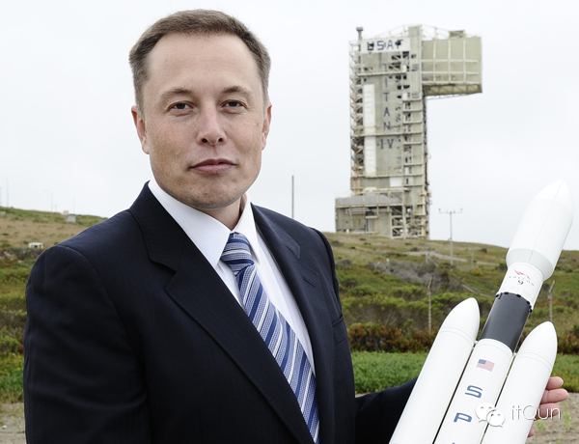
创业者:从传说的形象到现实(1)
传说中的创业者形象：Elon Musk
Execution(实践者)
Entrepreneurship(创业者)
Vision(洞察力)
Think Big & Impossible(梦想家)
RiskTaker(冒险家)
Perseverance(坚持)
A Journey with Pains and Gains(痛并快乐的创业旅程)

Slide 4
创业者:从传说的形象到现实(2)
现实中的创业者们
Execution: People management & fund raising
Entrepreneurship: IPO or not
Vision:
Core Excellence: 12306
Disruptive Innovation: To move IBM’s cheese
Think Big & Impossible: Too far or too big?
RiskTaker: Weiming Angels
Perseverance: To survive & wait for luck
A Journey with Pains and Gains: Weiming Angels

Slide 5
创业者:从传说的形象到现实(3)
现实中的创投者们:未名天使
Execution: 执行力
Entrepreneurship: 投资于创业者, 而不光是产品
Vision: 独创性
Think Big & Impossible: 现实性,赢利能力,概念能否被认同
RiskTaker: who & what
Perseverance: 投后不想
A Journey with Pains and Gains: enjoy journey not result

Slide 6
Prepare yourself：Habits & Attitudes
Vision ends up with action plan
执行力体现在良好的习惯上
对工作,对人,对世界的态度

Slide 7
Be yourself
对世界的态度, 其实就是对自己的态度
做一个坚韧的人

Slide 8
附录

Slide 9
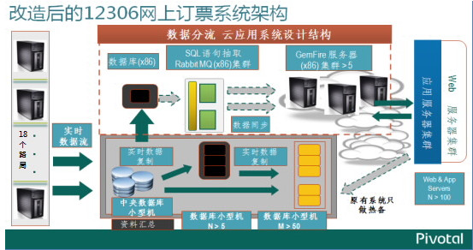
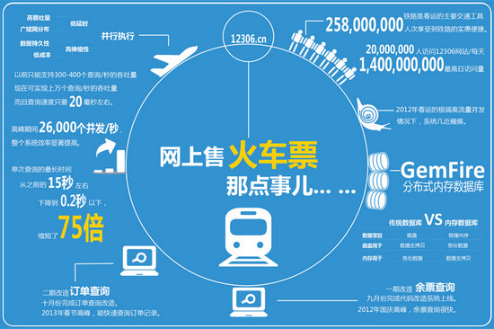
12306

Slide 10
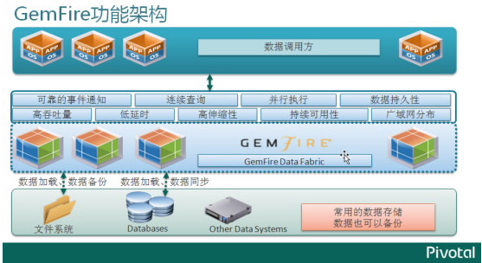
GemFire

Slide 11
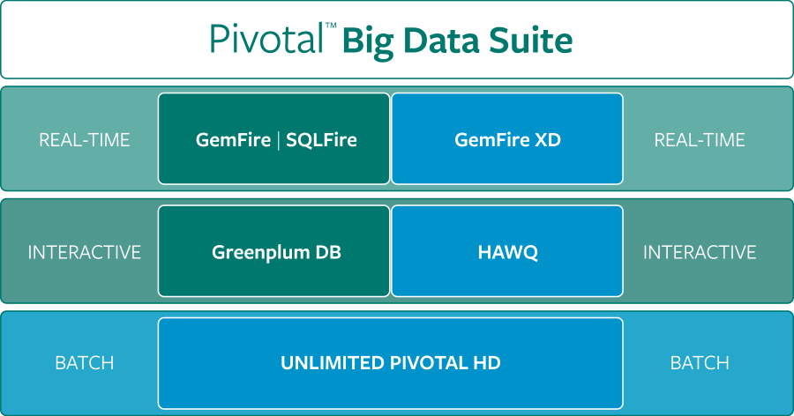
Pivotal BigData
Others: Cloud Foundry, RabbitMQ, Spring, PCC/ICM

Slide 12
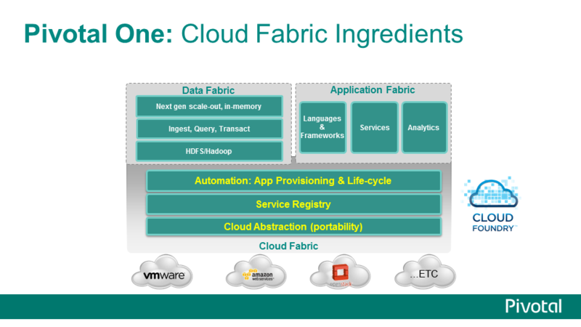
Android of Cloud

Slide 13
Performance results on HAWQ, Hive and Impala
Query Type | HAWQ | HIVE | SpeedUp | Impala | SpeedUp
user intelligence | 4.2 | 198 | 47x | 37 | 9x
Sales analysis | 8.7 | 161 | 19x | 596 | 69x
Click analysis | 2.0 | 415 | 208x | 50 | 25x
Data exploration | 2.7 | 1285 | 476x | 55 | 20x
BI drill down | 2.8 | 1815 | 648x | 59 | 21x
Facebook’s new query engine Presto: 7x than HIVE, similar as Impala

Slide 14

To move IBM’s cheese

