Slide 1
FOSS
Has everything to do,
An idea hacking talk,
Use it and make the real use of your priceless time you have !
Paras Kuhad

Slide 2
0. Psychology of things, and why it matters
1. I would start with asking a question to you
2. The problem of levels
3. If you guys want to do really good, then how foss comes here and How it works
4. Alright, who is doing open source ? Case studies ! The biggies
5. How simple ideas are and how powerful their impact is ! Case studies ! One man army
6. How to start ?
7. Start solving problems and get familiar with stuffs you really care about
8. Free is about freedom, freedom is about greatness and great things are $$$
9. Solving complex problems isn't enough
10. What is the cost to start
11. The last word

Slide 3

0

Slide 4
0 «
Psychology of things, why it matters !

Slide 5

This guy is holding papers to read his talk ! Yuk

Slide 6

I told you Psychology matters ! This is how we think about things
So true

Slide 7
That's how billions of facebook likes are generated each day
That's how billions of tweets are generated each day
That's how you write your sentiments on social networks and like pages which are either funny or either talk about 'heart touching' sentiments

Slide 8
1

Slide 9
1 «
Let's ask a question

Slide 10

Oh God Why !!

Slide 11

Are you guys really doing good ?

Slide 12
2

Slide 13
2 «
The problem of levels

Slide 14

This not my level !
I am not supposed to worry,
I and Infosys are made for each other.
Hail Shakuntla Devi

Slide 15
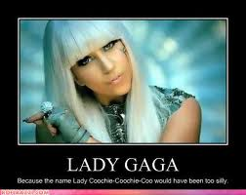


Slide 16
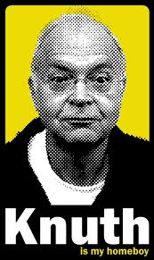
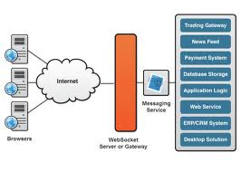

Slide 17


Slide 18
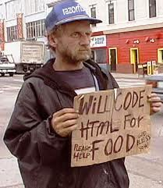
Comapnies calling me

Slide 19
We really care about things which really interests, or we are really interested in
So the problem of level is a fake problem
this is a straight forward excuse made by you and made for you.

Slide 20
The only thing which matters is how long you be with one problem, how passionate you are about it
how deeply you want to solve it
So wouldn't it be great if you work with your interests !

Slide 21
3

Slide 22
3 «
So, you want to do great, How FOSS helps

Slide 23
the greatest wisdom of this earth has been exposed on internet
We study open source every day, we study shared wisdom

Slide 24

Code is shared to make it more awesome to make it more usable to make it such so that more and more people can use it and only credit goes to you.
Y U No !!

Slide 25
4

Slide 26
4 «
Alright, who is doing open source ?

Slide 27

Who Not !!

Slide 28





Slide 29
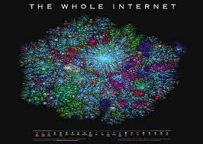

Future is open source

Slide 30
5

Slide 31
5 «
How simple ideas are and how powerful their impact is

Slide 32
Memcached : Caching system
Jquery : Awesome javascript library
Linux was a fun project , now red hat is 1 billion dollar company
Drupal -> Acquia
Even simpler ideas in nature has more impact
1000memories.com
Reddit, Hacker News
These are a few

Slide 33
6

Slide 34
6 «
How to start !!

Slide 35

Just tell me, How to start !!

Slide 36
You will have to figure out what problem you want to work on.
Learning things without a target doesn't make sense
You learn a stuff while doing it,
You don't want to think too big from the first day
beautiful things are simple in nature
Starts from simple things

Slide 37
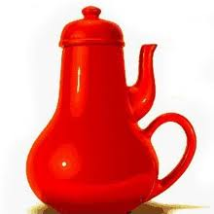
Just make useful things !

Slide 38
Lurk into community things, those are similar to your passion.
Use their experience, and already shared wisdom
don't re-invent the wheel, make genuine things

Slide 39
7

Slide 40
7 «
Start solving problems and get familiar with stuffs you really care about

Slide 41
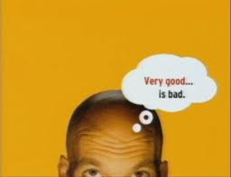

Slide 42
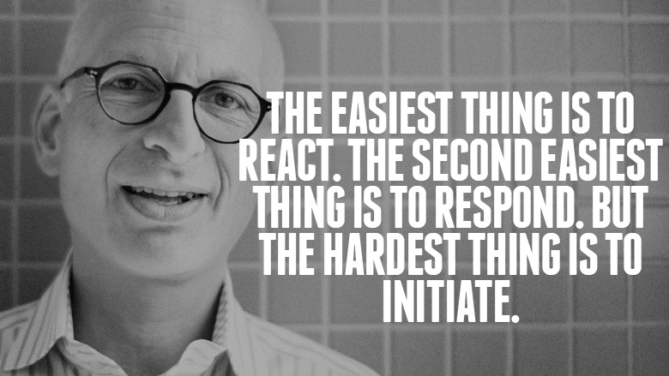

Slide 43
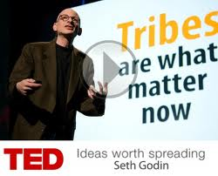
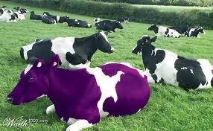
Lead your Tribe !!
Be the purple Cow

Slide 44
8

Slide 45
8 «
Free is about freedom, freedom is about greatness and great things are $$$

Slide 46
Free is not about $$
Free is ton about $$

Slide 47
Money != Creativity : you can end up filling excel worksheets with B Tech
but ,
Creativity = Money
Creativity = Hell lot of money !

Slide 48
you have some idea you can execute that with the help of FOSS, and what's the cost : practically zero dollars
yum install httpd
service httpd start > > > > > >

Slide 49
9

Slide 50
9 «
Solving complex problems isn't enough

Slide 51

You have to have use case !!

Slide 52
You have to have a use case, Its fun doing things you love,
but if you want to make a real world impact you have to have a use case
Make something which is useful
Other people can use it.

Slide 53
10

Slide 54
10 «
The Last word

Slide 55


Slide 56
You need to be creative,
You need to think out of the box,
You need to learn state of the art,
You need to learn what already is there,
Things which are great, are easy , but they take some time,
Overnight success means there has been a great work behind that

Slide 57
Thanks,
Questions Please

