Slide 1
Predict Default Loans with Lending Club Data
Hugo Yu
08-12-2020

Slide 2
Introduction
Build a tool to help the lending club investors to make better-informed decision on note choice
2007 to 2018 Lending Club historical data
GOAL
ANALYSIS
Results
Logistic regression, random forest, and gradient boosting tree
The model was able to predict the default loan with AOC score around 0.72 and the top important features were identified

Slide 3
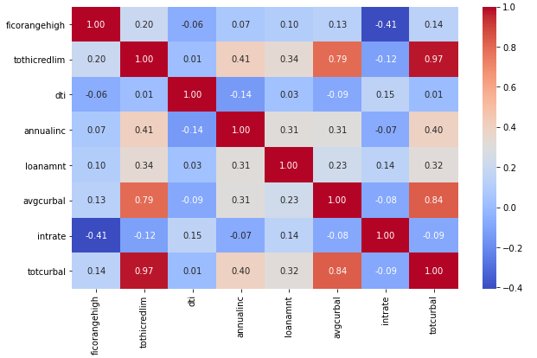
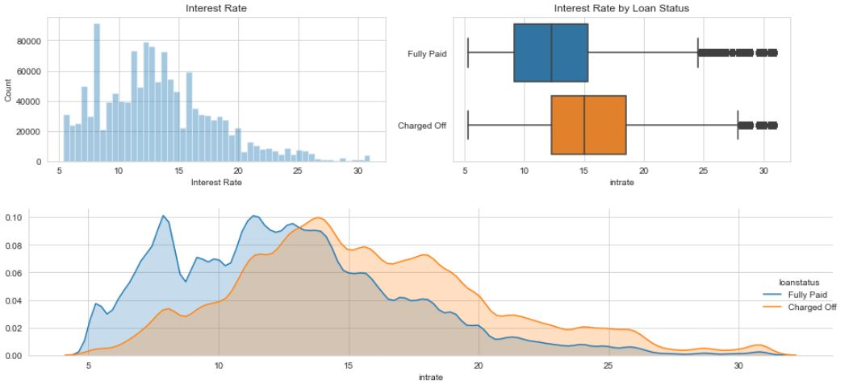
EDA and Data Preprocessing
Data description
historical 2007-2018
2260701 loans
150 associated features
latest note data by api
Feature Selection
field match
missing data
highly correlated features
zipcode and text features
Feature Engineering
label encoding
one-hot-encoding
Correlation heatmap
Interest Rate

Slide 4
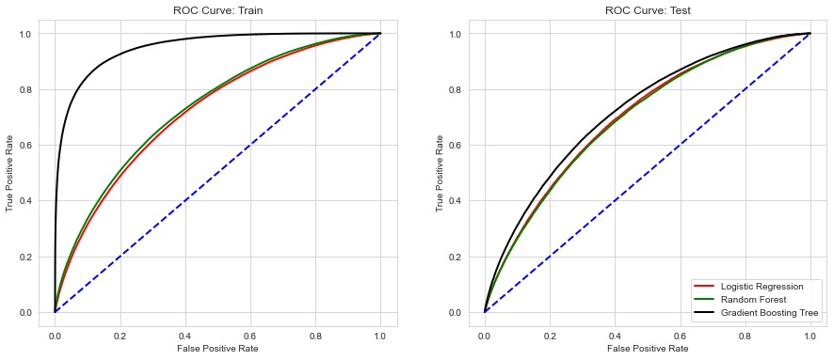
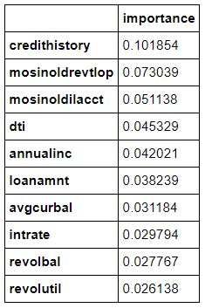
Model Training and Evaluation
Model Performance
Train/Test data split
train: test at 8:2
Model Selection
Logistic regression
Recursive Feature Elimination
Random forest
Gradient boost tree
feature importance
Top factors
In training dataset, GBT has the significantly higher AUC score than the other two. However, the GBT score is only slightly higher in test, indicating that the model is likely overfitting.

Slide 5
Summary and Future Work
The current model was able to predict the default loan at an AUC score around 0.72
The top 5 factors:
credit score
months since the oldest revolving account
months since the oldest installment account
borrower's installment to debt ratio
and borrower's annual income
Relate the zipcode feature to more meaningful information
NLP analysis for text feature
Fine tune the model
Use FLASK to create an online tool
Project details: https://github.com/pkuhugo/Fintech_Lending_Club/blob/master/20200705_lc.ipynb

