Slide 1

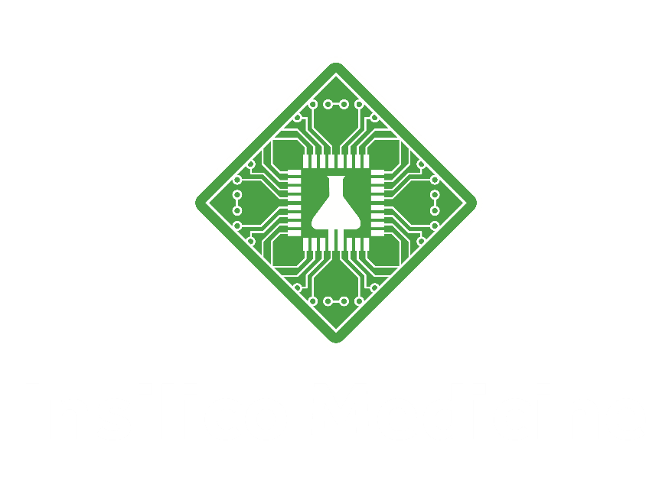
Macrocyclization Platform
2021.05.28

Slide 2
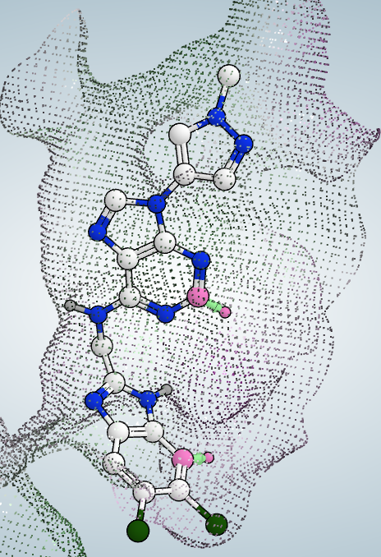
Macrocyclization Platform
Goal of macrocyclization platform: generation of macrocyclized hits
Macrocyclization Platform
Identification of similar macrocyclization pattern
Query binding mode
ab initio prediction of optimal macrocyclization
Identification of macrocyclization pattern
PDB Databank
Macrocyclic ligands database
Linker generation
Conformation sampling
Macrocyclization pattern sets
Pattern
Output:
Specific linkers
C
H
Output:
Linker length
Similar patterns
“rmsd”-based alignment
H
C
Two atoms and two angles

Slide 3



PDB structures with macro-cycle ligands
Molecules in RCSB PDB
Molecules with macro-cycle
PDBs with macro-cycle ligands
Nearby structures of macro-cycle ligands
http://ligand-expo.rcsb.org/
http://ligand-expo.rcsb.org/
Macro-cycle: maximum ring size >=8
Nearby: minimum distance between the coordinate center of a residue and the ligand <=10 angstrom
Structures with multiple models are taken the first one only.
Result location on cluster: /data/macrocycle_ligand_pdb

Slide 4
Process ligands in PDB structures
Ligand in complex
CIF/PDB
Ligand
CIF/PDB
Ligand
PDB
Ligand
SDF
Link option enumeration
Link option search
PDB → SDF
Issue:
N with 4 bonds → N+1
C with 5 bonds → 4 bonds

Slide 5
Enumerate link options at each macrocycle of a ligand
[20, 21, 22, 24, 25, 26, 27, 3, 4, 14, 19, 18]
20→21
20→18: [20, 21, 22, 24, 25, 26, 27, 3, 4, 14, 19, 18]
18→19: [20, 21, 22, 24, 25, 26, 27, 3, 4, 14, 19, 18]
19→14: [20, 21, 22, 24, 25, 26, 27, 3, 4, 14, 19, 18]
14→4: [20, 21, 22, 24, 25, 26, 27, 3, 4, 14, 19, 18]
4→3: [20, 21, 22, 24, 25, 26, 27, 3, 4, 14, 19, 18]
3→27: [20, 21, 22, 24, 25, 26, 27, 3, 4, 14, 19, 18]
27→26: [20, 21, 22, 24, 25, 26, 27, 3, 4, 14, 19, 18]
26→25: [20, 21, 22, 24, 25, 26, 27, 3, 4, 14, 19, 18]
25→24: [20, 21, 22, 24, 25, 26, 27, 3, 4, 14, 19, 18]
24→22: [20, 21, 22, 24, 25, 26, 27, 3, 4, 14, 19, 18]
[21, 22, 24, 25, 26, 27, 3, 4, 14, 19, 18, 20]
21→22
.
.
.
[18, 20, 21, 22, 24, 25, 26, 27, 3, 4, 14, 19]
18→20
Forward link
Reverse link

Slide 6
Profile and search link connection
B1
Connection vectors:
Vector_A = A2 – A1
Vector_B = B2 – B1
A1
A2
B2
Distance: A1 and B1
Angle: Vector_A and Vector_B
Dihedral: A1, A2, B1 and B2
Search template connection vectors against query:
Align connection vectors in query and template → rotation matrix, rmsd
Align the coordinate center of starting points in query and template → translation vector
Calculate sort_distance: 1/2*(Distance(A1_query, A1_template) + Distance(B1_query, B1_template)) (maybe maximum instead of average)
Calculate sort_angle: plane [1(1/2*(A2+B2), A1, B1], Angle(plane_query, plane_template)
Filters:
rmsd<0.2
sort_distance <1
distance diff < 0.2*distance_query
angle diff < 0.2*angle_query
dihedral diff < 0.2*dihedral
connection point
starting point

Slide 7
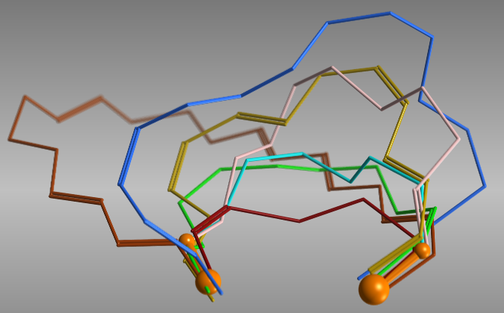
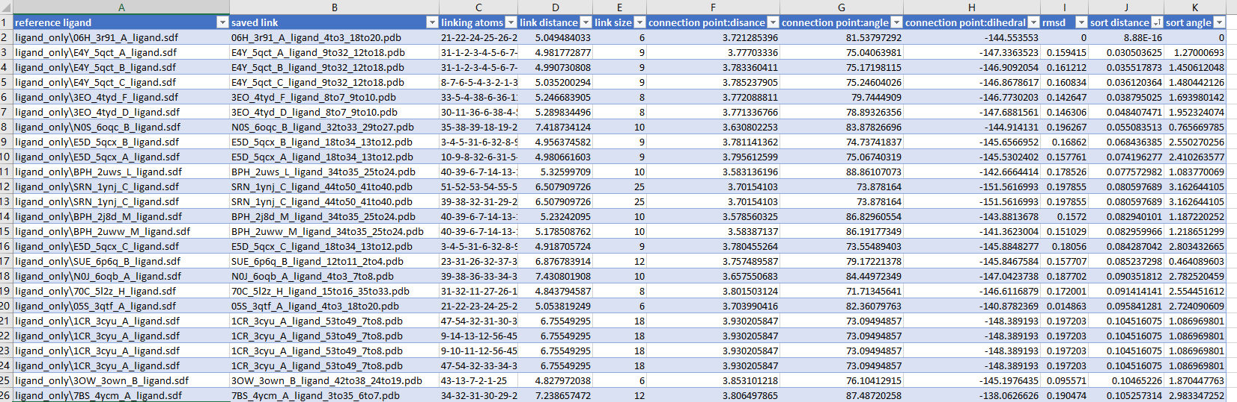
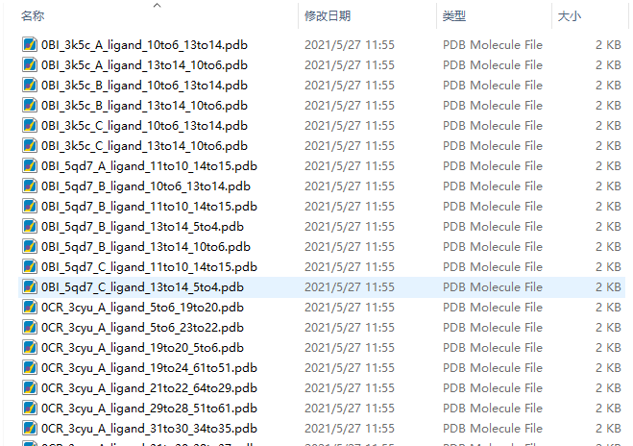
Test case: coordinates for 4 points (A1, A2, B1 and B2)
B1
A1: N 57.6010 10.9970 24.1100
A2: H 58.2930 9.8400 23.7190
B1: C 54.2440 10.1930 25.5000
B2: H 53.6670 9.2980 26.3930
A1
A2
B2
Distance: 3.72
Angle: 81.54
Dihedral: -144.54
connection point
starting point

Slide 8
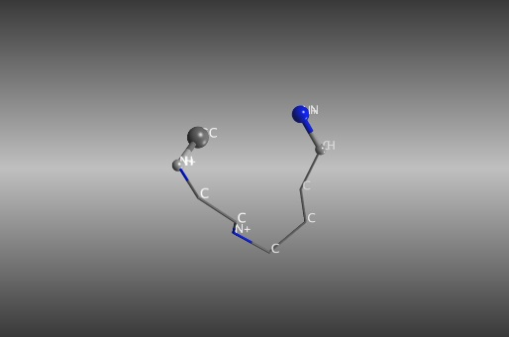
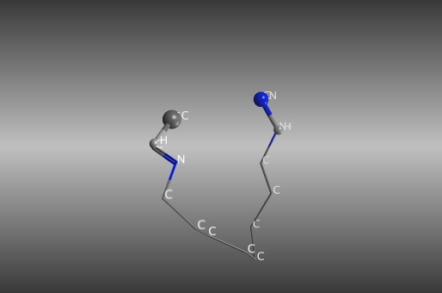
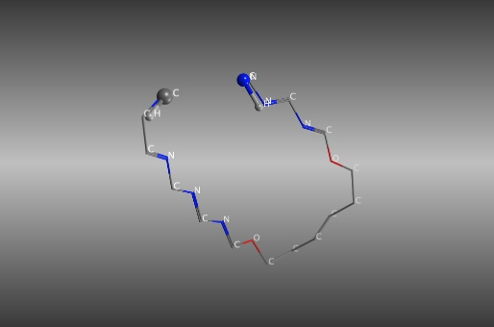
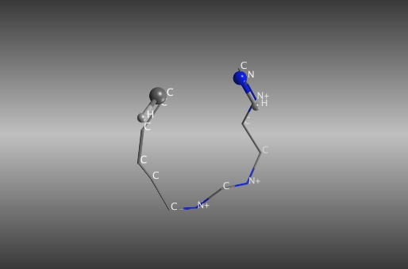
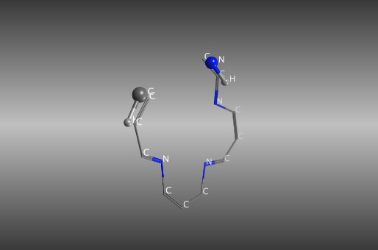
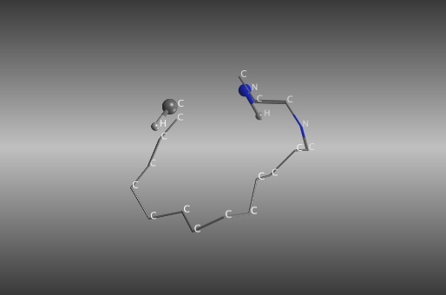
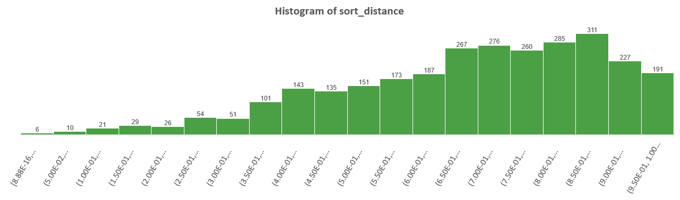
Examples from aligned links
0
0.03
0.2
0.4
0.6
0.8

Slide 9
Summary
Provide all possible link atoms from ligands in PDB structure for given coordinates
To take a query molecule as input (PDB/xyz) with definition of connection atoms
→ output query molecule with link atoms
→ output aligned reference ligand in complex
To save enumerated link options of all ligands in a database

Slide 10
Thanks！

