Slide 1

Real-Time Scalable Event Processing System
with Auto-Scaling Simulation
M.Tech Major Project
Presented by Piyush Kumar (M25DE1046)
Supervisor Subhash Bhagat
School of Artificial Intelligence & Data Science · Indian Institute of Technology Jodhpur · 29 July 2026
Notes:
Swap the white circle emblem with the official IIT Jodhpur logo (Insert > Picture) from iitj.ac.in/main/en/institute-logo.

Slide 2
The Problem: Traffic That Explodes in Seconds
When a blockbuster opens on a ticketing platform like BookMyShow, traffic doesn't rise gently — it detonates. A calm stream of a few hundred users becomes a flood of tens of thousands within seconds, all racing for the same limited seats.
Infrastructure sized for the average moment cannot survive that peak. Requests pile into queues, processing falls behind, and the backlog grows faster than the system can drain it.
The consequences are concrete: a dropped or delayed booking event can mean a double-sold seat, a failed payment, or lost revenue — precisely at the platform's most valuable moment.
10×–100×
surge in load within seconds of
a popular release going live
Static capacity vs. a spike it was never sized for
Requests queue up
Latency spikes, events delayed
Dropped events → double-booking, lost sales
Notes:
Surges are sudden and extreme; static infrastructure fails at the peak, and dropped booking events have real cost (double-booking, lost revenue).

Slide 3
Project Objectives
01
02
03
Real-time streaming pipeline
Load-reactive auto-scaling
Measured, honest proof
Ingest a high-volume stream of booking events through Apache Kafka with low, controlled latency.
Automatically add and remove processing workers as demand rises and falls — no manual intervention.
Benchmark the system under realistic surges and quantify the benefit with data.
Success: events flow producer → Kafka → workers end-to-end under load
Success: workers scale up on surge, back down when it clears
Success: with-vs-without comparison shows lag controlled
Notes:
Three objectives with measurable success criteria: build the pipeline, auto-scale on load, and prove the benefit with benchmarks.

Slide 4
From Proposal to Working System
Where the project stood last semester, and what exists now
LAST SEMESTER
THIS SEMESTER
The Proposal
A Running, Benchmarked System
Design & architecture approved
End-to-end pipeline running natively (no Docker)
Tech stack chosen (Kafka, Python, Docker)
Realistic booking-event simulator, 3 load profiles
Repository skeleton (~42 lines): a trivial producer and consumer
Lag-based auto-scaler: workers scale 1→3→1
Auto-scaler, metrics, benchmarks — not yet built
Metrics logging + with-vs-without benchmark graphs
Proposal claimed ~40% complete — but the core (scaler + benchmarks) was 0%.
The interesting work — the scaler and its evaluation — was built this semester.
Notes:
Honest before/after. Proposal claimed 40% but core was 0%; this semester delivered the working, benchmarked system.

Slide 5
Adapting the Design to Real Hardware
Every change is a documented engineering decision, driven by a 4 GB laptop
The memory math: Windows ~2.5 GB + Docker/WSL2 VM ~2 GB + Kafka & Zookeeper JVMs ~1.5 GB = ~6 GB demanded on a 4 GB machine
Docker + Compose
Native install in WSL2
Docker's VM overhead alone (~1.5–2 GB) left no room on 4 GB
Zookeeper
Kafka in KRaft mode
Removes an entire JVM; Kafka manages its own metadata quorum
Prometheus + Grafana
CSV logging + matplotlib
A monitoring stack can't coexist with the broker on 4 GB
Apache Kafka
Apache Kafka (kept)
The core streaming technology — unchanged, non-negotiable
Notes:
Memory math shows why the proposed stack couldn't run. Each deviation is justified; Kafka is kept.

Slide 6
System Architecture
Producer
Kafka (KRaft)
Consumer Group
Auto-Scaler
Booking-event simulator
keys events by session_id
booking-events topic
3 partitions, no Zookeeper
Worker pool consumes in
parallel; auto-rebalances
watches lag,
spawns / kills workers
auto-scaler resizes the worker pool
Events keyed by session_id
Partitions = parallelism ceiling
Group auto-rebalances
Lag drives scaling
A session's events hash to one partition, preserving per-session order.
Kafka gives each partition to one consumer, so 3 partitions ⇒ at most 3 workers.
Add or remove a worker and Kafka reassigns partitions across the group automatically.
The scaler reacts to produced-minus-processed backlog, not CPU.
Notes:
Pipeline plus four core mechanics: session_id keying, partitions as ceiling, consumer-group rebalancing, and lag-driven scaling.

Slide 7
Realistic Event Simulation
A booking funnel with real drop-off — so the benchmark measures something meaningful
search
100%
a booking_confirmed event
view
74%
{
"event_id": "a3f9c1e8...",
"event_type": "booking_confirmed",
"session_id": "sess-7b2e91c4", ← partition key
"user_id": 284519,
"timestamp": 1785304910564, ← for latency
"device": { "platform": "android" },
"event_details": {
"city": "Mumbai", "movie_id": "MOV1042",
"seat_category": "premium", "seat_count": 3,
"amount": 960 },
"payment": { "method": "upi",
"status": "success" }
}
select seat
39%
add to cart
22%
payment
13%
booking
9%
Sessions abandon at each step — a realistic ~9% search-to-booking conversion, not uniform noise.
Notes:
Booking funnel with realistic drop-off; a real sample event showing session_id (partition key) and timestamp (latency).

Slide 8
Streaming Layer: Apache Kafka in KRaft Mode
One broker, no Zookeeper — parallelism is bounded by partition count
booking-events topic
KRaft — no Zookeeper
The broker runs its own Raft-based metadata quorum, so it is both broker and controller. One fewer JVM to feed on 4 GB.
Partition 0
→ worker 1
Partition 1
→ worker 2
Partitions cap parallelism
Kafka assigns each partition to at most one consumer in a group — so 3 partitions is a hard ceiling of 3 concurrent workers.
Partition 2
→ worker 3
512 MB heap, acks=1
The broker heap is pinned and acks kept light so it coexists with Python and stays within the memory budget.
Ordering is guaranteed within a partition — enough for per-session correctness.
Notes:
Background on KRaft (Raft metadata quorum, no Zookeeper), partitions as the parallelism ceiling, and the memory-conscious broker config.

Slide 9
The Auto-Scaler — Core Contribution
A control loop that keeps the pipeline healthy by resizing the worker pool in response to real Kafka lag — the same signal production systems like KEDA scale on.
1
2
3
4
MEASURE
DECIDE
ACT
COOL DOWN
read group lag
compare to thresholds
spawn / kill worker
wait, avoid flapping
↺ loop repeats every 3 seconds
Lag, read from Kafka itself
Decision logic
lag = Σ ( log_end_offset − committed_offset )
every 3s:
lag = read_lag()
if lag > 300 and workers < 3:
spawn_worker()
elif lag < 50 and workers > 1:
kill_worker()
sleep(cooldown) # 10s
summed over all partitions = events produced but not yet processed
One persistent connection reads it every poll — no per-poll JVM overhead.
Notes:
Core: lag = sum(log-end - committed) read via one persistent connection; simple threshold logic with cooldown; grounded in KEDA-style lag scaling.

Slide 10
Scaling Decision Logic
Simple, tunable rules with the reasoning behind each
The rules
Why these choices
lag > 300
add a worker
Lag, not CPU
Consumer-group lag directly measures 'are we keeping up'. Production autoscalers (e.g. KEDA on Kubernetes) scale Kafka consumers on exactly this signal.
lag < 50
remove a worker
Cooldown prevents flapping
A new worker takes seconds to join and rebalance. Without a 10 s pause, the scaler would spawn 3 workers in 3 seconds, overshoot, then thrash up and down.
cooldown 10 s
wait after each action
Max = partition count
min 1 / max 3
bounds = partition count
A 4th worker can never receive a partition, so it would sit idle. The ceiling honours Kafka's own limit.
Notes:
Rules plus reasoning: lag-based like KEDA, cooldown stops flapping (with the mechanism), and max tied to partitions.

Slide 11
Experimental Setup
4 GB
2 / 4
512 MB
3
total RAM
cores / threads
Kafka heap cap
partitions & max workers
Stack
Method — two passes, same load
Hardware
Lenovo IdeaPad 330 · Intel i3-8130U · Windows 11
Baseline
Runtime
WSL2 / Ubuntu · Java 17
1 fixed worker, scaling OFF
Auto-scaling
Broker
Apache Kafka 4.3.1 (KRaft, no Zookeeper)
scaler free to add / remove workers
Client
Python 3 · kafka-python-ng 2.2.3
Analysis
pandas · matplotlib (CSV → graphs)
Repeating surge profile (3 cycles). Consumer-group offsets reset between passes so both start at zero lag — a fair, aligned comparison.
Notes:
Full rig and stack versions; baseline-vs-scaler method with clean offset resets for a fair comparison.

Slide 12
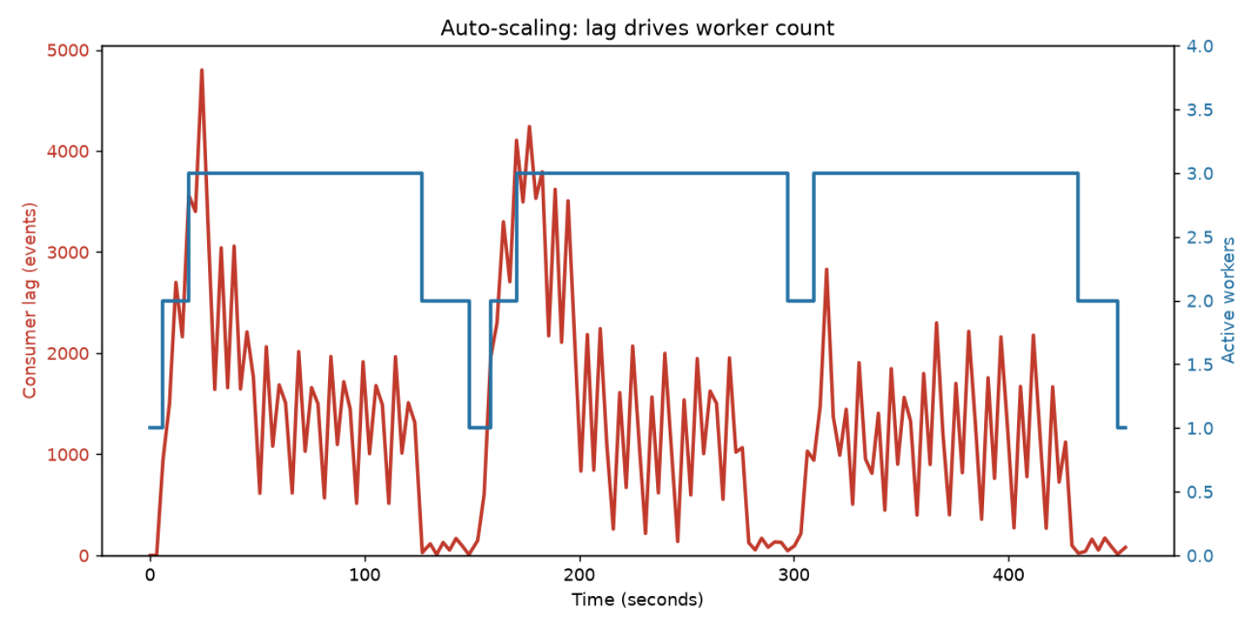
Results I — Scaling Behaviour
Lag rises, workers scale 1→3, backlog drains, workers scale back to 1
Peak lag ~4,800 events
at the start of each surge
Scaler steps 1→2→3
within one cooldown of the spike
Backlog drains, lag → 0
3 workers exceed the inflow
Scales back to 1
when the surge clears
Notes:
Three clean scale-up / scale-down cycles driven entirely by measured lag; peak lag ~4,800 recovers to near zero each cycle.

Slide 13
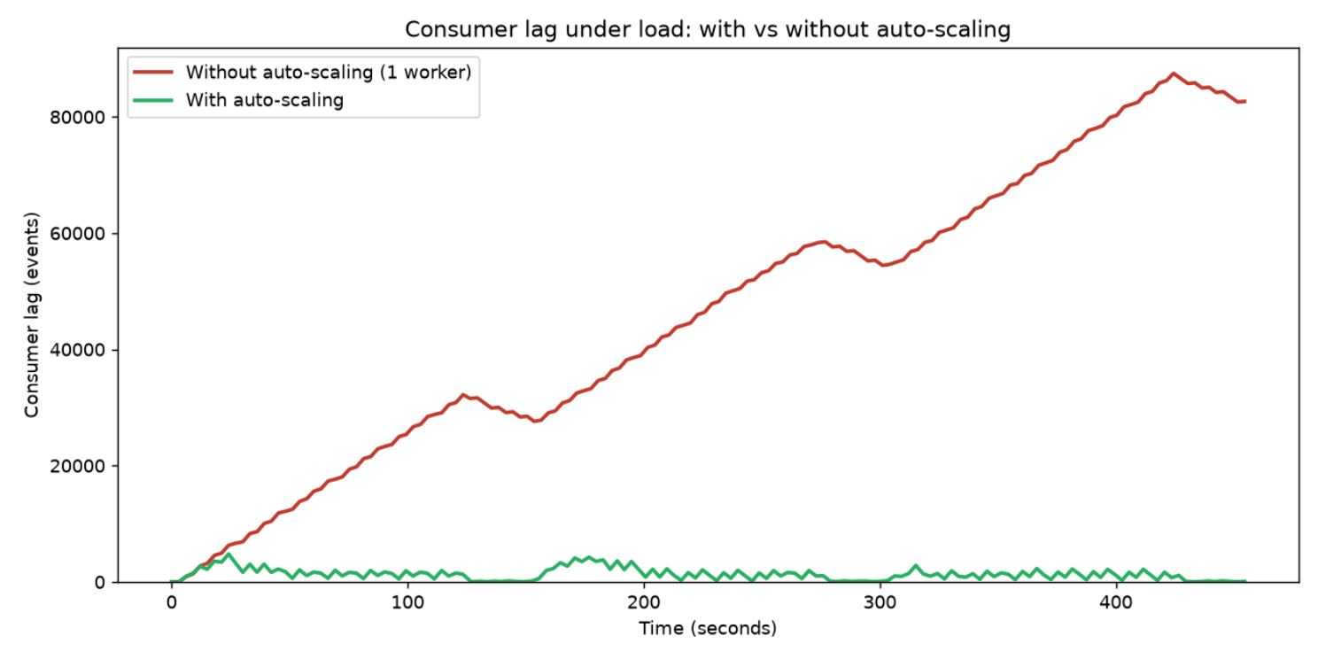
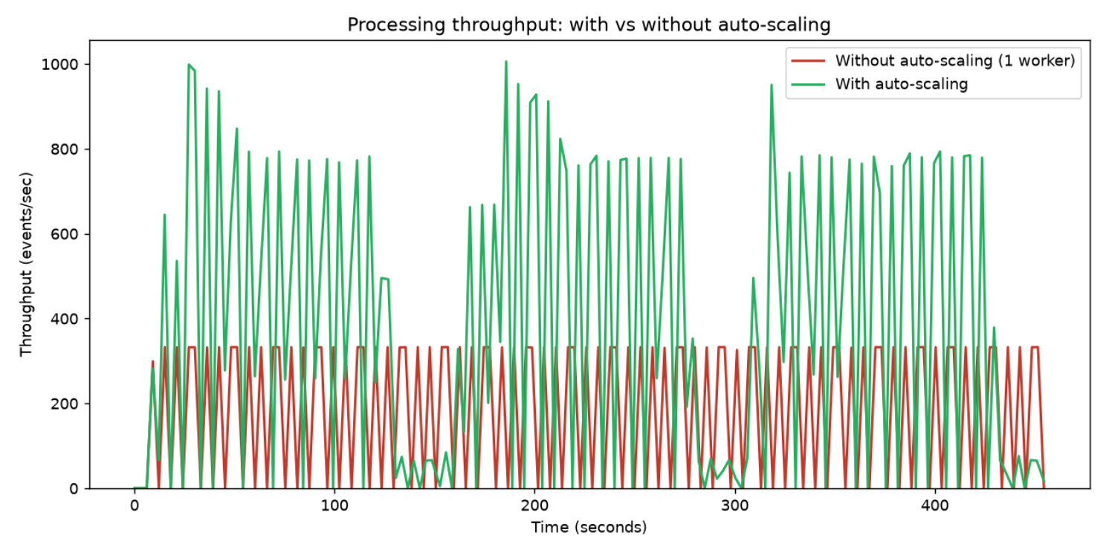
Results II — With vs Without Auto-Scaling
Same load, same machine — the auto-scaler is the only difference
Consumer lag over time
Processing throughput over time
~87,000 → ~0
~330 → ~1000
≈ 3×
peak lag: without scaling vs with
events/sec: 1 worker vs scaled
sustained throughput at peak
Notes:
The hero comparison: without scaling lag climbs to ~87,000 unbounded; with scaling it stays near zero. Throughput sustains ~3x the single-worker ceiling.

Slide 14
Challenges, Constraints & Insights
What the build surfaced — and why the design still scales
Problems faced & solved
Why it still scales
Per-partition backlog
Every scaling lever is a configuration value:
A partition that fell behind stayed behind even after adding workers — real distributed-systems behaviour, not a bug.
peak load
work per event
JVM-per-poll cost
partition & worker ceiling
scale thresholds
Polling lag via Kafka's CLI would launch a JVM every 3 s; solved with one persistent in-process connection.
Handling more load is a config change, not a redesign — up to this laptop's ceiling. Beyond it, the same design scales horizontally by adding partitions and machines, exactly as Kafka does in production.
Ephemeral /tmp on WSL
Kafka's log dir on /tmp was wiped on restart; re-format restores it (fix: move to a persistent path).
Notes:
Three genuine challenges and their fixes (great viva material), then the honest scalability argument.

Slide 15
Conclusion & Future Scope
Proven: under identical load, auto-scaling held lag near zero versus ~87,000 events, and sustained ~3× the single-worker throughput.
Delivered
Future scope
A working Kafka pipeline on a 4 GB laptop
Containerize & deploy on AWS / GCP
A lag-based auto-scaler (the core contribution)
Predictive (ML-based) scaling ahead of surges
Measured, aligned with-vs-without benchmarks
Multi-tenant event categories & queues
Code: github.com/pkumar827/realtime-event-processing-system
Thank you
Notes:
Quantified proof banner, delivered vs future, repo link, thanks.

