Slide 1

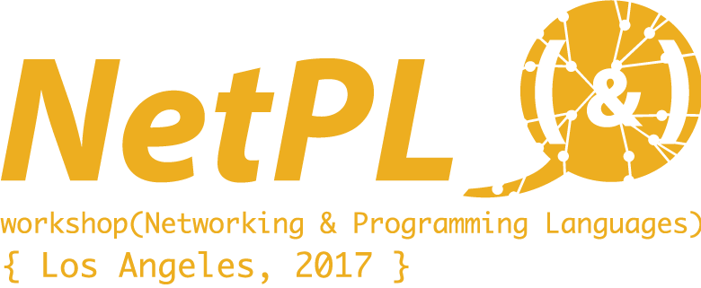
Verifying networks with symbolic execution and temporal logic
Matei Popovici, Radu Stoenescu, Lorina Negreanu,
Costin Raiciu
University Politehnica of Bucharest
Notes:
What is network verification?
The network verification problem takes as input a network topology – more precisely the dataplane snapshot of a network, that is, the collection of match-action and routing tables together with the box configuration files…. and a user policy, for example : “host B must be reachable from host A”, or “the source IP address cannot be changed on any route from A” … and answers the question: is the policy satisfied by the network?
The problem is a challenge, because we are constrained by the following:
We need to be able to guarantee that the answer is correct –
Network changes are fast, so we need an answer within seconds. Thus, we cannot rely on techniques such as testing – they can only show the presence, not the absence of bugs, and they do not scale.
Why is the network verification problem important?
First – the networks of today are increasingly complex – and administrators cannot solely rely on human wisdom and simplistic tools such as ping to handle a network.
Network verification has many applications related to SDN.
For instance, consider Neutron & OpenStack, which gives cloud tenants an API to build rich networking topologies, and configure advanced network policies in the cloud. Does a virtual topology actually guarantee the same behavior as the physical one? [make a tough argument]
Also, in 5G networks, we would like to instantiate services closer to the client. To ensure security, this requires deploying sophisticated boxes such as IDS, which are expensive to run, and affect performance. If we can verify client services we could guarantee that certain traffic (lets say UDP traffic) is not possible, end hence deploy more lightweight security boxes.
Having hopefully convinced you that network verification matters, let me take you through our solution.
It relies on three ingredients. We start from the dataplane snapshot of the network, and we generate a model of the network. The model is written in a specifically-design language called: Symbolic Execution-Friendly Language (SEFL). Model generation is automatic – we have built parsers that work on a variety of switches, routers and other boxes. A model is just like a computer program which describes how packets are modified by the network.
The second ingredient is symbolic execution. Instead of running our “network program” with a concrete input – that is – a concrete packet, we use a symbolic one. In a symbolc packet, header fields may have symbolic values – i.e. any potential value from the headerfields’ range.
For instance, in modelling a firewall, the CONSTRAIN instruction is used. Symbolically-executing it, will add appropriate constraints to the headerfields. If the constraints are unsatifiable, execution stops.
In modelling a router, we the conditional instruction IF. During symbolic execution, both branches of the IF will be explored, and appropriate constraints will be added on each path.
In modelling a NAT, we would use, among others, the ASSIGN instruction, which replaces current constraints/values of a headerfield.
I would like to point out that I’ve given you a very brief description of SEFL network modelling. There are a few more details, and more SEFL instruction which I will not explain now. For details, please see …
The takeaway here is that, using symbolic execution, we can explore all feasible paths a packet may take through the network.
Our third and final ingredient, and this papers’ contribution is the policy language NetCheck, which allows expressing user requirements. The language relies on
- branch operators (forall, exists). Evaluated at a hop A in the network, Forall f expresses that, on all paths, f is true.
- temporal operators (Future, Globally). Future f expresses that “f’ is true at some point of the network. Globally f expresses that f is true at all points.
NetCheck can express policies such as:
- A is reachable from B (exists F (port == A) )
- if a packets’ destination IP is private, it cannot reach the Internet. forall G ( destIP == 192.168.0.0/16 -> forall G (port != Internet))
This is my last slide:
- NetCheck is implemented in Scala, is extends, Symnet, a symbolic execution engine for SEFL
- NetCheck can run in seconds, and only explores relevant paths of the network model.
- We have expressed a variety of policies in NetCheck, inclusing: TCP-end-to-end reachability, tunnel invariance, traffic isolation, NAT correct operation, etc.
We care currently deploying NetCheck in order to verify larger-scale networks such as our University’s backbone.
Challenges:
- some policies require modifying the model: adding specific behaviour at certain hops in the network.

Slide 2
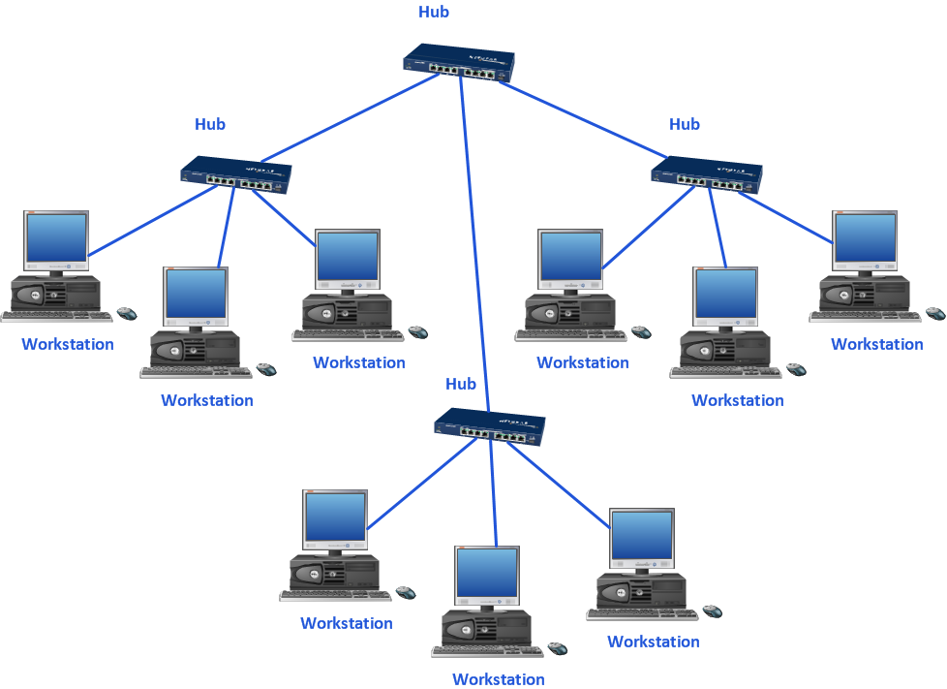
Network verification status quo
network model
Dataplane snapshot
SEFL
configuration files, forwarding tables, etc.
Symbolic execution-friendly language
User policy
imperative language
intended network behaviour
no loop instructions
“the packet is the memory”
Notes:
Network verification’s goal is to take the dataplane snapshot of a network as well as a user policy expressing some desired network behaviour and verify if the network complies with the policy.
With Symnet & SEFL we have made a first step towards this goal.
Our approach is to parse all box configuration files to a unified network model.
The language we use is SEFL: symbolic execution-friendly language. SEFL is a very simple imperative language specifically designed for Symbolic Execution.

Slide 3
Select an input port …
Port B
Port C
Port D
Port A
… perform symbolic execution on the network model
Symnet^{[1]} – symbolic execution engine
designed for SEFL
Explores all feasible
datapaths
Runs in seconds on
enterprise networks
[1] R. Stoenescu, M. Popovici, L. Negreanu, C. Raiciu: SymNet: Scalable symbolic execution for modern networks. SIGCOMM 2016:
Notes:
Once the model has been built, the next step is to select an input port, and perform symbolic execution starting at that specific port.
For this, we use Symnet, a symbolic execution engine specifically designed for SEFL. Due to SEFL’s design Symnet can run in seconds on big networks.

Slide 4
Select an input port …
Port B
Port C
Port D
Port A
… perform symbolic execution on the network model
User policy
reachability
Notes:
Therefore, if the intented policy is “reachability’, say between physical ports A and D of the network,
It is sufficient to inspect the set of execution paths provided by Symnet …

Slide 5
Select an input port …
Port B
Port C
Port D
Port A
… perform symbolic execution on the network model
User policy
reachability
manual inspection of symbolic execution output
Notes:
And look for paths traversing port D.

Slide 6
Select an input port …
Port B
Port C
Symbolic execution cannot deliver end-to-end verification by itself
Port D
Port A
… perform symbolic execution on the network model
PCs in vlan labs should not talk to those in vlan office
Where should symbolic packets be injected?
What fields should be symbolic?
Exploring all execution paths is necessary?
Notes:
On the other hand, consider another policy, belonging to our CS Departments’ network administrator.
“PC’s in vlan LABS should not talk to those in vlan OFFICE”
Verifying such a policy requires taking some decisions which are hard to take automatically:
- at what ports should symbolic execution be performed?
- what ports should be symbolic? (for instance, concrete mac addresses may speed up symbolic execution)
- should symbolic execution unfold the entire model, which is obviously unefficient?
So, a careful look at a complex policy reveals that Symbolic Execution alone is not enough to deliver end-to-end verification

Slide 7
How to express network behaviours?
Port B
Port C
Port D
Port A
SDN policy languages:
NetPlumber, Merlin, FatTire, Procera, FML, Kinetic
expressiveness, infrastructure independence, ease of usage
Temporal logic (CTL): NetCheck
suitable for expressing graph properties
Notes:
This work is a first step towards expressing and verifying complex user policies.
We have looked at a number of SDN policy languages, such as NetPlumber or Merlin and found several limitations, most notably in the ability of expressing complex queries.
There is not enough time to cover this in the talk, but see the paper for an example.
Thus, we have looked at other languages, particularly those which express properties over transition systems and have chosen CTL as an inspiration.

Slide 8
NetCheck policy language
Path operators
Temporal operators
exists φ
forall φ
future φ
globally φ
Inspired from CTL (each temporal operator is directly preceded by a path operator)
Notes:
NetCheck borrows from CTL paths operators and temporal operators.
Path operators are evaluated at network ports, and can express statements about the existing paths starting at that port.
Temporal operators are evaluated wrt a path and express statements about some or all network ports on that path.
Just like CTL, in NetCheck, each temporal operator is directly preceded by a path operator.

Slide 9
NetCheck implementation
Extends the Symnet execution engine
Performs symbolic execution while monitoring the policy’s truth-value
Requires a single-pass through the model (unlike CTL model checking)
Selectively explores symbolic execution paths
Notes:
NetCheck only borrows CTL’s syntax, but implements a different verification procedure from CTL model checking.
We have implemented this procedure as an extension to Symnet.
NetCheck performs symbolic execution and at the same time monitors how each symbolic state changes the truth-value of the formula.
Unlike model checking, NetCheck requires a single pass through the model and will explore execution paths only as long as necessary.

Slide 10



Reviewing symbolic execution
Firewall
A
unidirectional traffic
Router
Proxy
1
0
2
B
Notes:
I will use this simple topology to illustrate how NetCheck works.
Let us asssume that traffic is only generated at port A.

Slide 11
The physical topology
Firewall
A
0
1
port -> SEFL code
Router
Proxy
0
1
0
1
2
B
Notes:
In a SEFL model, each device is modeled as a box with input ports (shown as triangles) and output ports (shown as squares).
SEFL code is assigned to each port.

Slide 12
Symbolic execution
Symbolic packet
?
?
?
?
?
?
?
DestIP
SrcTCP
Firewall
Symbolic packet
A
?
?
?
?
?
0
Constrain(SrcTCP,==80)
1
?
=80
DestIP
SrcTCP
Router
Proxy
0
1
0
1
2
B
Notes:
The input for a SEFL model is a symbolic packet, which may have symbolic headerfields, that is, fields whose value can be anything within their specific range.
Suppose that the Firewall only accepts traffic from port 80. Then the resulting symbolic packet will have the appropriate constraint added.

Slide 13
Symbolic execution
Firewall
A
0
Constrain(SrcTCP,==80)
1
Symbolic packet
Symbolic packet
?
?
?
?
?
?
=80
?
?
?
?
?
=A
=80
DestIP
SrcTCP
DestIP
SrcTCP
Router
Proxy
0
if (DestIP == A)
then Forward(1)
else Forward(2)
1
0
1
2
B
Symbolic packet
?
?
?
?
?
!=A
=80
DestIP
SrcTCP
Notes:
The symbolic packet from output port 1 of the Firewall is forwarded to the input port 0 of the Router.
To model routing decisions in SEFL, we use the conditional instruction. Symbolic execution is branched at conditionals: on the then branch, the if condition is added, and the symbolic packet is forwarded on port 1, on the else branch, the complement of the condition is added, and the packet is forwarded on port 2.

Slide 14
Symbolic execution
Firewall
A
0
Constrain(SrcTCP,==80)
1
Symbolic packet
Symbolic packet
?
?
?
?
?
=A
80
?
?
?
?
?
=B
80
Router
DestIP
SrcTCP
Proxy
DestIP
SrcTCP
0
if (DestIP == A)
then Forward(1)
else Forward(2)
1
0
Assign(DestIP,B)
1
2
B
Notes:
Finally, suppose that the proxy modifies the destination ip. We model this using the assign instruction, which overrides existing constraints.

Slide 15
The output of Symbolic Execution
Firewall
A
0
Constrain(SrcTCP,==80)
1
Symbolic packet
?
?
?
?
?
=B
80
Router
Proxy
DestIP
SrcTCP
0
if (DestIP == A)
then Forward(1)
else Forward(2)
1
0
Assign(DestIP,B)
1
2
B
Symbolic packet
?
?
?
?
?
!=A
80
DestIP
SrcTCP
Notes:
Note that symbolic execution on this example produces two paths.

Slide 16
Firewall
A
0
Constrain(SrcTCP,==80)
1
Router
Proxy
OK
0
if (DestIP == A)
then Forward(1)
else Forward(2)
1
0
Assign(DestIP,B)
1
2
B
Is B reachable from A?
exists future (port == B)
Notes:
To verify that B is reachable from A, we define the policy exists future port = B, and perform symbolic execution starting at point A of the network.
NetCheck will start symbolic execution and as soon as port B is discovered via the first path, execution stops and policy compliance is reported.

Slide 17
OK
Firewall
A
DestIP == initial
0
Constrain(SrcTCP,==80)
1
DestIP != initial
Check constraints at port 1 against the complement of the
state property
Router
Proxy
0
if (DestIP == A)
then Forward(1)
else Forward(2)
1
0
Assign(DestIP,B)
1
2
B
Does the destination IP change?
Execute at port A:
Allocate(initial);
Assign(initial, DestIP)
forall globally (DestIP == initial)
Notes:
Let us look at another policy:
To check it, just after the packet is injected, we allocate a new variable and assign the Destination IP field.
Next, we run policy verification with the following formula: forall globally Dest Ip = initial
Thus, at each outputport, we must check that DestIP == initial. Do to this, we build the complement of the state property – in this case, Dest IP differs from initial.
We combine this constraint with the symbolic constraints computed at output port 1. If the combined set of constraints is unsatisfiable, the property is true, otherwise it is false.
We repeat this verification at each port.
Since the Assign instruction changes the current constraint, equality fails at output port 1 of the Proxy and the policy is invalidated.

Slide 18
OK
Firewall
A
0
Constrain(SrcTCP,==80)
1
OK
No
Router
Proxy
0
if (DestIP == A)
then Forward(1)
else Forward(2)
1
0
Assign(DestIP,B)
1
2
B
Does the destination IP change?
Execute at port A:
Allocate(initial);
Assign(initial, DestIP)
forall globally (DestIP == initial)

Slide 19
Results
Policy verification on our CS Department core
middlebox (Cisco Adaptive Security Appliance - ASA)
4 feasible paths for a packet with concrete L2 fields
~ 100 instructions per path
Symbolic execution | Policy verification
412 ms | 563 ms
Expressiveness:
TCP end-to-end connectivity, tunnel invariance, isolation, stateful NAT correctness, protocol verification
Notes:
We some preliminary results on NetCheck:
we ran policy verification over the core middlebox of our CS department network, with a partially symbolic packet, and explored 4 successful paths each with around 100 instructions.
We observed that NetCheck scales with Symnet, as is to be expected.
We have also experimented with different kinds of policies and found that NetCheck can express them.

Slide 20
Challenges
Is NetCheck easy to use?
Some policies require execution from different ports
e.g. vlan isolation
Some policies require code injection
e.g. tunnel invariance
Notes:
NetCheck is not perfect.
For instance, writing policies in NetCheck is non-trivial for someone without background in temporal logic. However, an intuitive surface-language can be mapped over CTL.
Also, NetCheck does not immediately provide with an answer to policies which require symbolic execution from different ports. Our initial policy example demonstrates such a situation.
Also, some policies require injecting certain behaviors at specific ports (for instance a TCP responder). We are looking at means for incorporating this into NetCheck.
So, with this, I conclude my talk.

Slide 21
Symbolic packet
?
?
?
?
?
?
?
DestIP
SrcTCP
Firewall
Symbolic packet
A
?
?
?
?
?
0
Constrain(SrcTCP,==80)
1
?
80
DestIP
SrcTCP
Symbolic packet
Symbolic packet
?
?
?
?
?
=A
80
?
?
?
?
?
=B
80
Router
DestIP
SrcTCP
Proxy
DestIP
SrcTCP
0
if (DestIP == A)
then Forward(1)
else Forward(2)
1
0
Assign(DestIP,B)
1
2
B
Symbolic packet
?
?
?
?
?
!=A
80
DestIP
SrcTCP

Slide 22
OK
OK
Firewall
A
0
Constrain(SrcTCP,==80)
1
OK
?
Router
Proxy
0
if (DestIP == A)
then Forward(1)
else Forward(2)
1
0
Assign(DestIP,B)
1
2
B
OK
Does the destination IP change?

Slide 23
Convert the dataplane to a model of the network
network model
SEFL ^{[1]}
Symbolic Execution-Friendly Language
Imperative language
“the packet is the memory”
no loop instructions
[1] R. Stoenescu, M. Popovici, L. Negreanu, C. Raiciu: SymNet: Scalable symbolic execution for modern networks. SIGCOMM 2016:

Slide 24
Firewall
A
0
Constrain(SrcTCP,==80)
1
Router
Proxy
0
if (DestIP == A)
then Forward(1)
else Forward(2)
1
0
Assign(SrcTCP,9999)
1
2
B

