Slide 1


Toward Building Memory-Safe Network Functions with Modest Performance Overhead
Keunhong Lee
Shinae Woo, Sanghyeon Seo, Jihyeok Park, Sukyoung Ryu, Sue Moon
Notes:
Hello Everyone. My name is KeunHong. My talk is about building network functions in Rust. This work came out of collaboration with two groups at KAIST, one my advisor Sue Moon’s networking group and the other programming language group led by Prof Sukyoung Ryu, and a Rust contributor, Sanghyeon Seo.

Slide 2
Memory management!
It causes many problems when we use C or C++
NULL pointer dereference
Use-after-free
Memory leak
Double free
Buffer overflow
These 5 bugs occupy more than 30% of severe Linux kernel bugs (CVE 1999-2016 with CVSS 7.5 or higher)
Type system is to prevent these bugs!
Linear (affine) type system
Strongly-typed language + Run-time validation
Notes:
Let me start this talk with common memory management problems in building network functions in C or C++.
When we use C or C++, the following five types of bugs are quite common:
NULL pointer dereference, use-after-free, memory leak, double free, and buffer overflow.
There 5 types of bugs account for more than 30% of Linus kernel bugs.
----------------Actually I reviewed all CVE database between 1999 and 2016.
----------------And I found 30% of bugs with CVSS 7.5 or higher fall in to one of the five types.
Much work in programming languages research has focused on fixing such bugs through type systems.
The main goal of type systems is exactly to ”reduce possibilites of bugs in computer program."

Slide 3
Problem Statement
Type system address traditional memory management problems
Enforced pointer types: No null pointer dereference nor use-after-free
Automated memory management: No double free nor memory leak
Enforced boundary checks: No buffer overflow nor underflow
Why not popular?
Garbage collection causes unexpected performance degradation
Type systems are not well optimized yet.
Emergence of Rust
Type-safe language for system programmers
No garbage collection, no runtime overhead
Based on affine type system
Limitations of affine type system in Rust
Too strict for general programs (single writable reference)
Abandon safety and use unsafe code OR abandon performance and use runtime verification
Can we make network functions using safe Rust code?
Notes:
There are many related but not always well-defined terms related to type systems.
Let’s first review quickly the common terms related to type systems we use in this work.
As I mentioned in the previous slide, type systems are to address memory management problems.
A type system may enforce pointer types
It can also automate memory management and does not allow double free or memory leak at the first place.
It can enforce boundary checks. That is, no buffer overflow or underflow is possible. This is what is typically called “memory-safe”
However, type safe languages are not popular enough in network systems, especially in data plane.
The main reason in the performance.
Most type safe languages rely on garbage collection and it causes unexpected performance degradation.
Also, due to several run-time verifications, type safe languages are considered as slow languages.
Rust, introduced its first version in 2015, takes position of type safe language for system programmers.
It removed garbage collection and runtime overhead using affine type system.
Thus, Rust generates binaries comparable to that of C language, in ideal case.
Zero cost abstraction, sounds very cool, but there is no free lunch.
Affine type system that Rust is based on, is actually too strict for general programs.
To bypass the restrictions, we have to abandon the safely or abandon the performance.
So our question in that can we make network functions using the safe Rust code which is based on the affine type system.
Strongly-typed: Java
Type-safe: Python

Slide 4
Rust: Type-safe language w/o overhead
Linear (affine) type system
An object is used exactly(at most) once in the whole program
Using this strict constraint, the lifetime of all variables can be tracked at compile-time (allocation-deallocation codes are automatically inserted by the compiler)
No garbage collector nor smart pointers (reference-counting pointers)
Allocation
Program path
Deallocation
Object1
Free2
Object2
Free4
Object3
Free3
Object4
Free1
Notes:
Rust’s selling point, zero-cost abstraction came from the affine type system. Affine type system is a variation of the linear type system.
In linear type system, an object is used exactly once in the whole program.
All variables are tracked in the compile time and enables memory management without garbage collection or smart pointers.
As seen in the figure, each object follows the single program path including variable renaming and passing function parameters.

Slide 5
Why Rust for Network Functions?
Memory access pattern of a network function
When processing a packet, NF refers to two kinds of states:
Local state: per-flow state
Global state: shared among multiple flows
Access patterns:
Global state: mostly read and rarely updated (per-flow)
Local state: frequently updated (per-packet)
Rust’s type system fits well
Local state: single writeable reference
Global state: shared read-only references
Notes:
I just mentioned that Rust’s type system is not suitable for general programs.
What about network functions?
Network functions have unique characteristics that distinguish them with general programs: the flow affinity.
When processing a packet, a network function refers to two kinds of shared states.
One is called the local state or per-flow state which is exclusively accessed by packets in specific network flow.
The other is called the global state and accessed by any packets.
Global states are mostly read and rarely updated, and
Local states are frequently updated by specific flows.
These access patterns directly mapped to Rust’s affine type system.

Slide 6
Network System Architecture for Rust
We have two separated execution stage:
Parallel execution stage:
Network functions run parallel on a multi-core system
They have read-only references of the global state and writable references of the local state
The threads run purely in parallel and there is no locking overhead (even for read-only locks)
Exclusive execution state:
All read-only references are collected
Only 1 thread is running and it has writable reference to both global state and local state
Global read
Global read
. . .
Global read
Global read
Local write
Local write
Local write
Local write
Global write
Local write
Notes:
To apply the affine type system for network functions, we have to separate network functions into two parts.
In parallel execution state, all RSS threads run in parallel and they have two references: read-only reference to global state and writable reference to local state.
Once we enter the parallel stage, verification for the references is done in compile-time, these references are used in parallel threads without any run-time verifications.
However, global state is somehow updated rarely. Then we enter the exclusive execution state where only a single thread is running and have writable access to both global state and local state.

Slide 7
Design of Our Evaluation Experiment
Baseline microbenchmark: IP reassembly
Synthetic fragmented IP packets with 100 fragments (virtual in-memory packets)
C implementation: DPDK’s IP reorder library
Result: Rust implementation is 17% slower than C
Target benchmark: NAT
IO: DPDK 17.02 with C FFI
IPv4 UDP NAT gateway
Workload: 100K flows with synthetic UDP packets (512B)
Global packet counter with 1 second aggregate time
Notes:
Now let’s move into some numbers.
First, for baseline comparison between C and Rust implementation, we chose IP reassembly as the microbenchmark. We took Intel’s DPDK IP reorder library for C implementation and compared it against our Rust implementation. The Rust implementation turns out to be 17% slower than C. That is, the performance penalty from Rust is about 17%, not x2 or x3
Next, we implement NAT in Rust and demonstrate even with global packet counters performance scales with the number of cores.

Slide 8
Details: NAT implementation in Rust
In the parallel execution stage:
When a flow arrives
Rewrite address, if found in the global forwarding table
Insert a new flow to the table from local address pool, if not
Forward packets
Record local statistics
In the global execution stage:
Apply newly assigned flow into the global table
Refill the local address pool from the global address pool
Aggregate the statistics
Notes:
Let me introduce how the NAT application is separated into the parallel execution stage and the global execution stage.
Basically, we have a large, global forwarding table which has address triplet, internal source, external source, and the destination.
We would like to keep the global table in read-only mode.
When a new flow arrives, allocate an external address from the local address pool and start forwarding for the packets in the flow.
We sometimes enter the global execution stage, when a new flow arrives or regular timeouts.
In the global execution stage, we apply locally allocated address to the global forwarding table, refill the local address pool, and aggregate statistics.

Slide 9
Performance of NAT in Rust
Performance increases proportionally to # of cores
Saturate 40G link using 16 cores
Notes:
We checked whether our NAT application and the parallel and exclusive execution stages are working well.
The performance increases proportionally to the number of cores and it saturates the 40G link using 16 cores.

Slide 10
Conclusion
Insights
Rust’s zero cost abstraction came from the affine type system
Shared state in network functions is mostly read and rarely updated
NF access patterns map well to Rust’s affine type system
Evaluation
We have implemented a prototype NAT gateway in Rust
It has parallel execution stage for RW accesses and exclusive execution stage to aggregate local states into global states.
Performance of the NAT gateway in Rust scales well to # of cores
Notes:
To summarize our work, we had insights that the state access pattern of network functions resembles the affine type system of Rust.
Using the similarity, we could build a NAT gateway without unsafe codes and software bypasses.
The performance scales to the number of cores and fast enough to saturate the 40G link.
Thank you, and any questions?

Slide 12
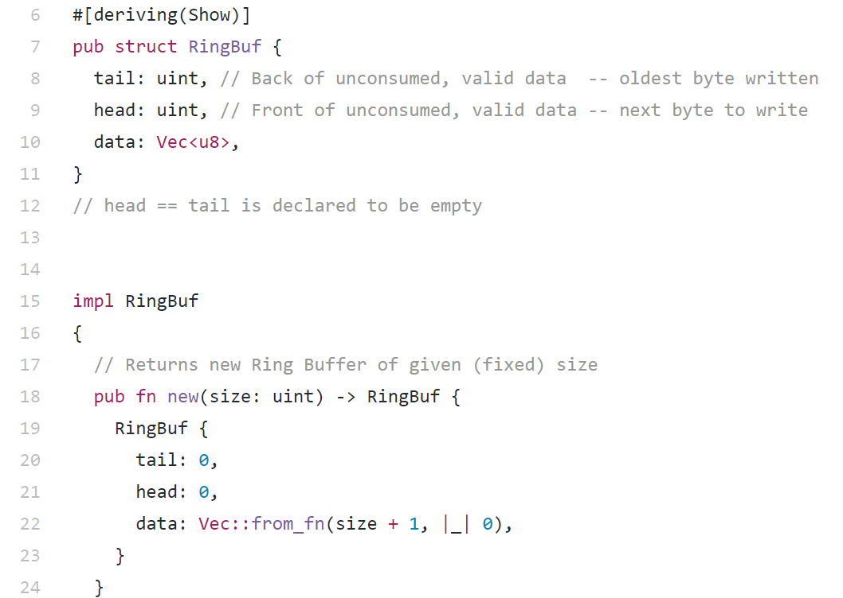
QuiltOS/QuiltNet TCP stack

