Slide 1


Creating Custom Network Packet Processing Pipelines on HMC-Enabled FPGAs
Jehandad Khan and Peter Athanas
Virginia Tech

Slide 2

FPGAs for Packet Processing
The ideal co-processor
Highly parallel
arbitrary data paths
No cache delays
Low power
Notes:
Being able to simulate a design without going into synthesis is the second benefit
Compared to CPUs and GPUs
Design effort

Slide 3

We
FPGAs

Slide 4
FPGAs for Packet Processing
The not-so-ideal co-processor
Long compile times
Complicated design process
Less abundant expertise
Cost
Limite Memory

Slide 5

We
FPGA Design

Slide 6

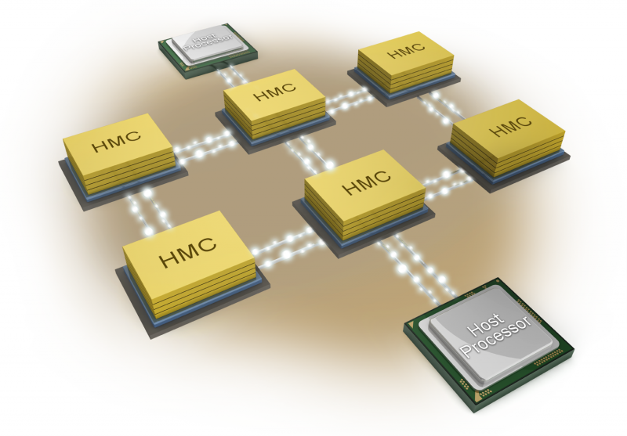
Objective of Investigation
FPGAs coupled with HMC?
What is the achievable throughput ?
What is the latency cost?
What are the tradeoffs ?

Slide 7
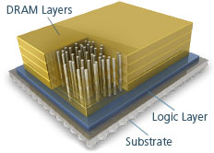
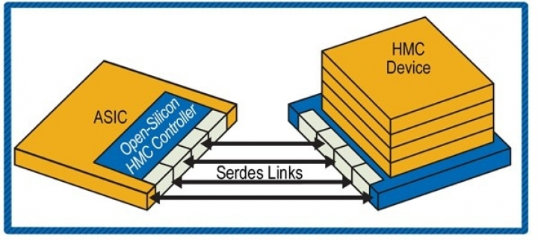
Hybrid Memory Cube
Lower Power
Raw random access bandwidth
Atomic operations
Latency concerns
Notes:
Mention the Pico HMC interface and other IP

Slide 8

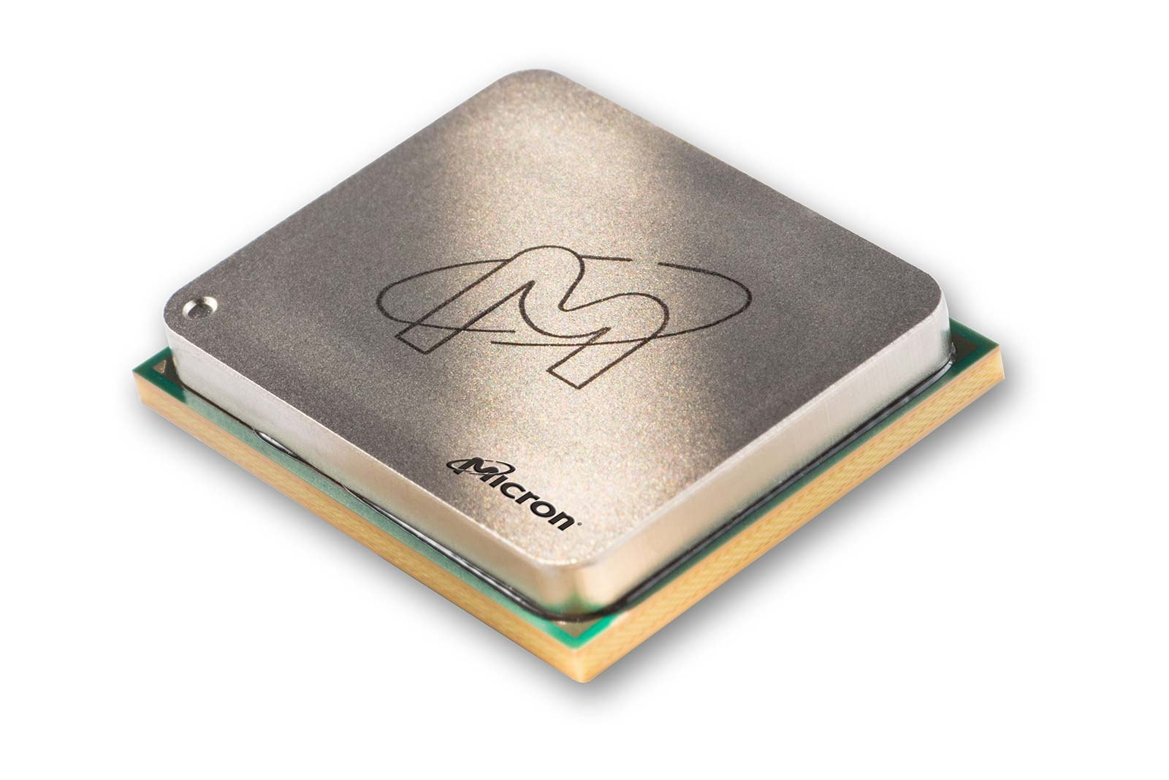
Hybrid Memory Cube
Half Width Links
10 AXIS interfaces
128-bit wide
Max throughput 45 Mlps/channel
Notes:
Also capable to connecting to other cubes

Slide 9
Hybrid Memory Cube
M-700 Backplane
AC-510
AC-510
AC-510
AC-510
AC-510
AC-510
Host

Slide 10





Overall Flow
Notes:
Passes and Projections …
Custom pragmas for hardware specific algs

Slide 11
HLS Benefits
Follow up on OpenCL work
Improved turnaround time
Automatic pipelining
Low area overhead
Becoming a mature technology
Direct integration of custom primitives

Slide 12
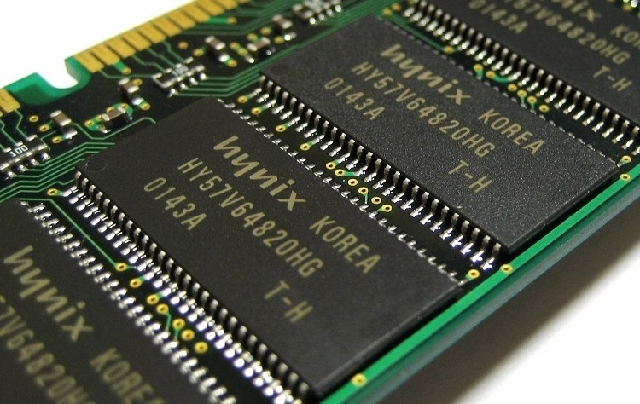

Lookup
On-chip resource limitation
Support Multiple Masks
Maximize area / throughput
Exploit HMC bandwidth

Slide 13
Lookup - Off-chip
Control Plane
Bloom Filter Mask0
HMC
Subsequent Stages
Incoming Packet
...
Priority Resolution
Offchip
Access
Actions
Update
Bloom Filter Mask N

Slide 14
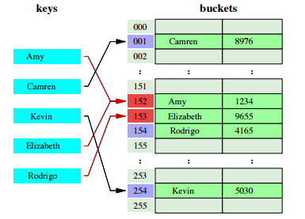
Lookup On-Chip
Suitable for small exact match tables
Hashed access
CRC32 as the hash function of choice

Slide 15
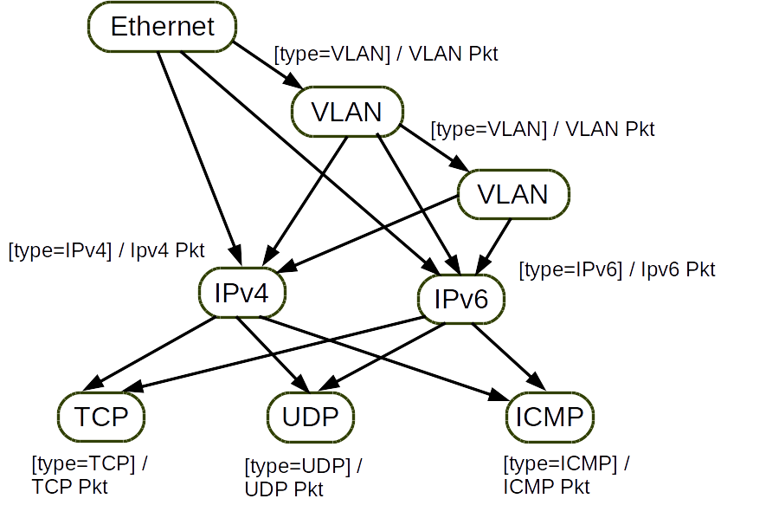
Parser
Expression balancing
Lookahead implementation
Variable FLIT width
Notes:
Unroll parser loops

Slide 16
Salient Features
Unroll parser loops
Add HMC interface
Merge Ingress and Egress
Generate Control Plane API
Add measurement logic

Slide 17
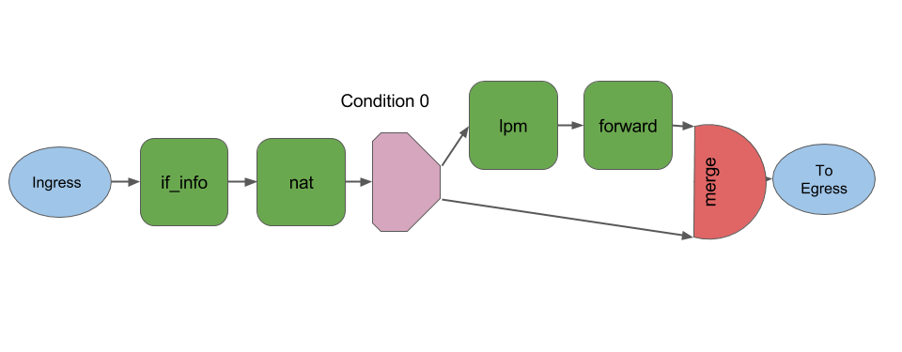
Simple NAT
Notes:
Mention the data flow aspect

Slide 18
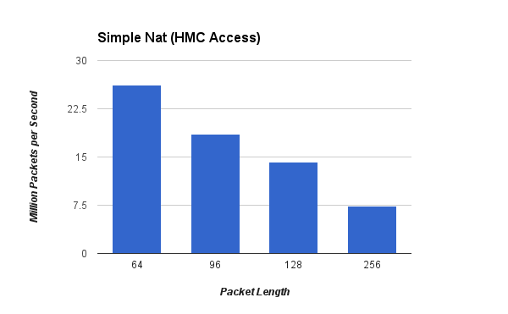
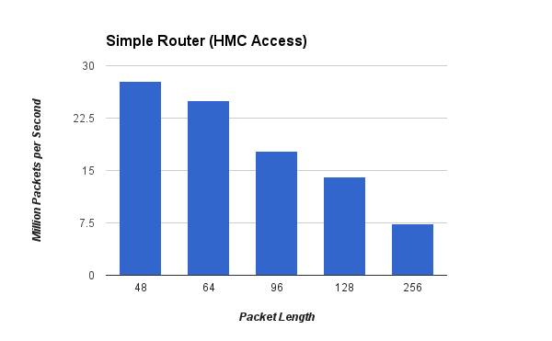
Results
Area Utilization (placeholder)

Slide 19
Future Work
CMCs
Take operations closer to memory
Atomic Operations
Flow counters

Slide 20
Questions

Slide 21
About Me
PhD Candidate @ Virginia Tech
Advised by Prof. Peter Athanas
Graduating this fall
Networking
FPGAs
Networking + FPGAs
Algorithm Acceleration

