Slide 1
Constant Time Updates in Hierarchical Heavy Hitters
Ran Ben Basat, Technion
Gil Einziger, Nokia Bell Labs
Joint work with
Erez Waisbard (Nokia Bell Labs)
Roy Friedman (Technion) and Marcello Luzieli (UFGRS)

Slide 2

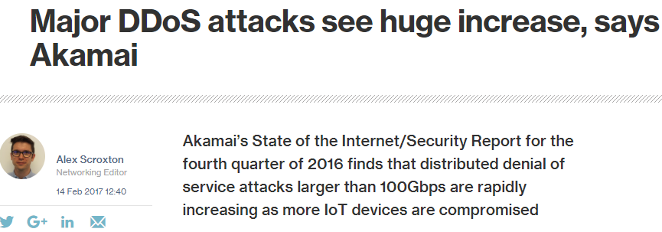
Distributed Denial of Service

Slide 3
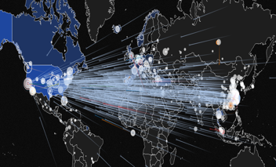
Hierarchical Heavy Hitters (HHH)
Hierarchical Heavy Hitters
identify traffic clusters.
They are at the core of numerous DDoS mitigation systems…
DDoS attack (Aug. 2014)
DREAM: dynamic resource allocation for software-defined Counting.
ACM SIGCOMM 2014
LADS: Large-scale Automated DDoS Detection System.
USENIX ATC 2006
Automatically Inferring Patterns of Resource Consumption in Network Traffic.
ACM SIGCOMM 2003

Slide 4






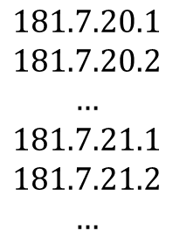
DDoS Mitigation
$$181.7.20.1$$
$$181.7.20.2$$
$$…$$
$$181.7.21.1$$
$$181.7.21.2$$
$$…$$
Can we block only the attacking devices?

Slide 5







Hierarchical Heavy Hitters
Hierarchical Heavy Hitters identifies frequent:
Flows (heavy hitters)
Source networks.
Source-Destination pairs.
$$181.7.∗.∗$$
$$181.7.20.∗$$
$$220.7.16.∗$$
$$220.7.16.9$$
$$181.7.20.13$$

Slide 6
State of the art
“Count each prefix independently.”
Level0 Counting
Level0 Counting
Level1 Counting
Level1 Counting
Compute all prefixes
181.7.20.6
181.7.20.6
181.7.20.*
Level2 Counting
Level2 Counting
181.7.*.*
181.*.*.*
Level3 Counting
Level3 Counting
*.*.*.*
Level4 Counting
Level4 Counting
Mitzenmacher et al., Hierarchical Heavy Hitters with the Space Saving Algorithm, ALENEX 2012

Slide 7
Randomized HHH (Our work)
“Select a prefix at random and count it”
Level0 Counting
Level1 Counting
Level1 Counting
Compute a random prefix
181.7.20.6
Level2 Counting
181.7.20.*
Level3 Counting
Level4 Counting

Slide 8

Additional Speedup
Level0 Counting
Level1 Counting
Level1 Counting
With probability 90%
Compute a random prefix
Level2 Counting
181.7.20.6
181.7.20.6
181.7.20.*
188.3.12.3
188.67.7.1
92.67.7.81
181.7.20.2
181.7.20.3
181.7.20.3
188.67.7.1
92.67.7.81
181.7.20.2
188.3.12.3
Level3 Counting
Level4 Counting
Ignore packet

Slide 9


We did the math
Accuracy and convergence guarantees .
After enough packets there are:
No false negatives.
No counting errors.
Only a few false positives.

Slide 10
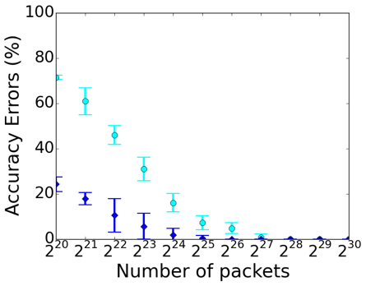
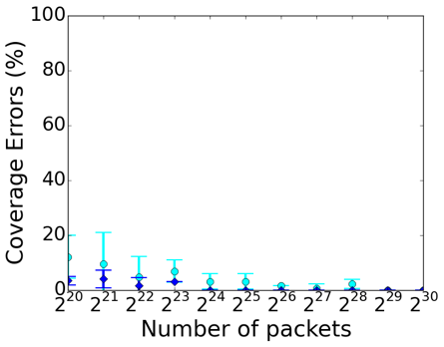


How much traffic is needed for convergence?
“Accuracy improves with the number of packets”
128M packets
128M packets
Counting Errors
False Negatives
32M packets
32M packets
One prefix packet
One prefix per 10 packets

Slide 11
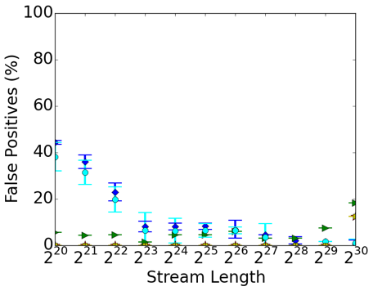

Comparison with other HHH algorithms
“Accuracy improves with the number of packets”
One prefix per packet
One prefix per 10 packets
Mitzenmacher et al.
Cormode et al., Finding hierarchical heavy hitters in streaming data, TKDD 2008

Slide 12
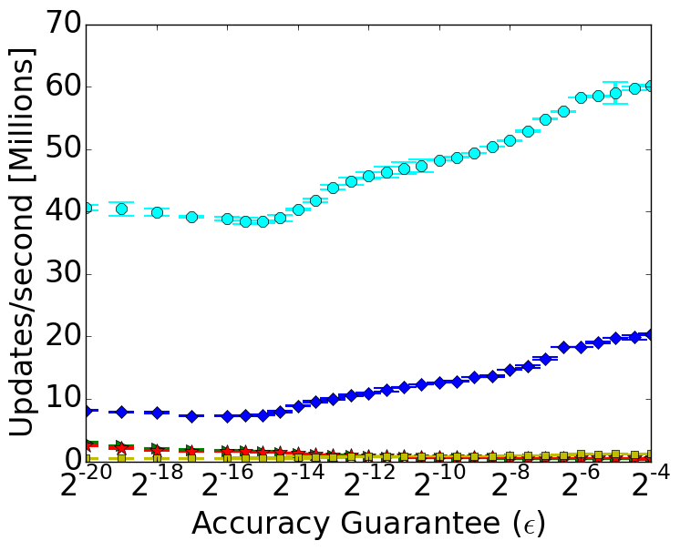
Comparison with other HHH algorithms
Up to X62 speedup!
One update per packet
One update per 10 packets
Mitzenmacher et al.
Cormode et al., Finding hierarchical heavy hitters in streaming data, TKDD 2008

Slide 13


Open vSwitch Implementation
Server A: Traffic Generator
We send min-sized packets with headers from Internet traces.
Server B: DPDK enabled Open vSwitch
Performs HHH Counting in data plane
Server A: Traffic generator
Serve B: Open vSwitch
Traffic Generator
Open vSwitch

Slide 14
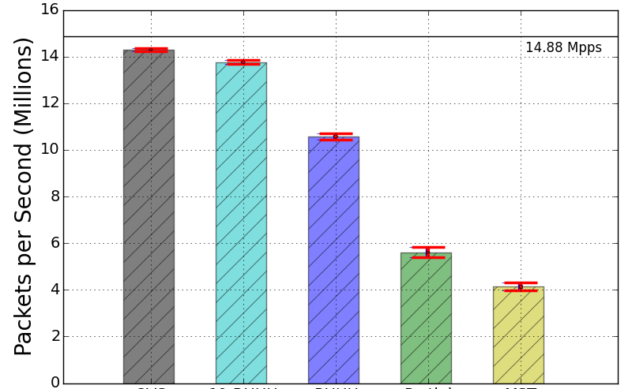


Comparing Implementation Overhead
Highlights:
Only -4% overheads for HHH in the OVS data plane!
+250% throughput improvement compared to previous work.
One prefix per packet
One prefix per 10 packets
OVS
Mitzenmacher et al.

Slide 15
Takeaways
Real time hierarchical heavy hitters measurement in networking devices.
Provable accuracy guarantees.
Open source code: https://github.com/ranbenbasat/RHHH
How to detect the maximal-prefix networks?

Slide 16

Any Questions

