Slide 1


A General Approach to Network
Configuration Verification
Ryan Beckett
with
Aarti Gupta, Ratul Mahajan, David Walker

Slide 2
Misconfigurations are common
Notes:
Why is network verification important? Because despite best practice and decades of experience.

Slide 3
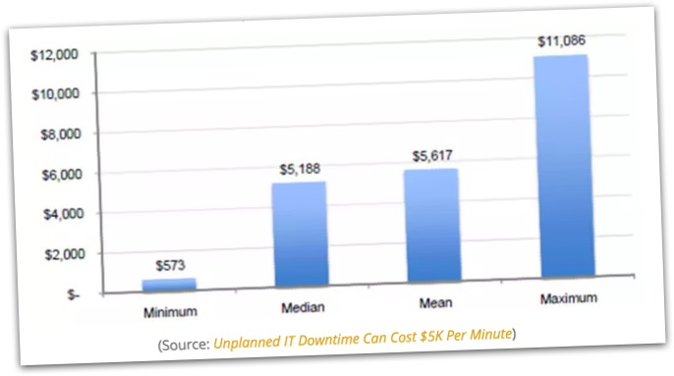
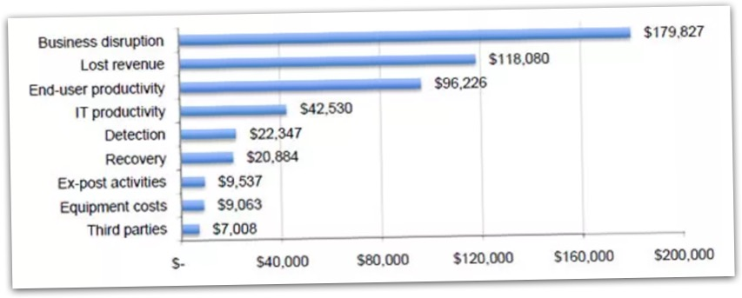
Misconfigurations are expensive
$
$
Notes:
In addition to being common, configurations are also expensive. Numerous studies that have looked at the problem have concluded that network outages caused by misconfiguration cost hundreds of thousands of dollars for every hour of downtime.

Slide 4
Why control-plane configuration is hard
Complexity
Low-level
Complex
-BGP, OSPF, RIP
-Route redistribution
-Metric conversions
-Protocol parameters
-Interface metrics
-Interface filters
Low-level
Distributed
Failures
Distributed
Failures
-Device configurations
-100,000s of lines
-Link failures common
-Router failures possible
Bugs
Notes:
One of the main reasons misconfigurations occur with such frequency is because…

Slide 5
Many data planes
In the presence of certain
eBGP routes from peers
When forwarding
a specific packet
Routes are exchanged in
a specific order
???
???
2
1
???
???
???
After particular
links have failed
Notes:
Furthermore, a single set of control plane configurations can result in a huge number of different data planes depending on the exact scenario, and some bugs will only appear in specific data planes.
Want to be proactively verify correctness under for all possible data planes that might emerge from the control plane.

Slide 6
Progress in Network Verification
Data Plane Analysis
Control Plane Analysis
HSA [1]
Veriflow [2]
Batfish [3]
Ping
Traceroute
[1] Kazemian et al, NSDI’12
ERA [4]
[2] Khurshid et al, NSDI’13
Network Design Coverage
[3] Fogel et al, NSDI’15
ARC [5]
[4] Fayaz et al, OSDI’16
[5] Gember-Jacobson et al, SIGCOMM’16
Bagpipe [6]
[6] Weitz et al, OOPSLA’16
Single
Packet
Single
Data Plane
Controllable
Data Plane
Multiple
Data Planes
All
Data Planes
Data Plane Coverage
Notes:
Fortunately, as a community, we have made some progress towards this, but we haven’t gone all the way. Here is the progress we have made so far.
Elaborate on why they don’t work (e.g., Bagpipe only works for a specific kind of BGP setup. can’t model iBGP, local-pref, etc).

Slide 7
‘‘
Is it possible to build a verification tool that achieves both high network design coverage and data plane coverage while remaining scalable enough to enable verification of many real networks?
’’

Slide 8
Progress in Network Verification
Data Plane Analysis
Control Plane Analysis
This Talk
HSA [1]
Veriflow [2]
Batfish [3]
Minesweeper
Ping
Traceroute
[1] Kazemian et al, NSDI’12
ERA [4]
[2] Khurshid et al, NSDI’13
Network Design Coverage
[3] Fogel et al, NSDI’15
ARC [5]
[4] Fayaz et al, OSDI’16
[5] Gember-Jacobson et al, SIGCOMM’16
Bagpipe [6]
[6] Weitz et al, OOPSLA’16
Single
Packet
Single
Data Plane
Controllable
Data Plane
Multiple
Data Planes
All
Data Planes
Data Plane Coverage

Slide 9
Our Approach
Represent the network as a combinational circuit
Relates the inputs and outputs of devices with SMT constraints
Any solution to these constraints represents a stable data plane
Use static analysis to optimize the circuit encoding
Remove protocol details when possible
Leads to an average 460x speedup

Slide 10
The Architecture

Slide 11
Workflow
1.
Vendor-Specific Configs
2.
Vendor-Independent Format
Cisco
Arista
Interfaces: {
Ethernet0/0: {
InterfaceCost: 1,
importPolicy: “PEER_IN”,
…
}
}
Juniper
Parse
Encode
3.
4.
Output
Circuit Encoding
192.0.0.0 ≤ out.prefix
out.prefix ≤ 192.1.0.0
best.valid ⇒ out.lp = 120
best.valid ⇒ out.ad = 20
+ Property
Solve
Notes:
Idea: (4) useful counter-example OR verified property

Slide 12
Demo
Notes:
“Minesweeper can detect violations of properties. Provide counter examples. Validate that we have fixed all the problems.”

Slide 13
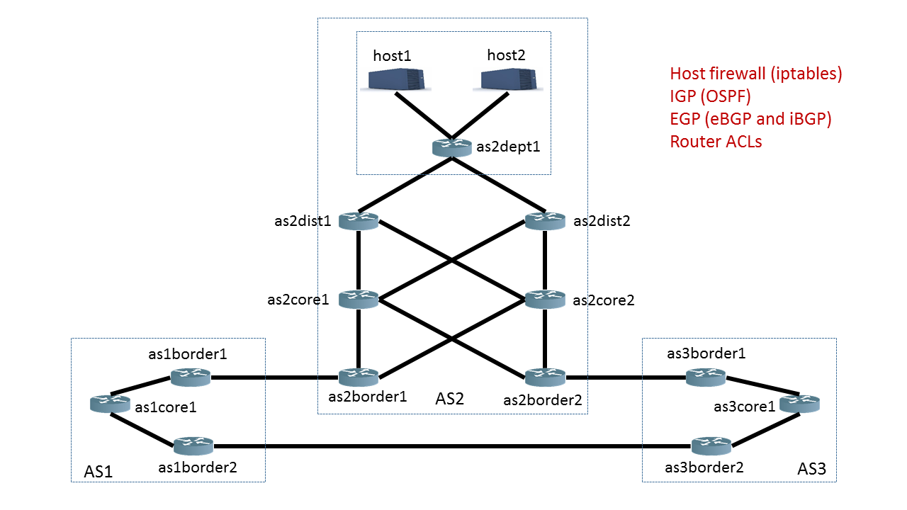
Demo: Topology
‘‘
Can the border routers
always reach host1?
’’

Slide 14
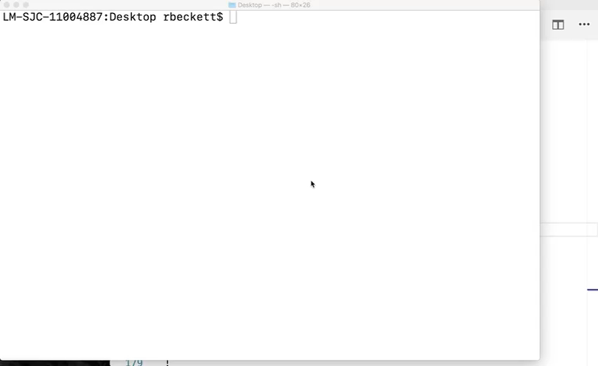
Notes:
This system will pinpoint “community, prefix length, etc that trigger the bug”

Slide 15
Example Encoding

Slide 16
Encoding Overview
‘‘
’’
Does P hold in the network?
N1
N2
N3
Network Encoding: N
S1
R1
R2
S2
⋀
Network Property: ¬ P
R3
Satisfiable: Property Violation
S3
Unsatisfiable: Holds for all data planes

Slide 17
Running Example
‘‘
Data plane packet
1
How does each router
forward a packet?
’’
N1
N2
N3
Symbolic Packet
{
}
0 ≤
dstIp
≤ 2³²
S1
R1
R2
S2
0 ≤
srcIp
≤ 2³²
0 ≤
dstPort
≤ 2¹⁶
???
???
0 ≤
srcPort
≤ 2¹⁶
R3
0 ≤
protocol
≤ 2⁸
S3
Notes:
At the end of the day, we care about how a packet is forwarded through the network.

Slide 18
Running Example
Protocol Interactions
2
N1
N2
N3
N1
N2
N3
Protocol
View
R1
R2
R1
R2
BGP
BGP
S1
S2
S1
CON
OSPF
OSPF
CON
S2
R3
R3
OSPF
CON
S3
S3

Slide 19
Running Example
Protocol Interactions
2
N1BGP
N1
N2
N3
Redistribution
From CON to BGP
BGP peering
Between R1 and R2
Circuit
View for R1
R1
R2
BGP
BGP
S1
CON
OSPF
OSPF
CON
S2
R1CON
R1BGP
R2BGP
R3
in4
e4
OSPF
CON
After R2
export filter
S3
R1OSPF
After R1
import filter
Notes:
Can a “routing record“ reach this point in a stable solution Define term. Black dots are routing records.

Slide 20
Running Example
Control Plane Info
3
N1BGP
Routing Record
valid:
1 bit
{
}
prefix:
[0,2³²)
prefixLen:
[0,2⁵)
R1CON
R1BGP
adminDist:
[0,2⁸)
localPref:
[0,2³²)
metric:
[0,2³²)
med:
[0,2³²)
ospfType
[0,2²)
R1OSPF

Slide 21
Running Example
R1 BGP import filter from R2
Import FIlters
4
ip prefix_list L deny 192.168.0.0/16 le 32
ip prefix_list L allow
route-map R1_Import_From_R2 10
match ip address prefix-list L
set local-preference 120
N1BGP
SMT constraint
If R2 exports a route
if e4.valid ∧ failedR1,R2 = 0 then if ¬ (FBM(e4.prefix, 192.168.0.0, 16) ∧
16 ≤ e4.prefixLen ≤ 32) then
in4.valid = true in4.lp = 120 in4.prefix = e4 .prefix
in4.metric = e4.metric
in4.prefixLen = e4 .prefixLen
…
else in4.valid = false
else in4 .valid = false
R1CON
If it passes the import filter
R1BGP
R2BGP
in4
e4
Then R1 has the same
route with local-pref 120
R1OSPF
Otherwise, R1 does not
have a route from R2

Slide 22
Running Example
Decision Process
5
N1BGP
What is the best BGP route?
R1-BGP-BEST = Min(in1, in4, in5, in7)
in1
in7
What is the best overall route?
R1CON
R1BGP
R2BGP
R1-BEST = Min(R1-BGP-BEST
in4
R1-OSPF-BEST
in5
R1-CON-BEST)
R1OSPF

Slide 23
Running Example
Decision Process
5
N1BGP
Does R1 have a RIB entry for R2?
RIB_{R1,R2} = (in4 = R1-Best)
R1CON
R1BGP
R2BGP
Does R1 have a FIB entry for R2?
e4
FIB_{R1,R2} = RIB_{R1,R2} ⋀ ¬ ACL(R1,R2)
in4
R1OSPF

Slide 24
Supported Features
Features
Implemented
Continued…
OSPF Intra-area
iBGP
OSPF Inter-area
Route Reflectors
eBGP Local-pref
Static Routes
eBGP Communities
Route Redistribution
eBGP MEDs
Multipath Routing
eBGP Path Prepending
Access Control Lists
eBGP Aggregation
IPV6

Slide 25
Property: Reachability / Isolation
‘‘
’’
Can router R3 (not) reach subnet S2?
N1
N2
N3
canReach_{R2} ⇔ FIB_{R2,S2}
canReach_{R1} ⇔
(FIB_{R1,R2} ⋀ canReach_{R2}) ⋁
(FIB_{R1,R3} ⋀ canReach_{R3})
S1
R1
R2
S2
canReach_{R3} ⇔
(FIB_{R3,R1} ⋀ canReach_{R1})
R3
Property: canReach_{R3}
S3
Notes:
Emphasize, reachability here is for all possible data planes

Slide 26
Supported Properties
Reachability
Waypointing
Isolation
Path Length
2
1
0

Slide 27
Supported Properties
Disjoint Paths
Black Holes
Forwarding Loops
Multipath Consistency
D
S

Slide 28
Supported Properties
Load Balancing
Fault-Invariance
.4
.6
Router Equivalence
Network Equivalence
=

Slide 29
Optimizations

Slide 30
Optimizations: Prefix Hoisting
Routing Record
FBM(r.prefix, 192.4.0.0, 16) ⋀
16 ≤ r.prefixLen ≤ 32
valid:
1 bit
{
}
=
prefix:
[0,2³²)
prefixLen:
[0,2⁵)
FBM(dstIp, 192.4.0.0, 16) ⋀
16 ≤ r.prefixLen ≤ 32
adminDist:
[0,2⁸)
localPref:
[0,2³²)
=
metric:
[0,2³²)
med:
[0,2³²)
(192.4.0.0 ≤ dstIp ≤ 192.4.0.0 + 2³²⁻¹⁶) ⋀
16 ≤ r.prefixLen ≤ 32
ospfType
[0,2²)
Integer Difference Logic!
Notes:
Set up mental model of what costs (prefix is a bitvector for every route record) (N representations of the control plane)

Slide 31
Optimizations: Slicing
Symbolic Record
{
valid:
1 bit
}
Statically analyze the configs to
determine when certain attributes
are irrelevant
prefixLen:
[0,2⁵)
adminDist:
[0,2⁸)
localPref:
[0,2³²)
[0,2³²)
Example: if the local preference
is never explicitly set, then it can
not influence the decision process
metric:
med:
[0,2³²)
ospfType
[0,2²)

Slide 32
Optimizations: Slicing
Maintain a single copy of export
variables when the export policy
is uniform to all peers
N1BGP
N1BGP
e2
e2
out2
Merge the import and export
records when the default import
policy is used
out3
e3
out3
R1BGP
R2BGP
R1BGP
R2BGP

Slide 33
Evaluation

Slide 34
Evaluation
Can Minesweeper find real bugs?
Run on a collection of 152 legacy networks
1—23K lines of configuration
Use OSPF, eBGP, iBGP, Static Routes, ACLs, Redistribution
How well does Minesweeper scale?
Test on a collection of synthetic data center benchmarks
Compare verification time across a wide variety of properties

Slide 35
Evaluation: Bug Finding
Mangement interface reachability
Loopback0
Found 67 violations of the property
Example: BGP peer sends /32 with length 2
Local equivalence of routers
Found 29 violations
Example: ACL has missing entry
Blackholes occur only at the network edge
Found 24 violations of the property
Reachability is the same after any 1 failure
Found no violations of the property

Slide 36
Evaluation: Scalability
Management interface reachability
< 60 ms
Local equivalence of routers
(For all n comparisons)
< 400 ms

Slide 37
Evaluation: Scalability
Black holes only occur
at the network edge
< 1.5 sec
Reachability is the same after
any single link failure
< 350 ms

Slide 38
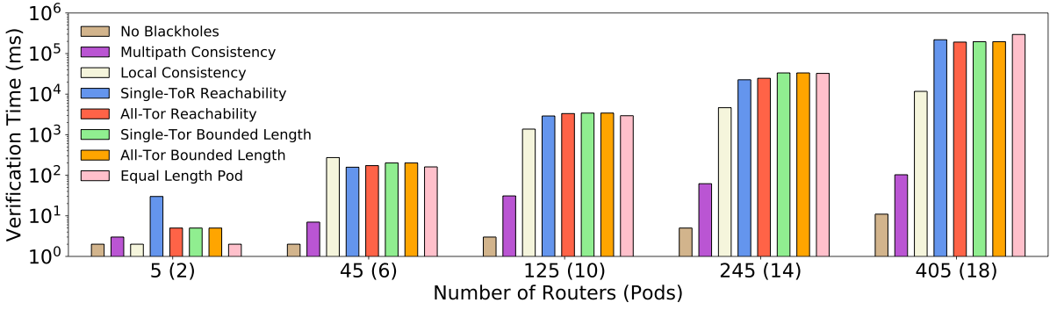
Evaluation: Scalability
< 5 minutes

Slide 39
Conclusions
Minesweeper is a general and scalable control plane verification tool
Represents the network as a combinational circuit
in1
out1
in2
out2
Our optimizations enable scaling to real networks
https://batfish.github.io/minesweeper/

