Slide 1
Recommending Mobile Apps - A Collaborative Filtering Viewpoint
Yuan Yao (姚远)
Nanjing University

Slide 2
Outline
Background and Motivations
Observations
The Proposed Approach
Empirical Evaluations
Conclusions

Slide 3
A New Ecosystem
Developer
User
App
1. User requirement changes
=> Simply choose another app
2. Developers infer user requirements, and update their apps accordingly
3. Users can express opinions on Apps, which can be seen as quality assessment
Loose coupling
Informal feedback
Mobile App Market
Notes:
Competitive, Fast evolving
Sentiment analysis, Opinion summarization

Slide 4
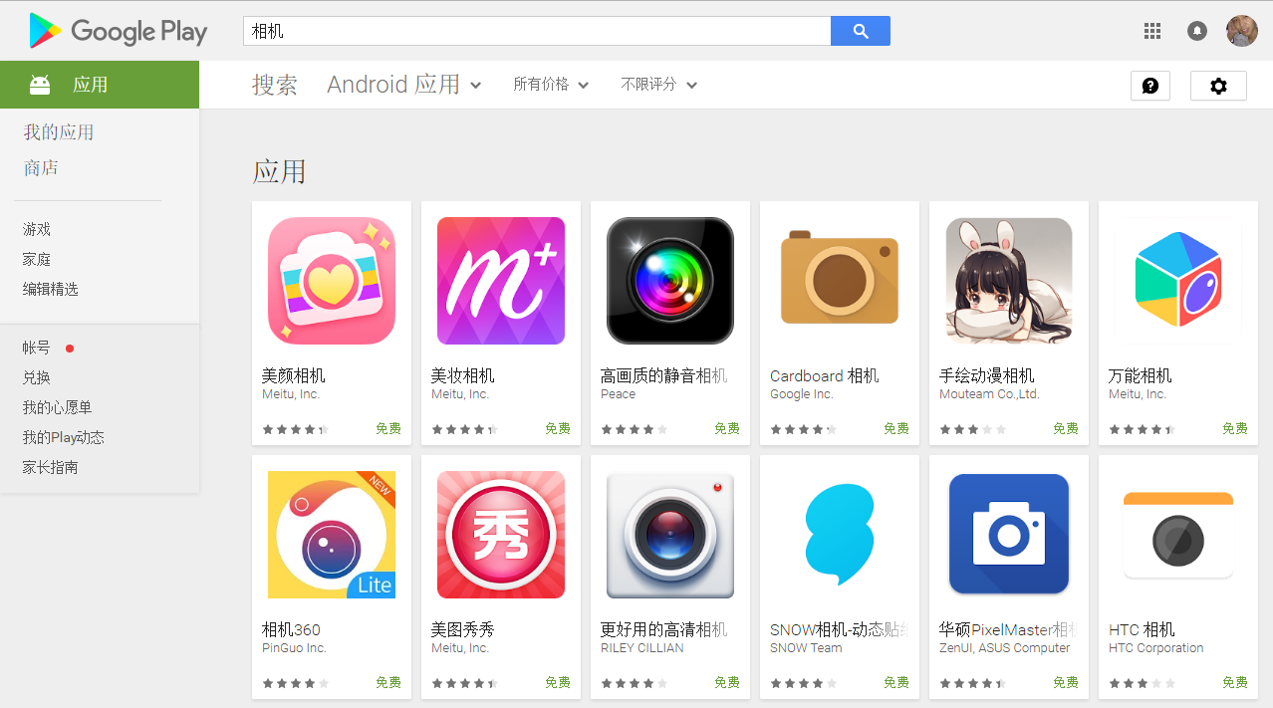
Too Many Apps…
Over 2.2m apps & over 50b downloads in Google Play
“camera” query in Google Play
99 results returned
Notes:
Users typically use 20-200 apps

Slide 5


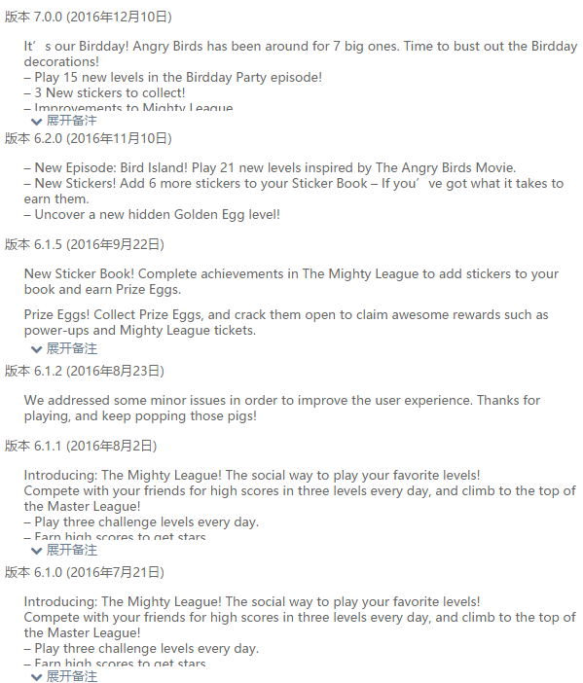
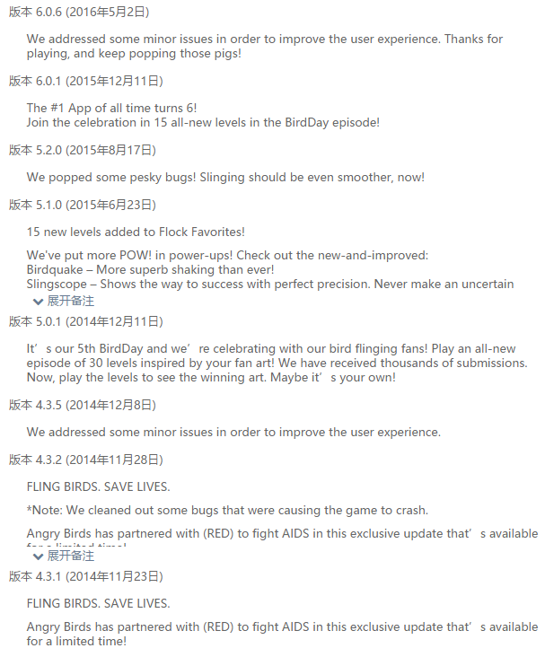
Too Many Updates…
Version logs of “Angry Birds”
14 updates in the past year
Notes:
Updates cause problems
Differs from traditional recommendation

Slide 6
Target Problem
Goal: Infer the preference degree (i.e., rating) of a user on the latest version of an app
Available information in mobile App market
Recommendation engine
The preference of users to latest app versions

Slide 7
Outline
Background and Motivations
Observations
The Proposed Approach
Empirical Evaluations
Conclusions

Slide 8
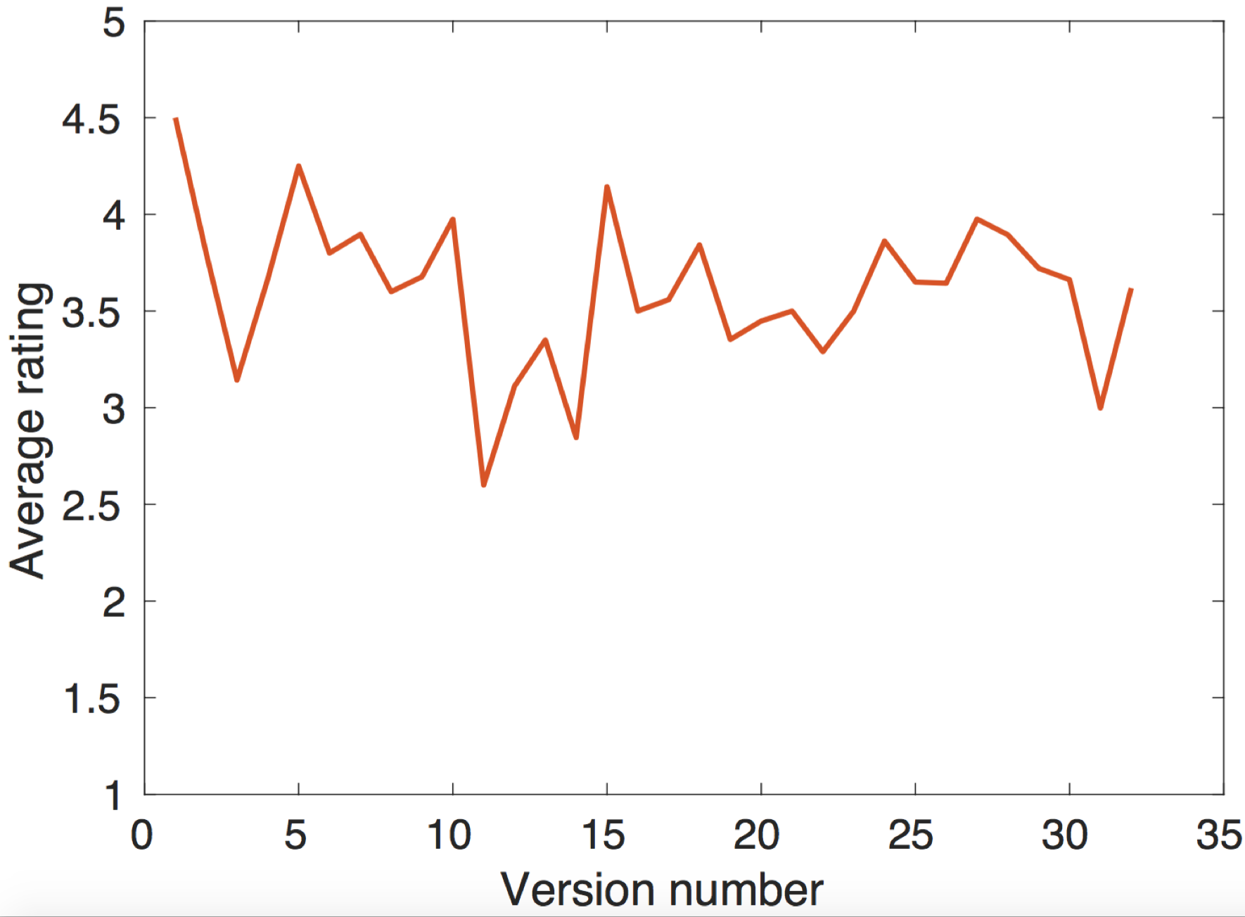

Observations
1. Users may rate differently on different versions of an app
App level

Slide 9




User ID
APP
Version
Rating
Happy Farm: Candy Day
“1.8.7”
“1.8.8”
---
“1.8.9”
105
“1.9.0”
User level
“1.9.1”
---
“1.0”
---
SuperLivePro
“1.1”
---
“1.2”
---
“1.3”
---
374
“1.4”
“1.5”

Slide 10


Observations
1. Users may rate differently on different versions of an app
Verification through rating variation (RV)
RV(a) – app level | RV(u) – user level
0.8241 (0.5223) | 0.8098 (1.0391)
Notes:
RV(a)表示app不同版本之间的平均打分的差异：the average difference of the average ratings on successive versions of the same app
RV(u)表示一个用户对于同一个app不同版本之间打分的差异: the average difference of users’ ratings on the versions of the same app
On average, the average rating of the new version is 0.8 smaller/larger than its previous version
A user’s rating on a new version is 0.8 smaller/larger than his rating on the other versions of the same app

Slide 11
Observations
2. A wide range of information that is helpful for recommendation is available in mobile app markets
Users’ ratings
Review text associated with ratings
App descriptions
Users’ social relationships

Slide 12
Outline
Background and Motivations
Observations
The Proposed Approach
Empirical Evaluations
Conclusions

Slide 13
The questions…
Q1: how to use user ratings?
Q2: how to use review text?
Q3: how to use version information?
Q4: how to use app descriptions?
Q5: how to use social relationships?

Slide 14
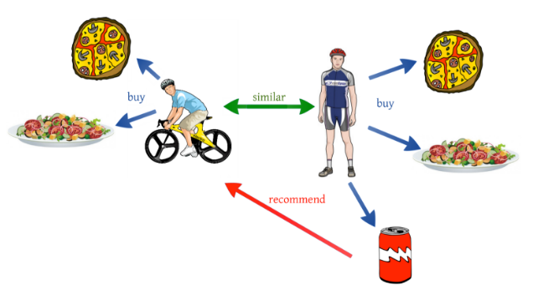

Q1: User Ratings
Collaborative filtering
Basic idea
A matrix factorization formulation
User-app rating matrix
User-version rating matrix (R matrix)
User latent factors
Version latent factors

Slide 15

Q2: Review Text
Factorize app-term/version-term text matrix as specified factors
Version level (matrix X) & App level (matrix Y)
Connect with ratings
Version latent factors
Term latent factors
App latent factors
Term latent factors
Version latent factors from ratings
App-version association matrix

Slide 16
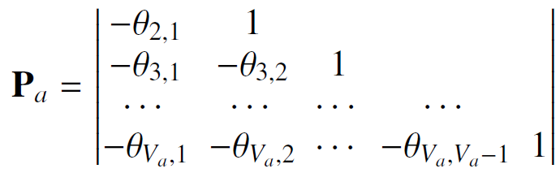
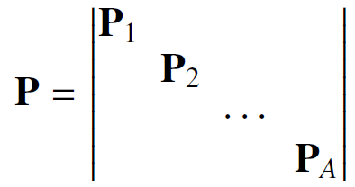

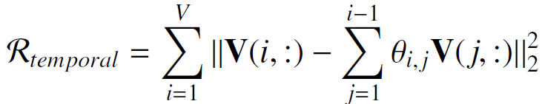
Q3: Version Information
Version latent factors
Multiple versions of the same app are close to each other (matrix P)
V1
V2
V3
V4
V5

Slide 17
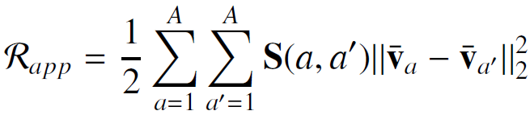

Q4: App Descriptions
Compute app similarities based on app descriptions
Similar apps are close to each other (matrix S)

Slide 18

Q5: Social Relationships
Connected users are similar to each other (Z matrix)
Similar to app descriptions

Slide 19
App Similarity (S)
1
Term 4
Term 2
Term 5
Term 1
Term 3
Term 6
3
2
1 | 1 |  | 3 | 2 | 1
 |  | 3 | 2 |  | 1
 | 1 | 1
App-Version Association (M)
App 1
App 2
App 1
App 2
App 3
App 3
App-Term Matrix (Y)
Version 2
Version 6
Version 1
Version 4
Version 3
Version 5
Term 2
Term 6
Term 1
Term 3
Term 4
Term 5
User 1
3 |  | 5 |  | 5
 |  |  | 4 |  | 2
 | 4 | 4
 |  | 5 | 3 |  | 1
5 |  | 3
User 2
Version 1
1 |  |  | 1 | 2
 | 1 |  | 2 |  | 1
 |  | 1 | 1
 |  |  | 1
 |  | 2 |  |  | 1
 | 1 | 1
User 3
Version 2
User 4
Version 3
User 5
Version 4
Rating Matrix (R)
Version Correlation (P)
Version 5
App 1
Version 1 | Version 2
Version 3 | Version 4 | Version 5
Version 6
Version 6
App 2
App 3
Version-Term Matrix (X)

Slide 20
Overall Model
R
X
Y
Input ratings and text
(latent factor sharing)
U
G
H
F₁
F₂
Latent factors (to learn)
P
S
Constraints (regularization)
R: user-version rating matrix
X: version-term matrix
Y: app-term matrix
P: version temporal correlation matrix
S: app similarity matrix
U: user latent factors
G: term latent factors
H: version latent factors from ratings
F₁: version latent factors from version text
F₂: app latent factors from app text

Slide 21
Outline
Background and Motivations
Observations
The Proposed Approach
Empirical Evaluations
Conclusions

Slide 22
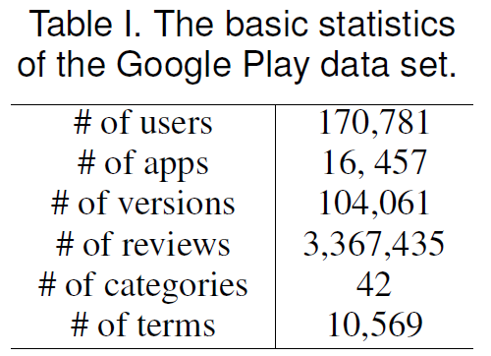
Evaluation Setting
Data set: Google Play
Evaluation metrics
RMSE/MAE
Select (100-γ)% ratings on latest app versions as test set
γ = 0 means cold start scenario

Slide 23
Evaluation Objectives
O1: how accurate is the proposed method?
O2: how does each component perform?
O3: how does performance vary over different categories?
O4: how scalable is the propose method?

Slide 24
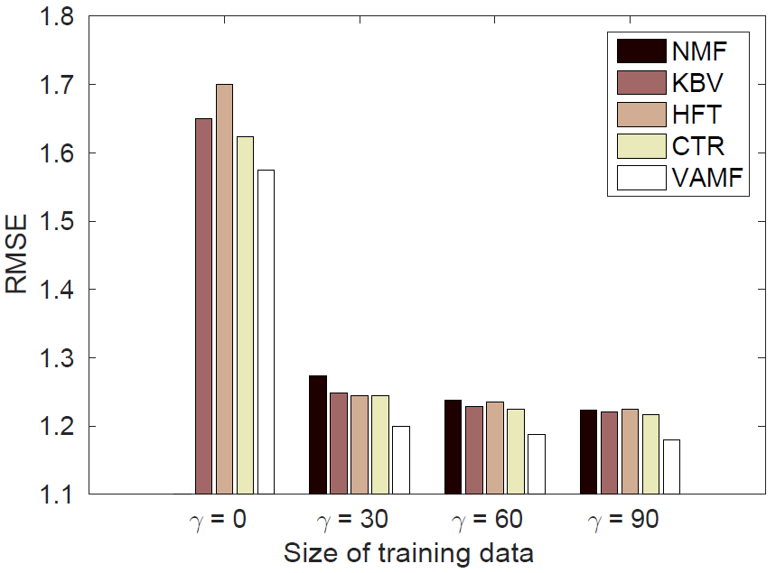
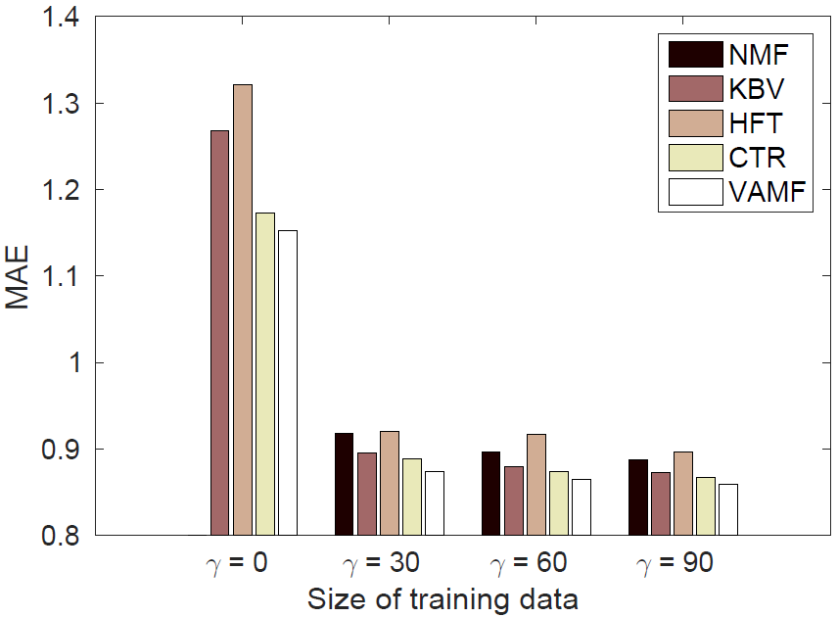
O1: Overall Accuracy
Accuracy: 3.6% - 5.8% improvement
(better)
Overall method
NMF: Lee and Seung, Algorithms for non-negative matrix factorization. NIPS 2000.
KBV: Koren et al., Matrix factorization techniques for recommender systems. Computer 2009
HFT:[McAuley and Leskovec, Hidden factors and hidden topics: understanding rating dimensions with review text. RecSys 2013.
CTR: [Wang and Blei, Collaborative topic modeling for recommending scientific articles. KDD 2011.

Slide 25
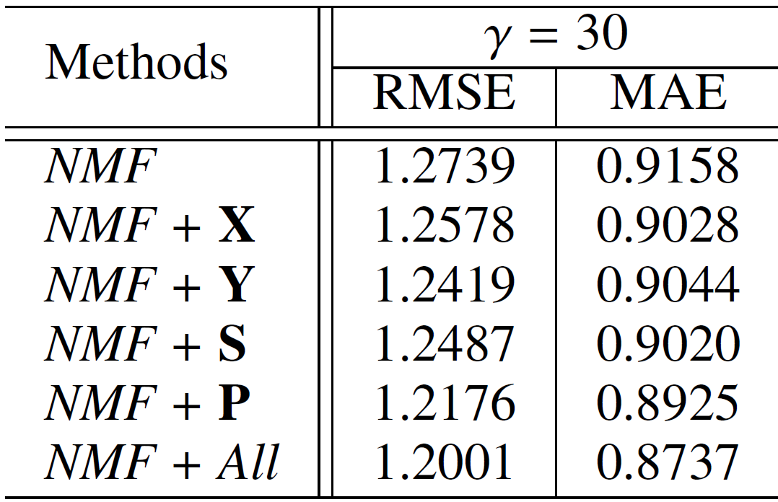
O2: Component Analysis
Base method
Add version-term
Add app-term
Add app description
Add version correlation
Overall method

Slide 26
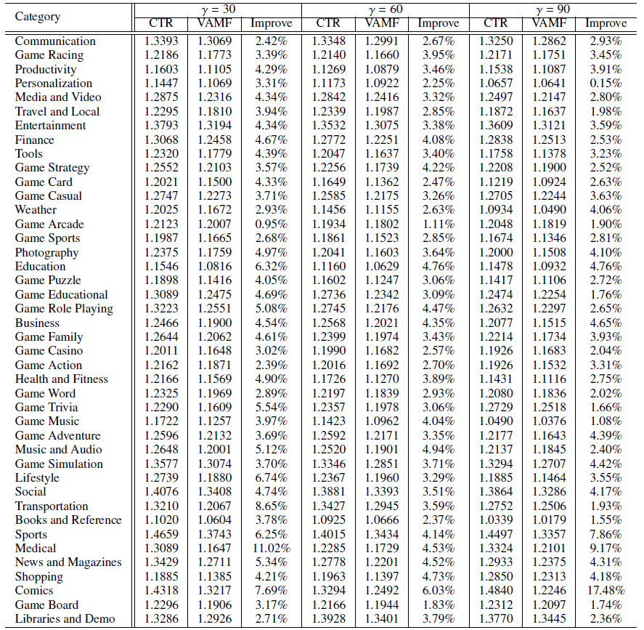
O3: Category Comparisons
RMSE is better in 42 out of 42 categories
MAE is better in 33 out of 42 categories

Slide 27
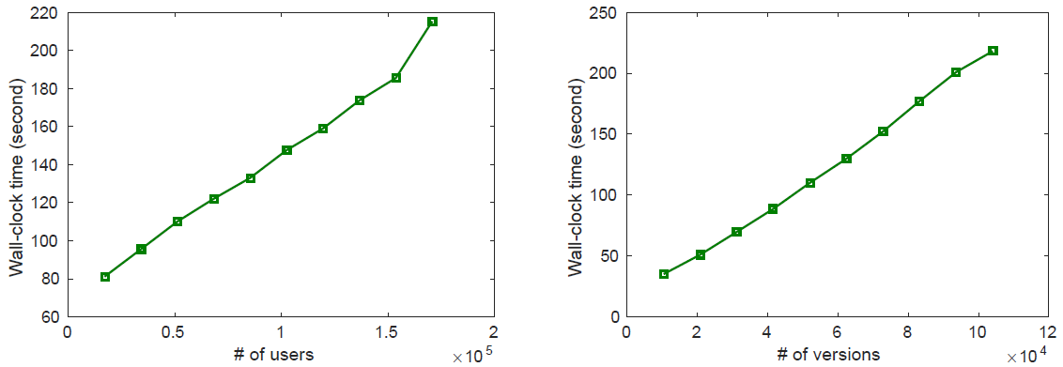
O4: Scalability
Training time: linear scalability
Time v.s. # of users
Time v.s. # of versions

Slide 28
Outline
Background and Motivations
Observations
The Proposed Approach
Empirical Evaluations
Conclusions

Slide 29
Summary
A mobile app recommender which
Infers users’ preference on the latest app versions
Collectively considers review ratings, review text, version correlation, and app descriptions
Experimental evaluations show that it
Outperforms several benchmark methods
Scales linearly w.r.t. data size

Slide 30
The Crawled Data (Ready to Share)
For each app, we have its:
app_id, app_name, app_category, app_author, app_release_date, app_price, app_size, app_current_rating_score, app_current_rating_count, app_all_rating_score, app_all_rating_count, app_description, app_whats_new
The version update logs
For each review, we have its:
app_id, user_id, rating, review_title, review_content, review_time, review_vote_sum, review_vote_count, app_version

Slide 31
Future Directions
Automatically learn the relatedness of multiple versions
Is user stickiness significant?
Do app developers really care about user feedback?
Version update logs v.s. user reviews
Does this affect app popularity/ratings?
Identify fake user reviews
Connect outer app evaluation with inner evaluation
Which inner factors affect outer satisfaction?
Traceability between update logs and code modifications
Automatically generate app update packages
Notes:
Whether use third-party libraries (which); does these libraries contain advertisement

Slide 32
Thanks!
Q&A
Yuan Yao
Email:
y.yao@nju.edu.cn
Homepage:
http://moon.nju.edu.cn/people/yuanyao/

