Slide 1
Find Similar Questions from Community-based QA Services
Stephanie Valentine, Jung-in Koh, Shiqiang Guo

Slide 2
The background of the problem
We ask questions in Community-based QA website like Stackoverflow.com, Quora etc.
We want know whether there exists similar questions that have answers already
But searching similar questions is not trivial, look at the two questions below:
“How can I express a for loop in Python?”
“Is there any way to iterate through a range of integers?”
Same meaning, but share no common words

Slide 3
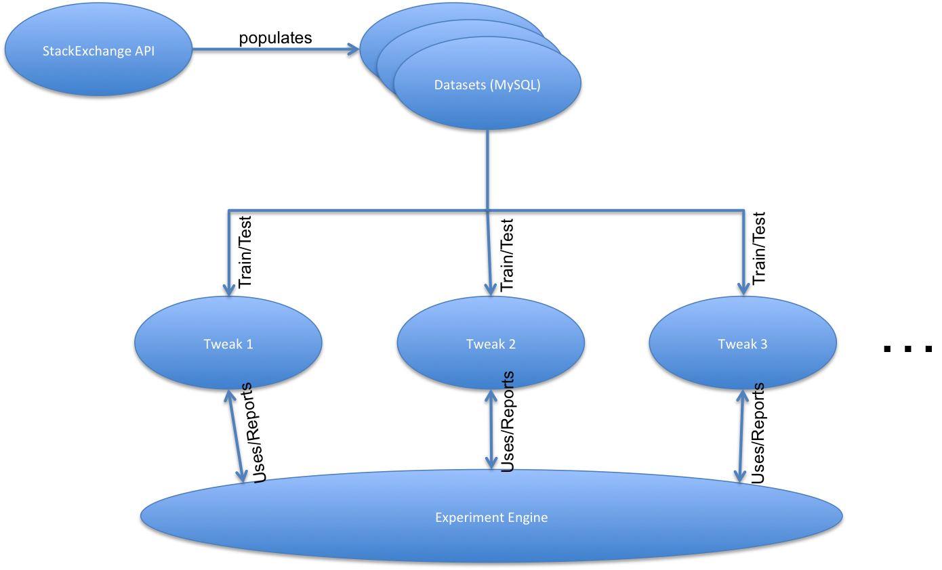
Our method

Slide 4
Vectorizers
TF-IDF Vectorizer
Synonym Vectorizer
Using wordnet to find synonyms of all terms
Adding td-idf of synonyms to the vector
NV Vectorizer
Get part-of-speech tags of terms
Boost noun and verb terms. Terms with tags
['NN','NNP','NNPS','NNS','VB','VBD','VBG','VBN','VBP','VBZ'] , their weight * 1.2

Slide 5
Data Source and metrics
HTTP request using API of stackexchange.com
Questions with tag “Python” from www.stackoverflow.com , about 280,000
Questions from english.stackexchange.com, about 35600
Documents
Title Only
Body Only
Title and Body
Metrics: NDCG

Slide 6
Result and evaluation

Slide 7
References
[1] Jeon, Jiwoon, W. Bruce Croft, and Joon Ho Lee. "Finding similar questions in large question and answer archives." In Proceedings of the 14th ACM international conference on Information and knowledge management, pp. 84-90. ACM, 2005.
[2] Wang, Kai, Zhaoyan Ming, and Tat-Seng Chua. "A syntactic tree matching approach to finding similar questions in community-based qa services." In Proceedings of the 32nd international ACM SIGIR conference on Research and development in information retrieval, pp. 187-194. ACM, 2009.
[3] Cao, X., Cong, G., Cui, B., Jensen, C.S., Zhang, C.: The use of categorization information in language models for question retrieval. In: CIKM 2009, pp. 265–274. ACM, New York (2009)
[4] Jijkoun, V., de Rijke, M.: Retrieving answers from frequently asked questions pages on the web. In: CIKM 2005, pp. 76–83. ACM, New York (2005)

