Slide 1
JOBFINDER: A PERSONALIZED RESUME-JOB MATCHING SYSTEM
Shiqiang Guo

Slide 2





Motivation
There are many job finding websites today.

Slide 3


They all use keyword Searching

Slide 4
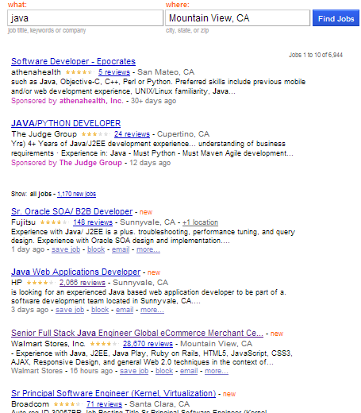
Problems of keywords Searching
Too many jobs return
The result is not ranked
7000 jobs returned when
searching with Java
Job finding become a tedious work

Slide 5
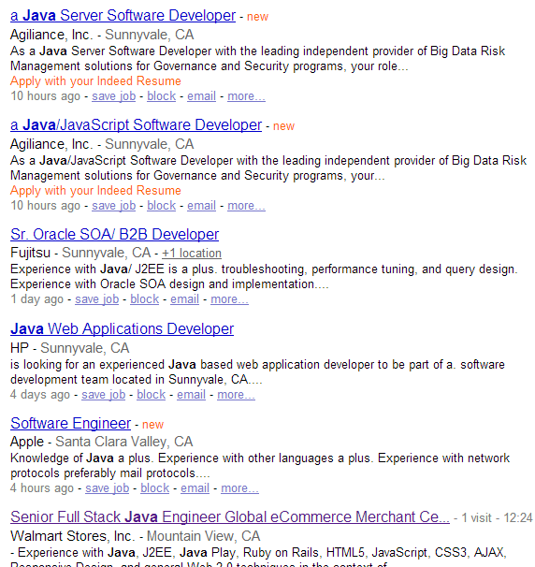
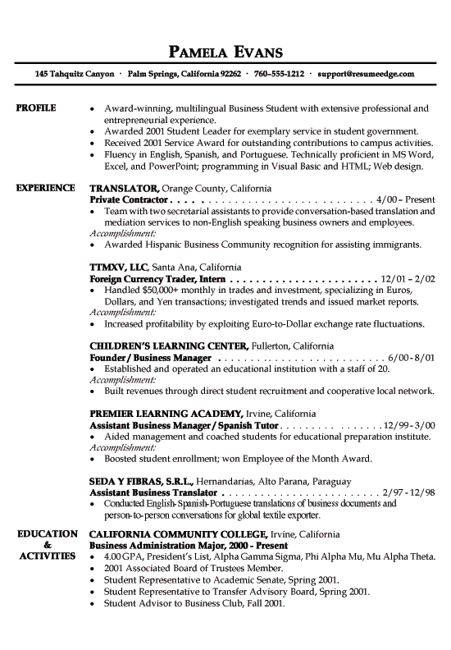
Job Finder

Slide 6
Contribution of our works
A resume – job matching system
A finite state transducer based tool for information extraction
A semi-automatic approach to collect technical terms
A statistical-based ontology similarity measure
Combined keyword searching and model matching

Slide 7
Recommender Systems
Content-based Recommendation (CBR)
suggest items that have similar content information to the corresponding users
Knowledge-based Recommendation (KBR)
rules and patterns obtained from the functional knowledge of how a specific item meets the requirement of a particular user
Knowledge-based Recommendation (KBR)
rules and patterns obtained from the functional knowledge of how a specific item meets the requirement of a particular user

Slide 8
Previous work
CASPER ACF
PROSPECT
…

Slide 9
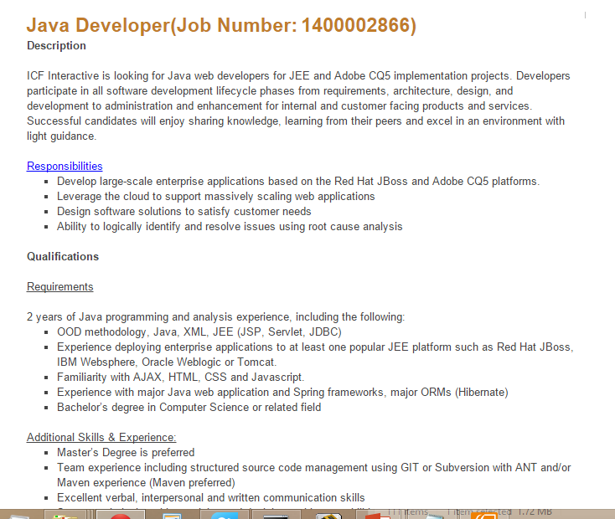
Problem Definition

Slide 10
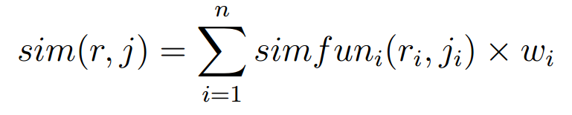
Problem Definition
r is the user‘s resume model, r_{i} is the feature of r
j is the job description model , j_{i} is the feature of j

Slide 11
Problem Definition
J is the set of jobs
Searching job → search(r, J)
Return list of jobs in J ranked by sim(r, j )

Slide 12
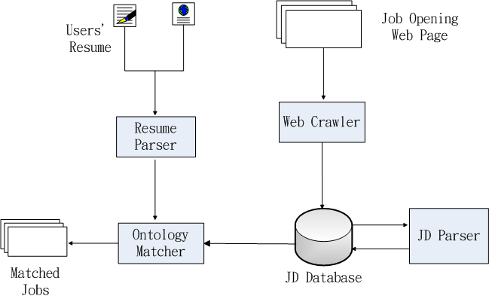
System Architecture

Slide 13
System Interface

Slide 14
Get the models from Resumes and Jobs
Users don’t like input personal information
Recruiter don’t like input job description in web forms
We need extraction information from plaint text

Slide 15
Some sentences from Job Description
A high-level language such as Java, Groovy, Ruby or Python; we use Java and Groovy extensively
HTML5/CSS3/JavaScript, web standards, jQuery or frameworks like AngularJS would be great
HTML CSS and Javascript a must 4. Experience with AJAX, XML, XSL, XSLT, CSS, JavaScript, JQuery, HTML and Web Services

Slide 16
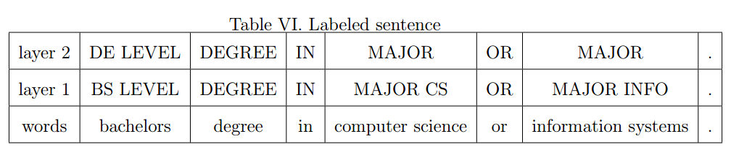
Pattern Matching

Slide 17
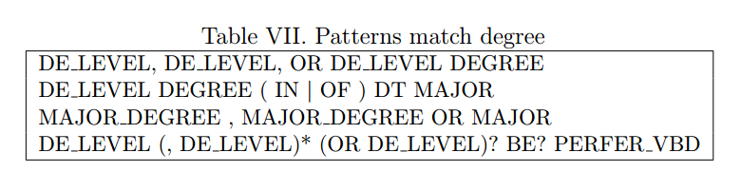
Other Patterns

Slide 18

Regular Expression Over Tokens
The unit of the expression is token or word
aaa ccc ddd
bbb ccc ccc sss ddd

Slide 19
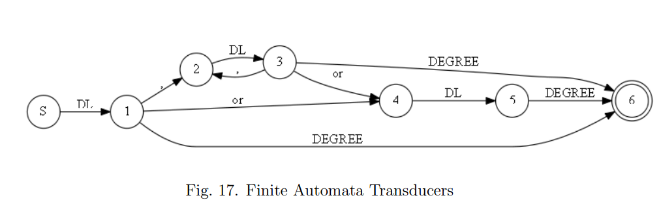
Finite Automata Transducers
A finite state transducer (FST) is a finite state machine with two tapes: an input tape and an output tape.

Slide 20
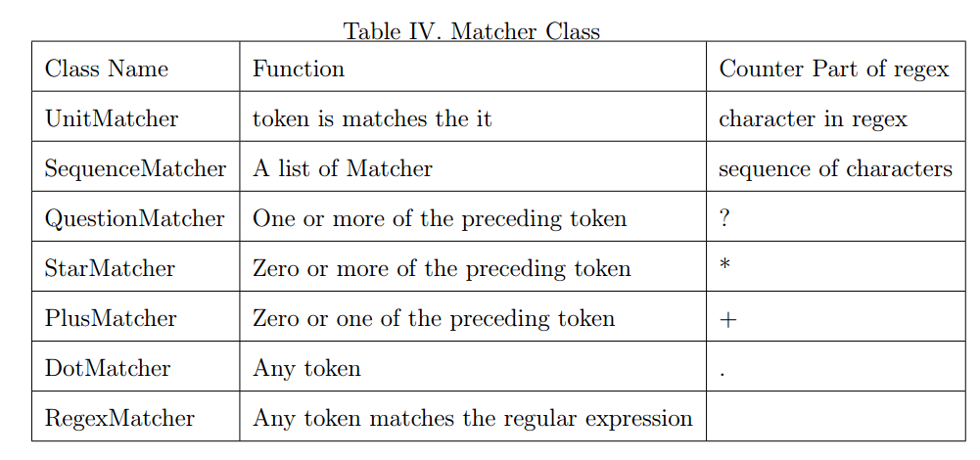
Grammer current support

Slide 21
Flexibility -- regular expression style

Slide 22
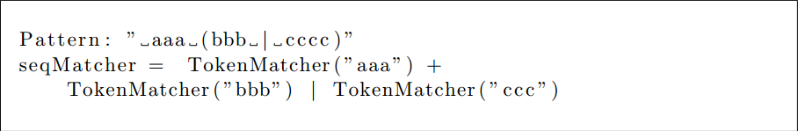
Flexibility -- connected by algebra operator

Slide 23
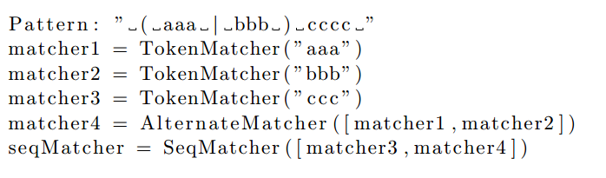
Flexibility – OO programming style

Slide 24
Flexibility
customized in catch function and output function by lambda expression

Slide 25
Flexibility
lambda x:x[0] – catch the original text
lambda x:x[2] -- catch the first layer label
lambda x:x[1] – output the second layer label

Slide 26
Processing the text
Transfer the sentence from
Bachelors degree in computer science or information systems
To

Slide 27
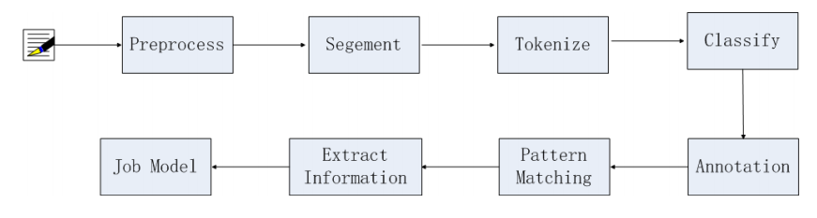
Information Extraction Pipeline

Slide 28
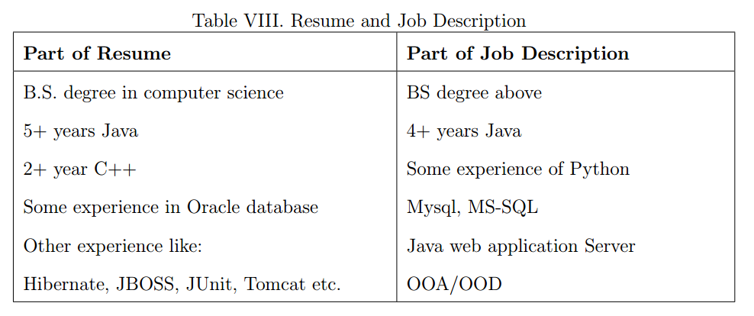
Similarity between concepts

Slide 29
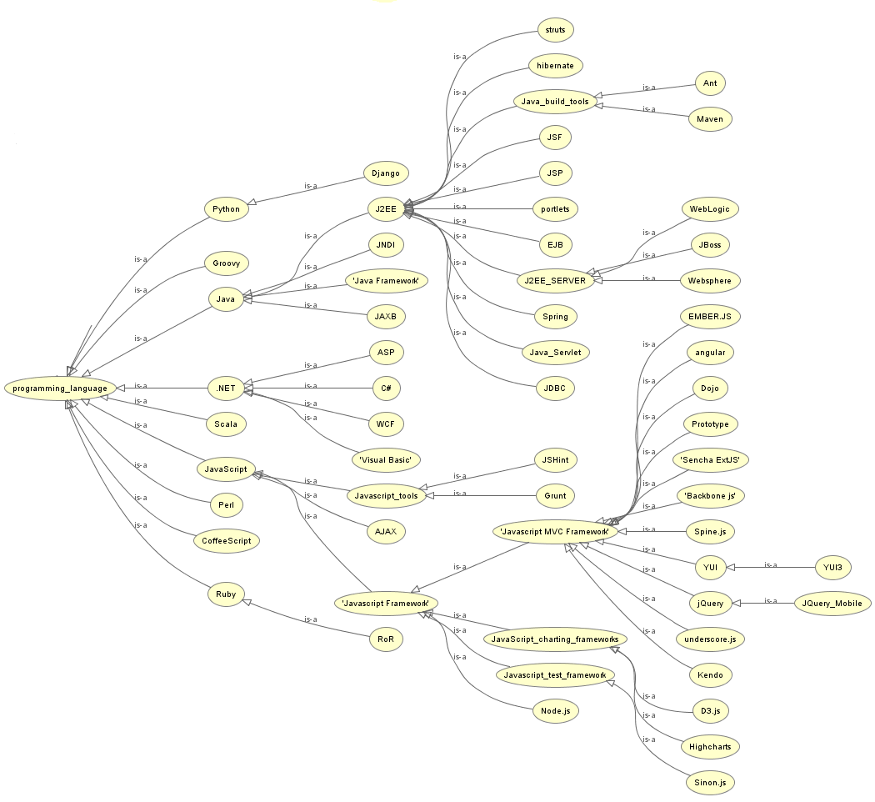
Ontology similarity

Slide 30


Ontology similarity
Path-based approaches
Feature-based measures
Content-based measures

Slide 31
Statistical-based Ontology Similarity Measure
A high-level language such as Java, Groovy, Ruby or Python; we use Java and Groovy extensively
HTML5/CSS3/JavaScript, web standards, jQuery or frameworks like AngularJS would be great
HTML CSS and Javascript a must 4. Experience with AJAX, XML, XSL, XSLT, CSS, JavaScript, JQuery, HTML and Web Services

Slide 32
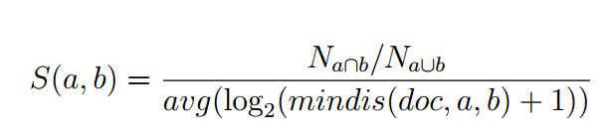
Statistical-based Ontology Similarity Measure
The ratio of the number of documents that two terms exist together to the number of documents have a least one them
The average log value of minimum distance of the two terms in documents that have them both.

Slide 33
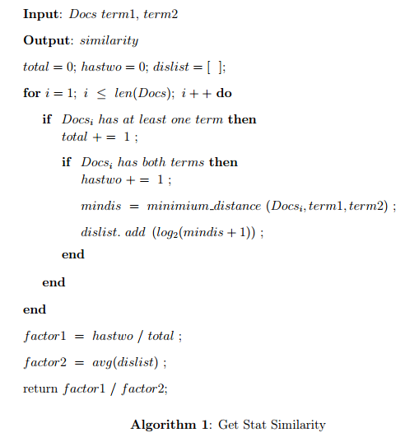
Algorithm of Similarity Calculation

Slide 34
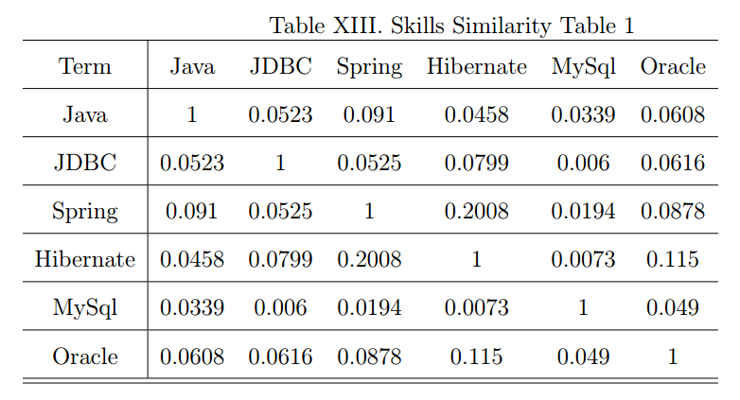
Similarity between terms

Slide 35
How to Find terms in Job Description
A high-level language such as Java, Groovy, Ruby or Python; we use Java and Groovy extensively
HTML5/CSS3/JavaScript, web standards, jQuery or frameworks like AngularJS would be great
HTML CSS and Javascript a must 4. Experience with AJAX, XML, XSL, XSLT, CSS, JavaScript, JQuery, HTML and Web Services

Slide 36
Pattern in sentences
< term , * , *, term >
< term , * , *, and term >
Bootstrap approach
Get some initial terms manually
Use the FST tool to find new terms
Checking on Dbpedia

Slide 37
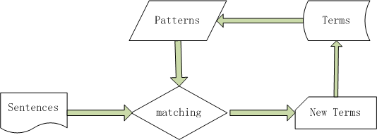
Bootstrap approach

Slide 38

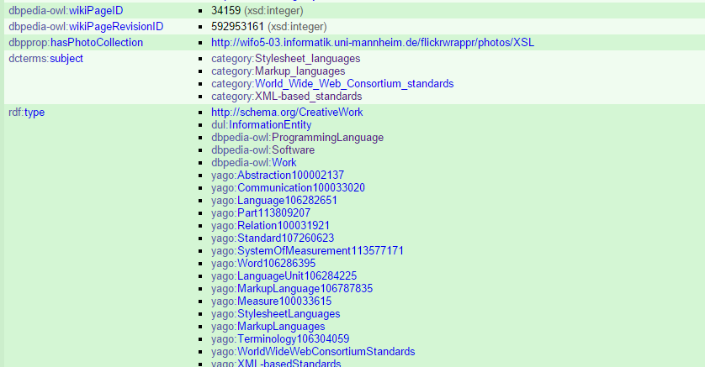
Dbpedia Page

Slide 39
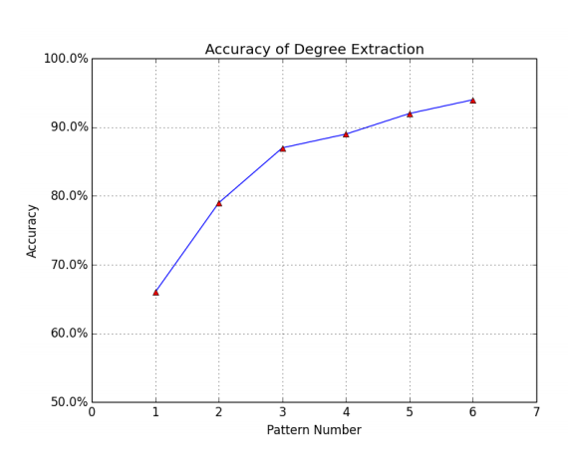
EVALUATION – Information Extraction

Slide 40
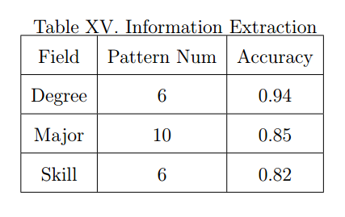
EVALUATION – Information Extraction
Accuracy of Information Extraction

Slide 41

EVALUATION – Ontology Similarity
Normalized Discounted Cumulative Gain(NDCG)

Slide 42
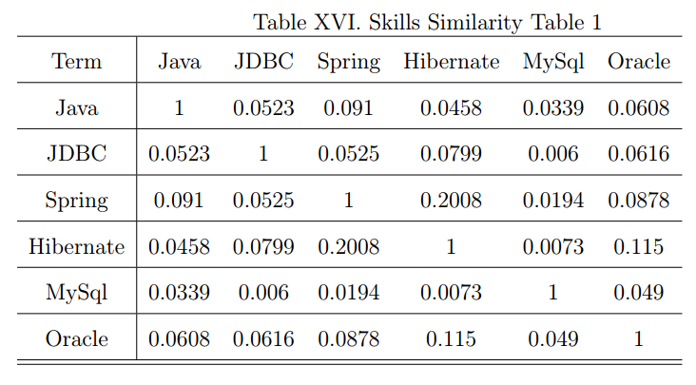
EVALUATION – Ontology Similarity

Slide 43
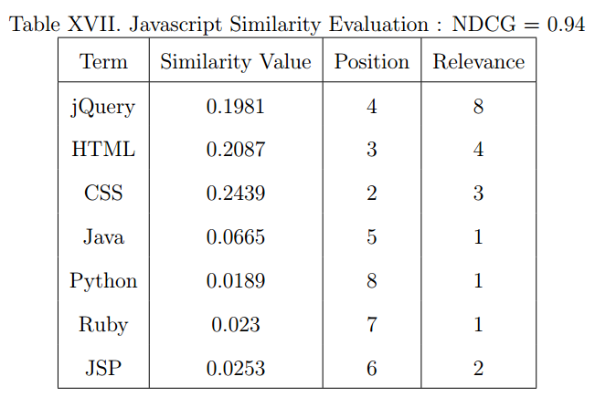
EVALUATION – Ontology Similarity

Slide 44
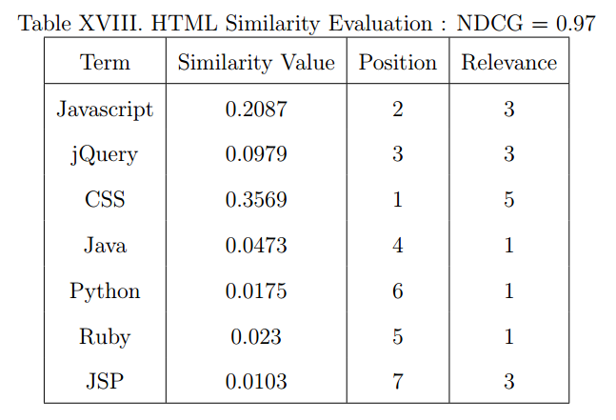
EVALUATION – Ontology Similarity

Slide 45

EVALUATION – System Performance
Measure
NDCG
Precision@K

Slide 46
EVALUATION – System Performance
5 resumes
100 jobs
Relevance value manually assigned

Slide 47
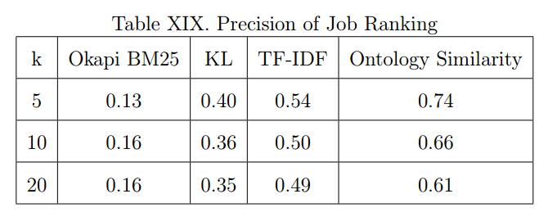
EVALUATION – System Performance

Slide 48
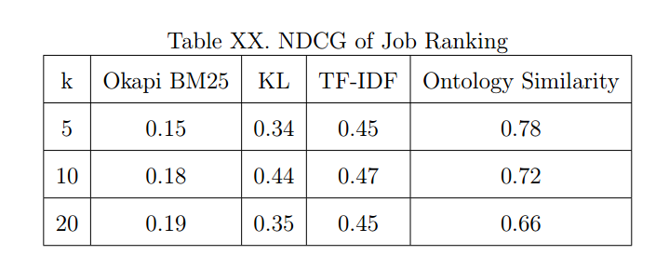
EVALUATION – System Performance

Slide 49
Conclusion ??

