Slide 1
JOBFINDER: A PERSONALIZED RESUME-JOB MATCHING SYSTEM
Shiqiang Guo

Slide 2





Motivation
There are many job finding websites today.

Slide 3


They all use keyword Searching

Slide 4
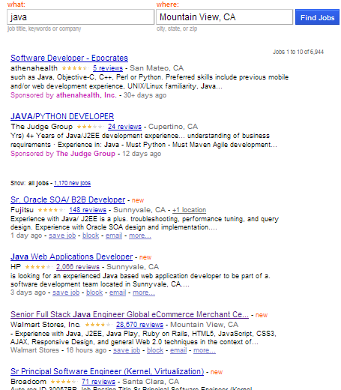
Problems of keywords Searching
When searching with Java
7000 unranked jobs returned.
Too many jobs return
The result is not ranked
Job finding become a tedious work

Slide 5
Main idea of JobFinder
A resume has completed personal information
Education
Work experience
Skills
Finding similarity between resumes and jobs
Ranking the jobs by their similarity value

Slide 6
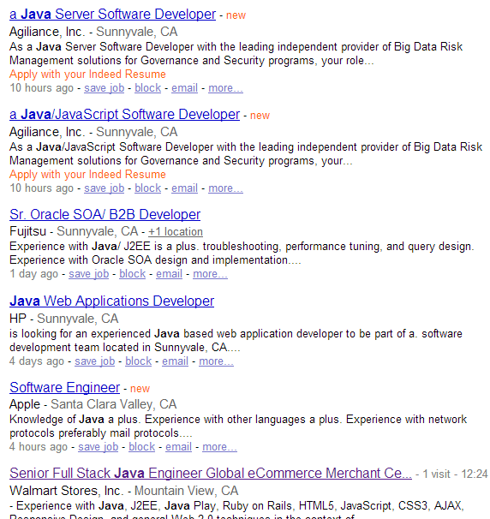
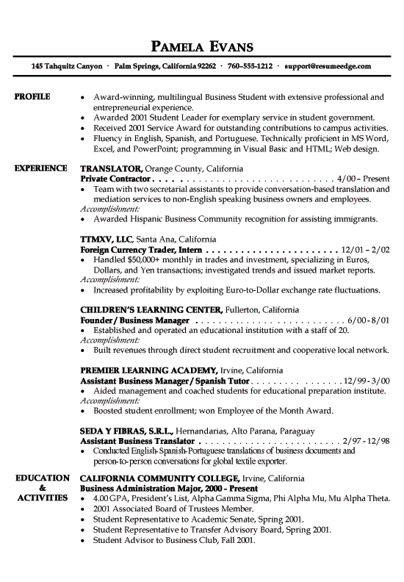
Job Finder

Slide 7
Contribution of our works
A resume – job matching system
A finite state transducer based tool for information extraction
A semi-automatic approach to collect technical terms
A statistical-based ontology similarity measure
Combined keyword searching and model matching

Slide 8
Recommender Systems
Content-based Recommendation (CBR)
suggest items that have similar content information to the corresponding users
Knowledge-based Recommendation (KBR)
rules and patterns obtained from the functional knowledge of how a specific item meets the requirement of a particular user
Knowledge-based Recommendation (KBR)
rules and patterns obtained from the functional knowledge of how a specific item meets the requirement of a particular user

Slide 9
Previous work
CASPER ACF
PROSPECT
…

Slide 10
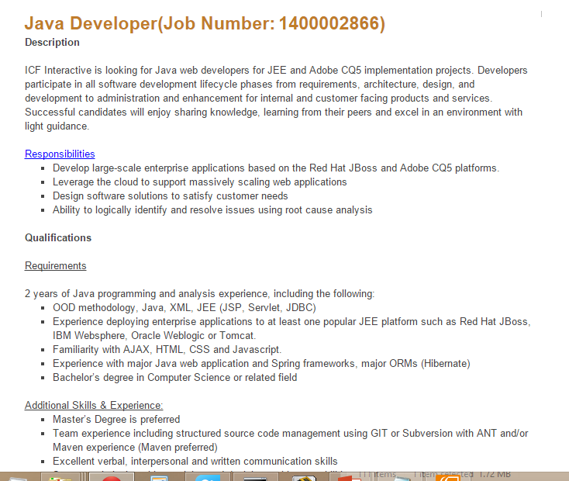
Problem Definition

Slide 11
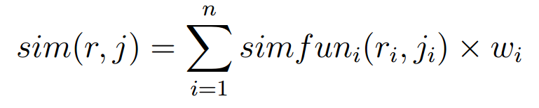
Problem Definition
r is the user‘s resume model, r_{i} is the feature of r
j is the job description model , j_{i} is the feature of j

Slide 12
Problem Definition
J is the set of jobs
Searching job → search(r, J)
Return list of jobs in J ranked by sim(r, j )

Slide 13
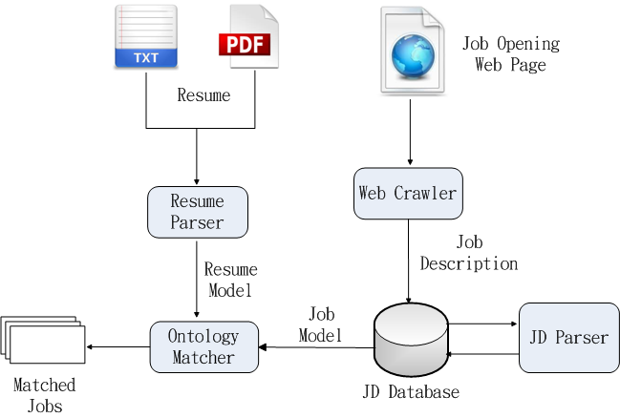
System Architecture

Slide 14
System Interface
DE_LEVEL

Slide 15
Information Extraction

Slide 16
Extracting the models
Ask users to input their profiles?
Users don’t like input personal information
Recruiter don’t like input job description in web forms
So we need extract information from plaint text

Slide 17
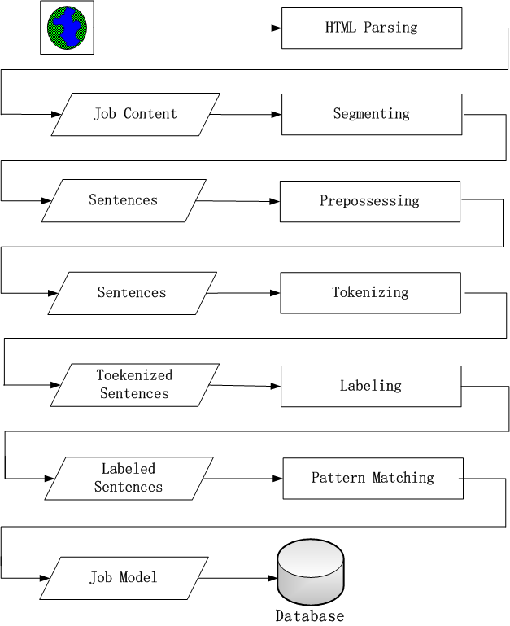
Information Extraction Stages
HTML Parsing
Segmenting
Preprocessing
Tokenizing
Labeling
Pattern Matching

Slide 18
Some sentences from Job Description
Bachelors degree in Computer or Information Systems
BS or MS in computer science or similar degree
MS/PhD Degree in Computer, Science, Engineering or Finance from top institution.
Requires a minimum of bachelors degree in a related, field or foreign equivalent.

Slide 19
Processing the text
Transfer the sentence from
Bachelors degree in computer science or information systems
To
DE_LEVEL | DEGREE | IN | MAJOR | OR | MAJOR | .
BS_LEVEL | DEGREE | IN | MAJOR_CS | OR | MAJOR_INFO | .
bachelors | degree | in | Computer Science | or | Information Systems | .

Slide 20
Pattern Matching
DE_LEVEL | DEGREE | IN | MAJOR | OR | MAJOR | .
BS_LEVEL | DEGREE | IN | MAJOR_CS | OR | MAJOR_INFO | .
bachelors | degree | in | Computer Science | or | Information Systems | .
DE_LEVEL | OR | MS_LEVEL | IN | MAJOR | OR | N/A | DEGREE
BS_LEVEL | OR | MS_LEVEL | IN | MAJOR_CS | OR | N/A | DEGREE
BS | or | MS | in | Computer Science | or | Similar | degree

Slide 21
Patterns Matching Degree
DE-LEVEL, DE-LEVEL, OR DE-LEVEL
DE-LEVEL DEGREE ( IN | OF ) DT MAJOR
MAJOR-DEGREE , MAJOR-DEGREE OR MAJOR
DE-LEVEL (, DE-LEVEL)* (OR DE-LEVEL)? BE? PERFER-VBD
MAJOR DEGREE
DE_LEVEL , OR DEGREE_JJ

Slide 22
Regular Expression Over Tokens
The unit of the expression is token or word
seqMatcher = parser.parse
( “ DE_LEVEL (, DE_LEVEL)* (or DE_LEVEL)? DEGREE”)

Slide 23
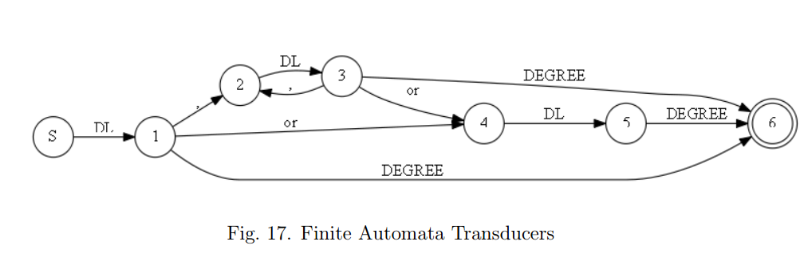
Finite Automata Transducers
A finite state transducer (FST) is a finite state machine with two tapes: an input tape and an output tape.

Slide 24
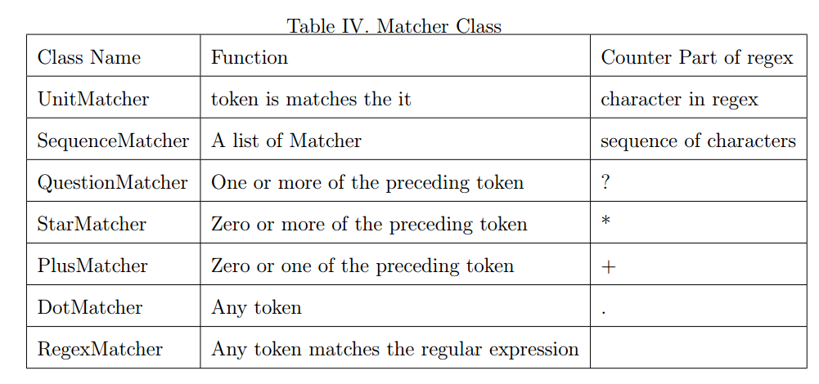
Matchers current support

Slide 25
Flexibility -- regular expression style
Pattern: DE-LEVEL DEGREE ( IN | OF ) DT? MAJOR
seqMatcher =parser.parse(”DE-LEVEL DEGREE ( IN | OF ) DT? MAJOR”)

Slide 26
Flexibility -- connected by algebra operator
Pattern: ”DE-LEVEL DEGREE (IN | OF) MAJOR”
seqMatcher = UnitMatcher(”DE-LEVEL”) + UnitMatcher(”DEGREE”) + ( UnitMatcher(”IN”) | UnitMatcher(”OF” ) ) + UnitMatcher(”MAJOR”)

Slide 27
Flexibility – OO programming style
Pattern: ”DE-LEVEL DEGREE (IN | OF) MAJOR”
matcher1 = UnitMatcher(”DE-LEVEL”)
matcher2 = UnitMatcher(”DEGREE”)
matcher3 = UnitMatcher(”IN”)
matcher4 = UnitMatcher(”OF”)
matcher5 = UnitMatcher(”MAJOR”)
matcher6 = AlternateMatcher([matcher3,matcher4])
seqMatcher = SeqMatcher([matcher1, matcher2, matcher6, matcher5])

Slide 28
Flexibility
customized in catch function and output function by lambda expression
DE_LEVEL | DEGREE | IN | MAJOR | OR | MAJOR | .
BS_LEVEL | DEGREE | IN | MAJOR_CS | OR | MAJOR_INFO | .
bachelors | degree | in | Computer Science | or | Information Systems | .

Slide 29
Flexibility – Lambda expression
lambda x:x[0] – catch the original text
lambda x:x[2] -- catch the first layer label
lambda x:x[1] – output the second layer label

Slide 30
Similarity Calculation

Slide 31
Resume and Job Description
Part of Resume | Part of Job Description
B.S. degree in computer science 5+ years Java 2+ year C++ Some experience in Oracle database Other experience like: Hibernate, JBOSS, JUnit, Tomcat etc. | BS degree above 4+ years Java Some experience of Python Mysql, MS-SQL Java web application Server OOA/OOD

Slide 32
How to Find terms in Job Description
A high-level language such as Java, Groovy, Ruby or Python; we use Java and Groovy extensively
HTML5/CSS3/JavaScript, web standards, jQuery or frameworks like AngularJS would be great
HTML CSS and Javascript a must 4. Experience with AJAX, XML, XSL, XSLT, CSS, JavaScript, JQuery, HTML and Web Services

Slide 33
Pattern in sentences
< term , * , *, term >
< term , * , *, and term >
Bootstrap approach
Collect fifty initial terms manually, add them to term list
Using the pattern matching library to find new terms
Checking the found terms on Dbpedia
Adding the new terms in to term list

Slide 34
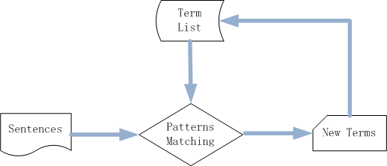
Bootstrap approach

Slide 35

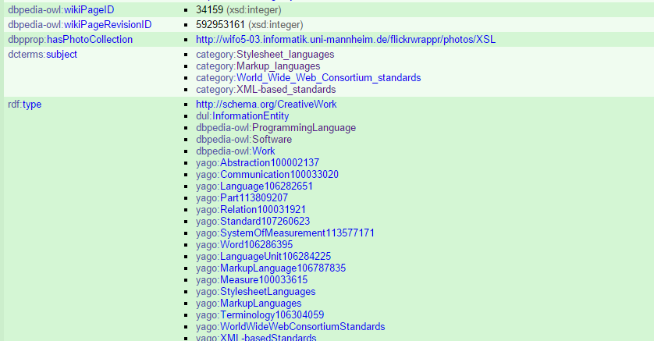
Dbpedia Page

Slide 36
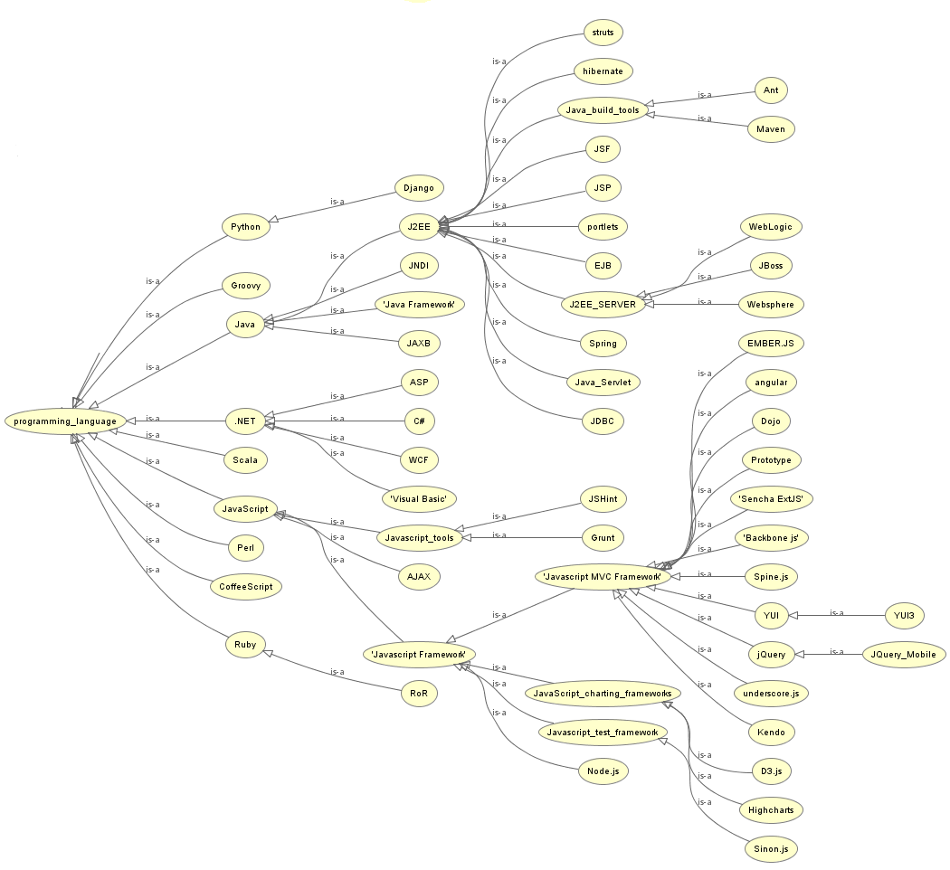

Slide 37


Ontology similarity
Path-based approaches
Feature-based measures
Content-based measures

Slide 38
Statistical-based Ontology Similarity Measure
A high-level language such as Java, Groovy, Ruby or Python; we use Java and Groovy extensively
HTML5/CSS3/JavaScript, web standards, jQuery or frameworks like AngularJS would be great
HTML CSS and Javascript a must 4. Experience with AJAX, XML, XSL, XSLT, CSS, JavaScript, JQuery, HTML and Web Services

Slide 39
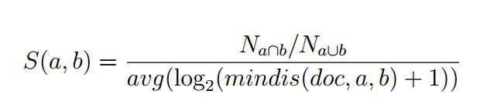
Statistical-based Ontology Similarity Measure
The numerator： The ratio of the number of documents in which the two terms exist together to the number of documents have a least one them.
The denominator： The average log value of minimum distance of the two terms in documents that have them both.

Slide 40
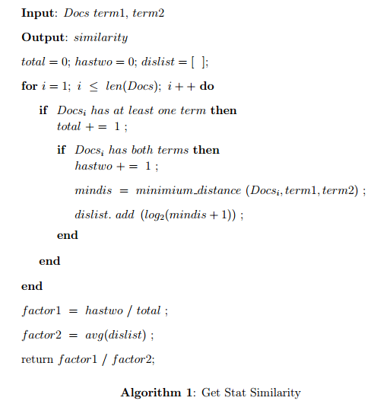
Algorithm of Similarity Calculation

Slide 41
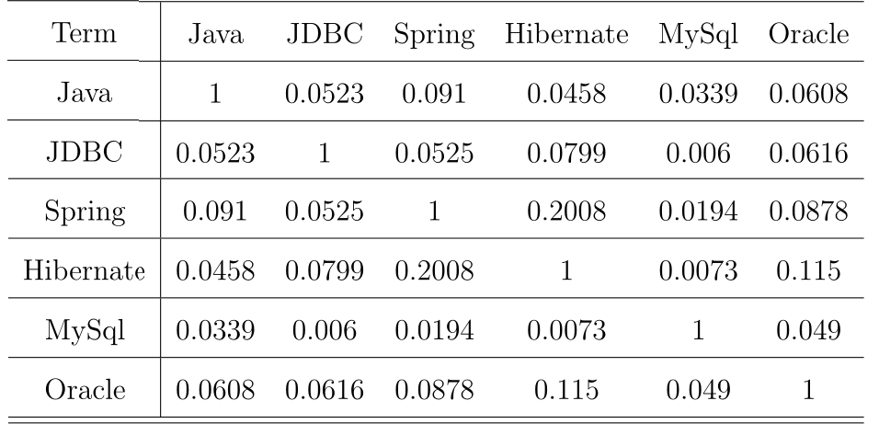
Similarity between terms

Slide 42
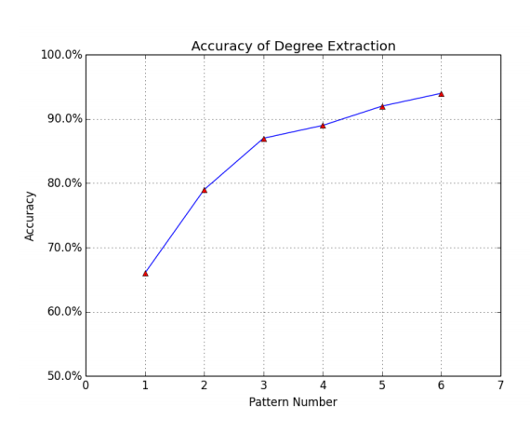
EVALUATION – Information Extraction

Slide 43
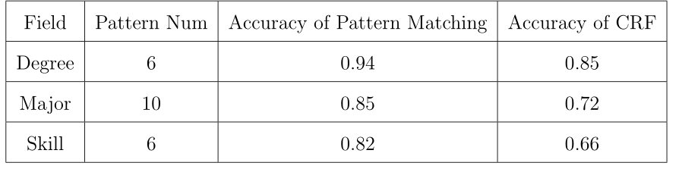
EVALUATION – Information Extraction
Accuracy of Information Extraction Comparing to CRF Model

Slide 44

EVALUATION – Ontology Similarity
Normalized Discounted Cumulative Gain(NDCG)

Slide 45
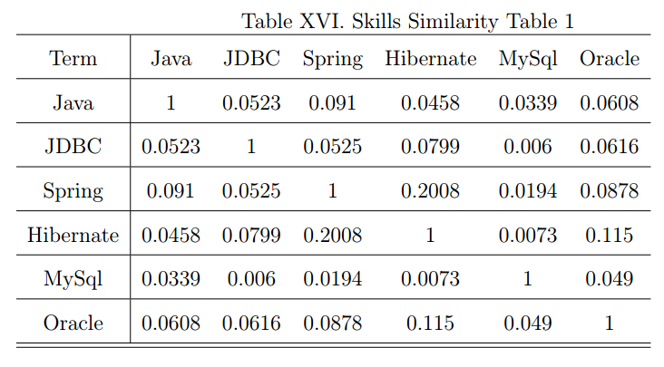
EVALUATION – Ontology Similarity

Slide 46
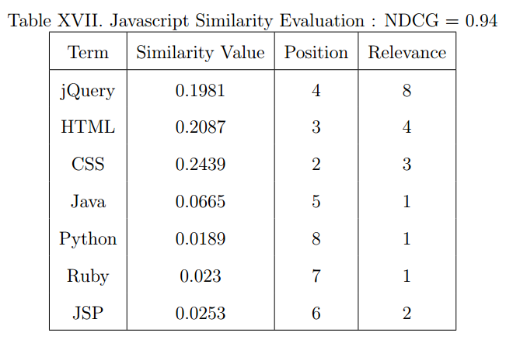
EVALUATION – Ontology Similarity

Slide 47
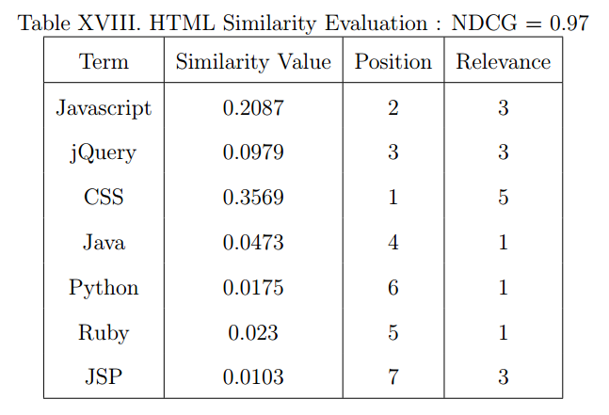
EVALUATION – Ontology Similarity

Slide 48
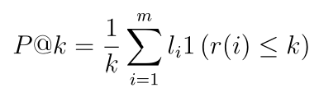
EVALUATION – System Performance
NDCG
Precision@K
The proportion of relevant documents in the first K

Slide 49
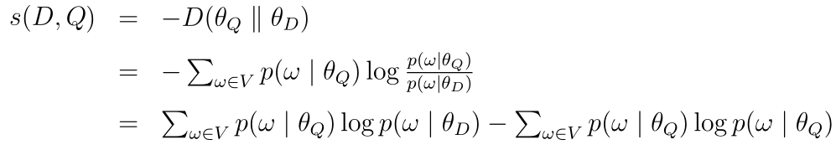
Models to Compare
Kullback-Leibler divergence

Slide 50

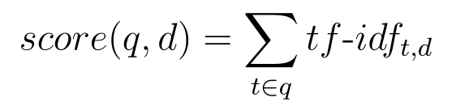
Models to Compare
TF-IDF：
TF is the term frequency
IDF is the inverse document frequency

Slide 51
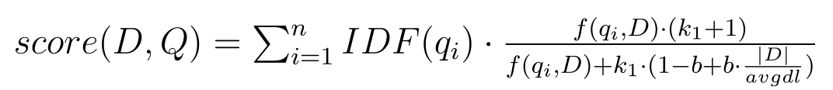
Models to Compare
Okapi BM25:
Given a query Q, containing the keywords q1,...,qn, the BM25 score of a document D

Slide 52
Experiment Setup
5 resumes
100 jobs
Relevance value manually assigned

Slide 53
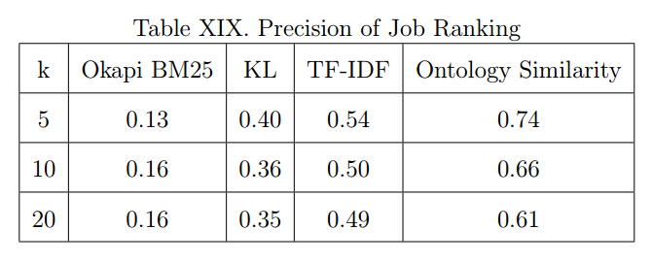
EVALUATION – System Performance

Slide 54
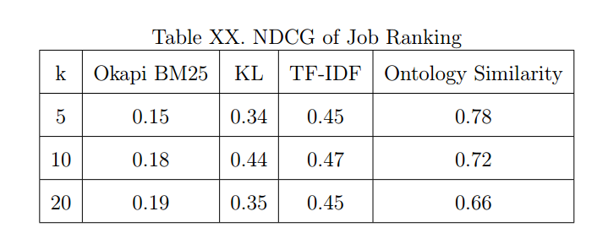
EVALUATION – System Performance

Slide 55
Conclusion

