Slide 1
Competitive Balance in Major League Baseball (MLB)
Reported by 李心宸
2022.4.20

Slide 2
What is Competitive Balance
Rottenburg (1956)：消费者愿意花钱去看比赛的一个必要因素是比赛结果的不确定性
Competitive balance refers to the equality of strength of teams in a sports league (Humphreys,2019).

Slide 3



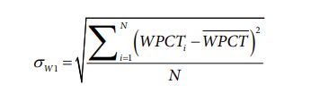

How to measure Competitive Balance
Measures of competitive balance can be divided into static and dynamic types.
Static measures
Static competitive balance measures reflect dispersion of winning percentages in sports leagues.
Standard Deviation Based Measures
is the average winning percent in the league in a single season; N is the number of teams in the leagues
Leagues with a higher σw1 have more variability in winning percentages around the mean and less competitive balance; the higher σw1, the worse the competitive balance is in a league in a given season. Leagues with smaller σw1 have less variation in winning percentages around the mean and more competitive balance in a season.
Herfindahl-Hirschman Index (HHI) Approach
si is team i’s share of some league outcome and the league contains N teams. A natural outcome share is each team’s share of the total number of wins in a league in a given season.
The higher the HHI, the higher the concentration of outcomes, and the less competitive balance in the league.

Slide 4
How to measure Competitive Balance
Limitations of static measures:
Sensitive to differences in league structure and institutional features which reduced their usefulness for comparing competitive balance across leagues, and over time in leagues with variable characteristics.
None of these measures reflect changes in the relative standings in leagues over time.

Slide 5

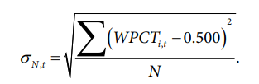



How to measure Competitive Balance
Dynamic measures
Competitive Balance Ratio (CBR)
Variation in winning percentages can be decomposed into two parts: within-team variation in winning percentages, capturing team-specific variation over seasons, and within-league variation in winning percentages, capturing within league variation at one point in time.
一个队在不同赛季的标准差，表示一个队在多个赛季胜率的变化波动；不同队在一个赛季的标准差
队伍间胜率的平均变化；赛季间胜率的平均变化
竞争平衡率的取值在0-1之间, larger CBR values indicate more competitive balance（何文胜等，2009；Humphreys,2002）。
如果遇到职业体育赛事调整、联赛扩张或缩小、推迟比赛以及罢赛等情况，比赛场数则会发生变化。

Slide 6
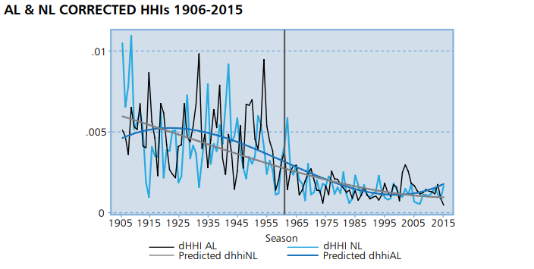
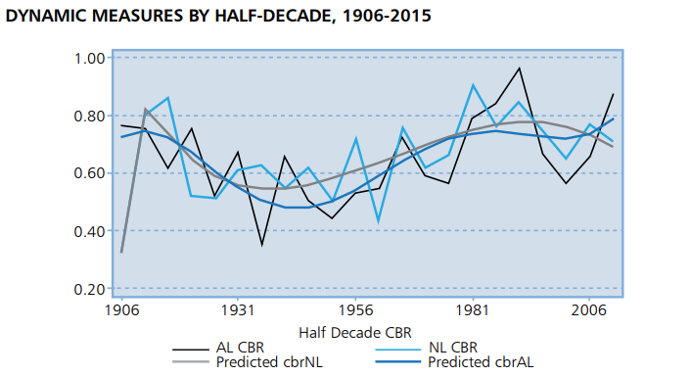
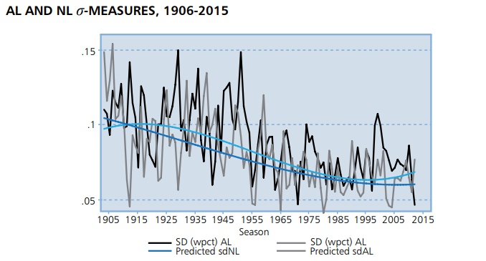
Competitive Balance in MLB
competitive balance in MLB over the 1906 through 2015 seasons
The static measures imply that competitive balance increased continuously in MLB over the sample period. The dynamic measures imply that competitive balance was high in the early days of MLB, declined in the 1930s to 1950s, and then improved after the early 1960s. A number of key institutional changes occurred in MLB after the mid-1960s, including the imposition of an entry draft（选秀） in 1965, the advent of free agency（自由球员） in 1975, and the imposition of a “competitive balance tax” on total team payroll in 1997 (Humphreys,2019).
National League (NL) was formed in 1876; American League (AL) was formed in 1901
职业体育联盟可以通过赛事设置、规则约束和优秀运动员公平分配等措施来安排各俱乐部的实力分配, 达到相对公平的程度, 以提高赛事的竞争平衡, 保证整体体育竞争水平的提高。

Slide 7
Competitive Balance in MLB
Competitive Balance Tax/ Luxury Tax
Luxury tax is an amount paid by a team when have a total payroll that exceeds a given amount. Typically, the proceeds of the tax are taken by the league and distributed to lower revenue teams (Simmons & Berri, 2019).
The luxury tax was essentially designed to slow the growth of salaries and to prevent large-market teams from signing all of the top players within a league. The money derived from this tax is distributed among the financially weaker teams. The luxury tax thus aims to create a more balanced league, because redistribution among clubs counteracts financial imbalances.
Those who carry payrolls above that threshold are taxed on each dollar above the threshold, with the tax rate increasing based on the number of consecutive years a club has exceeded the threshold.
A team's Competitive Balance Tax figure is determined using the average annual value of each player's contract on the 40-man roster, plus any additional player benefits. Every team's final CBT figure is calculated at the end of each season.
（40-man roster: Also called the reserve list, the 40-man roster is composed of all the players in a Major League club's organization who are signed to a major-league contract; player benefits: Life Insurance, Health Insurance, Pension）
Resource：Competitive Balance Tax https://www.mlb.com/glossary/transactions/competitive-balance-tax
MLB ROSTER HISTORY https://www.baseball-almanac.com/articles/baseball_rosters.shtml
Benefits https://www.mlb.com/player-resource-center/financial-resources/player-benefits

Slide 8
Competitive Balance in MLB
The first luxury tax in professional sports was introduced in 1996 by MLB as part of its Collective Bargaining Agreement (CBA). This agreement imposed a luxury tax of 35% for the first two years and 34% for the third year on the teams with the top five payrolls during the 1997, 1998 and 1999 seasons. Between 2000 and 2002, the luxury tax system was replaced by a revenue-sharing system.
MLB reintroduced a luxury tax system in 2003 and set fixed limits on payrolls for every year. For instance, the limit was $137 million in 2006, $148 million in 2007 and $155 million in 2008. The excess payroll is taxed at 22.5% for first-time offenders, 30% for the second offence and 40% for three or more offences (Dietl et al, 2010).

Slide 9
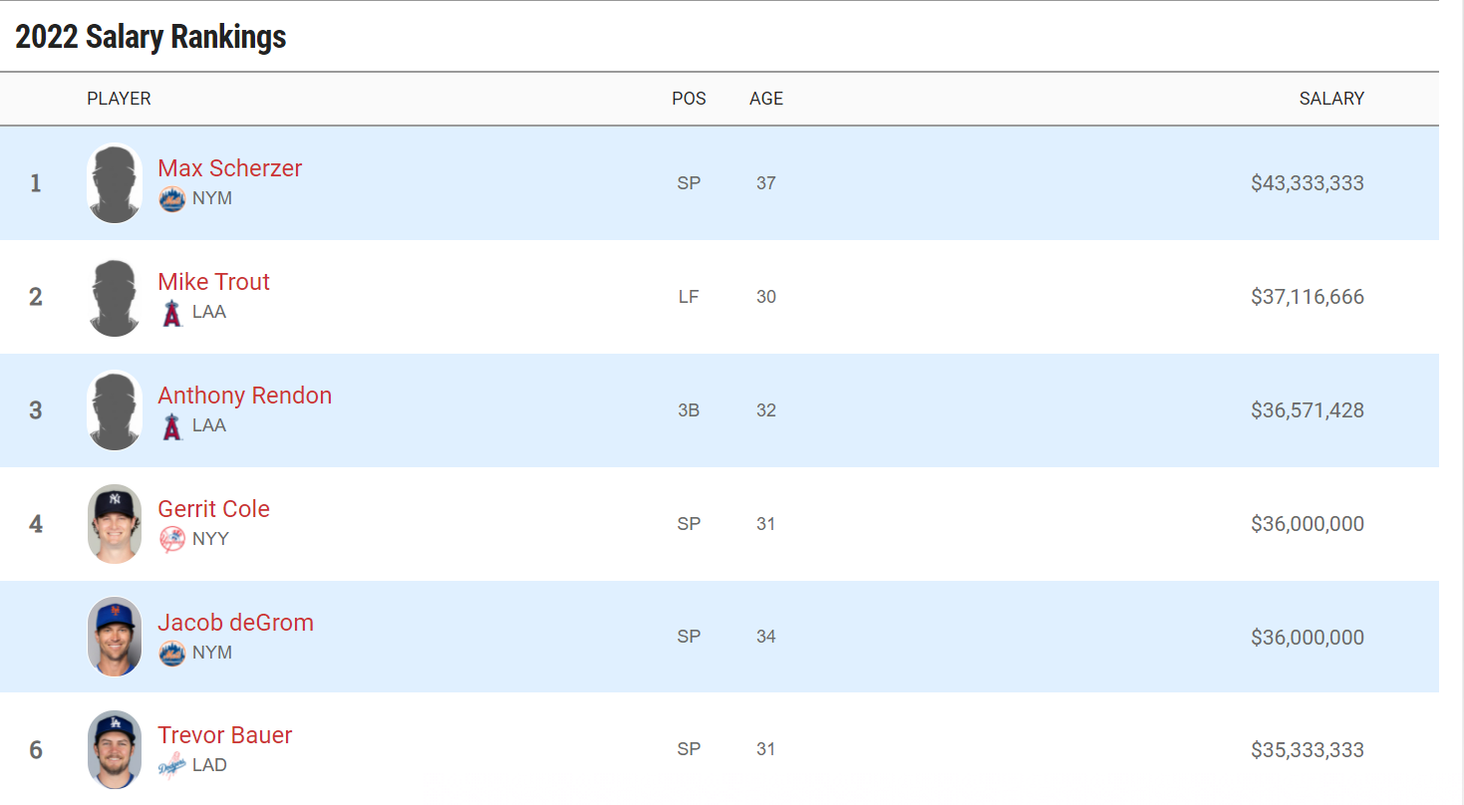
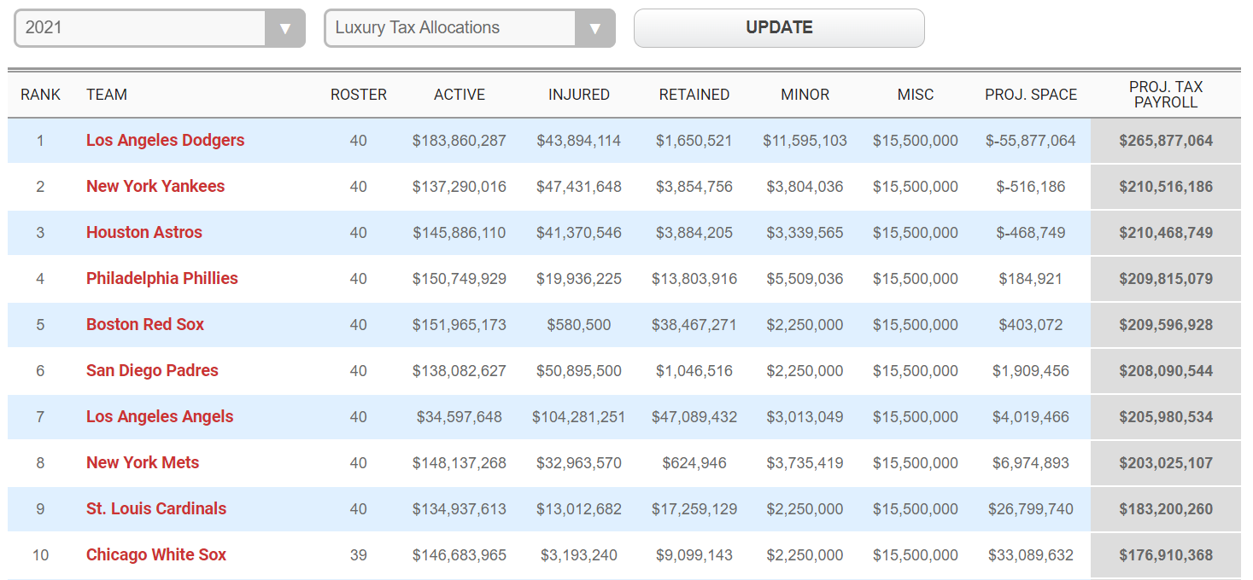
Competitive Balance in MLB
The following thresholds were put in place per the 2017-2026 collective bargaining agreement:
2017: $195 million 2018: $197 million
2019: $206 million 2020: $208 million
2021: $210 million. 2022: $230 million
2023: $233 million 2024: $237 million
2025: $241 million 2026: $244 million
A club that exceeds the Competitive Balance Tax threshold is subject to an increasing tax rate depending on how many consecutive years it has done so.
First year: 20 percent tax on all overages
Second consecutive year: 30 percent
Third consecutive year or more: 50 percent
If a club dips below the luxury tax threshold for a season, the penalty level is reset. So, a club that exceeds the threshold for two straight seasons but then drops below that level would be back at 20 percent the next time it exceeds the threshold.
There’s also a surcharge threshold for clubs that exceed the base threshold by $20 million or more.
$20 million to $40 million: 12 percent surcharge
$40 million to $60 million: 42.5 percent surcharge for first year; 45 percent for each consecutive year after that
$60 million or more: 60 percent surcharge
Resource：Competitive Balance Tax https://www.mlb.com/glossary/transactions/competitive-balance-tax
MLB Salary Rankings https://www.spotrac.com/mlb/rankings/
MLB Team Luxury Tax Tracker https://www.spotrac.com/mlb/tax/2021/
Notes:
洛杉矶道奇
纽约洋基
休斯顿太空人
费城费城人
波士顿红袜
圣地牙哥教士
洛杉矶天使
纽约大都会
圣路易斯红雀
芝加哥白袜

Slide 10
Competitive Balance in MLB
Does it really work?
Dietl et al (2010) develop a game-theoretic model of an n-club league consisting of small-market and large-market clubs and derive fan demand from a general utility function by assuming that a fan’s willingness to pay depends on the quality of the league. A higher luxury tax induces small clubs to increase their salary payments. If fans have a high preference for aggregate talent, however, large clubs will respond by decreasing their salary payments. Aggregate payrolls will increase with a higher tax rate, as the increase in salary payments by small clubs is always larger than the decrease in salary payments by large clubs. As a consequence, both competitive balance and total salary payments will increase.
Ajilore and Hendrickson (2002) analyze the effect of luxury taxes on competitive balance in MLB by empirically estimating the impact of luxury taxes on team competitiveness. The results show that the introduction of a luxury tax in MLB has reduced the competitive inequality of teams. （1995-2005 seasons）
However, the problem is that there is not a requirement of the league that the money received through revenue-sharing go to the players of the club, so the additional revenue can be used as seen fit. If the money is not going towards the players thought, there still exists this lack of balance between salaries of high-revenue teams and lower-revenue teams (Faunce, 2021).

Slide 11
References
Rottenberg S. The Baseball Players' Labor Market[J]. Journal of Political Economy,1956,64(3):242-258.
Humphreys B R. A practical guide to measuring competitive balance[J]. Sports (and) economics, 2019: 75-103.
何文胜,张保华,吴元生.职业体育联盟竞争平衡的测量与分析[J].体育科学. 2009,29(12):12-18.
Humphreys, B. R . Alternative Measures of Competitive Balance in Sports Leagues[J]. Journal of Sports Economics, 2002, 3(2):133-148.
Simmons R, Berri D J. Labor markets in professional team sports[J]. Sports (and) Economics, 2019: 243-269.
Competitive Balance Tax https://www.mlb.com/glossary/transactions/competitive-balance-tax
Dietl H M, Lang M, Werner S. The Effect of Luxury Taxes on Competitive Balance, Club Profits, and Social Welfare in Sports Leagues[J]. International Journal of Sport Finance,2010,(5):41-51.
MLB ROSTER HISTORY https://www.baseball-almanac.com/articles/baseball_rosters.shtml
Benefits https://www.mlb.com/player-resource-center/financial-resources/player-benefits
MLB Salary Rankings https://www.spotrac.com/mlb/rankings/
MLB Team Luxury Tax Tracker https://www.spotrac.com/mlb/tax/2021/
Ajilore O, Hendrickson J. The impact of the luxury tax on competitive balance in Major League Baseball[J]. Journal of Sports Economics, 2002, 3(2).
Faunce M T. Major League Baseball’s Biggest Failure–The Competitive Balance Tax[J]. 2021.

