Slide 1

Username and password generator using PyQt6 A Graphical User Interface (GUI) Application for Secure Credential Management
JUNE 24,2024.

Slide 2

Nnaemeka Onyeagba
Paul Kwame Yahya
Mariia Stepura
We are presenting…..

Slide 3

Agenda
Introduction.
Features.
Code Structure.
Pros and Cons.
Conclusion

Slide 4


INTRODUCTION

Slide 5
INTRODUCTION
Overview of the application: PyQt6 library is a tool that provides an intuitive and user-friendly experience for generating usernames and passwords.
Purpose: Generate and manage secure usernames and passwords, to enhance security by generating strong, unpredictable passwords and to manage them efficiently.
Built with: Python, PyQt6, configparser, logging, pyperclip.

Slide 6
FEATURES

Slide 7
FEATURES
Generate usernames and passwords.
Evaluate password strength.
Save credentials securely.
Validate login credentials.
Copy credentials to clipboard.

Slide 8
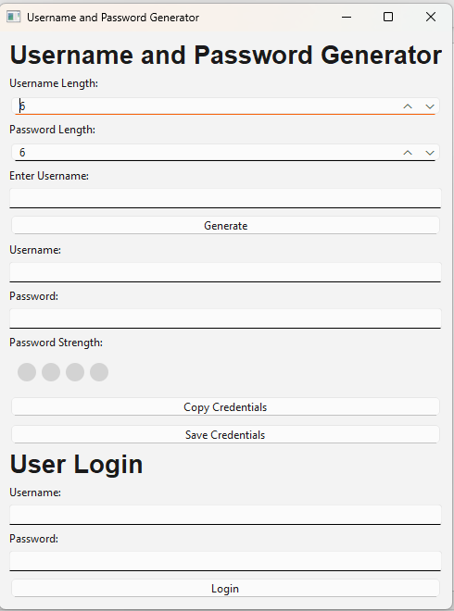
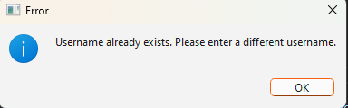
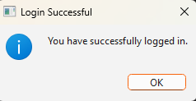
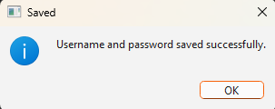
FEATURES

Slide 9
CODE STRUCTURE

Slide 10



CODE STRUCTRE
Configuration.py
CredentialManager.py
CredentialManager.py
class CredentialManager:
def __init__(self):
self.config = configparser.ConfigParser()
self.config.read(CONFIG_FILE)
def generate_password(self, length):
try:
charset = string.ascii_letters + string.digits + string.punctuation
return ''.join(random.choice(charset) for _ in range(length))
except Exception as e:
logging.error(f"Error generating password: {e}")
def generate_username(self, length):
try:
charset = string.ascii_lowercase + string.digit
return ''.join(random.choices(charset, k=length))
except Exception as e:
logging.error(f"Error generating username: {e}")
logging.basicConfig(filename='password_generator.log', level=logging.ERROR, format='%(asctime)s - %(levelname)s - %(message)s')
CONFIG_FILE = 'users.ini'
Notes:
Retrieve Length Values:
password_length = self.password_length_spinbox.value()username_length = self.username_length_spinbox.value()
The method retrieves the desired lengths for the password and username from the spin boxes in the UI.
Generate Password and Username:
password = self.manager.generate_password(password_length)
username = self.username_input.text() or self.manager.generate_username(username_length)
The password is generated using the specified length.
The username is taken from the input field if provided; otherwise, it is generated using the specified length.
Check for Existing Username:
if self.manager.config.has_option('Users', username):
The method checks if the generated or entered username already exists in the configuration file.
If the username exists, an error message is shown, and the method exits early.
Evaluate Password Strength:
strength_value, strength_name = self.manager.evaluate_password_strength(password)
The password is evaluated for strength, returning a numeric value and a descriptive name for the strength level.
Update UI Elements:
self.username_entry.setText(username)
self.password_entry.setText(password)
The generated username and password are displayed in their respective text fields in the UI.
Display Password Strength:
self.strength_widget.set_strength(strength_value, strength_name)
The password strength widget is updated to visually represent the strength of the generated password.
Error Handling:
The entire method is wrapped in a try-except block to handle and log any potential errors that occur during the process.
except Exception as e:
logging.error(f"Error generating credentials: {e}")
Visual Representation:
Password Length SpinBox: Allows the user to specify the length of the password.
Username Length SpinBox: Allows the user to specify the length of the username.
Username Input Field: Optional input where the user can provide a custom username.
Generated Username and Password Display: Text fields showing the generated credentials.
Password Strength Widget: Visual bars indicating the strength of the password.
Key Takeaways:
The generate method showcases the core functionality of generating and displaying secure credentials.
User input is used to customize the lengths of the generated username and password.
The method includes checks to avoid duplicate usernames and provides feedback through the UI.
Password strength is evaluated and visually represented to encourage the use of strong passwords.
Robust error handling ensures that any issues are logged for troubleshooting.
This example code snippet highlights how the application integrates various components to achieve its primary goal of generating and managing secure credentials efficiently and securely.

Slide 11


CODE STRUCTRE
PasswordStrengthWidget.py
SaveCredentials.py
def evaluate_password_strength(self, password):
if len(password) < 6:
return 0, "Too short"
strength = sum([any(c in group for c in password) for group in (string.ascii_lowercase, string.ascii_uppercase, string.digits, string.punctuation)])
strength_names = {1: "Weak", 2: "Moderate", 3: "Strong", 4: "Very Strong"}
return strength, strength_names.get(strength, "Unknown")
def save_credentials(self, username, password):
try:
if not self.config.has_section('Users'):
self.config.add_section('Users')
self.config.set('Users', username, password)
with open(CONFIG_FILE, 'w') as configfile:
self.config.write(configfile)
self.show_message("Saved", "Username and password saved successfully.")
except Exception as e:
logging.error(f"Error saving credentials: {e}")

Slide 12
PROS AND CONS

Slide 13
PROS AND CONS
Pros
Cons
Enhanced Security
Limited Security Features
Basic User Interface
Convenience
Credential Management
Notes:
Password generation: Strong, random password (uppercase+lowercase+digits+special characters)
Password Strength Evaluation: Provides an immediate feedback on the strength of the password

Slide 14
CONCLUSION

Slide 15
CONCLUSION
The primary goal of the Username and Password Generator is to provide users with a secure and convenient way to create, evaluate, and manage their credentials.
It addresses the common challenges of generating strong, unique passwords and ensures that these credentials are stored and validated securely.

Slide 16

Thanks a lot!
Feel free to ask:

