Slide 1
Eventual Consistency in real time financial systems with Microservices Architecture BITS ZG628T: Dissertation (April 2018)
TUSHAR DILIP PHADKE 2016HT12516

Slide 2
ACKNOWLEDGEMENT
I express my gratitude to my supervisor Mr. Anurag Srivastava for providing me a means of accomplishing my most cherished goals
I record my heart full of thanks and gratitude to my additional examiner Mr. Tejas Jog
I expresses my gratitude to Mr. Jens Emmerich, Chief Architect, Amdocs Development Centre from Mobile Financial Solutions division for providing me a valuable input and feedback in understanding financial domain and Amdocs business model
Last but not least I would like to thank BITS WILP, Pilani for providing me an opportunity to carry this project, along with purposeful guidance and moral support extended to me throughout the duration of the project work

Slide 3
Agenda
Background Information
Electronic Payment Systems
Order and Payment systems in CSP environment
Microservice Architecture
Eventual Consistency and importance
Approaches for achieving Eventual Consistency
2 Phase distributed transactions
Service orchestrator pattern
Service choreography pattern
Hybrid Pattern
Final architecture for achieving Eventual Consistency
Observations
Summary

Slide 4
Background Information

Slide 5
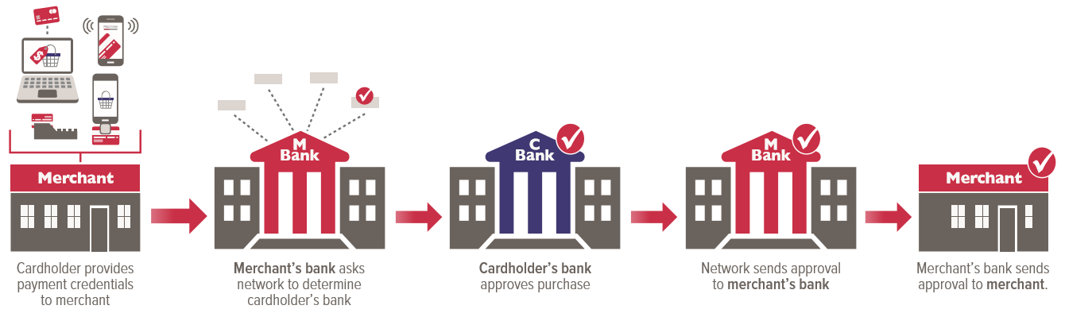
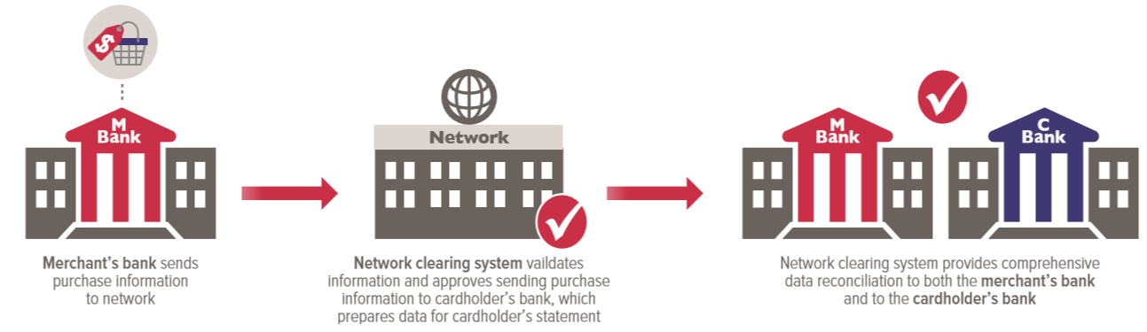
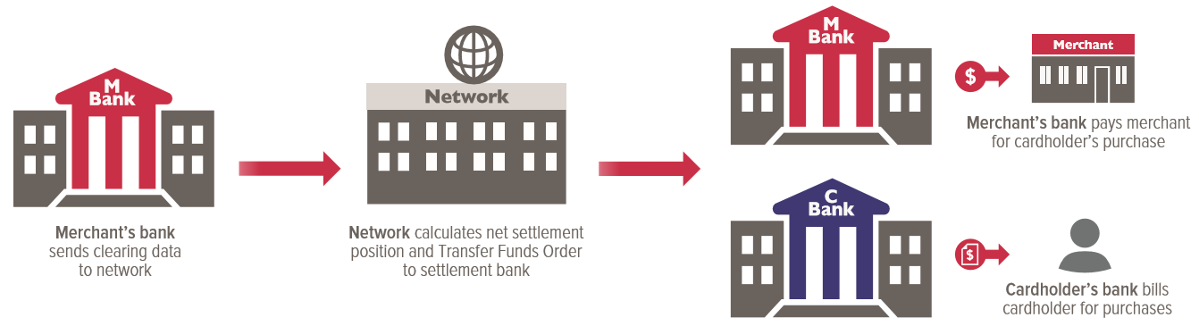
Electronic Payment Systems
Payment Authorization
Payment Clearing
Payment Settlement

Slide 6
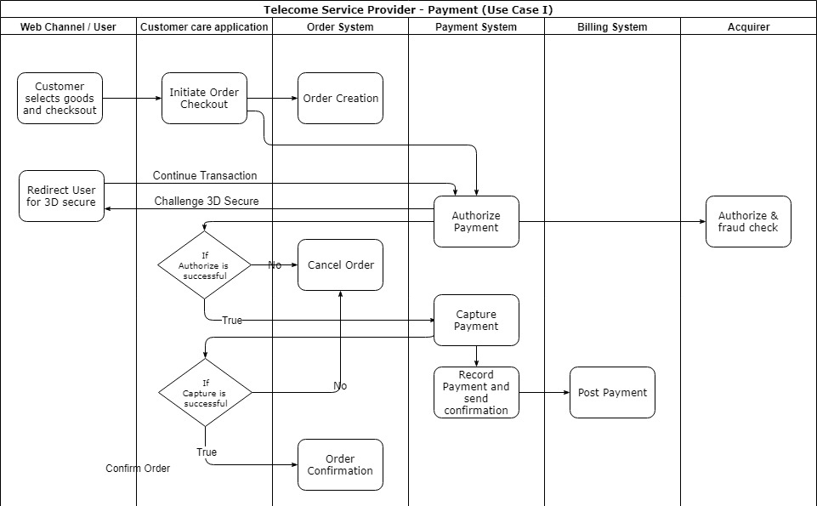
Order and Payment system at CSP Use case I

Slide 7
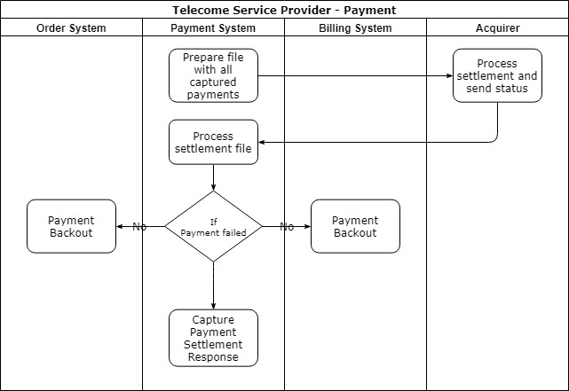
Order and Payment system at CSP Use case II

Slide 8
Microservices Architecture
Microservices is a major architectural shift and is fundamentally different way of building software
An approach to develop a single application as a suite of small services, each running in its own process and communicating with lightweight mechanisms, often an HTTP resource API
These services are built around business capabilities and independently deployable by fully automated deployment mechanism
Microservices architecture should adhere to 7 principles described in next slide

Slide 9
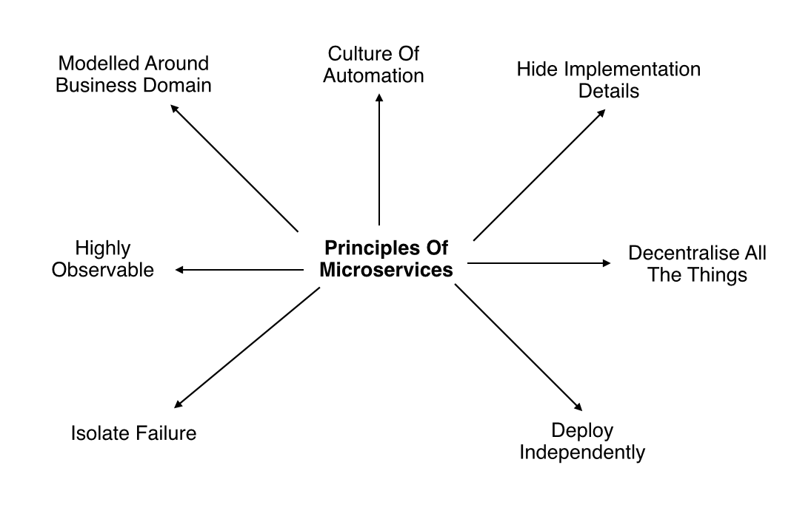
Microservices Architecture Principles

Slide 10
Eventual Consistency and importance
Any distributed system is not safe from network failures, thus network partitioning generally has to be tolerated for high availability over consistency
Microservices are designed on the BASE (Basically Available, Soft state, Eventual consistency) philosophy (choosing availability over consistency)
In opposite a monolithic application manages transactions as it RDBMS supports ACID (Atomicity, Consistency, Isolation, Durability) transactions
Sharing a database across microservices violate of the principle (deploy independently) of a Microservices-based architecture

Slide 11
Eventual Consistency continues..
In our problem statement, if by any chance a payment is failed after authorize call, then Order and Billing system has to be notified about state of payment. So each system can take corrective action (eventual consistency) or get back to consistent state across microservices
Similarly state change has to be notified to other microservices in order to maintain eventual consistency
If eventual consistency is not maintained between these microservices then CSP may suffer from financial impact like shipping goods without payment, inconsistent billing/revenue’.

Slide 12
Approaches for achieving Eventual Consistency

Slide 13
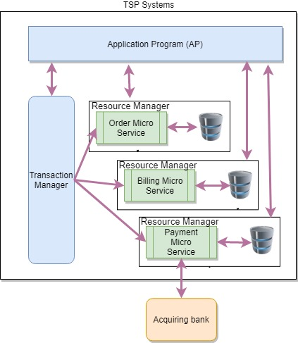
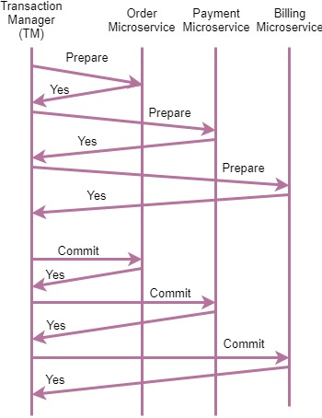
Using Two Phase Distributed Transactions (XA)

Slide 14
Using Two Phase Distributed Transactions (XA)
Benefits
XA with 2 PC always give highest confidence and protection against failures where multiple diverse resources are being used
Most major software vendor’s provides support for XA with 2 PC
Drawbacks/Tradeoffs
Expensive because of additional I/O prescribed by the protocol and requires special-purpose platforms
Very complex and very hard to maintains, debug
Hard to detect, debug and trace transactions to resolve consistency issues
The XA with 2 PC is not useful in case of “Use case II” or custom rollback with acquirer

Slide 15
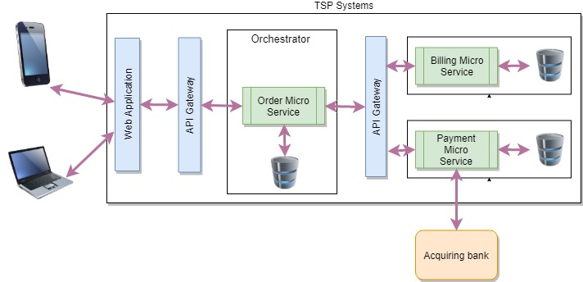
Using Service Orchestrator Pattern

Slide 16
Using Service Orchestrator Pattern
Benefits
Provides a better way to control the flow in application when there is synchronous processing
Easy to manage exceptional flows. E.g. In our problem statement if updating billing system fails, then orchestrator can update Order Microservice to cancel order and update Payment Microservice to cancel authorization and refund payment if payment was successful
Drawbacks/Tradeoffs
Couples the services together creating dependencies
Not useful in case of “Use case II” for maintaining eventual consistency
Service which is working as orchestrator is dependent on other microservices

Slide 17
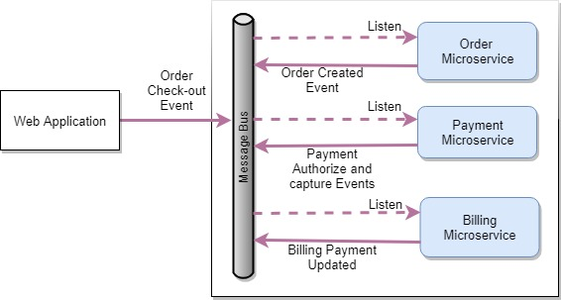
Using Service Choreography Pattern

Slide 18
Using Service Choreography Pattern
Benefits
Enable faster end to end processing without any blocking
Service can start consuming new events without direct dependency between services
Aligns well with continuous delivery as there is no direct dependency between services
Control is distributed and no single point of failure
Drawbacks/Tradeoffs
Async programming is often significant mind shift for developer and code is hard to read by just looking at it
Each service need to maintain casual order between messages
Service which is working as orchestrator is dependent on other microservices
In case 3D secure requirement, end user is authorized with issuer bank which requires synchronous processing which hard to achieve in this pattern

Slide 19
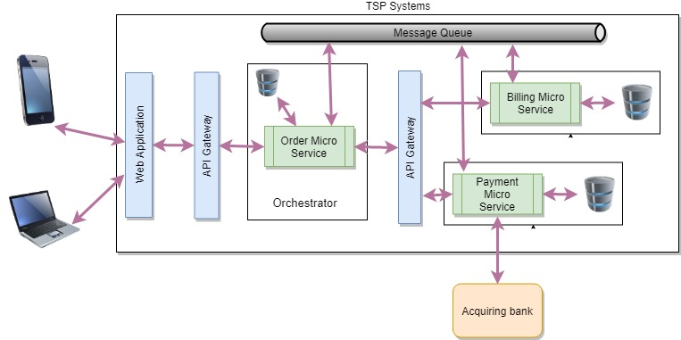
Using mix strategy

Slide 20
Using mix strategy
Benefits
Provides benefits of both architecture (choreography and orchestrator) pattern
Easy to manage exceptional flows
In future any new microservice can subscribe to queue topic for listening to events and act accordingly without any changes in publisher
Drawbacks/Tradeoffs
Each service needs to maintain casual order between messages
The “Order” microservice will have dependency on “Billing” and “Payment” microservice. This will break the microservice principal “deploy independently”

Slide 21
Final Approach for Eventual Consistency and Proof Of Concept

Slide 22
Mix Strategy - final approach for Eventual Consistency
Best fit for achieving eventual consistency across microservices in our problem statement
Easy to manage exceptional flows allowing to have custom handling for maintaining eventual consistency
The proof of concept developed to validate this understanding

Slide 23
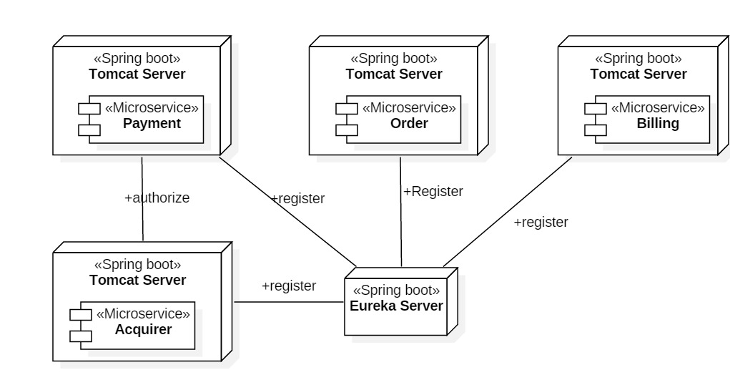
Proof Of Concept – Deployment Diagram
Technology Stack
Microservice – Spring Boot
API registry – Eureka Server, Ribbon for load balancing
Hibernate 5 – JAP and ORM
HSQLDB – local database
Kafka Queue – Async processing

Slide 24
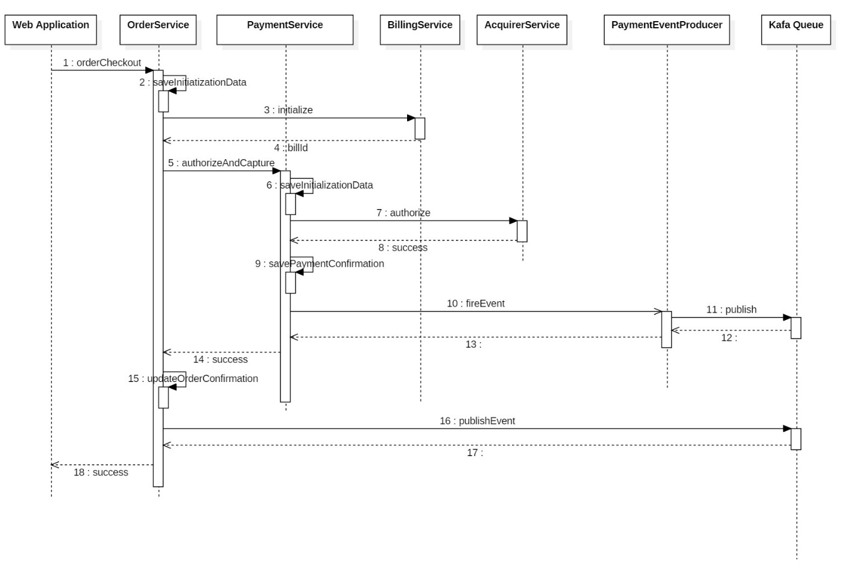
Proof Of Concept – Sequence Flow (Use case I)

Slide 25
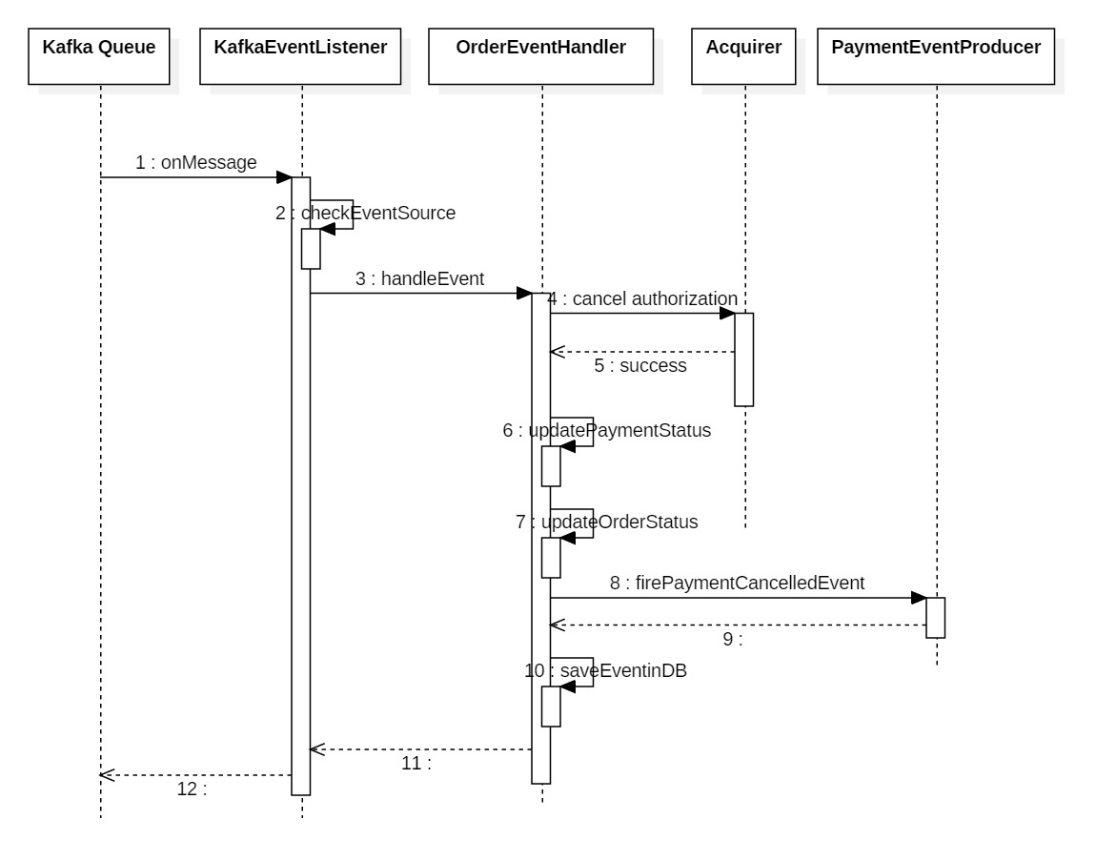
Proof Of Concept – Sequence Flow (Use case II)

Slide 26
Observations / Action Taken
The two methods, “authorize” and “capture” were merged into single operation to avoid additional eventual consistency handling in case user abandons checkout after “authorize”. If user abandons checkout after “authorization” then authorization with acquirer also need to be cancelled otherwise that amount will be blocked on user’s card
Even if we use orchestrator for real time payment processing, each microservice should publish state into the queue. This eases out the additional exception handling in orchestrator layer and each service can take corrective action. This also reduces the response time.
Even if we have a queue for notifying each service about state, if event handler fails to handle event due to system error then system should log the failure and should have a process to correct failed events.
All event should have context information about event like originator, payment identifier, order identifier, bill identifier, customer identifier and state of originator
In case acquirer identifies the authorize request as a candidate for 3D secure authorization, the payment has to be suspended till user is authenticated. Then each service is called again with 3D secure authorization details. So REST operation should be idempotent

Slide 27

Questions and Answers

Slide 28
Thank You

