Slide 1
Eventual Consistency in real time financial systems with Microservices Architecture BITS ZG628T: Dissertation (April 2018)
TUSHAR DILIP PHADKE 2016HT12516

Slide 2
ACKNOWLEDGEMENT
I express my gratitude to my supervisor Mr. Anurag Srivastava for providing me a means of accomplishing my most cherished goals
I record my heart full of thanks and gratitude to my additional examiner Mr. Tejas Jog
I expresses my gratitude to Mr. Jens Emmerich, Chief Architect, Amdocs Development Centre from Mobile Financial Solutions division for providing me a valuable input and feedback in understanding financial domain and Amdocs business model
Last but not least I would like to thank BITS WILP, Pilani for providing me an opportunity to carry this project, along with purposeful guidance and moral support extended to me throughout the duration of the project work

Slide 3
Agenda
Background Information
Electronic Payment Systems
Order and Payment systems in CSP environment
Microservice Architecture
Eventual Consistency and importance
Approaches for achieving Eventual Consistency
2 Phase distributed transactions
Service orchestrator pattern
Service choreography pattern
Hybrid Pattern
Final architecture for achieving Eventual Consistency
Observations
Summary

Slide 4
Background Information

Slide 5
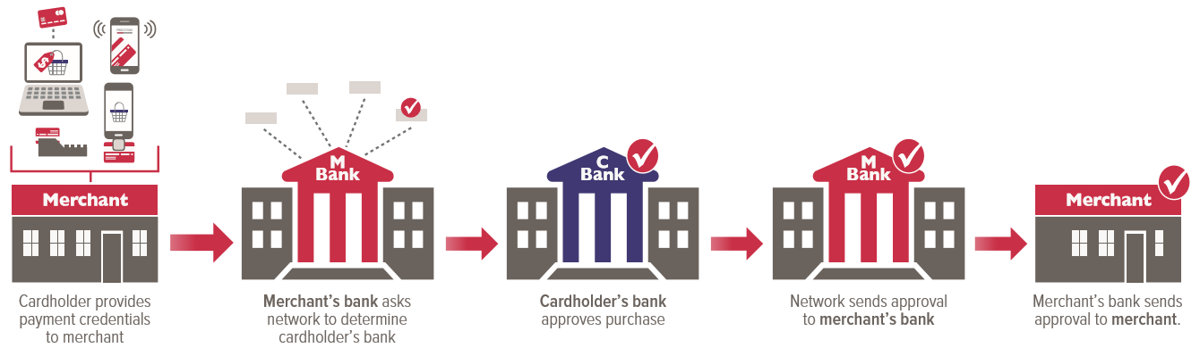
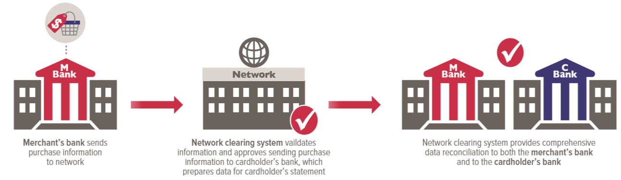
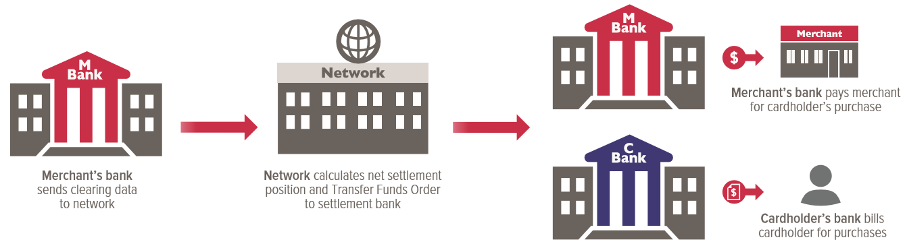
Electronic Payment Systems
Payment Authorization
Payment Clearing
Payment Settlement

Slide 6
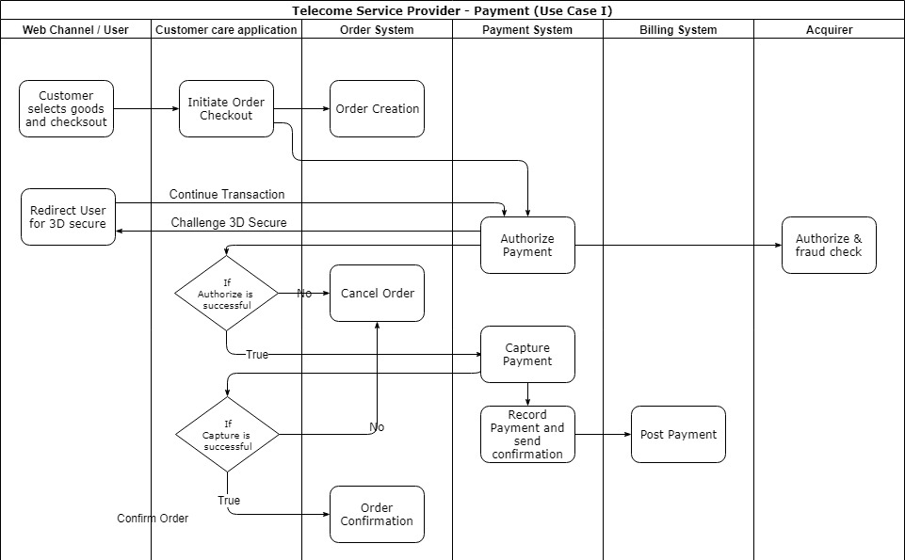
Order and Payment system at CSP Use case I

Slide 7
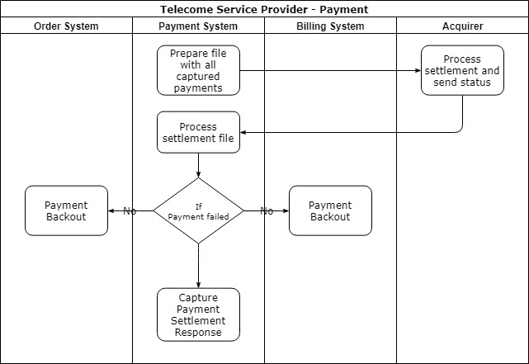
Order and Payment system at CSP Use case II

Slide 8
Microservices Architecture
Microservices is a major architectural shift and is fundamentally different way of building software
An approach to develop a single application as a suite of small services, each running in its own process and communicating with lightweight mechanisms, often an HTTP resource API
These services are built around business capabilities and independently deployable by fully automated deployment mechanism
Microservices architecture should adhere to 7 principles described in next slide

Slide 9
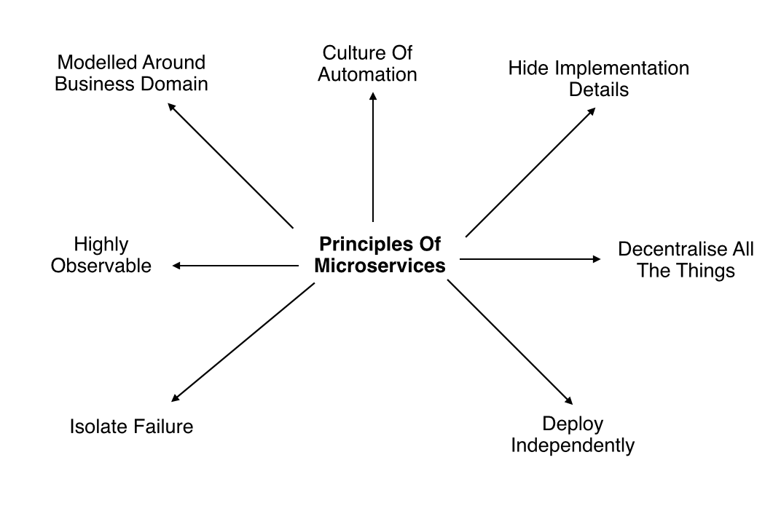
Microservices Architecture Principles

Slide 10
Eventual Consistency and importance

Slide 11
Research Methodology
Identify Gaps
Tools Used
Analyze Situation

Slide 12
Identify Gaps
Large variation in the number of subscribers for each company
Variety of data schemes available
Statistical data kept confidential by TSPs

Slide 13
Research Tools Used
Smart phone with android v2.1 or above
WhatsApp application of v2.12.0.1 or above
Data monitor application
Internet connection – data pack

Slide 14
Analyze Current Situation
Acquire a 3G connection on 3G enabled smartphone
Make VoIP calls using WhatsApp for 5 mins
Calculate average number of MBs consumed for the same
Calculate the average cost per MB of data consumed using data schemes available of different TSPs
Calculate the total cost of making this call
Calculate total profit/loss incurred by the TSPs
Install data monitor
Calculate the cost if the call was a simple voice call

Slide 15
Assumptions
Rational consumer – cheaper is better
Consumer buys 1GB, 3G data pack only
Every WhatsApp user buys a data pack
WhatsApp calling for 20 mins/day per user
Whole subscriber population has prepaid connection

Slide 16
Cost Comparison – Different modes of calling
20 Min. Call | Rate | Data Usage | Cost(in Rs.)
With 2G data pack | Rs.200/1GB | 15MB | <1
With 3G data pack | Rs.250/1GB | 15MB | 3.66
Traditional voice calling | 2p/sec | N/A | 24
Without 3G data pack | 4p/10kB | 15MB | 61.44
Only 1GB data plans are considered
Airtel plans have been taken for comparison

Slide 17
Graphical Comparison

Slide 18
Calculation of Loss
Top 4 TSPs market share = 73.34%

Slide 19

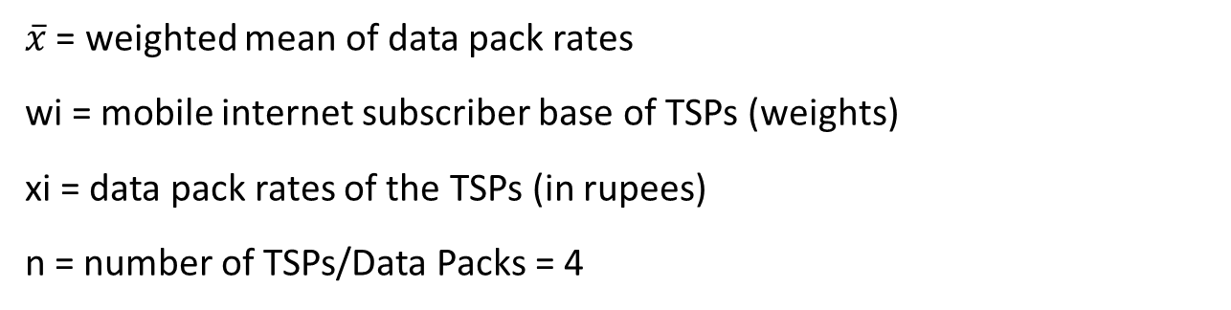
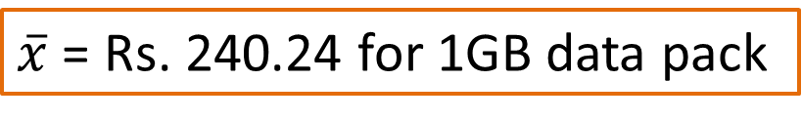
Calculation of Loss(Cont.)
$\overline{x}$ = weighted mean of data pack rates
wi = mobile internet subscriber base of TSPs (weights)
xi = data pack rates of the TSPs (in rupees)
n = number of TSPs/Data Packs = 4
$\overline{x}$ = Rs. 240.24 for 1GB data pack

Slide 20
Calculation of Loss(Cont.)
Loss incurred = (potential traditional-voice-call revenue) – (revenue earned through data packs)
For a 20 min. call:
Loss_{STD} = Loss_{local} = Rs. 24 – Rs. 3.52
= Rs. 20.48

Slide 21
Recommendations
Revenue Share Model
Partial Share in Spectrum Purchase
Quality Of Service (QoS)

Slide 22
Quality of Service
DEFINITION: The collective effect of service performance which determines the degree of satisfaction of a user of the service indicating the performance of a broadband network and of the degree to which the network conforms to the stipulated norms

Slide 23
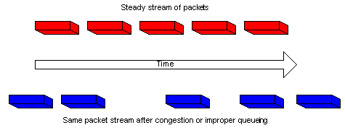
Challenges Faced By VoIP
PROBLEM 1:
Jitter: Refers to the variation in the delay of received packets. Jitter is a typical problem in packet switched network. The quality of voice calls over IP reduces due to this effect.
Solution: Use a jitter buffer.

Slide 24
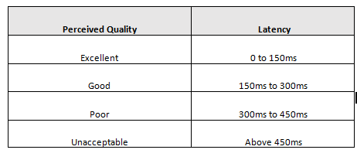
Challenges Faced By VoIP (Cont)
PROBLEM 2:
Latency: Refers to delay in data transmission from source to destination. Causes delay in the transmission of voice and the receiver gets a delayed response.

Slide 25
Solution: Time prioritization of traffic by marking packets with ToS values
Challenges Faced By VoIP (Cont.)

Slide 26
Challenges Faced By VoIP (Cont.)
PROBLEM 3:
Bandwidth: Defined as bit rate measure of available or consumed data communication resources. Sharing of bandwidth leads to degradation of quality of VoIP calls.
Solution: 1. Simple, purchase more bandwidth
2. Sacrifice other data types

Slide 27

Security Threats in VoIP
Leakage of data
Several cases of leakage of confidential data and personal photographs.
Applications like Oreka convert IP voice conversations to simple .wav files.
Unauthorized access to data packets
Tapping IP packets at nodes.

Slide 28

Questions and Answers

Slide 29
Thank You

