Slide 1







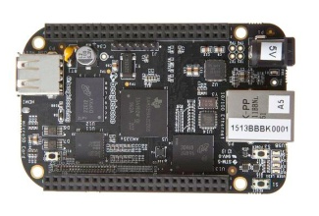
LEDEND:
Qt Application
PC
Linux System
TCP/IP
Fan Device
BeagleBone Black
Ethernet
BBB 1
…
BBB 2
CAN Bus
RS485
A 2
B 2
A 1
B 1
CANopen
Modbus
…
…
Qt
A 3
B 3
Linux

