Slide 1
Presentation on Capstone project aly6140
BY Pranav Khanna

Slide 2
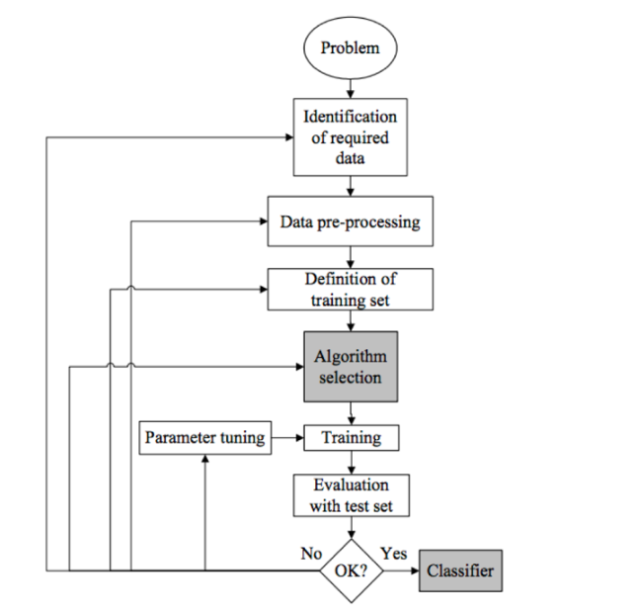
Sequence of steps to create a model:

Slide 3
problem: To Find the list of donors that can contribute to charity for an organization.
Class Attribute : Income ( <=50k or >50K)
Our task is to find the best machine learning algorithm to split the class attribute accurately.
Total size of dataset : 45223
Number of attributes : 14

Slide 4
Packages used:
NumPy - To calculate some required numerical data.
Time – To calculate the time used for processing the algorithm.
Pandas – Used this package extensively for modifying the dataframe, but making use of functions.
Matplotlib- Used this library to visualize the skewed data.
Sklearn - All machine learning libraries are present in the Sklearn module.

Slide 5
Data preprocessing:
Attributes 'capital-gain’ and ‘capital-loss’ data values were asymmetrical so used apply(lambda x: np.log(x + 1)) function so that computation cost is less.
Used MinMaxScalar function change the range of numerical attributes to 0 to 1.
Used LabelBinarizer() function for the classifying attribute income to numerical values.
Used Get_Dummies to convert all other features to numerical values.

Slide 6
Machine Learning Algorithm used:
SGDClassifier Algorithm – This algorithm gave good results but the other two outperformed it.
SVM Algorithm – This algorithm was the second best among the three as the dataset is quite sparse but the computation of SVC was much higher even for a small dataset like this.
Random Forest Algorithm – Choose this as the best algorithm as it took less time to compute and was as accurate as other two algorithm.

Slide 7
Evaluating the model and performance tuning
For final evaluation of the model I have implemented the accuracy score and F-1 score packages to find the veracity of my model.
Further I have implemented feature selection to find the best features that can be used for the income prediction.
Used GridSearchCV to find the best combination of hyperparameters.
Accuracy Score: 0.8579
F1-Score : 0.7289

Slide 8
Thank you
Question?

