Slide 1
E-Commerce Sales Analytics Group – 3

Slide 2
Participants
PEDDA LACHIGALLA LIKITH
Shaik Elak
Divya Mehra
Ayush K Sonawane
Thanush Kumar.S
Bhavesh Sahu
Ravina Manoj Supariwale

Slide 3
Company Overview
Olist is an eCommerce marketplace integrator that enables small and medium-sized businesses (SMBs) to sell their products on major online marketplaces like Amazon, Mercado Livre, and others.
It provides logistics, payments, and customer service solutions to sellers, simplifying the online selling process.
The company’s goal is to empower merchants by giving them access to a large customer base without the need to manage their own eCommerce platforms.

Slide 4
Project Objectives
Analyze eCommerce sales trends.
Identify customer purchasing patterns.
Assess product performance and category-wise revenue.
Optimize marketing and sales strategies through data insights.
Improve business decision-making with interactive dashboards.

Slide 5
KPI
Weekday vs Weekend Payment Statistics
Objective: Compare customer spending behavior on weekdays vs weekends.
Insights:
78.18% of the total payment value occurs on weekdays, indicating higher shopping activity during the week.
Average payment value per order is slightly higher on weekends, suggesting customers might purchase higher-value items when they have more time.

Slide 6
KPI
2) Orders with Review Score 5 & Credit Card Payments
Objective: Identify top-rated orders where customers used credit cards.
Insights:
The majority of 5-star reviews come from credit card payments, indicating a possible correlation between payment convenience and satisfaction.
This suggests that improving checkout experience for credit card users could enhance customer satisfaction.

Slide 7
KPI
3) Average Delivery Time for Pet Shop Orders
Objective: Evaluate how long pet-related orders take to be delivered.
Insights:
Comparing with other product categories, pet products show slightly longer/slower delivery trends.
This may be due to specialized packaging, supplier availability, or warehouse stock levels.

Slide 8
KPI
4) Average Price & Payment Value (São Paulo City)
Objective: Analyze the purchasing behavior of customers from São Paulo.
Insights:
Average payment value: 172
Average product price: 120
Customers in São Paulo tend to spend more per order compared to other regions.
Possible reasons:
Higher disposable income.
Greater availability of high-value products.
More frequent online shopping behavior.

Slide 9
KPI
5) Shipping Days vs Review Scores
Objective: Identify the impact of shipping speed on customer reviews.
Insights:
Orders delivered in fewer days tend to have higher ratings.
Longer delivery times correlate with more negative reviews, affecting overall customer satisfaction.
Faster shipping services could improve customer experience and retention.

Slide 10
Business Insights & Recommendations
Enhance Weekend Sales Performance : Implement exclusive weekend discounts and promotional campaigns to encourage higher sales during off-peak periods.
Encourage Digital Payment Adoption : Partner with banks and financial institutions to offer cashback or EMI options, increasing transaction volume and customer convenience.
Optimize Delivery Timelines : Streamline logistics operations and introduce express shipping options to reduce delivery time and enhance customer satisfaction.
Target High-Value Customer Segments : Personalize offers and loyalty programs for regions with higher spending behavior to maximize revenue potential.
Improve Customer Experience for Better Reviews : Enhance post-purchase engagement, provide real-time order tracking, and offer proactive support to improve customer ratings and retention.

Slide 11
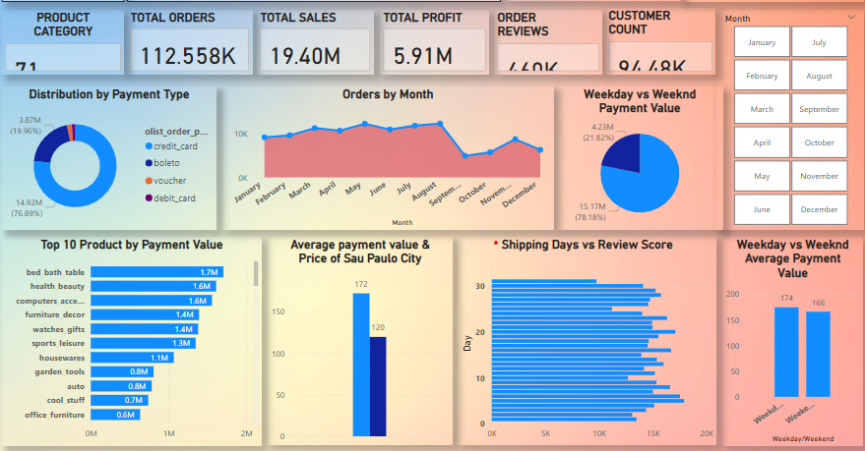
Power BI Dashboard

Slide 12
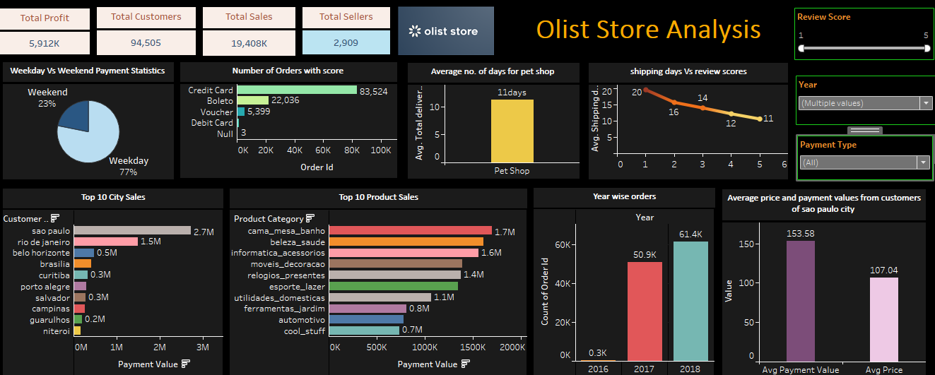
Tableau Dashboard

Slide 13
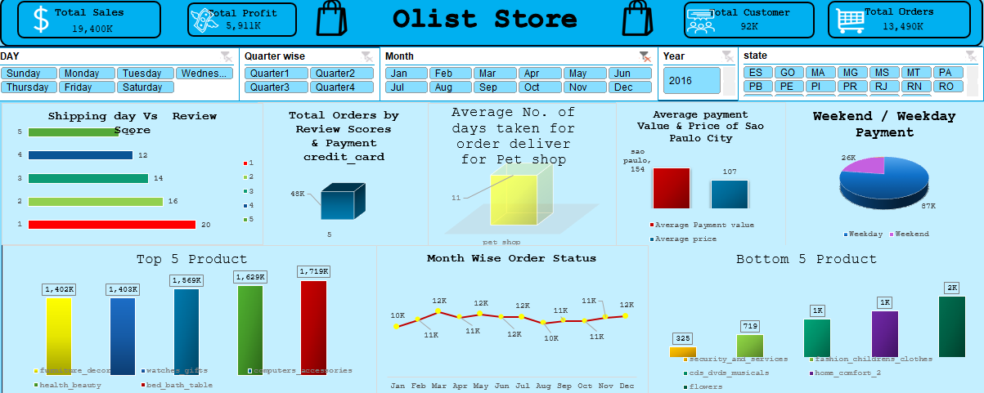
Excel Dashboard

Slide 14
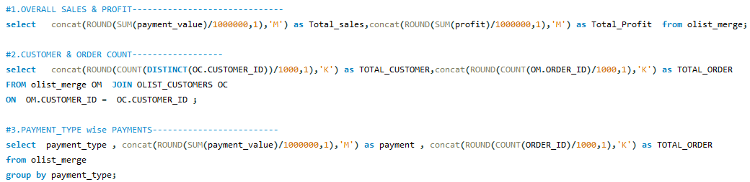
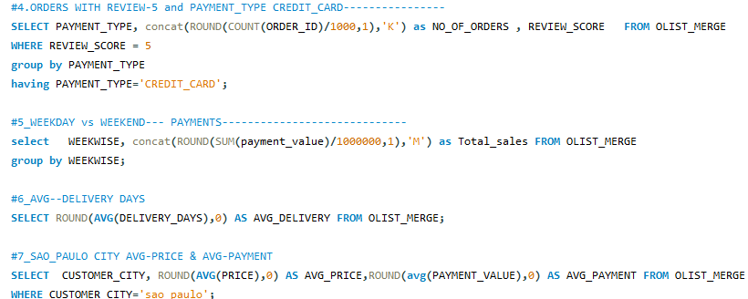
SQL Queries

Slide 15
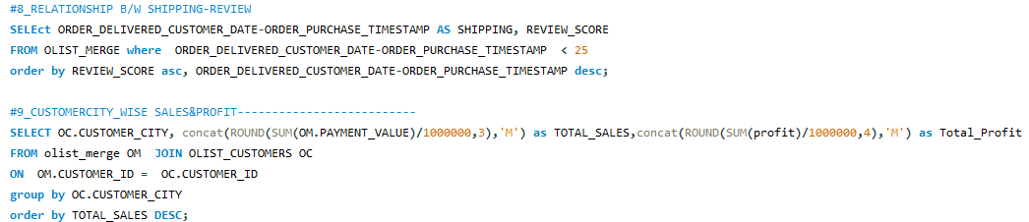
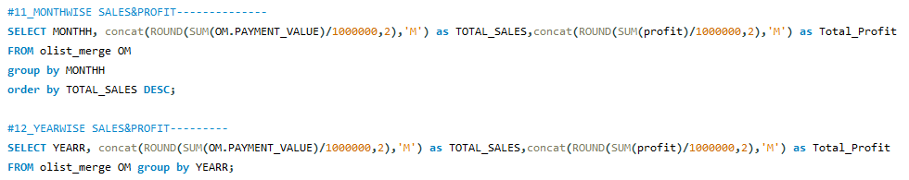

Slide 16
Thank you

