Slide 1

Algorithmic Trading Challenge
Columbia University
Group 3
23/4/2018

Slide 2
Agenda
Introduction ：What we are gonna do
Method: Feature Selection and Models
Evaluation: Model Performance

Slide 3
Introduction ：What we are gonna do

Slide 4

What we are gonna do
Forecasting project that aims to develop new models to predict the stock market's short-term response following large trades.
Develop empirical models to predict the behaviour of bid and ask prices following such "liquidity shocks"

Slide 5
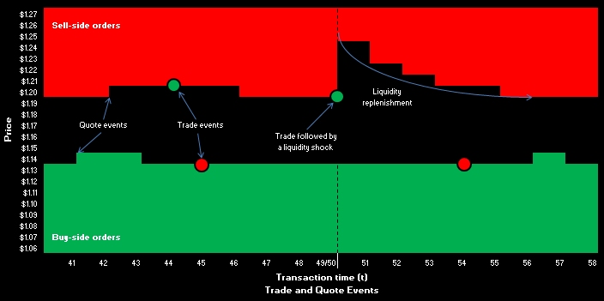
Background Information
What is Liquidity?
What is Liquidity Shock?
What is Market resiliency?
The meaning of modelling market resiliency

Slide 6
Method: Feature Extraction and Models

Slide 7
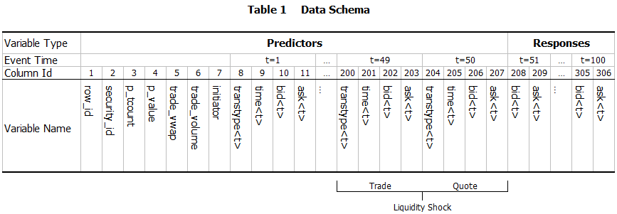
A glimpse of the data
Trade and quote data from the London Stock Exchange
The preprocessed dataset comprises observations of the limit order book before and after a liquidity shock

Slide 8
Feature Extraction
We want to extract semantically meaningful features from the original data
The features can be divided into 4 categories:
Price (information about the bid/ask normalized price time series)
Liquidity book (information about the depth of the liquidity book)
Spread (information about the bid/ask spread)
Rate (information about the arrival rate of orders and/or quotes)

Slide 9
Models we intend to use
Models to be used:
SVM
Random Forest
GBM, Xgboost
ARMA MODEL
Neural Networks
Model hypothesis:
Future events will depend on post-liquidity shock events to be predicted. In this way, the prediction error will tend to increase with the distance from the liquidity shock.

Slide 10
Evaluation: Model Performance

Slide 11
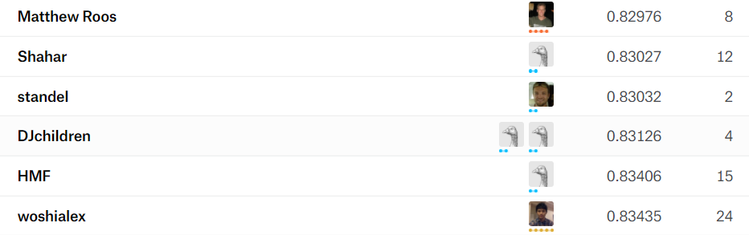
Evaluation
Performance evaluation will be conducted using root mean square error.
For each prediction, RMSE will be separately calculated for the bid and ask at each time step following a liquidity shock.
The lower, the better.

Slide 12
the end
thanks！

