Slide 1

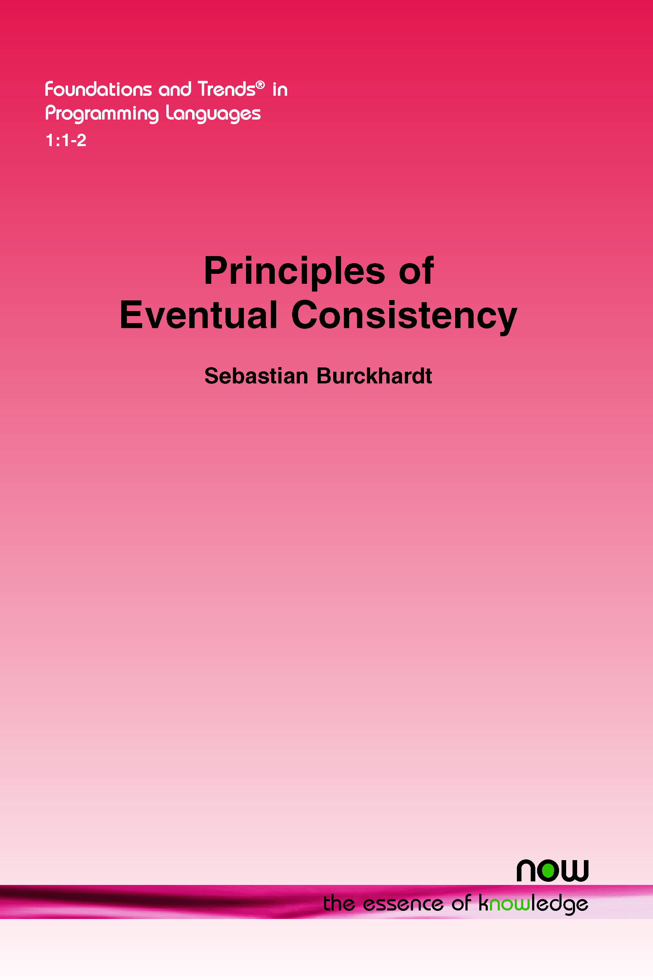
Sebastian Burckhardt
from Basel, Switzerland.
PhD from University of Pennsylvania (advised by Rajeev Alur, Milo Martin)
At Microsoft Research, Redmond, since 2007
Interests:
Programming models for distributed/parallel/concurrent systems.
Eventual Consistency (e.g. specifications, CRDTs)
Elastic services, actor systems (e.g. Orleans)
Serverless programming models

Slide 2
Stateful abstractions for serverless
Sebastian Burckhardt
Microsoft Research, Redmond

Slide 3
background how to build a scalable, available cloud service?
From scalable, available components.
Keep the “hard stuff” out of the application logic (distributed protocols, failure detection, failure recovery,...)

Slide 4
Composed SERVICES
Stateful Service
Stateless
Service
Stateful Service
Services represent logical functionality, not physical machines.
Often: multiple languages, REST APIs
Stateless
Service
Stateless
Service
Stateful Service

Slide 5
Composed SERVICES
restartable
retryable
recoverable
Stateful Service
Stateless
Service
Stateful Service
All components are highly available.
Localized failure recovery via idempotent or testable APIs.
Stateless
Service
Stateless
Service
Stateful Service

Slide 6
internal Partitioning
services are internally partitioned so they can scale beyond the capacity of a single machine.
May be extremely fine-grained - single function invocation (stateless) - single key-value pair (stateful)

Slide 7
General pattern
Application-Defined
Service
Partitions
At least two layers of scheduling/placement indirection.
(In)dependent questions:
What are the layers and how are they implemented
Where’s the customer boundary
Schedule/Place on
Pool of Virtual Machines
Schedule/Place on
Pool of Physical Machines

Slide 8
ExamPle: IAAS
Customer
Logical
Service
Partitions
e.g. Docker + Kubernetes
Provider
Pool of Virtual Machines
Pool of Physical Machines

Slide 9
ExamPle: xAAS
Customer
Provider
Logical
Service
Partitions
e.g. AppService, AppEngine
X =
functions
storage
queues
databases
...
Pool of Virtual Machines
Pool of Physical Machines

Slide 10
this is not an “Either, or”
- Customers are buying at all levels of the abstraction stack.
- Good technology is useful no matter who runs it.

Slide 11
developers choosE
Control
Productivity
Assembly
Java, C#
Python
C, C++

Slide 12
developers choosE
Control
Productivity
Infrastructure as a Service
Platform as a service
Functions as a Service
e.g. AWS Lambda, Azure Functions
Containers as a service

Slide 13
developers choosE
SERVERLESS
Control
Productivity
Infrastructure as a Service
Platform as a service
Functions as a Service
e.g. AWS Lambda, Azure Functions
Containers as a service

Slide 14
Top-growing cloud services 2019
Place | Service | Growth | 2018 Use | 2019 Use
#1 (tie) | Serverless | 50% | 24% | 36%
#1 (tie) | Stream Processing | 50% | 20% | 30%
#3 | Machine Learning | 44% | 18% | 26%
#4 | Container-as-a-Service | 42% | 26% | 37%
#5 | IoT | 40% | 15% | 21%
#6 | Data warehouse | 38% | 29% | 40%
#7 | Batch processing | 38% | 26% | 36%
Source: Forbes, RightScale 2019 state of the cloud report

Slide 15
Serverless Functions
Easy to deploy
Elastic scale
Load-based cost (e.g. pay per invocation)
Free language choice, easy REST interface
string helloworld()
{
return “Hello, World”;
}
> curl http://my-function-app.azure.com/helloworld
Hello, World

Slide 16
Demo
Hello, World with Azure Functions

Slide 17
Serverless Functions Are Not “PuRe”. they can call other services.
async void delete_all()
{
await cloudstorage.delete_file(“*”);
}
Functions can call external services:
key-value stores, queues, blob storage, pub-sub, databases, ...
= the “standard library” of cloud programming!
async void counter_increment()
{
var current = await cloudstorage.read(“counter”);
current = current + 1;
await cloudstorage.write(“counter”);
}

Slide 18
Definition of “Serverless”?
To most people, serverless just means “stateless functions with per-invocation billing”.
My preferred definition is broader:
Serverless ≈ “the concept of a server is not visible in the application logic”

Slide 19
“Serverless” is not just about compute
Serverless Compute
Serverless Storage
Serverless Transport
Stateless Functions
Table Storage
Blob Storage
Queue Storage
Connected via calls and triggers:
Functions can call storage (e.g. update state, enqueue messages)
Storage can trigger functions (e.g. process queue messages, react to insertions)

Slide 20
Stateless Functions are nice and popular,
but...

Slide 21
Problem: State & synchronization in serverless functions is too tricky.
Lots of loading/saving of state from/to storage
Difficult to prevent races and conflicts between functions
async void counter_increment()
{
var current = await cloudstorage.read(“counter”);
current = current + 1;
try
{
await cloudstorage.write(“counter”);
}
catch(ETagException)
{
// Retry ? Back off ?
}
async void counter_increment()
{
var current = await cloudstorage.read(“counter”);
current = current + 1;
await cloudstorage.write(“counter”);
}

Slide 22
Problem: State & synchronization in serverless functions is too tricky.
Solution: Add stateful abstractions to serverless programming model.
Lots of loading/saving of state from/to storage
Difficult to prevent races and conflicts between functions
Serverless Orchestrations
Serverless Entities
Critical Sections
Serverless Compute
Serverless Storage
Serverless Transport

Slide 23
Stateful Serverless Programming with Azure Durable Functions v2
Sebastian Burckhardt (MSR), Chris Gillum (Azure) & Durable Functions Team

Slide 24
summary: pain points with stateless functions
Sychronization functions can interleave and race, synchronization via storage is challenging
Partial execution hosts can fail in the middle of a function, leaving behind inconsistent state
Cost/Performance Double billing, excessive data movement

Slide 25

2 new types of stateful functions
Orchestrations
(≈ Workflows)
provide
durable execution state
critical sections
Stateless Functions
Entities
(≈ Actors)
provide
durable application state
operation sequencing

Slide 26
orchestrations = durable execution state
Reliably execute some combination of functions.
e.g. a simple sequence of functions, or multiple parallel function calls
Advantages:
Solves the partial execution problem Automatically recover from last position in workflow.
Solves the double billing problem Can persist execution state in storage - don’t get charged while waiting

Slide 27
Example 1
Upload file, then add to index
void addtoblobstorage(string name, byte[] data)
{
...
}
void upload_image(string name, byte[] data)
{
await addtoblobstorage(name, data);
await addtoindex(name);
}
void addtoindex(string name)
{
...
}

Slide 28
example 2
Send many messages in parallel
list<userid> getFriends()
{
...
}
void send_text_to_all_friends(string text)
{
var friends = await getFriends();
await Task.WhenAll(
friends.Select(f => send(f, text)).ToList());
}
send(userid destination, string text)
{
...
}

Slide 29
orchestrations: what’s new about it?
Do what was traditionally done with workflow “languages” (e.g. XML-based, or graphical designers)
But written in standard async-await style code.
Thus, we get to enjoy the maturity of the host language:
all of the standard sequential control flow (conditionals, loops, switches, ...)
all of the task-based asynchronous control flow (await, Task.WhenAll, Task.WhenAny, ...)
all of the exception handling (try/catch/finally)
all of the existing tooling (IDE, debugger etc.)

Slide 30
The trick: user separates deterministic coordination from nondeterministic tasks
Activities
“do the actual tasks”
Can be nondeterministic
Must be idempotent
Executed in a single billing activation
Orchestrations
“coordinate activities”
Must be deterministic
Executed in multiple billing activations
list<userid> getFriends()
{
...
}
void send_text_to_all_friends(string text)
{
var friends = await getFriends();
await Task.WhenAll(
friends.Select(f => send(f, text)).ToList());
}
send(userid destination, string text)
{
...
}

Slide 31
C# Example Of an Orchestration
[FunctionName("SmsAuthenticationWorkflow")]
public static async Task<bool> Run([OrchestrationTrigger] IDurableOrchestrationContext context)
{
// send an SMS to the user
int challengeCode = await context.CallActivityAsync<int>("SendSms”, context.GetInput<string>());
// user has 90 seconds to respond
var timeoutTask = context.CreateTimer(context.CurrentUtcDateTime + TimeSpan.FromSeconds(90));
Task<int> challengeResponseTask = context.WaitForExternalEvent<int>("SmsChallengeResponse");
// wait for the response or the timeout
Task winner = await Task.WhenAny(challengeResponseTask, timeoutTask);
if (winner == challengeResponseTask)
return true;
else
return false;
}

Slide 32
Caveat
We require orchestration code to be deterministically replayable. Source of bugs. Examples:
DateTime.UtcNow, new Random()
I/O
global static variables
User must wrap these in activities, or use built-in deterministic versions
Research w/ intern Christopher Meiklejohn: Use programming language Koka (Daan Leijen) to guarantee determinism as an effect.

Slide 33
implementation: how does it work?
void send_text_to_all_friends(string text)
{
var friends = await getFriends();
await Task.WhenAll(
friends.Select(f => send(f, text)).ToList());
}
Example Log in Table Storage:
started, input = (text)
called getFriends
received result { alice, bob }
called send(alice, text)
called send(bob, text)
received result
received result
finished
Runtime uses record & replay to “rehydrate control state”
Under failures, activities may be duplicated

Slide 34
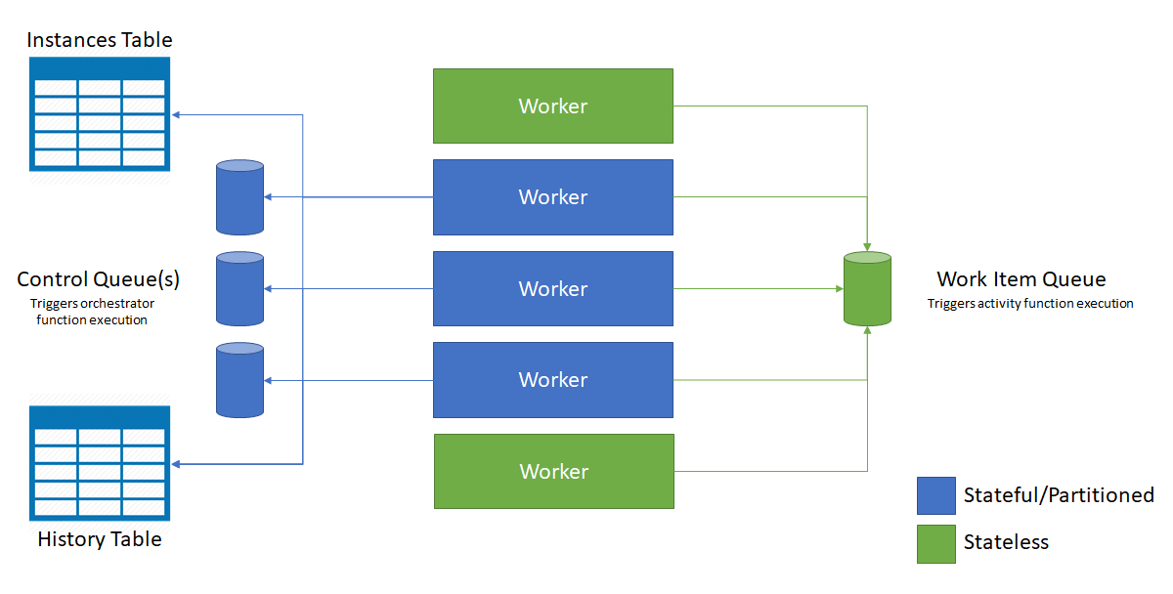
current implementation architecture

Slide 35
2 new types of stateful functions
Orchestrations
(≈ Workflows)
provide
durable execution state
critical sections
Stateless Functions
Entities
(≈ Actors)
provide
durable application state
operation sequencing

Slide 36
entities = durable application state
Entity = smallest piece of state, a “single key-value pair”, a virtual actor (Orleans)
Runtime delivers “operations” (messages) to entities via ordered async channels
Runtime executes operations on entities, one at a time. Operations can
read and update state
send messages
perform external calls
Durable: All state + messages reliably kept in cloud storage, message processing is exactly-once w.r.t to internal effects and at-least-once w.r.t. external effects

Slide 37
example entity: Bank Account
public class Account : IAccount
{
public int Balance { get; set; }
public Task<int> Get()
{
return Task.FromResult(Balance);
}
public Task Modify(int Amount)
{
Balance += Amount;
return Task.CompletedTask;
}
// boilerplate for class-based syntax
[FunctionName(nameof(Account))]
public static Task Run([EntityTrigger] IDurableEntityContext ctx) => ctx.DispatchAsync<Account>();
}
each entity identified by a (name,key) pair, e.g. (“AccountEntity”, “32974-234093-00”)
Accessible via interface
public interface IAccount
{
Task<int> Get();
Task Modify(int Amount);
}

Slide 38
Call vs. Signal
An entity can signal another entity send message, fire and forget
An orchestration can call an entity and wait for ack/result
But entities cannot call entities (to prevent deadlock)

Slide 39
Feature: Explicit locking
Orchestrations can use critical sections
Effective for preventing unwanted data races and interleavings
Critical sections never fail spuriously and require no rollback or compensations (though applications are free to do those things on their own, using exception handlers)

Slide 40
example: transfer funds
var fromAccount = new EntityId("AccountEntity", from);
var toAccount = new EntityId("AccountEntity", to);
using (await ctx.LockAsync(fromAccount, toAccount))
{
var source = context.CreateEntityProxy<ICounter>(fromAccount);
var destination = context.CreateEntityProxy<ICounter>(toAccount);
if (amount <= await source.Get())
{
await Task.WhenAll(
source.Modify(-transferAmount),
destination.Modify(transferAmount),
);
}
}

Slide 41
message diagram
orchestration
fromAccount
toAccount
var fromAccount = new EntityId("AccountEntity", from);
var toAccount = new EntityId("AccountEntity", to);
using (await ctx.LockAsync(fromAccount, toAccount))
{
var source = context.CreateEntityProxy<ICounter>(fromAccount);
var destination = context.CreateEntityProxy<ICounter>(toAccount);
if (amount <= await source.Get())
{
await Task.WhenAll(
source.Modify(-transferAmount),
destination.Modify(transferAmount),
);
}
}
lock
lock
ok
get
balance
add
add
ok
ok
release
release

Slide 42
Deadlock prevention
We enforce some simple rules to prevent deadlocks:
Runtime acquires locks in order (fixed global total order).
Critical sections cannot be nested.
Within a critical section:
can call only entities that were locked.
can signal only entities that were not locked.
cannot call the same entity more than once in parallel.

Slide 43
Critical sections vs Transactions?
The big difference: critical sections don’t fail or roll back.
Challenges for transactions as a programming model:
Developers struggle with “why and when” transactions fail, and “what to do about it”
Transaction implementations often perform badly under high conflict rates
Unclear how to incorporate external effects (explicit undo-code ? What about failures in undo ?)

Slide 44
status
Azure Durable Functions have been out for about 2 years now. (thanks to Chris Gillum & Durable Functions team)
Entities (& critical sections) are a new feature we implemented this year, building on research done last year w/ intern Christopher Meiklejohn
In public preview since Build, to be shipped next week (for Ignite, Nov 4)
Much work left to be done
make existing implementation more correct
build better-performing implementation(s)

