Slide 1
The Global Object Tracker (GoT)
Git, but for objects
Rohan Achar, Crista V. Lopes
University of California, Irvine

Slide 2
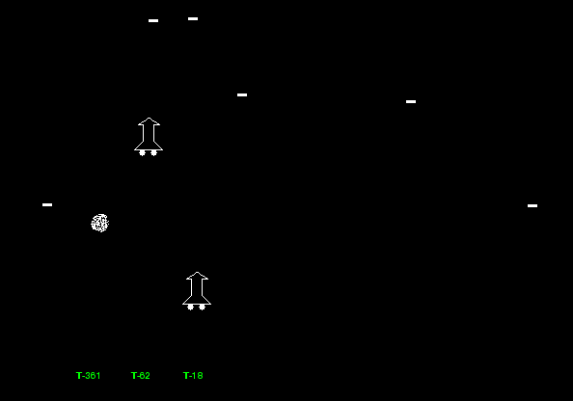
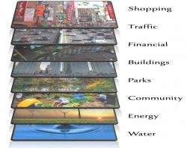

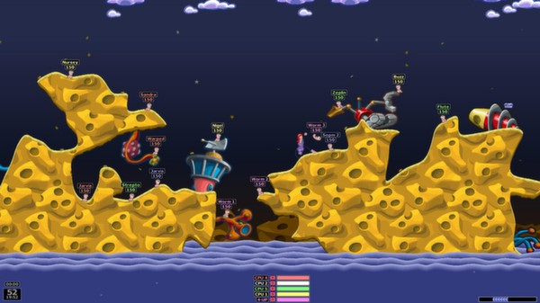
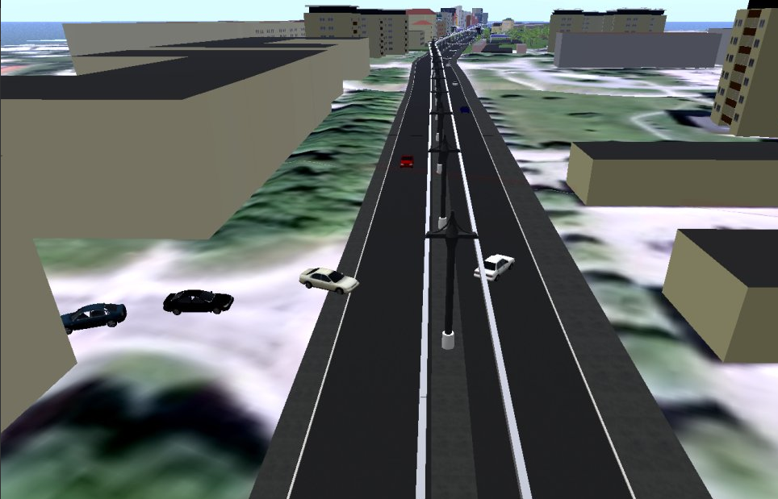
Shared Environment Applications

Slide 3
Characteristics
Large shared state
Highly mutable state
Frequent communication
Notes:
guarentee

Slide 4
Design Goals
G1: Expressive state updates.
Support various needs of application with respect to consistency and isolation.
G2: Fast state updates.
Low latency state synchronization, as soon as needed but not sooner.
G3: Observable and trackable state updates.
Support reasoning about distributed state updates.

Slide 5
G1: Expressive State Updates
Transactional integrity
Some parts of the state may depend on each other
Isolation
Nodes may want, or need, to be temporarily isolated from state changes

Slide 6
G2: Fast State Updates
Optimizing for Consistency + Optimizing for Latency + Optimizing for Isolation
Sweet spot
Getting the latest write.
Getting the latest write as fast as possible.
Getting the latest write as fast as possible but only when you need it.
Notes:
PACELC Theorem[1]
Consistency vs Latency
Consistency deals with receiving the latest write.
→ Does not tell when the write is received.
Latency deals with accessing data as quickly as possible.
→ Does not tell what data is received.

Slide 7
Update latency
“The time taken for a write at one node to be available at another node.”
A mix of consistency and latency.
Not just consistency: There is a notion of time.
Not just latency: There is a notion of what is being read.
Related to Probabilistic Bounded Staleness[2]
Adding isolation:
Not just getting it: There is a notion of when to get it.
[2] Bailis, Peter, et al. "Probabilistically bounded staleness for practical partial quorums." Proceedings of the VLDB Endowment 5.8 (2012)
Notes:
To the best of our knowledge.

Slide 8
Components of Update latency
Nodes
State C1
State C2
Node C
Fetch
Package
+ Transfer
State B2
Node B
State B1
Package
+ Transfer
Node A
Local Write
State A1
State A2
A: Write Latency
C: Read Latency
A -> B: Update Latency
A -> C: Update Latency
Time
Notes:
Update latency >= read + write

Slide 9
GoT: Global Object Tracker

Slide 10
GoT: Global Object Tracker
Synchronizing mutable state is modeled as a Version Control Problem[3][4].
Takes inspiration from Git.
It is Git, but for Objects.
[3] Burckhardt, Sebastian, and Daan Leijen. "Semantics of concurrent revisions." European Symposium on Programming. 2011.
[4] Crooks, Natacha, et al. "Tardis: A branch-and-merge approach to weak consistency." SIGMOD 2016.

Slide 11
GoT
Distributed execution is performed in GoT Nodes.
Each GoT Node has a repository of shared objects called Dataframe.
Dataframe == Git repository == Specialized Node Object Heap
Changes to the dataframe are shared through explicit push, and fetch commands (again, like in Git)

Slide 12
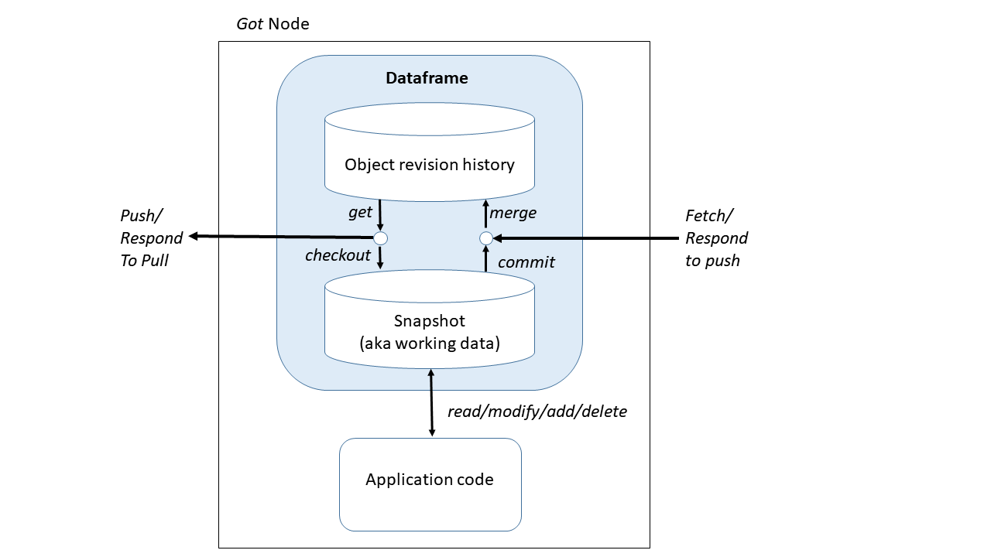
Dataframe
Snapshot
Provides read stability.
Mutable object store/heap for the code.
Object Version history
Publicly visible state of the node.
Stores versions as a graph of patches.
Like DARCS[5]
Graph represent happened-before relations between versions.
Four operations
Commit, push, fetch, checkout.
[5] Roundy, David. "Darcs: distributed version management in haskell." Proceedings of the 2005 ACM SIGPLAN workshop on Haskell. ACM, 2005.

Slide 13
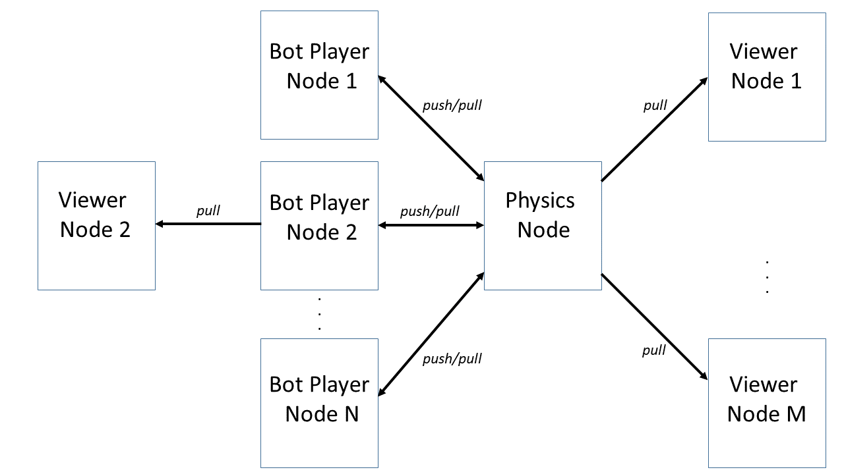
GoT Example: Multi-bot Space Race

Slide 14
GoT Example: Multi-bot Space Race
Data Model:
Two types: Player, Asteroid
@pcc_set
class Player(object):
oid = primarykey(int)
crashed = dimension(bool)
winner = dimension(bool)
position = dimension(tuple)
velocity = dimension(tuple)
def __init__(self, object_id):
self.oid = object_id
...other initializations,
including non-shared fields...
# Example of non-shared field
self.world = World()
def act(self, asteroids, players):
... do smart things with the ship...
...Other functions...
@pcc_set
class Asteroid(object):
oid = primarykey(int)
position = dimension(tuple)
velocity = dimension(tuple)
def __init__(self, object_id):
self.oid = object_id
self.position = self.gen_start_pos()
def gen_start_pos(self):
...Generate a start position...
return pos

Slide 15
GoT Example: Multi-bot Space Race
Dataframe API | Equivalent Git API | Purpose
read_{one, all} | N/A | Read objects from snapshot
add_{one, many} | git add <untracked> | Add new objects to snapshot
delete_{one, all} | git rm <files> | Delete objects from snapshot
 | git add <modified> | Objects are locally modified and tracked in the snapshot.
commit | git commit | Write changes in snapshot to local version history.
checkout | git checkout | Update snapshot to local version history HEAD.
push | git push | Write changes in local version history to remote version history.
fetch | git fetch && git merge | Get changes from remote version history to local version history
pull | git pull | Fetch and then checkout.
def sr_physics(df):
df.add_many(Asteroid, ASTEROIDS)
df.commit()
while True:
start = time.perf_counter()
# Pick up new updates
df.checkout()
# state changes.
for a in ASTEROIDS:
a.move()
for p in df.read_all(Player):
p.process()
p.crashed = is_crashed(p)
p.winner = reached_finish(p)
# Make changes public.
dataframe.commit()
elapsed = time.perf_counter()-start
time.sleep(DELTA_TIME-elapsed)
def main(port):
node = GotNode(sr_physics, server_port=port,
name="spacerace.got",
Types=[Player, Asteroid])
node.start()
Notes:
Highlights

Slide 16
GoT Example: Multi-bot Space Race
Dataframe API | Equivalent Git API | Purpose
read_{one, all} | N/A | Read objects from snapshot
add_{one, many} | git add <untracked> | Add new objects to snapshot
delete_{one, all} | git rm <files> | Delete objects from snapshot
 | git add <modified> | Objects are locally modified and tracked in the snapshot.
commit | git commit | Write changes in snapshot to local version history.
checkout | git checkout | Update snapshot to local version history HEAD.
push | git push | Write changes in local version history to remote version history.
fetch | git fetch && git merge | Get changes from remote version history to local version history
pull | git pull | Fetch and then checkout.
def bot_driver(df, player_id):
df.pull()
my_player = Player(player_id)
df.add_one(Player, my_player)
df.commit()
df.push_await()
while (not my_player.crashed
and not my_player.winner):
start = time.perf_counter()
df.pull()
my_player.act(
df.read_all(Asteroids),
df.read_all(Player))
df.commit()
df.push()
elapsed = time.perf_counter()-start
sleep_t = SYNC_TIME - elapsed
if sleep_t > 0:
time.sleep(sleep_t)
GotNode(bot_driver,remote=[(args.physics_node)],
Types=[Player, Asteroid]).start(
args.player_id)
Notes:
Bold and Beautiful

Slide 17
Dataframe operations: Commit
Object Version Graph
Root
{a=8}
Ver1
Snapshot
[a=8]
Version = Ver1
Staged = {b=5}

Slide 18
Dataframe operations: Commit
Object Version Graph
Root
{a=8}
Ver1
{b=5}
Ver2
Commit
Ver1 → Ver2, {b=5}
Snapshot
[a=8,b=5]
Version = Ver2
Staged = {}

Slide 19
Dataframe operations: Push
Object Version Graph
Object Version Graph
Root
Root
{a=8}
{a=8}
Ver1
Ver1
{b=5}
Ver2
Snapshot
Snapshot
[a=8,b=5]
Version = Ver2
Staged = {}
[a=8]
Version = Ver1
Staged = {}

Slide 20
Dataframe operations: Push
Object Version Graph
Object Version Graph
Root
Root
{a=8}
{a=8}
Push Ver1 → Ver2, {b=5}
Ver1
Ver1
{b=5}
{b=5}
Ver2
Ver2
Snapshot
Snapshot
[a=8,b=5]
Version = Ver2
Staged = {}
[a=8]
Version = Ver1
Staged = {}

Slide 21
Dataframe operations: Checkout
Object Version Graph
Object Version Graph
Root
Root
{a=8}
{a=8}
Ver1
Ver1
{b=5}
{b=5}
Ver2
Ver2
Checkout
Ver1 → Ver2, {b=5}
Snapshot
Snapshot
[a=8,b=5]
Version = Ver2
Staged = {}
[a=8,b=5]
Version = Ver2
Staged = {}

Slide 22
Dataframe operations: Checkout
Object Version Graph
Object Version Graph
Object Version Graph
Root
Root
Root
{a=8}
{a=8}
Ver1
Ver1
{b=5}
{b=5}
Ver2
Ver2
Snapshot
Snapshot
Snapshot
[a=8,b=5]
Version = Ver2
Staged = {}
[a=8,b=5]
Version = Ver2
Staged = {}
[]
Version = Root
Staged = {}

Slide 23
Dataframe operations: Fetch
Object Version Graph
Object Version Graph
Object Version Graph
Root
Root
Root
{a=8}
{a=8}
{a=8}
Fetch
Resp: Root → Ver1, {a=8}
Ver1 → Ver2, {b=5}
Ver1
Ver1
Ver1
{b=5}
{b=5}
{b=5}
Ver2
Ver2
Ver2
Snapshot
Snapshot
Snapshot
[a=8,b=5]
Version = Ver2
Staged = {}
[a=8,b=5]
Version = Ver2
Staged = {}
[]
Version = Root
Staged = {}
Notes:
Color codey

Slide 24
Conflict Detection
Object Version Graph
Object Version Graph
Root
Root
{alive=True, health=2}
{alive=True, health=2}
Ver1
Ver1
{health=1}
{health=1}
Ver2
Ver3

Slide 25
Conflict Detection
Object Version Graph
Object Version Graph
Root
Root
{alive=True, health=2}
{alive=True, health=2}
Ver1
Push Ver1 → Ver2, {health=1}
Ver1
{health=1}
{health=1}
{health=1}
Ver2
Ver3
Ver2
Conflict Detected!

Slide 26
Conflict Resolution
Object Version Graph
Object Version Graph
Root
Root
{alive=True, health=2}
{alive=True, health=2}
Ver1
Ver1
{health=1}
{health=1}
{health=1}
Ver2
Ver3
Ver2
Resolved state is determined by three-way merges.
Custom three-way merges are possible.

Slide 27
Conflict Resolution
def merge(conf_iter, orig_snap, your_snap, their_snap):
orig_snap["health"] = (
your_snap["health"] + their_snap["health"]
- orig_snap["health"]
)
if orig_snap["health"] == 0:
orig_snap["alive"] = False
return orig_snap
Object Version Graph
Object Version Graph
Root
Root
{alive=True, health=2}
{alive=True, health=2}
Ver1
Ver1
{health=1}
{health=1}
{health=1}
Ver2
Ver3
Ver2

Slide 28
Conflict Resolution
def merge(conf_iter, orig_snap, your_snap, their_snap):
orig_snap["health"] = (
your_snap["health"] + their_snap["health"]
- orig_snap["health"]
)
if orig_snap["health"] == 0:
orig_snap["alive"] = False
return orig_snap
Maintaining Transactional Integrity
Object Version Graph
Object Version Graph
Root
Root
{alive=True, health=2}
{alive=True, health=2}
Ver1
Ver1
{health=1}
{health=1}
{health=1}
Ver2
Ver3
Ver2
{alive=False, health=0}
{alive=False, health=0}
Ver4
Resolution can happen any time the version graph
receives data: Commit, Fetch, Responding to a Push.
State supplied by three-way merge.
New version identifier is created.

Slide 29
Granularity of Conflict Resolution
Node State level resolution
Default: O(1)
Type level resolution
Default: O(T)
Increasing Update Latency
Object level resolution
Default: O(T*o)

Slide 30
Granularity of Conflict Resolution
Each GoT Node owns their dataframe.
Each GoT Node can define their own merge strategies.
Visualizer can unconditionally accept changes from server. (Left)
Visualizer might create “new” values from conflicting results to smooth animations. (Right)
def node_state_ conflict_resolution(
original_snap,
your_snap,
their_snap):
return their_snap
def conflict_resolution_for_player_object(
conflict, original_snap,
your_snap, their_snap):
# These will be Player objects only.
orig,yours,theirs = conflict
if any(v != World.MAX_SPEED
for v in theirs.velocity):
yours.velocity = self.calculate_smoothen()
# Setting a local only field
yours.target_position = theirs.position
yours.target_velocity = theirs.velocity
yours.velocity = theirs.velocity
your_snap.resolve_with(yours)
return your_snap

Slide 31
Spacetime: A Practical Implementation of GoT

Slide 32
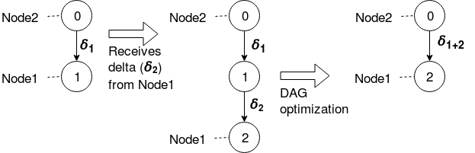
Implementation Challenges
Unbounded growth of versions.
Reference counting Garbage collector.
Versions that are already observed or can be skipped are deleted,
Edges are merged to maintain happened-after relation from Root.
Trade off: Reference counter needs to track both parent remote nodes and child remote nodes.
Notes:
Write: We lose versions, but we do not lose updates.

Slide 33
Implementation Challenges
Network efficiency.
Multiple patches are merged and sent as one patch. (Similar to git squash)
Object Version Graph
Remote Object Version Graph
Root
[]
Root
[]
Fetch (Root)
return: [<Root → Ver2, {a=5, b=3}>]
{a = 5, b = 3}
{a = 4, b = 3}
Ver2
[a=5,b=3]
Ver1
[a=4,b=3]
{a = 5}
Ver2
[a=5,b=3]
Trade off: Heavier restrictions on network topology of nodes.

Slide 34
Implementation Challenges
Some GoT nodes may not need all the objects in the repository.
Synchronization over a subset of types rather than all types.
EG: Physics node and Player nodes sync over Player (login details), Ship, Asteroid and visualizer needs to only sync over Ship and Asteroid.

Slide 35
Design Goals
G1: Expressive state updates.
Support various needs of application with respect to consistency and isolation.
G2: Fast state updates.
Low latency state synchronization, as soon as needed but not sooner.
G3: Observable and trackable state updates.
Support reasoning about distributed state updates.

Slide 36
Update latency
Cost of communication
Serialization, deserialization, making fetch requests, transferring data.
Cost of reconciliation.
Optimizing Update latency → Minimize the cost of these steps.

Slide 37
Experimental Setup
Nodes
Reader
Accept Obj
Fetch Changes
Send Changes
Server
Accept Obj
Spacetime/Redis/MySQL
Send Change
Ack?
Writer
Add obj
A -> B: Update Latency
A -> C: Update Latency
Time

Slide 38
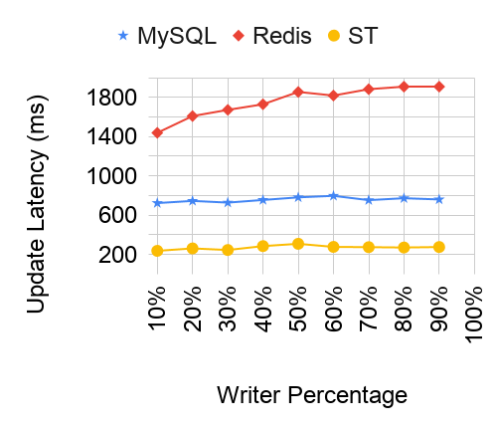
Experiment 1
Update latency vs Varying percentage of writers and readers.
100 clients, 100 objects/records/hashsets.
Notes:
SPACETIME not ST

Slide 39
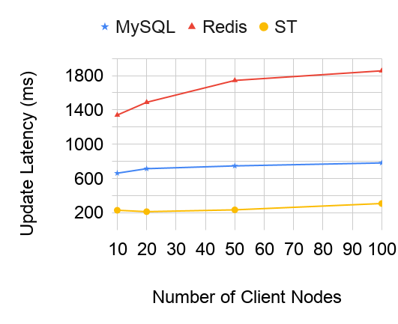
Experiment 2
Update latency vs Varying number of client nodes.
50% of clients were writers. 100 objects

Slide 40
Thank You Suggestions? Code at: https://github.com/Mondego/spacetime Arxiv Paper: https://arxiv.org/pdf/1904.06584.pdf

