Slide 1

By:
H.T. Kung and John Robinson
Presented by:
Dwarkamoye Mohanty
Prem Chand Lingamgunta

Slide 2
Introduction
Concurrency control is the management of contention for data resources
There are two general approaches to concurrency control: locking and backup. The more popular approach are based on locking schemes
This paper investigates solutions to concurrency control relying almost entirely on a backup mechanism
The authors identify a number of inherent disadvantages of locking and proposes an optimistic approach

Slide 3
Disadvantages of Locking
Description: A mechanism where one process can deny certain processes access to some portion of the DB
Disadvantages:
  Lock maintenance represents overhead.
  There are no general-purpose deadlock-free locking protocols for DBs w/ high concurrency
  Concurrency is significantly lowered whenever it is necessary to leave some congested node locked
  Locks cannot be released until the end of the transaction
  Locking may be necessary only in the worst case

Slide 4
Optimistic Approach
”Optimistic”, because it is based on the observation that, in most applications, the likelihood of two transactions accessing the same object is low
The approach “hopes” that conflicts do not occur and transactions are allowed to proceed as though there were no possibility of conflict
A concurrency control scheme is considered pessimistic when it locks a given resource early in the data-access transaction and does not release it until the transaction is closed

Slide 5
Optimistic Concurrency Control
Kung and Robinson proposes two families of optimistic concurrency control which eliminate the use of locking.
This approach provides the following Advantages:
  It is deadlock free
  Avoids any time consuming node-locked scenarios
  If the transactions become query dominant, the concurrency control overhead becomes almost negligible.
  The approach is completely general. It applies equally well to any shared directed graph structure and associated access algorithm

Slide 6
Idea behind Optimistic Approach
Since reading a value or a pointer from a node can never cause a loss of integrity, reads are completely unrestricted
Writes are severely restricted.
Transactions consist of three phases:
  Read Phase: All writes take place on local copies of the object to be modified
  Validations Phase: The step in which it is determined that the transaction will not cause a loss of integrity
  Write Phase: Copies are made global

Slide 7
Read and Write Phase
Read is also referred to as the “Working Phase”
Each transaction has a tentative version of each of the object that it updates
READ operations are performed immediately
WRITE operations record the new values of the objects as tentative values
Two records are kept of the objects accessed within a transaction: a read set and a write set

Slide 8
Read and Write Phase
If validation succeeds, then the transaction enters the write phase
After write phase, all written values become “global”
When a transaction completes, it will request its validation and write phases via “transactionEnd’ call

Slide 9
Validation Phase
This is especially important with long-running transactions.
Method uses an update scheme to test whether the underlying data source has been updated by another transaction since the beginning of the current transaction.
Kung and Robinson employ Serial Equivalence for verifying the correctness of concurrent execution of transactions.

Slide 10
Validation of Serial Equivalence
Explicitly assigns each transaction a Transaction Number , t(i), at the end of the read phase.
Transaction numbers are assigned in order, If the transaction is validated and completes successfully, it retains this number.
If it fails the validation checks and is aborted, or if the transaction is read-only, the number is released for reassignment.
Transaction numbers are integers assigned in ascending sequence.

Slide 11
Assigning Transaction Numbers
Transaction numbers must be assigned somewhere before validation.
Can we assign transaction numbers before read phase?
Consider two transactions T1 and T2 assigned n and n+1
numbers.
Even if T2 completes read phase before T1. It waits for
completion of read phase of T1 before being validated .
Is it a valid approach?
For these similar considerations Transaction numbers are
assigned at the end of read phase for a better response time.

Slide 12

Two transactions are serially equivalent if and only if all pairs of conflicting operations are executed in the same order for all objects they both access.
Take all pairs of conflicting operations one from T1 and one from T2.
If the T1 operation reflected first on server mark all pairs as (T1, T2) otherwise mark it as (T2,T1)
All pairs should be marked as either (T1,T2) or (T2,T1).

Slide 13
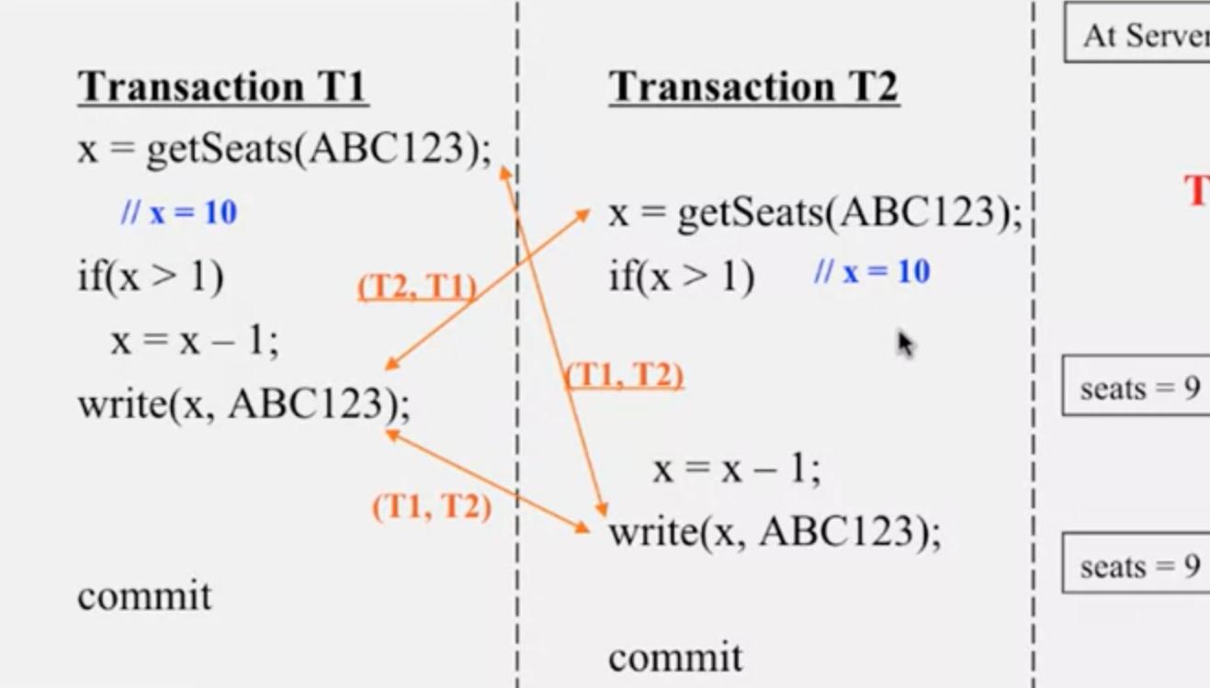

Slide 14

Case 1: What should be done when validation fails?
Transaction is aborted ,restarted receiving a new
transaction number at end of read phase.
Case 2: What happens when validation fails repeatedly?
Concurrency control detects “starving” transaction.
The entire database is write locked and “starving”
transaction will run to completion.

Slide 15

Consider transaction Ti comes before Tj:
Operations confirm to the following validation conditions:
  Ti completes before Tj starts.
  Writes of Ti doesn't affect the read phase of Tj and Ti completes write phase before Tj starts write phase.
  The write set of Ti doesn't intersect the readset or writeset of Tj.

Slide 16
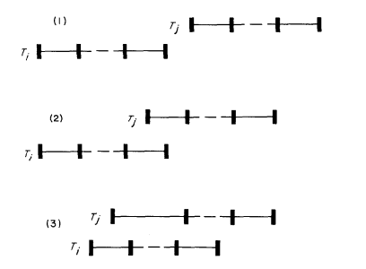

Slide 17
Serial Validation
This model implements validation conditions (1) and (2) of serial equivalence.
When no two transactions may overlap in the write phase, condition 3 is satisfied.
Implementation consists of placing the assignment of Tid, validation, and subsequent write phase all in a critical section.

Slide 18


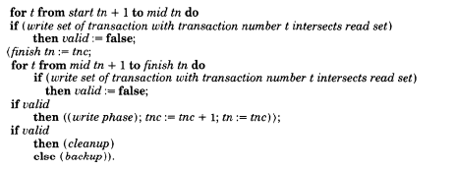

Slide 19
Parallel Validation
This model implements all validation conditions of serial equivalence.
Retains optimization properties of Serial Validation.
Extends validation to allow multiple transactions to be in the validation phase at the same time.
Condition 3 must be satisfied as well as condition 2. The write set of the transaction being validated must be checked for overlaps with the write set of earlier overlapping transactions

Slide 20

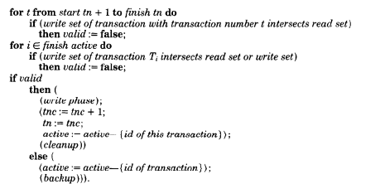

Slide 21
Conclusion
In a locking approach, transactions are controlled by having them wait at certain points, while in an optimistic approach, transactions are controlled by backing them up.
In a locking approach, serial equivalence can be proven by partially ordering the transactions by first access time for each object, while in an optimistic approach, transactions are ordered by transaction number assignment.
The major difficulty in locking approaches is deadlock, in an optimistic approach, the major difficulty is starvation.

Slide 22


