Slide 1
CS5570 Architecture of Database Management Systems
Distributed Database Management Systems
Kendall Bingham Computer Science Electrical Engineering University of Missouri-Kansas City Kansas City, MO, USA.

Slide 2
Distributed Database
Definition: Multiple interrelated databases distributed over a network.
Distributed Processing
Definition: Operations distributed over multiple computing systems

Slide 3
Advantages
Availability – probability that the system is available during a time interval
Reliability – probability that the system is running at a given point.
Performance
Expansion ( scalability )

Slide 4
Transparency
Organization Transparency
Location Transparency
Naming Transparency
Replication Transparency
Fragmentation Transparency
Design Transparency
Execution Transparency
Notes:
Organization Transparency aka distribution or network transparency. Freedom from operational details of the network.
Naming transparency, names are unambiguous without location information.
Fragmentation – vertical or horizontal
Replication Transparency

Slide 5
Distributed Database
Notes:
Transparency
Distributed and replicated

Slide 6
Fragmentation
SID | Name | GPA | School
1 | A Arnett | 3.8 | UMSL
2 | B Barker | 3.6 | UMKC
3 | C Cline | 3.1 | UMSL
Horizontal
Location1
Location2
SID | Name | GPA | School
2 | B Barker | 3.6 | UMKC
SID | Name | GPA | School
1 | A Arnett | 3.8 | UMSL
3 | C Cline | 3.1 | UMSL

Slide 7
Fragmentation
SID | Name | GPA | School
1 | A Arnett | 3.8 | UMSL
2 | B Barker | 3.6 | UMKC
3 | C Cline | 3.1 | UMSL
Vertical
Location1
Location2
SID | Name | School
1 | A Arnett | UMSL
2 | B Barker | UMKC
3 | C Cline | UMSL
SID | GPA
1 | 3.8
2 | 3.6
3 | 3.1

Slide 8
Scalability
Horizontal – Adds nodes and new systems into the distributed system
Vertical – Expanding the capacity of individual nodes.

Slide 9
Autonomy
Ability of nodes in the system to operate independently.
Design – Independence of the data model
Communication – Can decide when/how to communicate with other nodes
Execution – Ability to act on the data independently

Slide 10
Replication
Full – Each node has all the data
Very high read performance
Low write performance
No Replication – Data is only contained at one node
Partial Replication

Slide 11
Concerns
Concurrency – maintain consistency among copies
Recovery – Ensuring each node has consistent copies with other nodes
Communication – Failure of one or more message networks
Distributed Commits
Distributed Deadlock

Slide 12
Concurrency Control
Distinguished Copy – Copy of data at a particular node is designated as the distinguished copy. All locks and changes are made to it.
Primary Site
Primary Site with backup site
Primary Copy
Choosing a new coordinator
Backup takes over if there are backups ( chooses new backup
Election
Notes:
Primary site is like centralized with locking and modifications.
Disadvantages
Primary site can suffer from failure
Possible overloading since one site does all locking/unlocking.
Primary site can’t release write-lock until all sites have been updated.
Backup
Primary copy is distributed among sites.

Slide 13
Voting
Lock request sent to all copies.
If a majority respond YES then proceed
Increased message traffic
Much more complex recovery

Slide 14
Distributed Recovery
Messages and recovery
If A sends a message to B and does not get a response there are 3 possibilities
Message lost because of communication failure. Site B never got the message.
B is down
B got the message and responded, but response is lost.
Distributed Commit
How do they all commit at once?

Slide 15
Two Phase Commit
There are two phases to the commit.
Ready Phase
Commit Phase

Slide 16
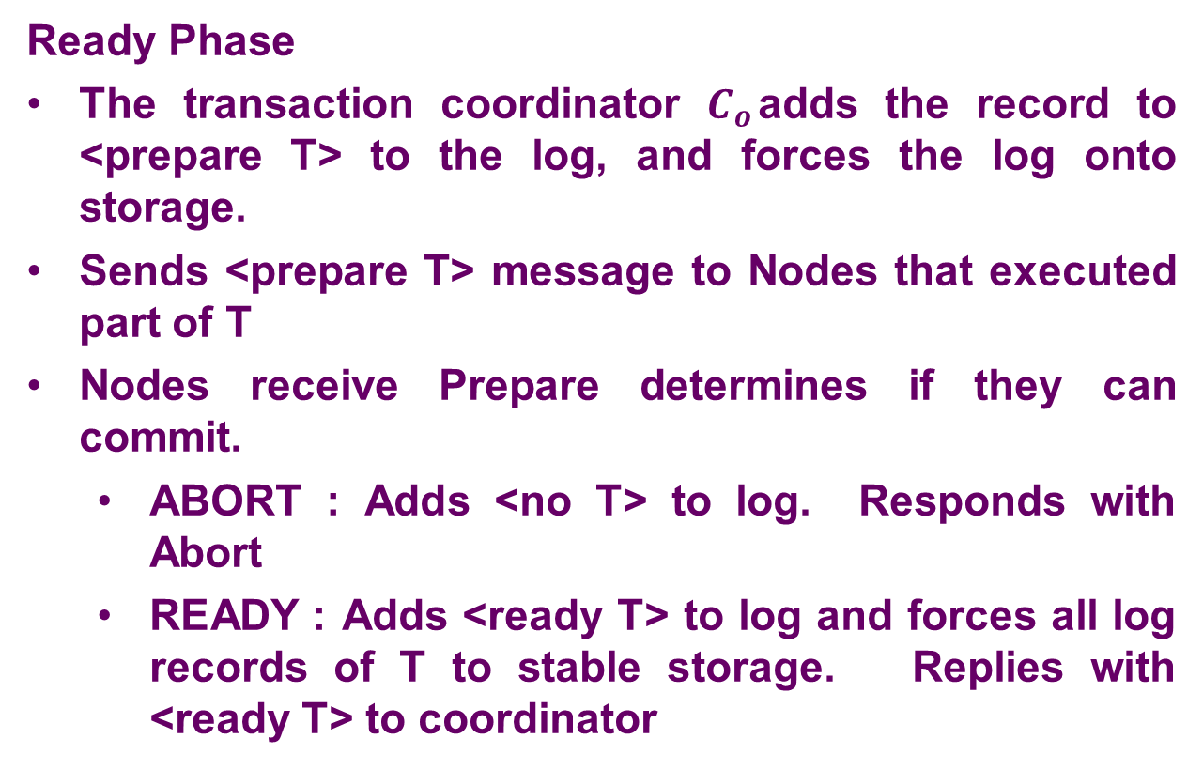
Two Phase Commit
Ready Phase
The transaction coordinator $C_{o}$adds the record to <prepare T> to the log, and forces the log onto storage.
Sends <prepare T> message to Nodes that executed part of T
Nodes receive Prepare determines if they can commit.
ABORT : Adds <no T> to log. Responds with Abort
READY : Adds <ready T> to log and forces all log records of T to stable storage. Replies with <ready T> to coordinator

Slide 17
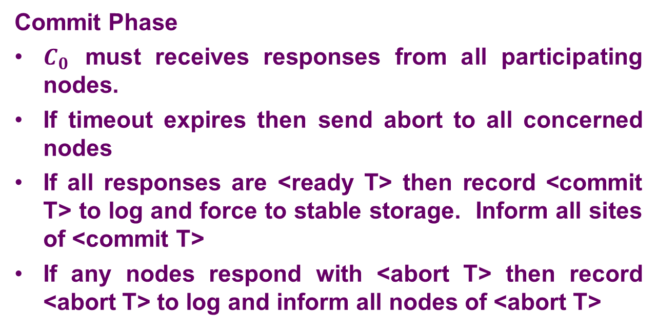
Two Phase Commit
Commit Phase
$C_{0}$ must receives responses from all participating nodes.
If timeout expires then send abort to all concerned nodes
If all responses are <ready T> then record <commit T> to log and force to stable storage. Inform all sites of <commit T>
If any nodes respond with <abort T> then record <abort T> to log and inform all nodes of <abort T>

Slide 18
Two Phase Commit
$$T=\{t_{1}, t_{2}, t_{3}\}$$

Slide 19


Two Phase Commit
$$T=\{t_{1}, t_{2}, t_{3}\}$$
T
$$t_{2}$$
$$t_{3}$$

Slide 20



Two Phase Commit Ready Phase
$$T=\{t_{1}, t_{2}, t_{3}\}$$
$$<prepare T>$$
T
$$<prepare T>$$
$$t_{2}$$
$$t_{3}$$

Slide 21


Two Phase Commit Ready Phase
$$T=\{t_{1}, t_{2}, t_{3}\}$$
$$<ready T>$$
T
$$t_{2}$$
$$<ready T>$$
$$t_{3}$$

Slide 22


Two Phase Commit Ready Phase
$$T=\{t_{1}, t_{2}, t_{3}\}$$
$$<commit T>$$
T
$$t_{2}$$
$$<commit T>$$
$$t_{3}$$

Slide 23
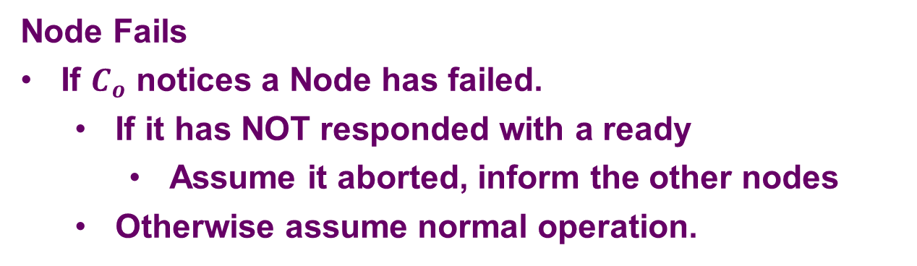
Two Phase Commit Failures
Node Fails
If $C_{o}$ notices a Node has failed.
If it has NOT responded with a ready
Assume it aborted, inform the other nodes
Otherwise assume normal operation.

Slide 24
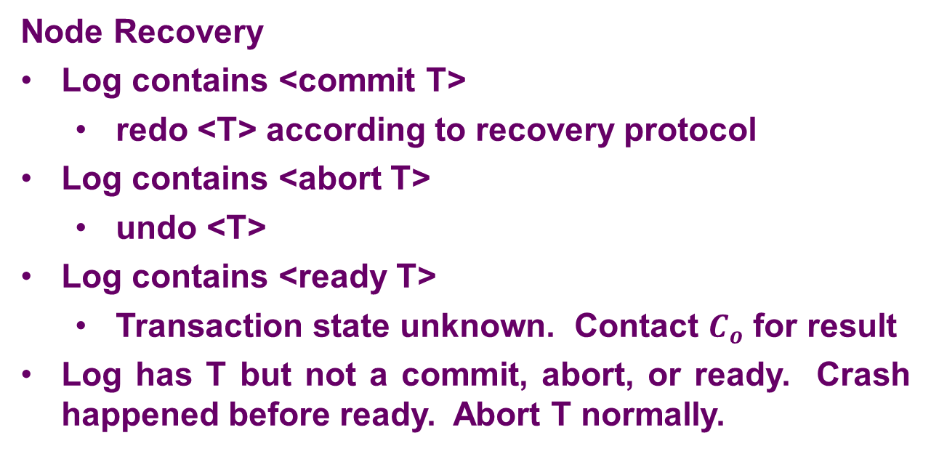
Two Phase Commit Failures
Node Recovery
Log contains <commit T>
redo <T> according to recovery protocol
Log contains <abort T>
undo <T>
Log contains <ready T>
Transaction state unknown. Contact $C_{o}$ for result
Log has T but not a commit, abort, or ready. Crash happened before ready. Abort T normally.

Slide 25
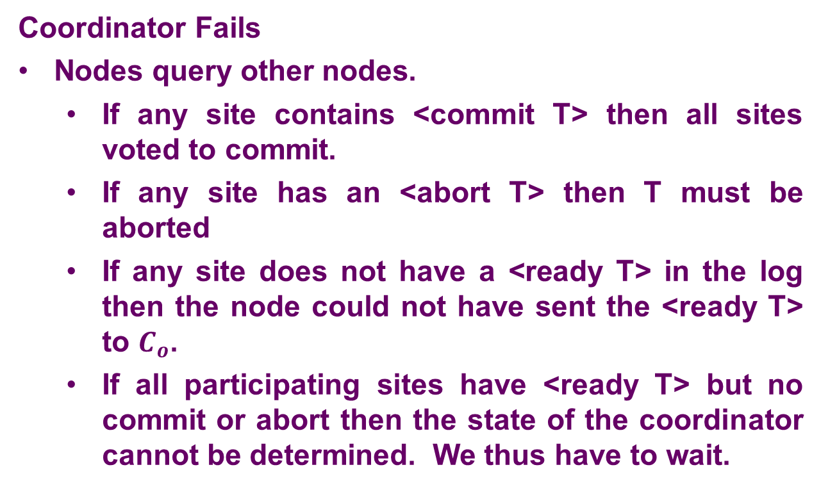
Two Phase Commit Failures
Coordinator Fails
Nodes query other nodes.
If any site contains <commit T> then all sites voted to commit.
If any site has an <abort T> then T must be aborted
If any site does not have a <ready T> in the log then the node could not have sent the <ready T> to $C_{o}$.
If all participating sites have <ready T> but no commit or abort then the state of the coordinator cannot be determined. We thus have to wait.

Slide 26
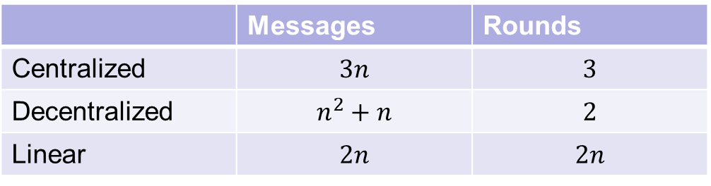
Two Phase Commit Communication
Coordinator
Decentralized
Linear
 | Messages | Rounds
Centralized | $$3n$$ | $$3$$
Decentralized | $$n^{2}+n$$ | $$2$$
Linear | $$2n$$ | $$2n$$

Slide 27
Three Phase Commit
Commit Phase is broken up into 2 phases
Ready-To-Commit
Commit

Slide 28
References
https://en.wikipedia.org/wiki/Distributed_database
Elmasri – Fundamentals of Database Systems
https://docs.oracle.com/cd/B10501_01/server.920/a96521/ds_concepts.htm

