Slide 1
CS5570 Architecture of Database Management Systems
Multi-Version Concurrency Control
Kendall Bingham Computer Science Electrical Engineering University of Missouri-Kansas City Kansas City, MO, USA.

Slide 2
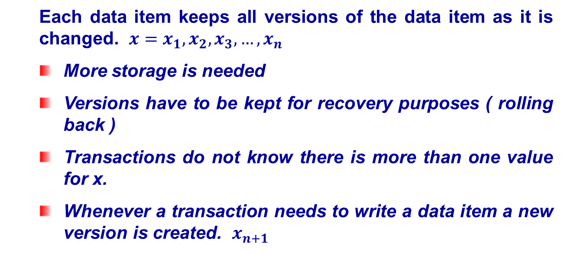
Multi-Version Concurrency
Each data item keeps all versions of the data item as it is changed. $x=x_{1}, x_{2}, x_{3}, …, x_{n}$
More storage is needed
Versions have to be kept for recovery purposes ( rolling back )
Transactions do not know there is more than one value for x.
Whenever a transaction needs to write a data item a new version is created. $x_{n+1}$

Slide 3
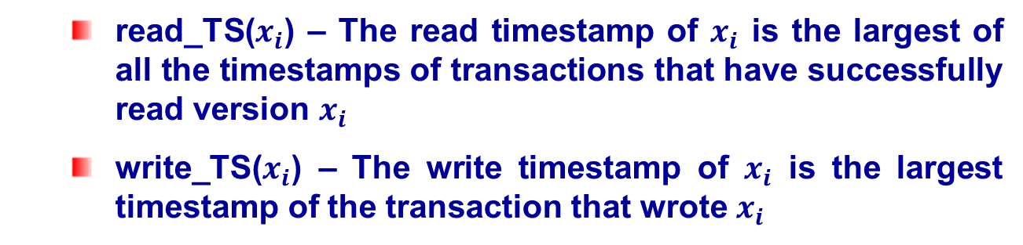
MV Timestamp Ordering
read_TS($x_{i}$) – The read timestamp of $x_{i}$ is the largest of all the timestamps of transactions that have successfully read version $x_{i}$
write_TS($x_{i}$) – The write timestamp of $x_{i}$ is the largest timestamp of the transaction that wrote $x_{i}$

Slide 4
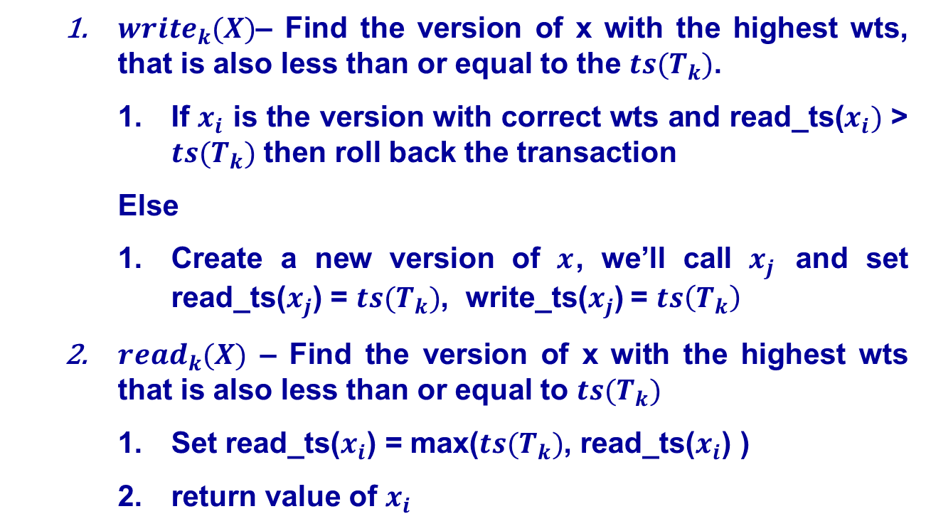
MV Timestamp Ordering
$write_{k}(X)$– Find the version of x with the highest wts, that is also less than or equal to the $ts(T_{k})$.
If $x_{i}$ is the version with correct wts and read_ts($x_{i})$ > $ts(T_{k})$ then roll back the transaction
Else
Create a new version of $x$, we’ll call $x_{j}$ and set read_ts($x_{j}$) = $ts(T_{k})$, write_ts($x_{j}$) = $ts\left(T_{k}\right)$
$read_{k}(X)$ – Find the version of x with the highest wts that is also less than or equal to $ts(T_{k})$
Set read_ts($x_{i}$) = max($ts(T_{k})$, read_ts($x_{i}$) )
return value of $x_{i}$
Notes:
W2(x), r5(x), r2(x), w1(x), w10(x) What ts transactions can write a new version? Which cannot.

Slide 5
MV Timestamp Ordering
Can we have deadlocks?
Can we have cascading roll backs?
Notes:
W2(x), r5(x), r2(x), w1(x), w10(x) What ts transactions can write a new version? Which cannot.

Slide 6
Multi-Version 2PL
A 3rd locking mode is given. Certify, read and write
Transactions are allowed to read the original version of x, but not allowed to read a new written version x’

Slide 7
Multi-Version 2PL
 | Read | Write
Read | Yes | No
Write | No | No
 | Read | Write | Certify
Read | Yes | Yes | No
Write | Yes | No | No
Certify | No | No | No

Slide 8
MV 2PL
Can we have deadlocks?
Can we have cascading roll backs?

Slide 9
Snapshot Isolation
Each transaction reads from its own snapshot ( copy ) of the database.
Writes are collected into a writeset only visible to transaction
At commit, if no other active transaction has an overlap, then transaction is applied

Slide 10
Snapshot Isolation Benefits
Reads are never blocked
No Locking
Avoids
Dirty Read
Lost Update
Inconsistent read
Phantom

Slide 11
Snapshot Sample
T | Next | Id | Name | Salary
100 | 105 | 1 | Smith | 80000
…
105 | 132 | 1 | Smith | 85000
…
132 | Null | 1 | Smith | 90000
TID | Status
100 | Committed
105 | Committed
132 | Active

