Slide 1
CS5570 Architecture of Database Management Systems Introduction
Kendall Bingham Computer Science Electrical Engineering University of Missouri-Kansas City Kansas City, MO, USA.

Slide 2
Outline
1. Introduction to Transaction
Transaction Processing
Application Server
2. Transaction Properties
3. Availability
4. Performance
5. What next

Slide 3
Transaction
A transaction is a mechanism for manipulating a database in consistency-preserving manner.
A transaction is initiated through a query
Some real-life examples of a query
Airline seat reservation transaction to buy an airline ticket
On-line purchase from Internet
Withdraw money from an ATM.
E-bay bidding
Etc.
Notes:
Transaction : Program that operates on shared data.
Read, write, commit,start abort
Reasons for abort?
Active, committed and uncommitted

Slide 4
Transaction Properties
A transaction must enforce the following characteristics ( ACID)
Atomicity
Consistency
Isolation
Durability

Slide 5
Transaction
A transaction is a mechanism for manipulating a database in consistency-preserving manner. It changes a consistent state of the database to the next consistent state.
Let S_{i} be an initial consistent state of the database D and T_{i} is a transaction. Thus,
T_{i}
S_{i} <is₁, is₂, …, is_{m}> S_{j} ; where is₁, is₂, …, is_{m} are the intermediate state of the database, and S_{j} is the final consistent database state.
Notes:
Transactions support many operations
Read ( ) Does it change the data?
Write() Does it change data? ( Initial value and final value )
Initial State Next State Final State
A(100) -----------Read A’(100) --------Write--------- A’’
Balance Inquiry
A(100) Read A’(100)
State transition is done by a transaction.
Would a program of all reads need to be a transaction?

Slide 6
Transaction
The successful state transfer S_{i} → S_{j} guarantees that the intermediate states (is₁, is₂, …, is_{m}), that may or may not be consistent, were not be visible (not accessible) to other transaction T_{j}.
The presence of S_{j} guarantees that the transition is successful.
The inaccessibility of (is₁, is₂, …, is_{m}) guarantees that T_{i} performed its updates without any interference.
The persistence of S_{j} guarantees that the updates of T_{i} is durable in the database.

Slide 7
Transaction
Database definition
Database (D) = {d₁, d₂, ..., d_{n}}; where d_{i}’s are computable objects such a relation or a tuple of the relation.
Every d_{i} is associated with a set of States s_{i1}, s_{i2}, ... s_{i∞}. A state s_{i} is said to be consistent if it satisfies all its consistency constraints. If at time t, s_{i}’s of all d_{i}’s satisfy their consistency constraints then D is said to be consistent.

Slide 8
Transaction
Consistency Constraints
A set of assertions or constraints that must be satisfied by all operations to the database. These constraints may be explicitly defined or implied when transaction code is written.
Examples
Last account balance = Current balance + Debit amount
Cost of an item = Amount paid - Tax

Slide 9
Outline
1. Introduction to Transaction
2. Transaction Processing
Application Server
2. Transaction Properties
3. Availability
4. Performance
5. What next

Slide 10
Transaction Processing (TP)
The consistency-preserving requirement of a transaction makes its processing quite hard. It must satisfy the following:
Reliability and Availability: system should rarely fail and running all the time
Response and Throughput: in less than 1 second and at least thousands of transactions/second
Scalability: can grow from balance enquiry to internet scale
Security: must not compromise the institution’s integrity
Atomicity: must install its updates completely in the database successfully
Durability: a transaction is a legal contract, therefore, its updates must persist in the database

Slide 11
Transaction Processing (TP)
What makes TP Important:
It is at the core of electronic commerce (conventional and mobile)
It is the core of most medium-to-large businesses. They use TP for their production systems and cannot operate without it
It is probably the single largest computer application with more than $80B/year cost
Nearly all academic research and development use TP to manage their research and data

Slide 12
TP System (DBMS) Infrastructure
End User’s Viewpoint
Enter a request query from an input device (monitor, cell phone, PDA, tablet, ATM, browser, etc.)
The query is processed as one or more transactions by the DBMS that installs its updates in the database successfully
The user receives a reply, if a reply is required
The TP system (DBMS) ensures that each transaction
is an Atomic action (independent unit of work),
executes and commits exactly once, and
produces results that persist (durable) in the database.
TP system has tools to enforce these requirements

Slide 13

TP System (DBMS) Infrastructure
End-User
Query
Result
Presentation Manager
Front-End (Client)
Transaction Control
(routes requests)
Back-End (Server)
DBMS

Slide 14
DBMS Characteristics
Transaction characteristics
Typically < 100 transaction types per application (finance, bank, load, etc.)
Transaction size varies with application. Typically 0-30 disk accesses, 10K - 1M instructions executed, 2-20 messages
A large-scale example: airline reservation system
150,000+ active display devices (direct access)
Indirect DB accesses through Internet (travel agents, customers, etc.)
thousands of disk drives
3000 transactions per second, peak

Slide 15
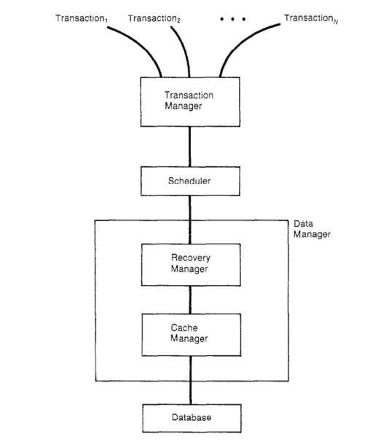
Database System

Slide 16
Storage
Two types of storage
Volatile
Expensive
Fast
Stable
Cheaper
Slower
Notes:
Volatile

Slide 17
Cache Manager
The Cache
Stores parts of the database “Buffer”
Dirty/pin
The Cache Manager
In charge of buffering information in the cache
Commands of Fetch and Flush
Notes:
Volatile

Slide 18
Recovery Manager
Operations
Start, Commit, Abort, Read and Write
Ensures the database
Contains only the effects of committed Transactions
Contains no effects of aborted transactions.
Notes:
During Recovery only access to stable shortage.

Slide 19
Scheduler
Purpose
Orders the operations so the transactions are
serializable
Recoverable
Actions on an operation
Execute – Pass it to the DM
Reject – Refuse the operation
Delay – Place in a queue.

Slide 20
Transaction Manager
Purpose
Determines scheduler and process for submission.

Slide 21
Outline
1. Introduction to Transaction
2. Transaction Processing
3. Application Server
2. Transaction Properties
3. Availability
4. Performance
5. What next

Slide 22
Application Servers
An application server is a software module that creates, executes and manage TP application. It is also referred to as TP monitors.
App Server = TP monitor + web functionality
Application programmer writes an application (e.g., a query) to process a single request and application server scales it up and deploys it on large systems. For example,
Application developer writes a query for debit/credit task. The application server deploys it to 10s/100s of servers and on the Internet.

Slide 23
Application Servers
Main components of an application server
an application programming interface (API) (e.g., Enterprise Java Beans)
tools for program development (programming language, library, functions, etc.)
tools for system management (application deployment, auditing, fault and performance monitoring, billing, resource and user management)

Slide 24
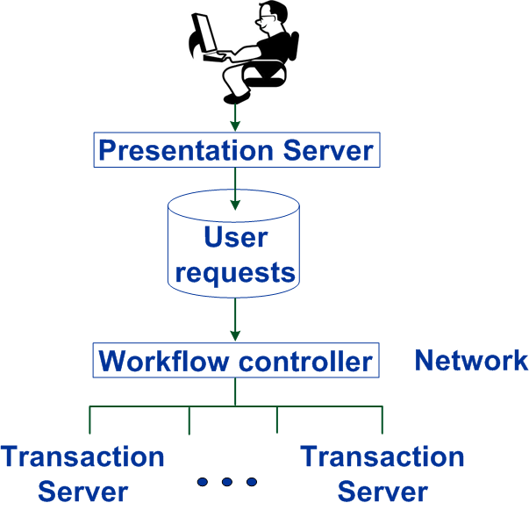
Application Servers Architecture

Slide 25
ATM Application Example

Slide 26
Application Servers Architecture (Web)

Slide 27
Internet Retailer

Slide 28
Serialization Graph

Slide 29
Consistency Preservation Example
T₂: Start;
B = Read(x);
C = Read(y);
If (B > C+1) then B = B - 1;
Write(x, B);
Commit;
T₁: Start;
A = Read(x);
A = A - 1;
Write(y, A);
Commit;
Consistency predicate is x > y.
Serial executions preserve consistency. Interleaved executions may not.
H = r₁[x] r₂[x] r₂[y] w₂[x] w₁[y]
try it with x = 4 and y = 2 initially

Slide 30
Isolation
Intuitively, the effect of a set of transactions should be the same as if they ran independently
Formally, an interleaved execution of transactions is serializable if its effect is equivalent to a serial one.
Implies a user view where the system runs each user’s transaction stand-alone.
Of course, transactions in fact run with lots of concurrency, to use device parallelism.

Slide 31
Durability
When a transaction commits, its results will survive failures (e.g. of the application, OS, DB system … even of the disk).
Makes it possible for a transaction to be a legal contract.
Implementation is usually via a log
DB system writes all transaction updates to its log
to commit, it adds a record “commit (T_{i})” to the log
when the commit record is on disk, the transaction is committed.
system waits for disk ack before asking to user

Slide 32
Outline
1. Introduction to Transaction
2. Transaction Processing
3. Application Server
4. Transaction Properties and Formalization
5. History and Schedule
6. Availability
4. Performance
5. What next

Slide 33
Availability
Fraction of time system is able to do useful work
Some systems are very sensitive to downtime
airline reservation, stock exchange, telephone switching
downtime is front page news
Downtime Availability
1 hour/day 95.8%
1 hour/week 99.41%
1 hour/month 99.86%
1 hour/year 99.9886%
1 hour/20years 99.99942%
Contributing factors
failures due to environment, system mgmt, h/w, s/w
recovery time

Slide 34
Outline
1. Introduction to Transaction
2. Transaction Processing
3. Application Server
4. Transaction Properties and Formalization
5. History and Schedule
6. Availability
7. Performance
5. What next

Slide 35
Performance Requirements
Measured in max transaction per second (tps) or per minute (tpm), and dollars per tps or tpm.
Dollars measured by list purchase price plus 5 year vendor maintenance (“cost of ownership”)
Workload has this profile:
10% application server plus application
30% communications system (not counting presentation)
50% DB system
TP Performance Council (TPC) sets standards
http://www.tpc.org.
TPC A & B (‘89-’95), now TPC C &W

Slide 36
TPC-A/B — Bank Tellers
Obsolete (a retired standard), but interesting
Input is 100 byte message requesting deposit/withdrawal
Database tables = {Accounts, Tellers, Branches, History}
Start
Read message from terminal (100 bytes)
Read+write account record (random access)
Write history record (sequential access)
Read+write teller record (random access)
Read+write branch record (random access)
Write message to terminal (200 bytes)
Commit

Slide 37
Outline
1. Introduction to Transaction
2. Transaction Processing
3. Application Server
4. Transaction Properties and Formalization
5. History and Schedule
6. Availability
7. Performance
8. What next

Slide 38
What’s Next?
This chapter covered TP system structure and properties of transactions and TP systems
The rest of the course drills deeply into some of these areas, one by one.

